Slide 1
AdventureWorks
Annual Sales Report - 2012

Slide 2
Executive Summary
Higher demand for bicycles observed during summer and spring months
Bicycle stores offer lower prices during off-seasons, before spring and summer
Winter discounts do not affect consumer demand for bicycles
High prices during summer do not discourage consumer purchases
Some individuals make bulk purchases in the fall, expecting end-of-year discounts

Slide 3
Table of Contents
01
02
03
Annual Sales
Order Counts
Average Orders
Annual sales and seasonality
Order count and unit prices
Average order per person

Slide 4
01
Annual Sales & Seasonality

Slide 5
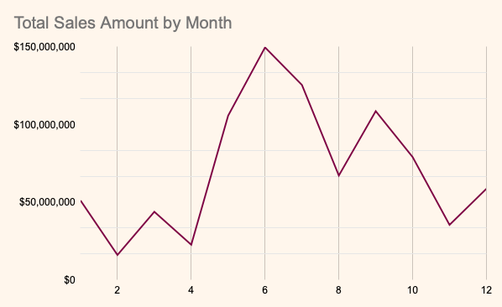
We observe the impact of seasonality. Specifically, during the summer and spring months, the demand for bicycles is observed to be above the average in comparison to other seasons
$71,898,861

Slide 6
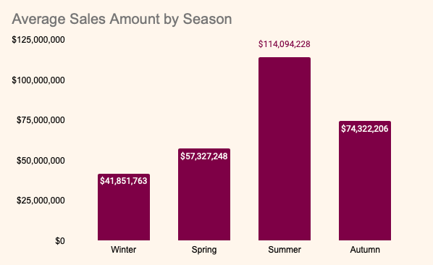
The demand for bicycles decreases during winter, and it seems that high-income buyers don't take advantage of potential discounts in winter season

Slide 7
02
Order Count & Unit Prices

Slide 8
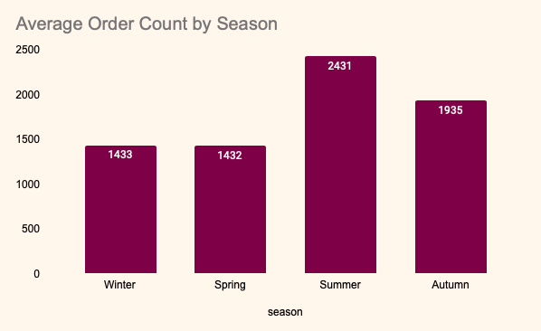
Bicycle stores clearance sales before spring and summer to offer lower prices during off-seasons. Winter discounts don't increase bicycle demand, summer high prices don't discourage purchases.
$46,939
$38,416
$29,212
$40,042

Slide 9
03
Average Order per Person

Slide 10
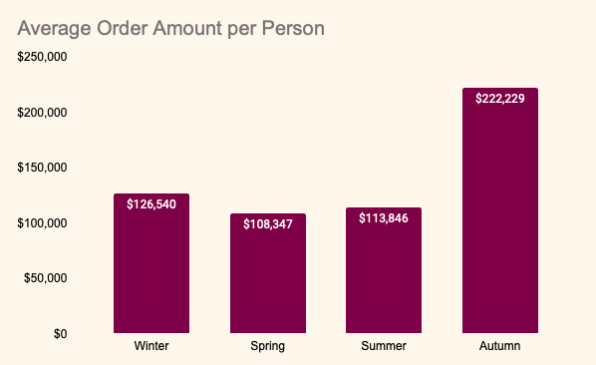
In addition to the trend of purchasing in the summer, people may also make bulk purchases individually in the fall, expecting end of year discounts
5.3
4.3
4.3
6.3

Slide 11
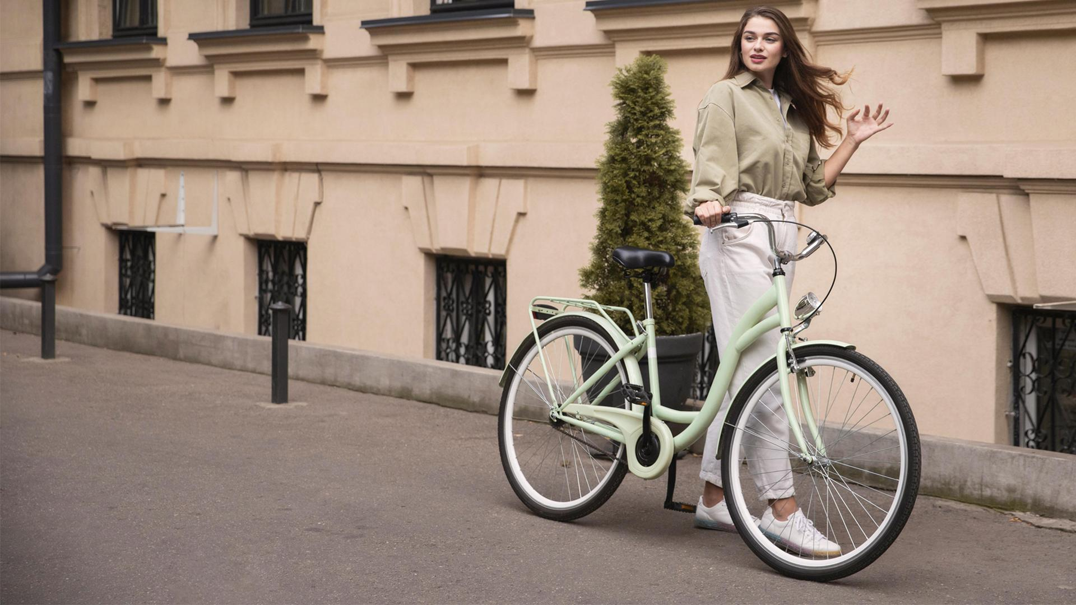
Thank you.

