Slide 1

Video-based parking spot detection using machine learning
Teammembers
Olga Țurcan <@cherryDevBomb>
Viorel Gurdiș <@viorelyo>
Raul-Robert Zavaczki <@zraul123>

Slide 2
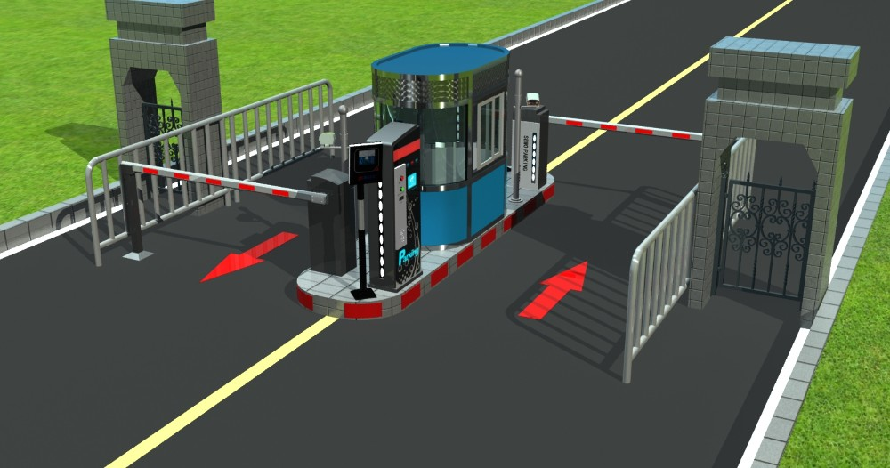
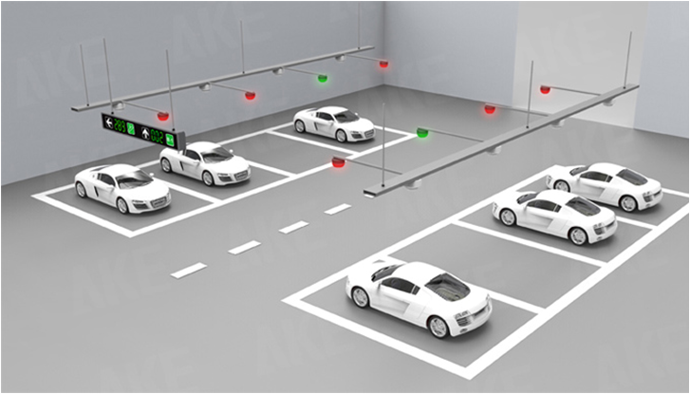
Problem definition
Why is it important?
Average search time for parking spot == 7.8 min.
Traffic!!!
Existing solutions?
Counter-based
Sensor-based
Image recognition - based
Problem definition
Related work
Proposed approach
Methodology
Dataset & results
Experimental results
Used tools
Demo
Faced challenges
Conclusion & improvements
Notes:
Raul

Slide 3
Related work
Acharya, D., Yan, W., and Khoshelham, K. (2018). Real-time image-based parking occupancy detection using deep learning. [ref]
Pre-trained CNN to extract features → Support Vector Machine classifier
Tschentscher, M. and Neuhausen, M. (2012). Videobased parking space detection. [ref]
HSV color histogram → Support Vector Machine classifier
Števanák, R., Matejov, A., Šuppa, M., and Jariabka, O. (2017). Pkspace: An open-source solution for parking space occupancy detection. [ref]
Multi-Layer Perceptron classifier
Problem definition
Related work
Proposed approach
Methodology
Dataset & results
Experimental results
Used tools
Demo
Faced challenges
Conclusion & improvements
Notes:
Raul

Slide 4
Proposed approach
Classify each marked spot from image
Update DB with classification results
Image extraction from video stream
Refresh information displayed to users
Image preprocessing
Video Stream
Problem definition
Related work
Proposed approach
Methodology
Dataset & results
Experimental results
Used tools
Demo
Faced challenges
Conclusion & improvements
Notes:
Raul

Slide 5
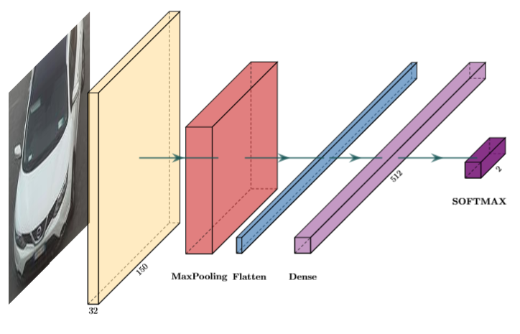
Methodology
Custom CNN
Adam gradient-based optimizer
Sparse-categorical cross-entropy loss function
Problem definition
Related work
Proposed approach
Methodology
Dataset & results
Experimental results
Used tools
Demo
Faced challenges
Conclusion & improvements
Notes:
Olga

Slide 6
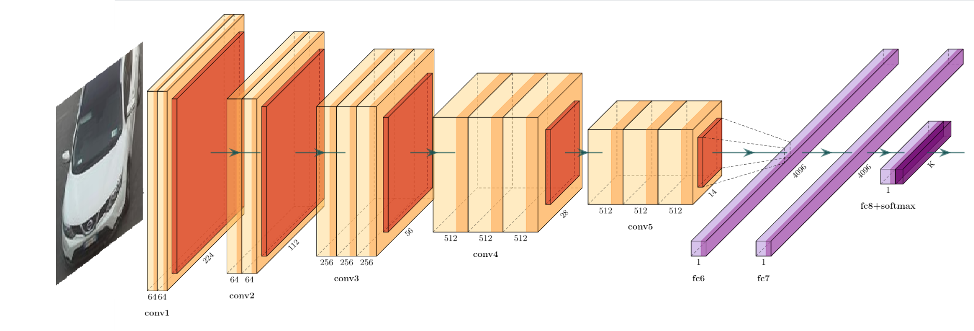
Methodology
VGG-16
Stochastic gradient descent optimizer
Sparse-categorical cross-entropy loss function
Problem definition
Related work
Proposed approach
Methodology
Dataset & results
Experimental results
Used tools
Demo
Faced challenges
Conclusion & improvements
Notes:
Olga

Slide 7
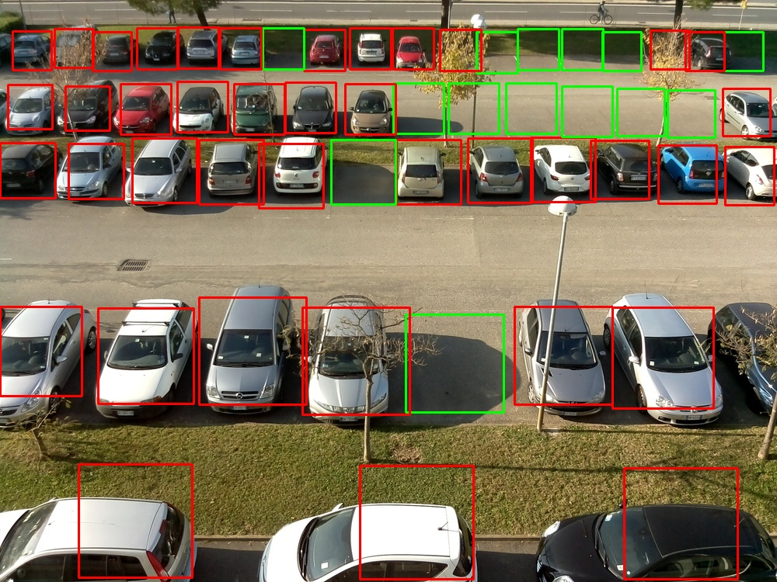
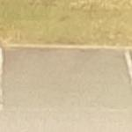
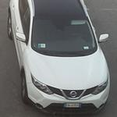
Dataset & results
CNRPark+EXT [ref]
150x150 px patches, free and occupied
8000 images
Problem definition
Related work
Proposed approach
Methodology
Dataset & results
Experimental results
Used tools
Demo
Faced challenges
Conclusion & improvements
Notes:
Olga

Slide 8
Dataset & results
Validation split for training dataset: 33% (2666 images)
Tested on 920 images
Model | Training Accuracy | Validation Accuracy
Custom CNN model | 0.99 | 0.96
VGG-16 model | 0.86 | 0.79
Problem definition
Related work
Proposed approach
Methodology
Dataset & results
Experimental results
Used tools
Demo
Faced challenges
Conclusion & improvements
Notes:
Olga

Slide 9
Experimental results
Tested on 920 images
Model | Accuracy | Busy |  | Free
 |  | Precision | Recall | Precision | Recall
Custom CNN model | 0.86 | 1 | 0.77 | 0.74 | 1
VGG-16 model | 0.79 | 0.87 | 0.75 | 0.70 | 0.85
Custom CNN model (+improvements) | 0.98 | 0.99 | 0.98 | 0.97 | 0.99
Problem definition
Related work
Proposed approach
Methodology
Dataset & results
Experimental results
Used tools
Demo
Faced challenges
Conclusion & improvements
Notes:
Olga

Slide 10









Used Tools
Pillow
Problem definition
Related work
Proposed approach
Methodology
Dataset & results
Experimental results
Used tools
Demo
Faced challenges
Conclusion & improvements
Notes:
Viorel

Slide 11
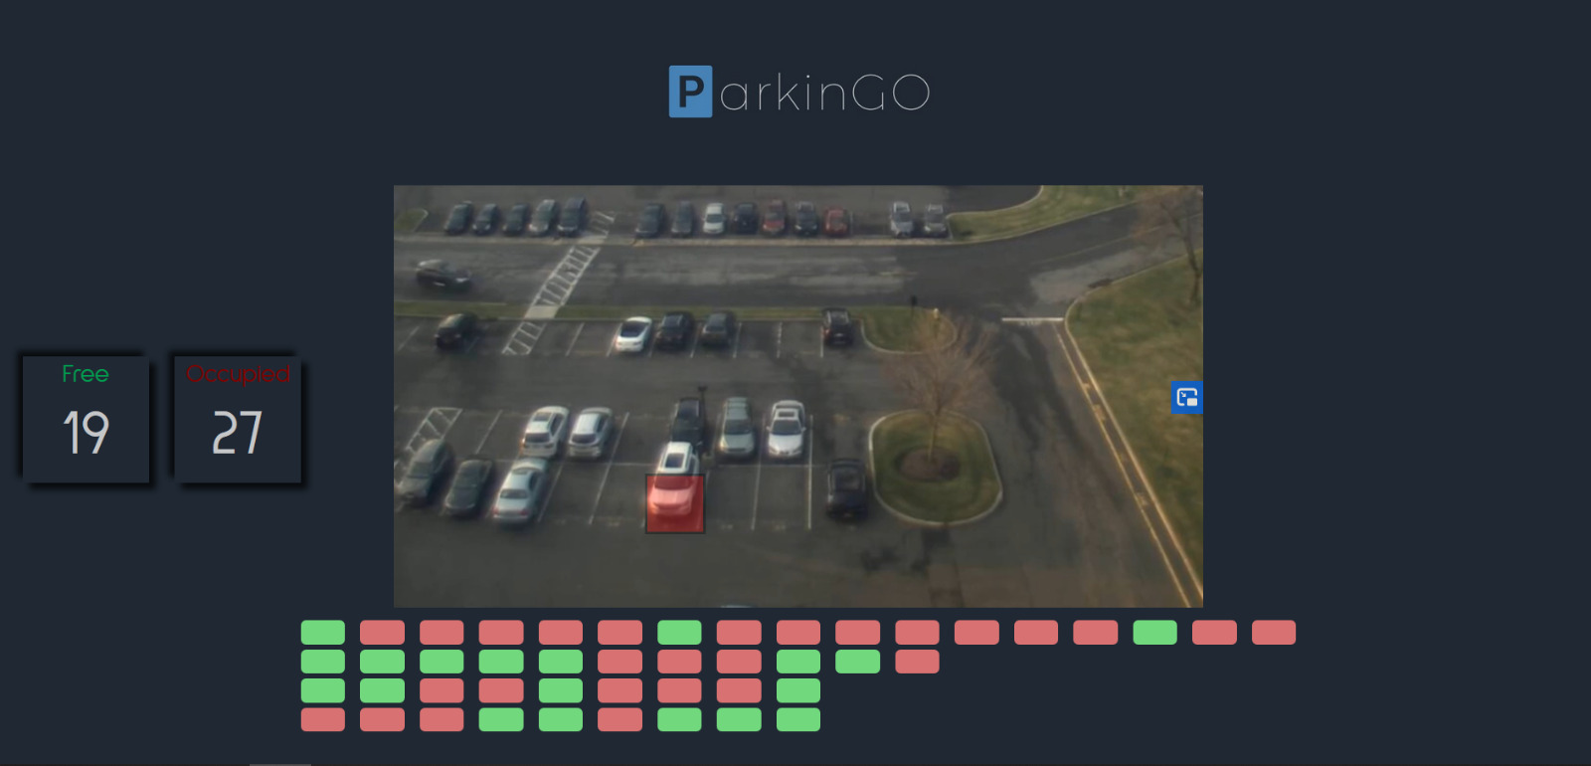
Demo
Problem definition
Related work
Proposed approach
Methodology
Dataset & results
Experimental results
Used tools
Demo
Faced challenges
Conclusion & improvements
Notes:
Viorel

Slide 12

Faced challenges
Finding the right information
Choosing the fittest approach for our problem
Understanding the framework
Hardware limitation
Finding open source video stream for demo
Algorithm improvement
Problem definition
Related work
Proposed approach
Methodology
Dataset & results
Experimental results
Used tools
Demo
Faced challenges
Conclusion & improvements
Notes:
Viorel

Slide 13
Conclusion & Future improvements
What we learned?
Basics of image processing
What we achieved?
Proof of Concept application
Limitations
Future ideas
Tensorlow & Keras
Writing a research paper
High accuracy on slots classification
Comparable results with alternative solutions
Lightweight application
Automatic spots detection
Extending the training dataset for other weather & light conditions
Finetuning of the model & image preprocessing
Accuracy based on image quality
Spots are manually marked
Limited by weather & light conditions
Problem definition
Related work
Proposed approach
Methodology
Dataset & results
Experimental results
Used tools
Demo
Faced challenges
Conclusion & improvements
Notes:
Viorel

Slide 14
Thank you!

