Slide 1

Goal of the Analysis
Evaluate promo campaign performance across products, cities, and stores.
Notes:
Good morning, dear colleagues. Today, we’ll walk through key findings from our retail campaign data analysis.
The goal of this presentation is to evaluate the performance of promotional campaigns across products, cities, and store networks.
Why is this important? In retail, promotions are major levers for growth, but without analytics, we risk underperforming campaigns, overspending, and missing customer expectations.
Data analytics helps us move from gut-feel decisions to evidence-based strategies, optimizing ROI and improving targeting.

Slide 2
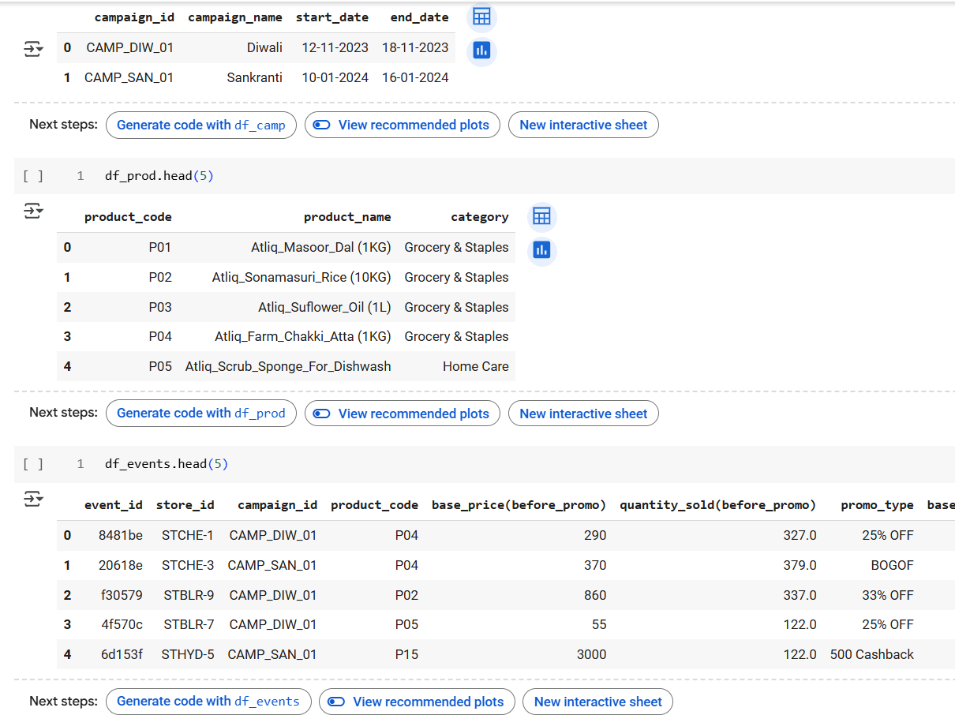
Datasets to analyse
Store Distribution by City

Slide 3

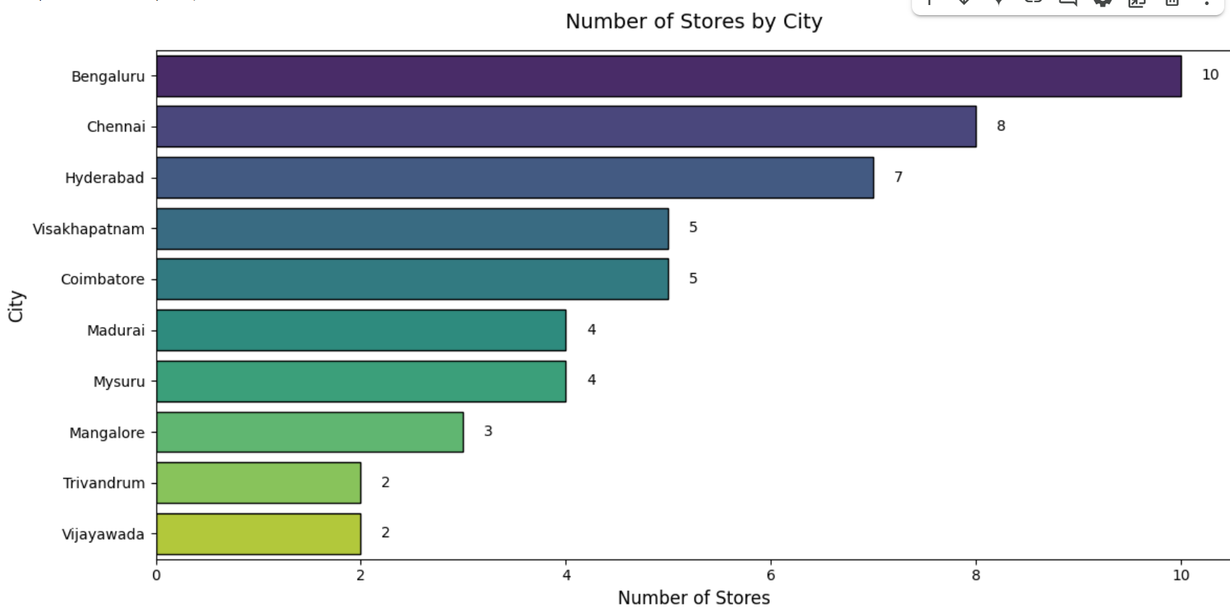
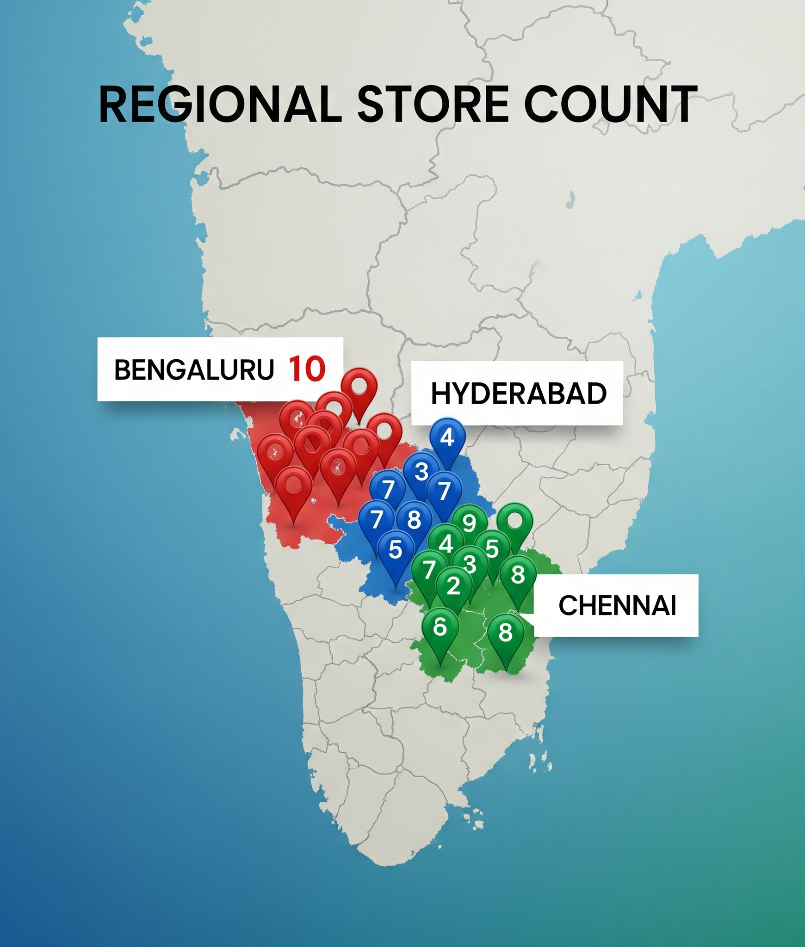
Store Distribution by City
Bar chart: Number of stores per city.
Notes:
We start with store distribution. The city with the most stores is Bengaluru, followed by Hyderabad, Chennai, and.
Interestingly, This visualization helps identify high-priority cities for future store investments or localized marketing.

Slide 4
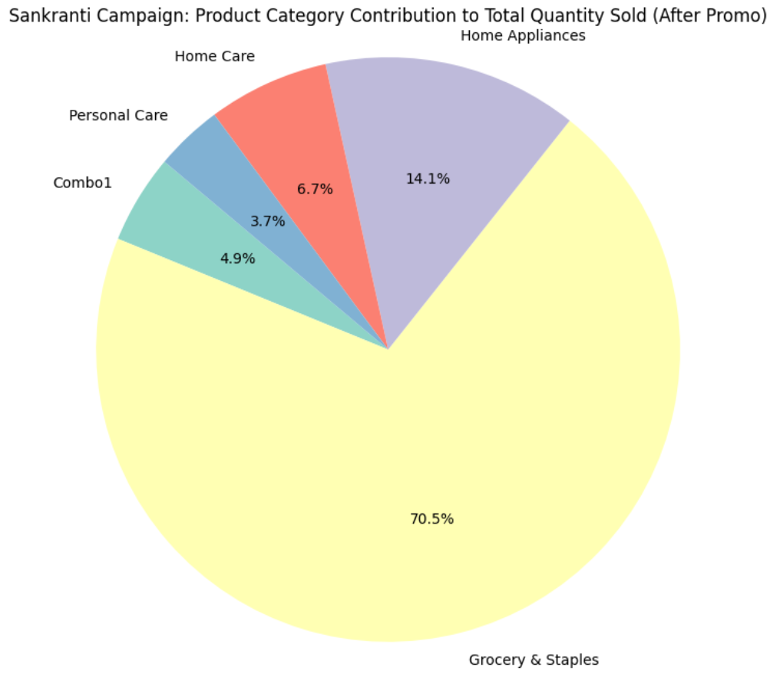
Sankranti Campaign – Sales by Product Category
Pie chart: % contribution of each category.
Grocery & Staples dominates.
Notes:
During the Sankranti campaign, Grocery & Staples contributed the largest share of total quantity sold after promotion.
Home Care and Personal Care were much lower. This tells us that promotions tied to seasonal and daily-use products have the most impact. These insights should guide future category-level budget allocations.

Slide 5
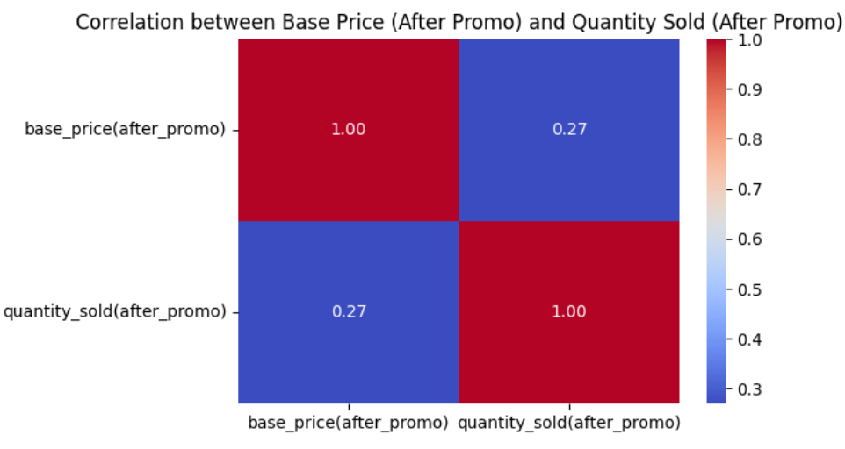
Price vs. Quantity Correlation
The 0.27 correlation indicates a weak positive relationship between price and quantity sold after promotion
Notes:
Here we explore the relationship between post-promo base price and quantity sold. The heatmap shows a negative correlation: as prices go down, units sold go up. This reinforces that price sensitivity is high, so discount levels should be carefully optimized per category.

Slide 6
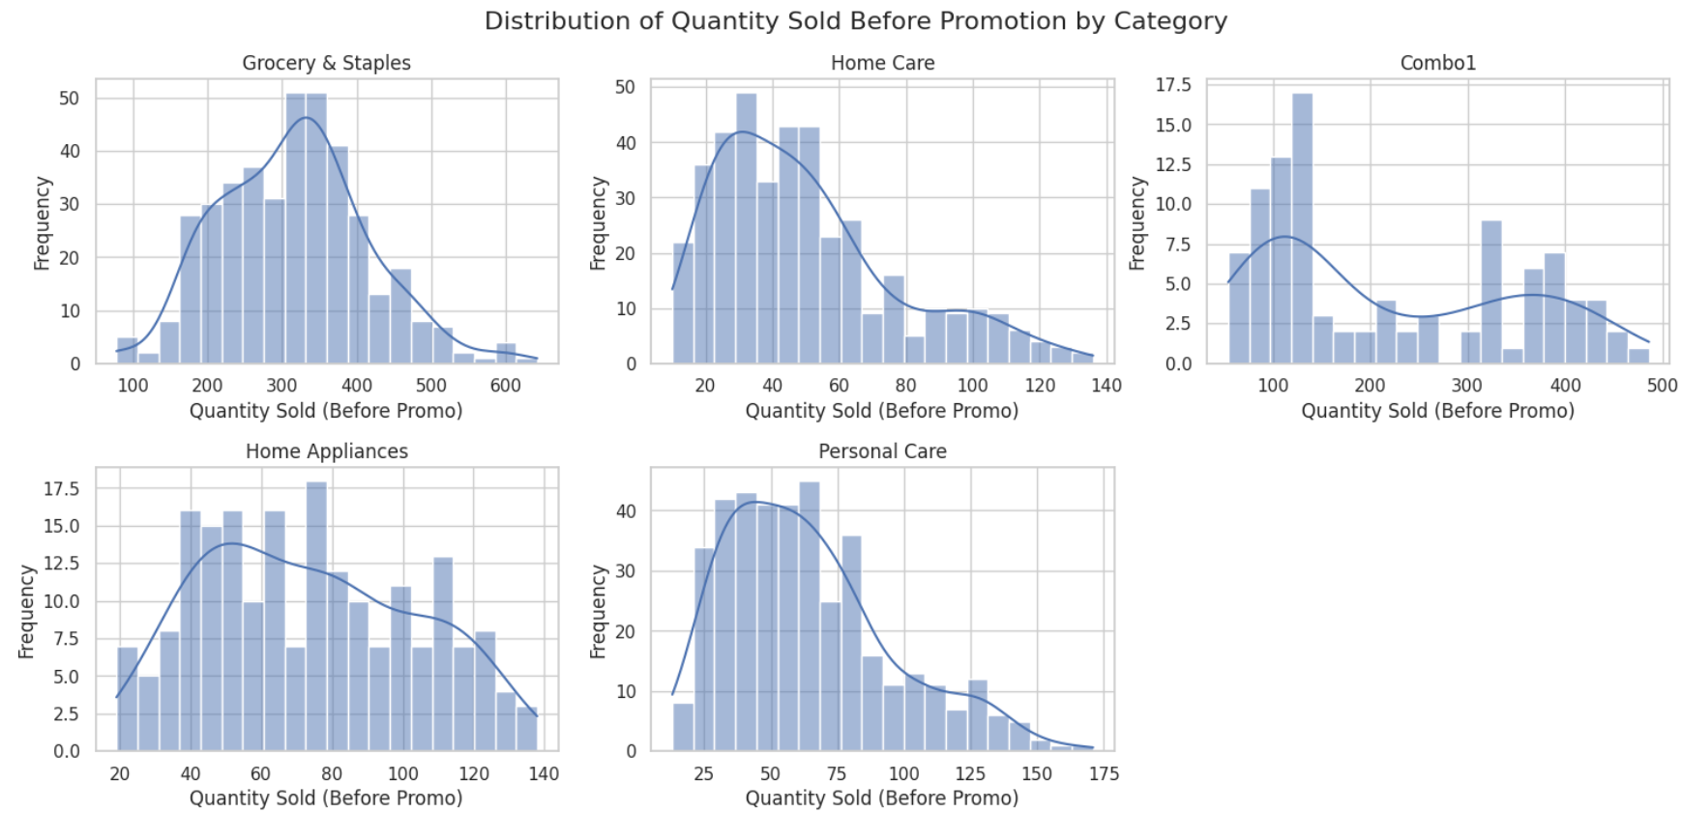
Pre-Promo Sales Distribution by Category
Histograms: Quantity sold before promo across categories.
Notes:
“Here’s a breakdown of quantity sold before the promotion. Grocery led again, with strong consistent demand. But Home Appliances had the lowest pre-promo sales. This reinforces what we know — everyday products are purchased more often. High-ticket items like appliances may need more time or added incentives, such as cashback offers.”

Slide 7
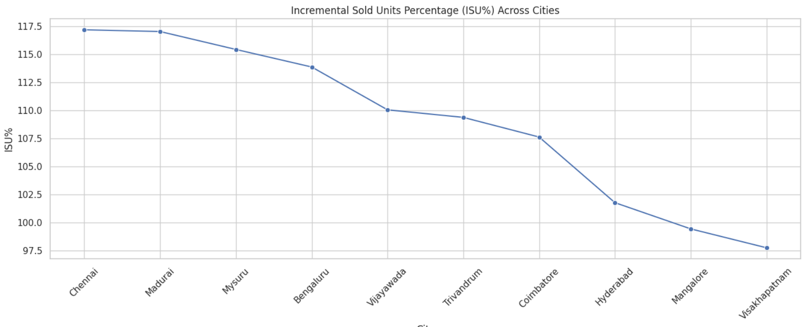
ISU% Across Cities
Line chart: Incremental Sold Units % by city.
Highlight top and bottom cities.
Notes:
ISU% measures the impact of promotions on unit sales. [Top City] had the highest increase, while [Bottom City] had almost no change. This suggests city-level factors like store density, regional preferences, or execution quality play big roles. We need to customize promo strategies per region for maximum effectiveness.

Slide 8
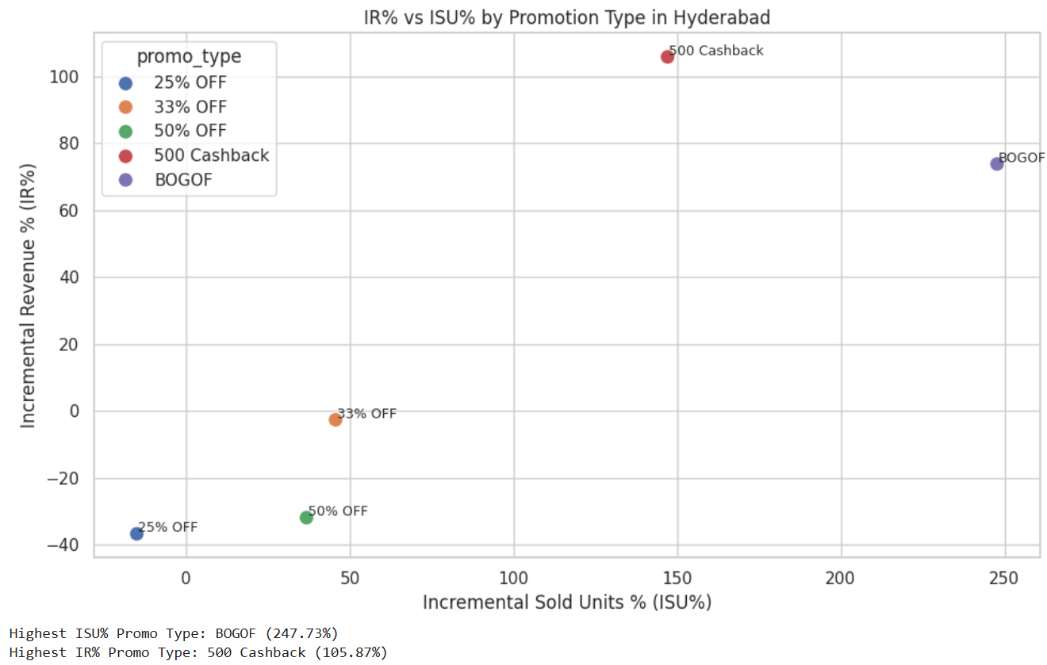
Promo Type Effectiveness in Hyderabad
Scatter plot: IR% vs ISU% for promo types.
Balance unit growth vs revenue growth.
Notes:
In Hyderabad, we compared IR% (revenue growth) and ISU% (unit growth) across promo types. One promo led in sales volume, another in revenue. The takeaway: balance is key. We shouldn’t just focus on boosting units if it erodes profitability. Use both metrics together to evaluate success.

Slide 9
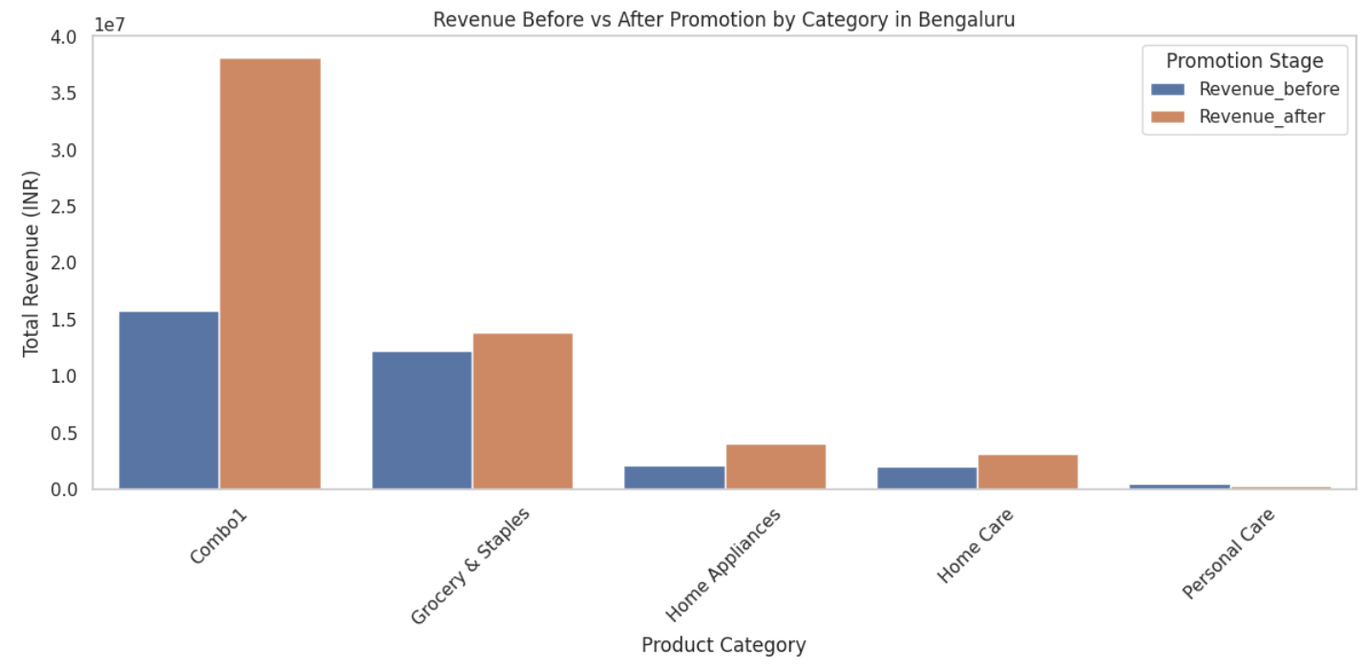
Revenue by Category in Bengaluru
Bar chart: Revenue before vs after promotion by category.
Notes:
This bar chart compares revenue before and after promotion in Bengaluru. Personal Care showed strong uplift, while categories like Home Appliances barely moved. This points to the need for targeted promotion formats — e.g., bundle deals or cashback may work better for durables.

Slide 10

Key Takeaways & Next Steps
Summary: What worked, what to fix, what to test next.
🎯 Personalize promotions by product category and city.
💡 Move from blanket discounts to strategic formats (bundles, cashback).
🔁 Monitor IR% and ISU% continuously to guide refinements.
Notes:
To wrap up:
1. Essentials like Grocery & Staples respond best to promotions.
2. Cities and product types need custom strategies.
3. Use both IR% and ISU% for a full performance view.
Next steps? Test promotions by region and product type. Use these insights to prioritize high-impact campaigns and eliminate ineffective spend.
Thank you! Open to questions.

