Slide 1
Supermarket Dashboard Analysis
Power BI Report Summary
Vipasha Agarwal
25/04/2025

Slide 2
About the Dataset
- Dataset: Supermarket Sales Data
- Includes:
- Sales
- Profits
- Customer Metrics
- Product Categories
- Regions

Slide 3
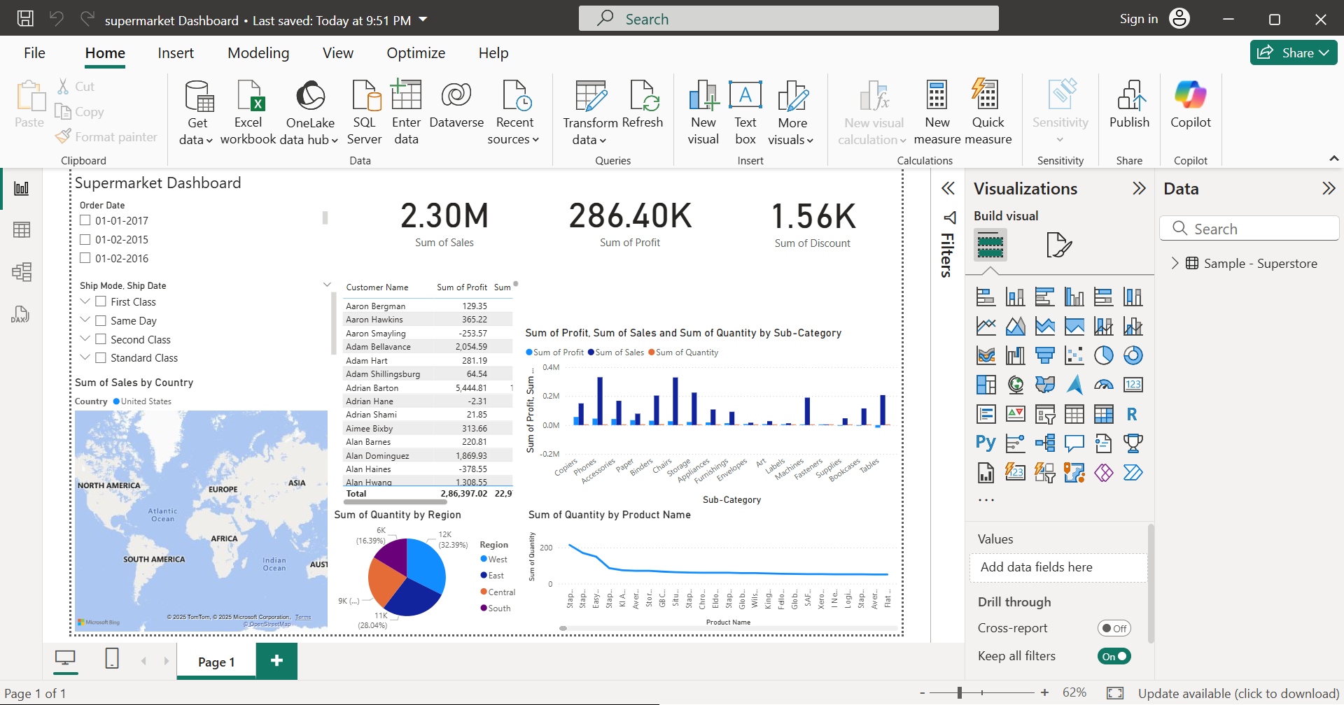
Dashboard Overview

Slide 4
Key Metrics & Visuals
- Sales Overview: Highest in West around 725.46k
- Profit Margins: Best in staples
- Customer Trends: Growing in west in phones

Slide 5
Insights Derived
- Top 3 selling product categories are phones and chair
- Regions with highest profitability are west
- Improvement areas identified as south and central

Slide 6
Conclusion
- Sales and Profits are seasonal
- Focused marketing in low-performing regions
- Expand best-selling categories
- Power BI enabled real-time, interactive analysis

Slide 7
Thank You

