Slide 1



SSIP Gujarat Hackathon 2020
“An approach to having a user-friendly employee management system”

Slide 2
Team Detail
Team ID : SGH001926 Industry Type : Medium
Problem ID : SGH077
Submitted by:- Guided by:-
Vaghela Vipasha (3rd IT) Team Leader Prayag Patel
Daftari Charmi (3rd ICT) Team Member
Desai Saakshi (3rd IT) Team Member

Slide 3
ABSTRACT
To develop a web application which can store and monitor information of employees in that it will include leave management, client management, task system that which tasks are allocated to which employee and also the attendance system using thumb impression. Task management system to track task assigned to an employ like task assignment, deadline for task, resource allocation to employ for task etc.

Slide 4

Overview
Employee Management System(EMMS) is a distributed application, developed to maintain the details of employees working in any organization.
This software is very user-friendly and eliminates the limitation of real-time access control.

Slide 5
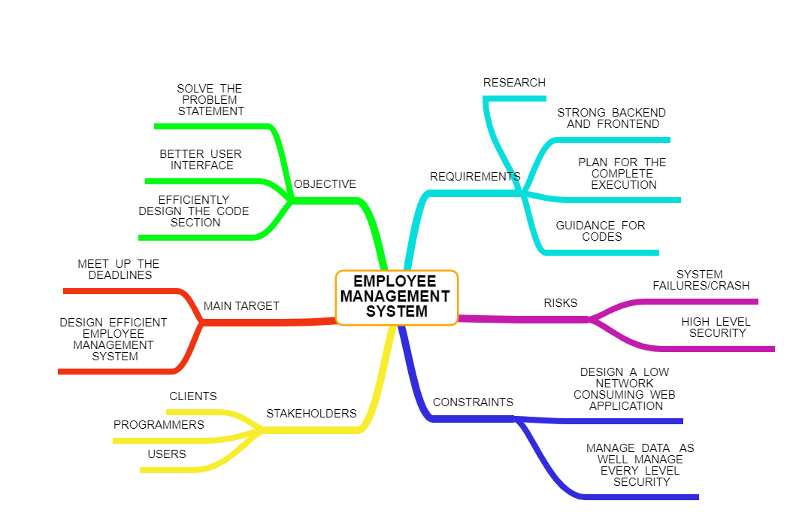

Slide 6
Road map-1
Database Information System
Database Queries
User
Retrieve
Insert
Application Program Interface
Database
Update
Delete

Slide 7
Road Map-2
Display Menu
Login
Help
Exit
EMPLOYEE
ADMIN
Display employee details
Project management and task tracking
Employee data
Leave management
Employee rating and all over work progress
Employee of the month
Bonus and stars
Number of projects incurred
Retrieve
Insert
Update
Delete
Attendance management system
Overtime hours
Total precentage
Number of hours
Number of meetings attended
Read only the data from database
Salary according to leaves
Numbers of leaves taken
Deadline reminder
Current project
Start date
Submission date
Project conference
Number of projects
TERMS OF SERVICE
Accept or reject leaves
Leave
Apply for leave

Slide 8
Iterative Waterfall Model For EMMS
FEASIBILITY STUDY/ANALYSIS
COMPARATIVE STUDY
DESIGN
PROTOTYPES
CODING
TESTING
MAINTENANCE
PROS AND CONS OF EMMS
ROAD MAPS
COMPLETE DESIGN OF VARIOUS STAGES

Slide 9











Login
Admin performs various operations
New employee is added by admin
Task management
Profile and portfolio assigned to the employee
EMMS System
Procedure
Salary, deadlines and leave management
Employee added to system database
Roadmap to future
Performance and reward management
Work performed by employee
Access over complete system and security
Work submissions as per deadline

Slide 10
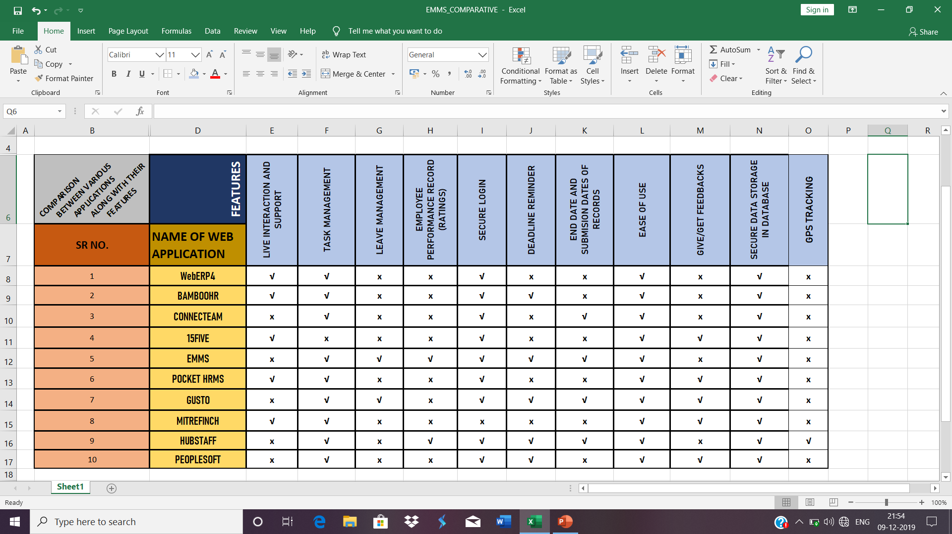
COMPARATIVE STUDY
Notes:
Odoo system reference

Slide 11
Tools And Technology Under Use
HTML5, CSS3, BOOTSTRAP
Mongo DB, Apache server,
jQUERY
Java Script, Angular JS, Node.JS

Slide 12
Tools And Technology Under Use (In Brief)
HTML5
Page layout
Complete structure design
CSS3
Page designing
Effective and more attractive pages
JAVA SCRIPT
Gives control over application
Validation tasks
MONGO DB
Uses internal memory for storing
Fast in-place updates
Rich queries
5. ANGULAR JS
Html declares only static views but fails in declaring dynamic views in web application
Views created are more expressive and creative
6. NODE.JS
Handles files: opens files on server and returns control to client
Eliminates waiting
Generates dynamic page
Can help perform various functions on files over server

Slide 13
PROCESS OVERVIEW
USER-WEB INTERFACE
REQUEST CONVERSION IN QUERY FORM
CLIENT/USER REQUEST OUTPUT
DATABASE
REQUEST BY USER/ADMIN FOR CERTAIN DATA
FILTERED AND SELECTED DATA
RETRIEVED DATA PASSED BACK ON SERVER

Slide 14
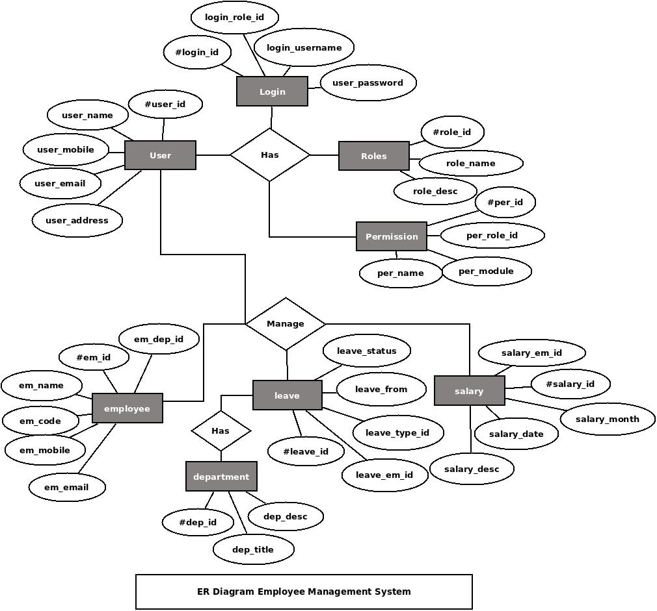
E-R diagram for employee management

Slide 15
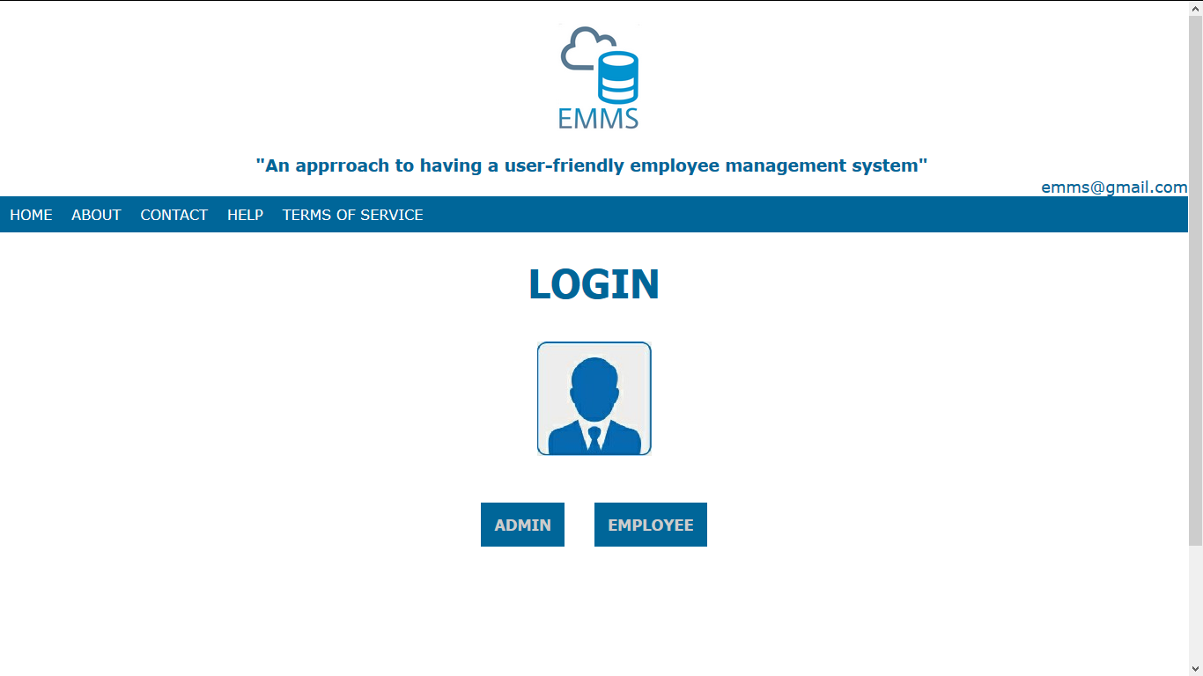
Prototype slide-1 {Main Screen For Login}

Slide 16
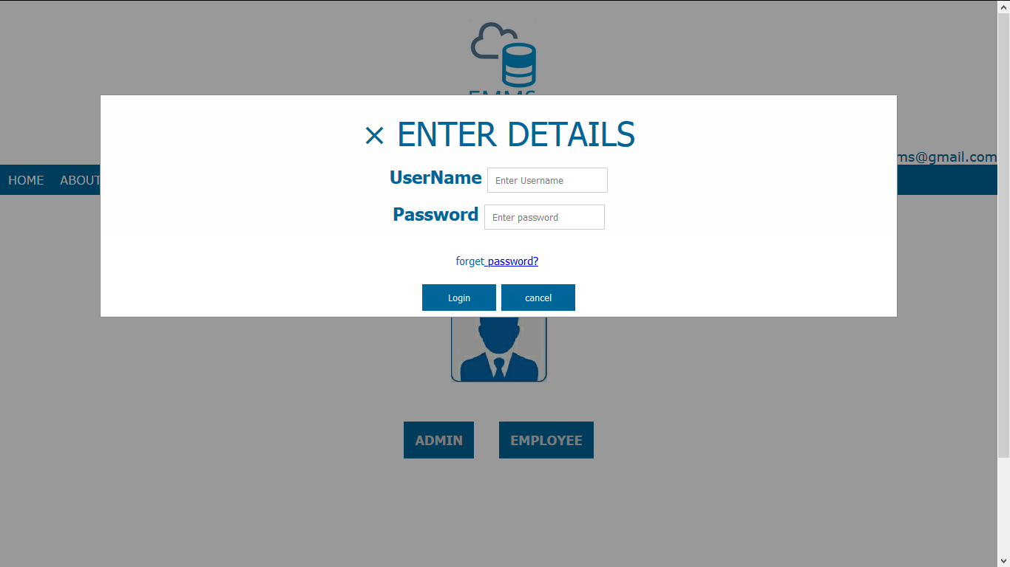
Prototype slide-2 {Detail input}

Slide 17
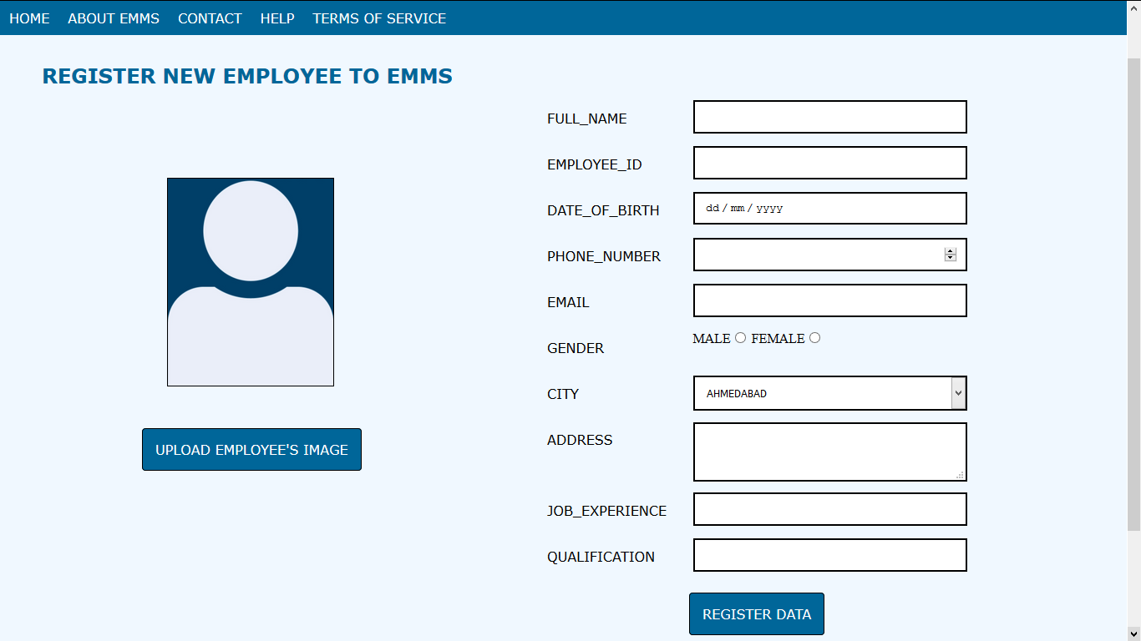
Prototype slide-3 {Adding a new employee data}

Slide 18
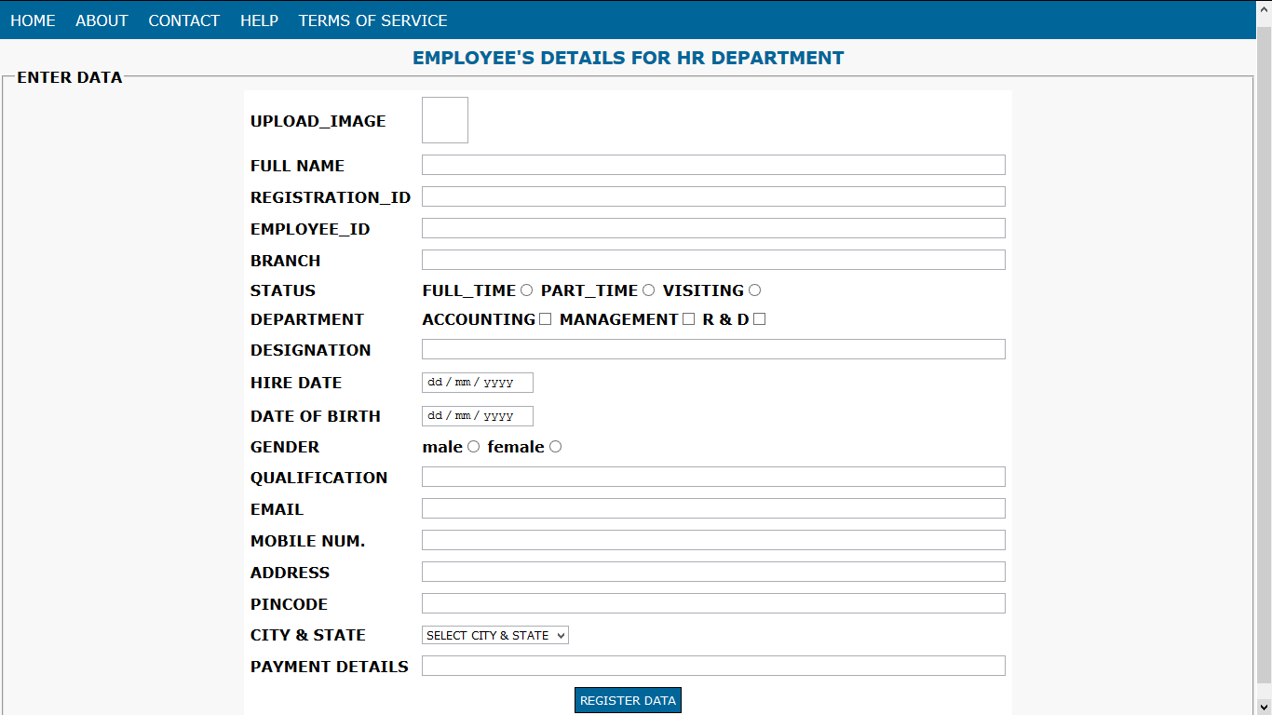
Prototype slide-4 {Datasheet and details for the HR}

Slide 19
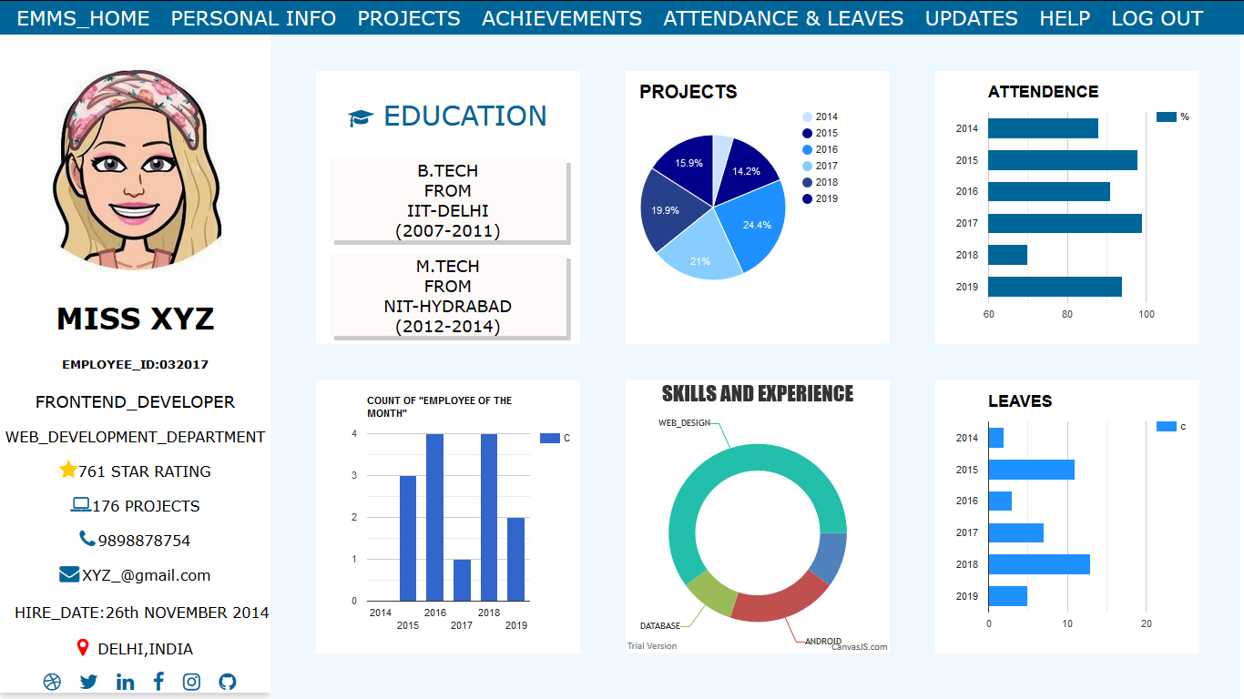
Prototype slide-5 {Representation of how employee details will be managed}
Reasons for such design:
Easy projection of details
Space management
Efficient data distribution
New approach
Space optimisation

Slide 20
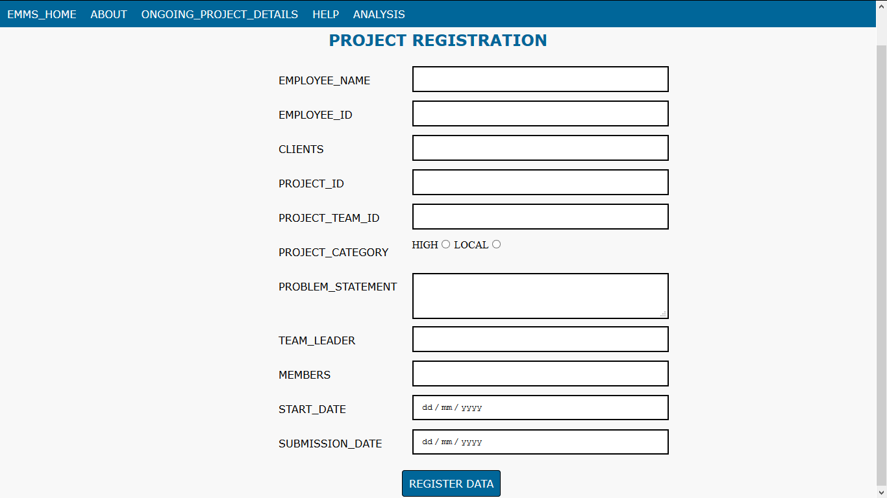
Prototype slide-6 {Details for new project and related information}

Slide 21

“An approach to having a user-friendly employee management system”
ADMIN
EMPLOYEE

Slide 22
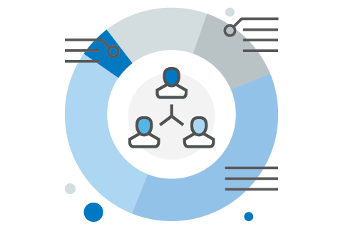

Slide 23
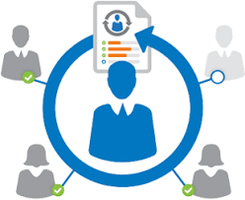

Slide 24
Personal goals , projects, and tasks ideally aligned with the organisation’s goals are entered into the system.
Software aggregates and summarises employee’s progress for optional formal review

Slide 25
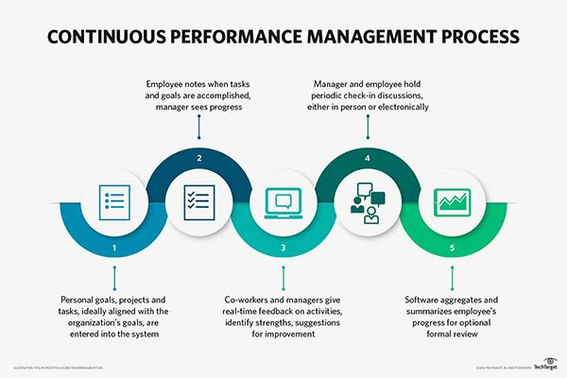
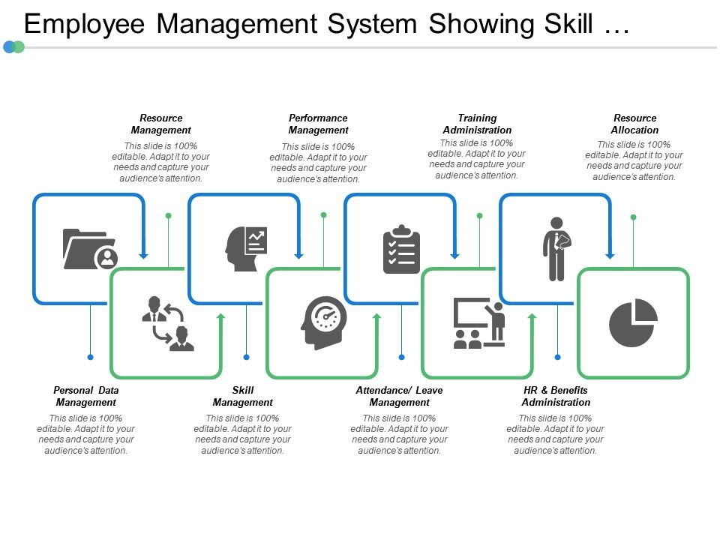
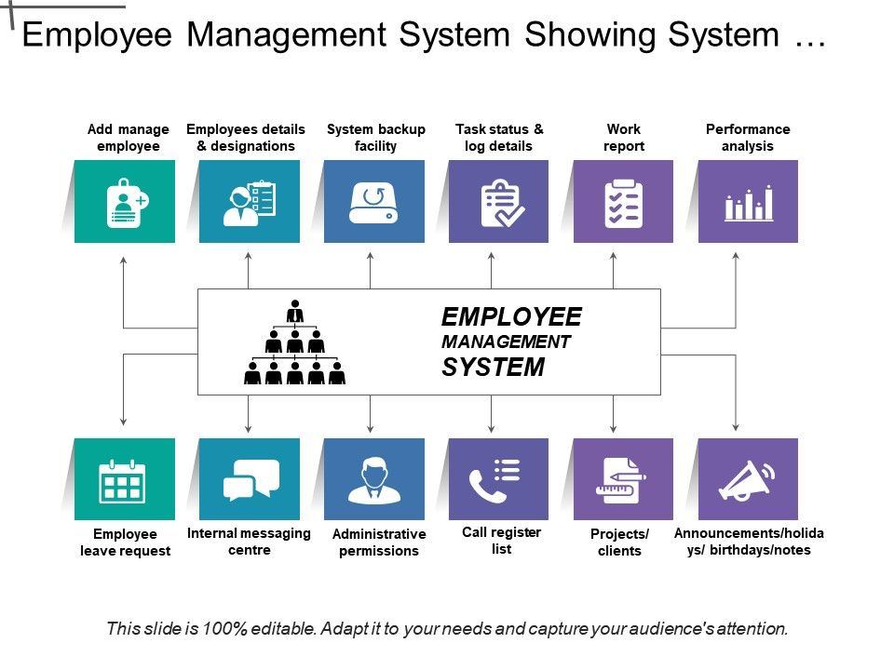

Slide 26


Slide 27
Main problem solving approach
Isolation of multiple operations performed over the database
A durable system that sustains system failures/crash
A new approach in the overall web page designing (using pie-charts, histograms etc)
Strong and effective coding methods
Every employee data maintained with strict security
A better employee management environment

Slide 28
6th December:
Rough plan for complete execution and roadmaps made
10th December:
Presentation and prototypes were designed
13-14th December:
Final report and files verified for errors with guide
Coming days:
Run the complete code for any loop holes and fixations or additions
3rd December:
Complete project and problem statement analysis
Start
End
12th December:
Final report and synopsis ready with all fields and necessary texts
4th December:
Meet-up between the team members in order to distribute work
8th December:
Approached the guide for tips and guidance
15th December:
Project synopsis and report along with templates were submitted as per deadlines
Coming days:
Design the complete web application as per plan

Slide 29

THANK YOU!

