Slide 1
Ethical Hacking Internship
(25 July 2021 - 27 Aug 2021)
Submitted BY:
Avaneesh Jha
(vipavaneesh@gmail.com)
TASK 2

Slide 2
Vulnerabilities found In http://zero.webappsecurity.com
The following 3 vulnerabilities has been found in http://zero.webappsecurity.com:-
SQL injection Reference links:-
https://www.youtube.com/watch?v=UdBOgjlXaAI
https://gist.github.com/mort666/19d3dc1051a71c2c86885e1607d69442
Cross-Site Scripting Reference links:-
https://gist.github.com/mort666/19d3dc1051a71c2c86885e1607d69442
https://resources.infosecinstitute.com/topic/web-application-pentest-guide-part-ii/
Clickjacking:-
Foud by running a online free vulnerability scan on the given website using the scanner provided by https://pentest-tools.com/website-vulnerability-scanning/website-scanner#.

Slide 3
Netsparker Hasn’t been Used so no screenshots possible!
I found these vulnerabilities by manually searching and gathering information over the internet.
So, No Netspaker Scan report Screenshot can be attached.
All the reference links have been distinctly given alongwith the vulnerabilities found. The idea about these three vulnerabilities has been taken from those reference links only. The report follows the format of the report given in the link provided in the Ethical-Hacking_-Problem-Statement.pdf file task3.
Netsparker hasn’t been used because of the following two reasons:-
When tried to download from the provided google drive link I got “Error 404 The requested URL was not found on this server”.
When tried to download it from its official website no free trial download link was found.

Slide 4
Blind SQL injection in http://zero.webappsecurity.com.
Summary:-
Blind SQL injection vulnerability found at two places in url http://zero.webappsecurity.com/bank/pay-bills.html of http://zero.webappsecurity.com, first at the question mark icon in the Pay Saved Payee subtab and second in the Purchase Foreign Currency subtab at select currency option list . By exploiting this vulnerability and doing hit and trial an attacker can map the whole database by carefully analysing whether the POST request returns true or false by inserting a carefully crafted payload in the vulnerable parameter. In our website payeeId (used in the first subtab ) and currencyId (used in the second subtab) are vulnerable.
Tools Used: - Burpsuite

Slide 5
Steps To Reproduce:-
Login to http://zero.webappsecurity.com/login.html with username=username and password=password. (Obtained from http://bugmenot.com/view/zero.webappsecurity.com.)
Go to Pay Bills section.
Setup manual proxy on the web browser being used and open burpsuite configured accordingly with intercept on.
In the Pay Saved Payee subtab:
Click on the question mark symbol. A request gets generated and intercepted in burpsuite.
Send the intercepted request to repeater.
In the repeater change payeeId value from sprint to ' and click on send.
The query statement gets revealed in the exception part of the response.
Set payeeId=' or '1 '='1 and click on send.

Slide 6
Steps To Reproduce (Continued...):-
Change the proxy setting of browser back to default and go to the Purchase Foreign Currency subtab.
Change the proxy settings of the browser again to manual proxy so that burpsuite can intercept the request.
Now in the Purchase Foreign Currency subtab:
Select any currency from the currency select option list. A request gets generated and intercepted in the burpsuite.
Go to Burpsuite and send the intercepted request to repeater.
In the repeater change currencyId value to ' and click on send.
The query statement gets revealed in the exception part of the response.
Set currencyId=' or '1 '='1 and click on send.

Slide 7
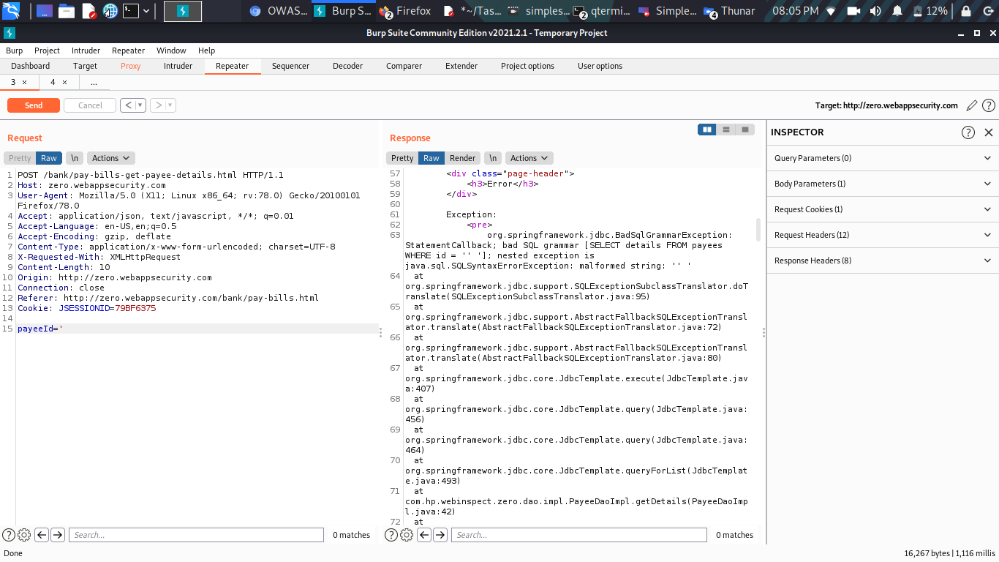
POC Screenshots
1) Query statement revealed using ‘ payload in payeeId:_

Slide 8
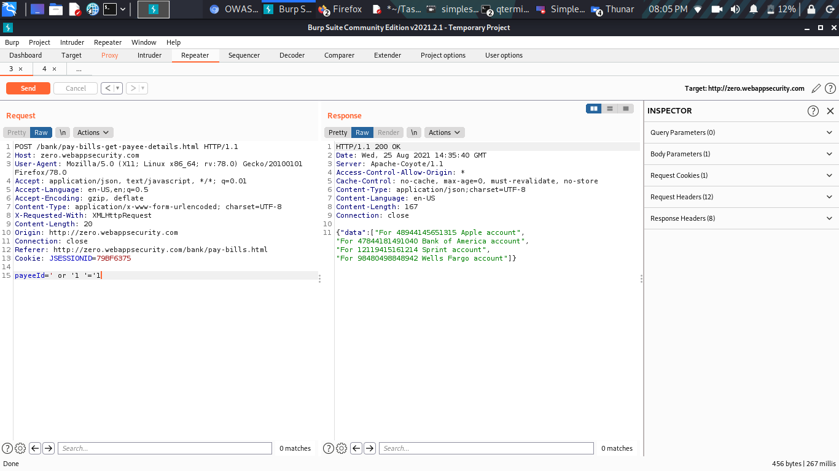
POC Screenshots
2) All the entries of the column retrieved using ' or '1 '='1 payload in payeeId:_

Slide 9
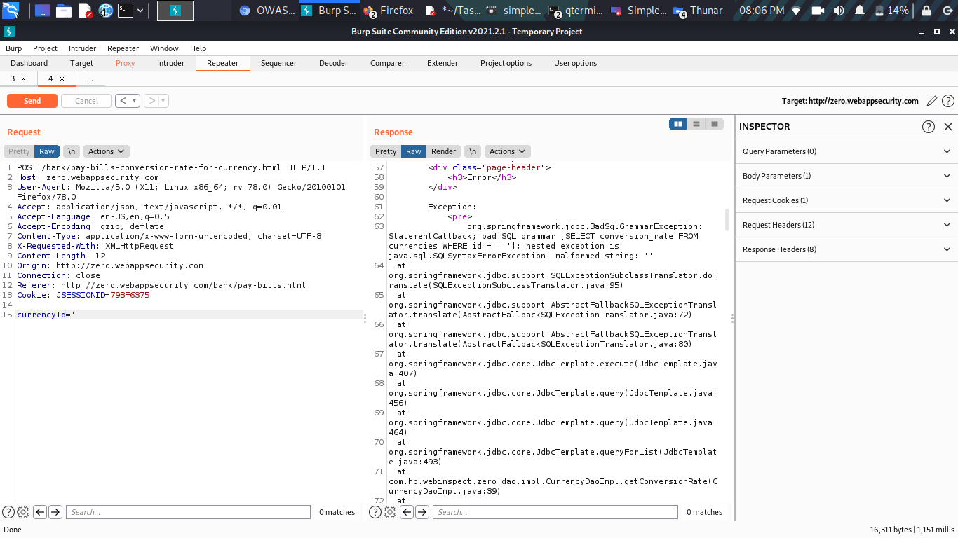
POC Screenshots
3) Query statement revealed using ‘ payload in currencyId:_

Slide 10
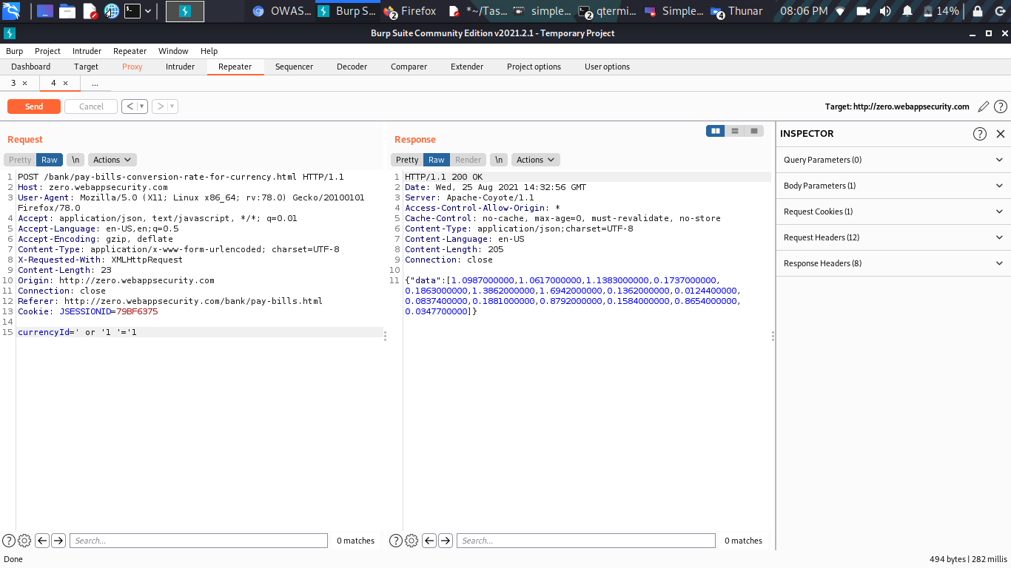
POC Screenshots
4) All the entries of the column retrieved using ' or '1 '='1 payload in currencyId:_

Slide 11

Supporting Material/References:
Video Demonstration:-
https://drive.google.com/file/d/1BZq1DHN6VuGdI5dzE2h_nrsQ_pPxLhU8/view?usp=sharing

Slide 12
Impact:-
The attacker can map the whole database in a hit and trial manner by inserting carefully crafted payloads in the vulnerable parameters of the query statements i.e. at currencyId or payeeId.
Confidential user details like login credentials and cvv numbers can be stolen which may be used to steal money.
All user details may be made public.
Can lead to Broken Authentication.

Slide 13

THANK YOU

