Slide 1
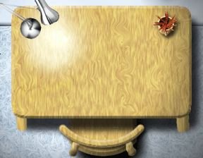





Winter 2009 Final Presentation
Piglets:
Trevor Prater
Max Lampert
Craig Abernethy
Chickens:
Visual Artist: Malcolm Wyatt-Mair
Sound Artist: Justin Amoyen
Kevin Amoyen
Chris Davidson
Mee Cha

Slide 2
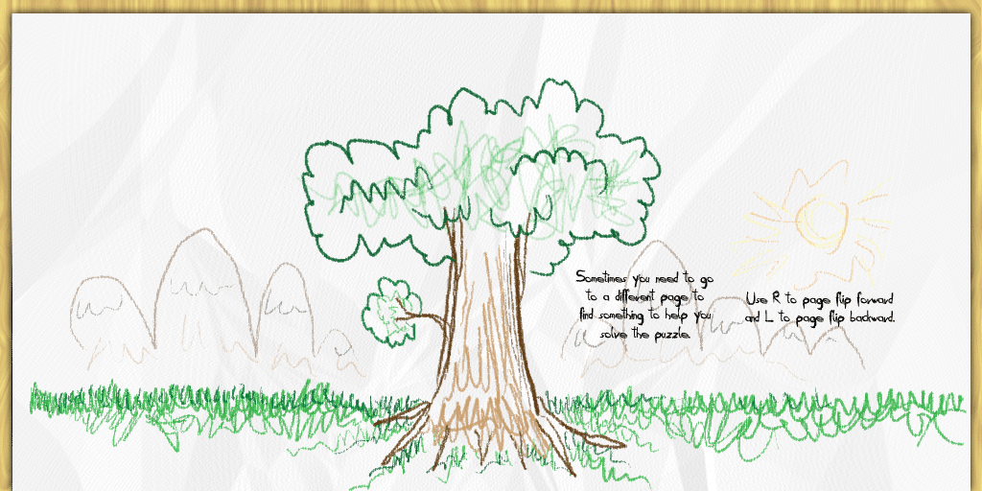
The Concept
Play as a sketched character, ripping and pasting your way through a drawn world
Place ripped pieces in strategic locations in order to overcome obstacles and proceed toward your goal.
The story consists of a
collection of childhood
memories expressed by
the art in each level.
Music

Slide 3
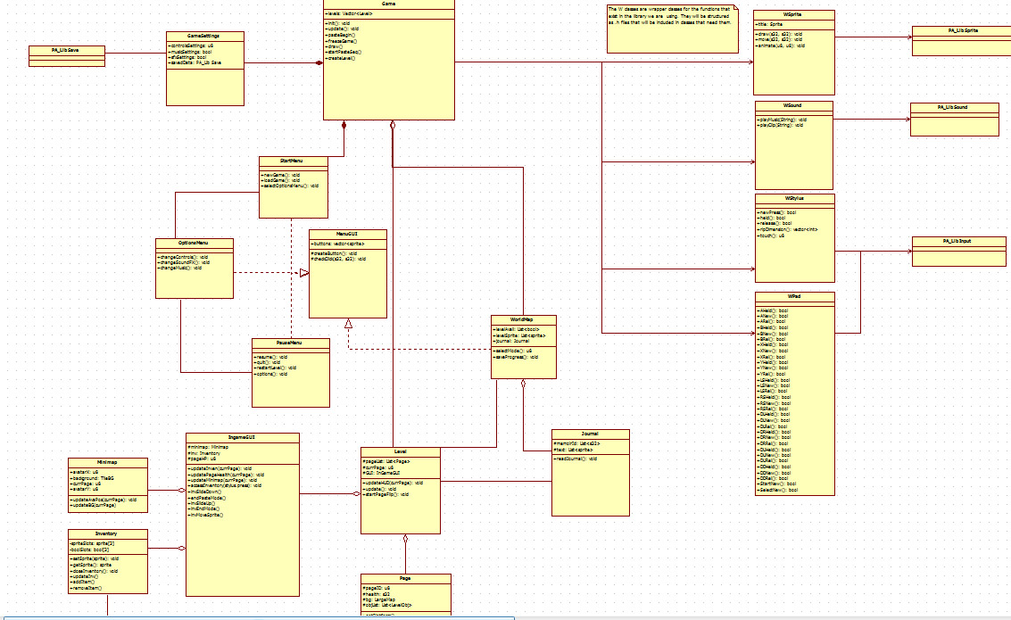

The Plan
Architecture
  Unified Modeling Language
    Class Diagrams
    Sequence Diagrams
Coding Sprints

Slide 4
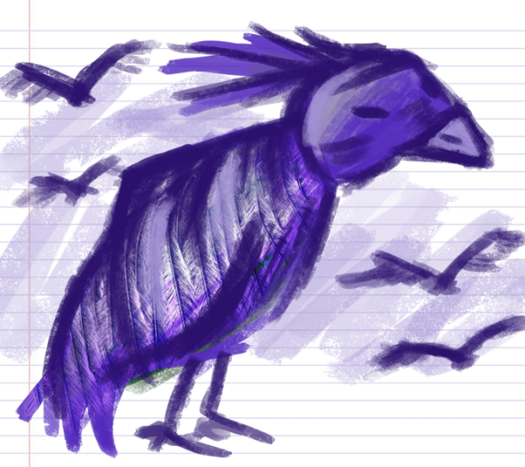
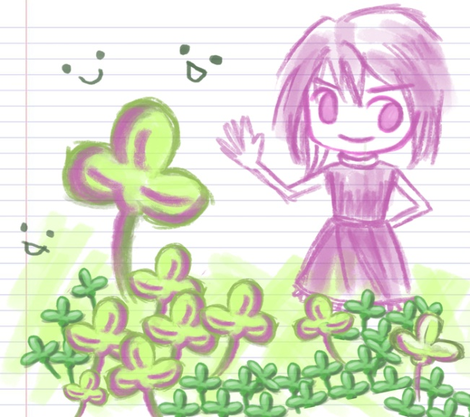
Sprint #1
Building a Class code base that will display and dynamically load in a level through a text parser.

Slide 5
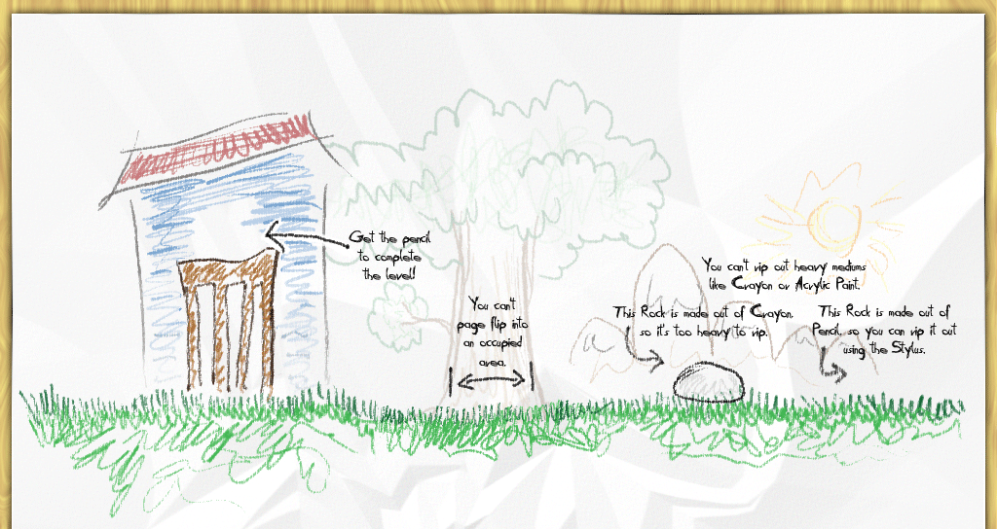
Sprint #2
Implementation of mechanics and world map
Start to switch libraries from PALib to LibNDS
  PaLib didn’t have the control we needed. Or so we thought.

Slide 6
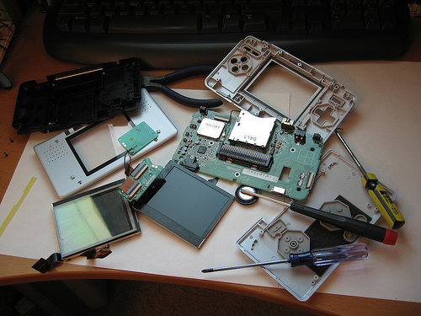
Sprint #3
Learn LibNDS and how the DS hardware works at a low level.
Implement mechanics using LibNDS.
Switched back to PALib last minute
  After learning how the hardware
  and memory allocation works at
  a low level, we found that we could
  accomplish what we need with
  PALib after all.

Slide 7
Development Road blocks
Library switch
  Palib
    Cons: very hack-jobbed, disorganized, automagic memory allocation
    Pros: handled sprites and backgrounds easily, strong community, tutorials and Open Source
  LibNDS
    Cons: Lower level, we had to manually rewrite graphics functions, poor documentation, community and close source
    Pros: learned NDS memory management and hardware specifics

Slide 8
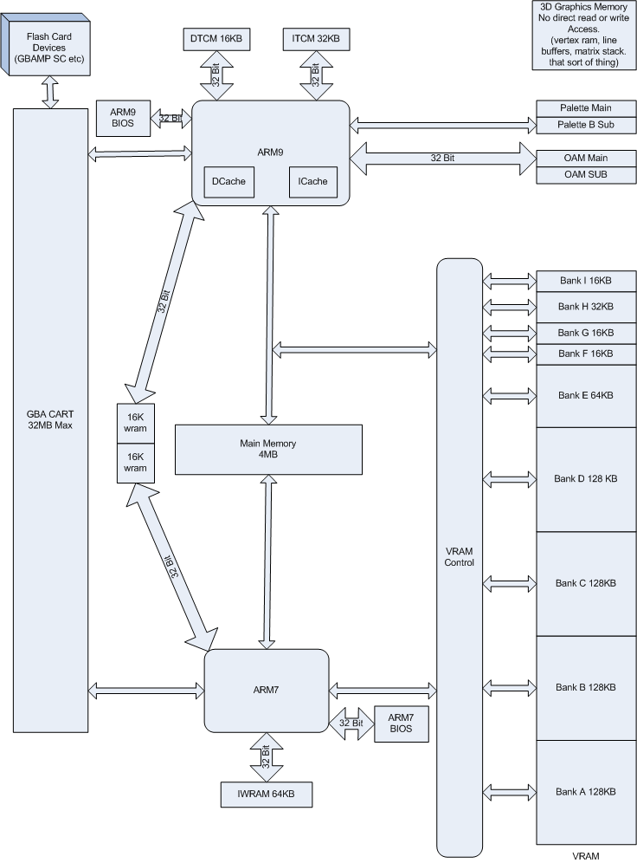
NDS hardware
Specifics of the DS hardware
  Memory
Problems we had
  Memory
Things we learned
  Memory

Slide 9

Mechanic Changes I
Page Rip
Remove an object from the page and place it into your inventory.
Ripping too much can be bad for the world.
Big Change: The rip now is a drag and drop mechanic instead of a lasso tool.
Page Flip
  This mechanic changes the “page” in a level.
  Big Change: No longer a recursive flip
  Ie: if you page flip on top of multiple holes, you don’t end up on the page with the last hole.

Slide 10
Mechanic Changes II
Friends!
  Adding a friends menu as a part of the HUD
  Players use friends as special level objects to traverse levels
  The player can select 2 friends to bring in to any level before starting it

Slide 11
Mechanic Changes III
Journal
  It is now a container for friends and media
    Media examples: colored pencil, charcoal, etc.
  Rather than collecting memoirs, the collected media unlocks some special levels and friends

Slide 12
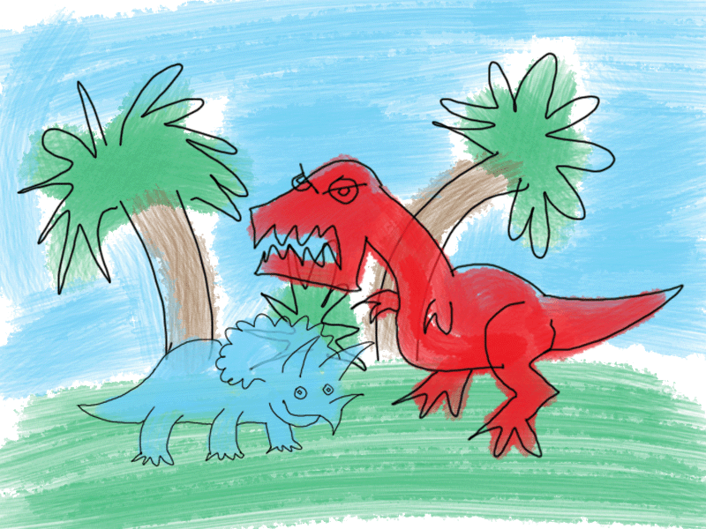
Future Implementations (Spring Qtr.)
Add artificial intelligence for non-playable characters to interact with the player.
More story content (art and possibly text)
Refine and test mechanics
  Test the friends feature
  Perfecting rip

Slide 13
Game Demo
☺

Slide 14
Ripholes thanks you for listening
What are your questions?

