Slide 1

Database migrations and database backup

Slide 2
What is database schema ??
A database schema is the blueprint or structure of a database. It defines how data is organized and how the relationships between data are structured.
Simple Explanation
Think of a database like a library. The schema is the plan that decides:
What shelves exist
What type of books go on each shelf
How books are categorized
How different sections relate to each other

Slide 3
Why are migrations used ???
Schema Version Control
Migrations track and manage changes to the database structure over time.
Safe Database Updates
They allow schema modifications without losing existing data.
Team Collaboration
Ensure all developers and environments use the same database schema.
Rollback Support
Allow developers to revert database changes if errors occur.

Slide 4
Problems if database schema are modified manually.
Inconsistent Environments
Different developers or servers may end up with different database structures.
No Change History
Manual changes are not tracked, making it difficult to know what was modified.
Difficult Rollbacks
It becomes hard to revert changes if something breaks.
Higher Risk of Errors
Manual edits can introduce mistakes that break the application or corrupt data.

Slide 5
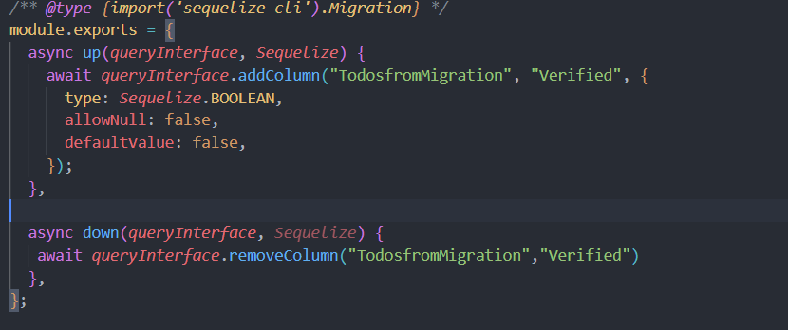
Purpose of up and down functions in migration

Slide 6
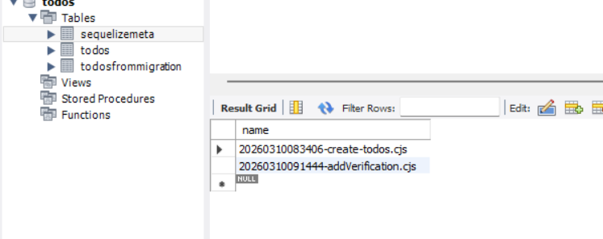
How do migration tools keep track of executed migrations?

Slide 7
Risks of Running Migrations in Production Databases
Data Loss or Corruption
Incorrect migration scripts or failed transformations can delete, overwrite, or corrupt existing
production data.
Performance Degradation
Heavy migration operations (index creation, table rewrites) can consume CPU, memory, and I/O,
slowing the live application.
Deployment Failures & Rollback Complexity
If a migration fails midway, it can leave the database in an inconsistent state, making rollbacks difficult and risky.

Slide 8
Why Database Backups Should Be Created Before Changing a Schema ?
Data Recovery
Safe Rollback
Protection Against Human Errors
Business Continuity

