Slide 1
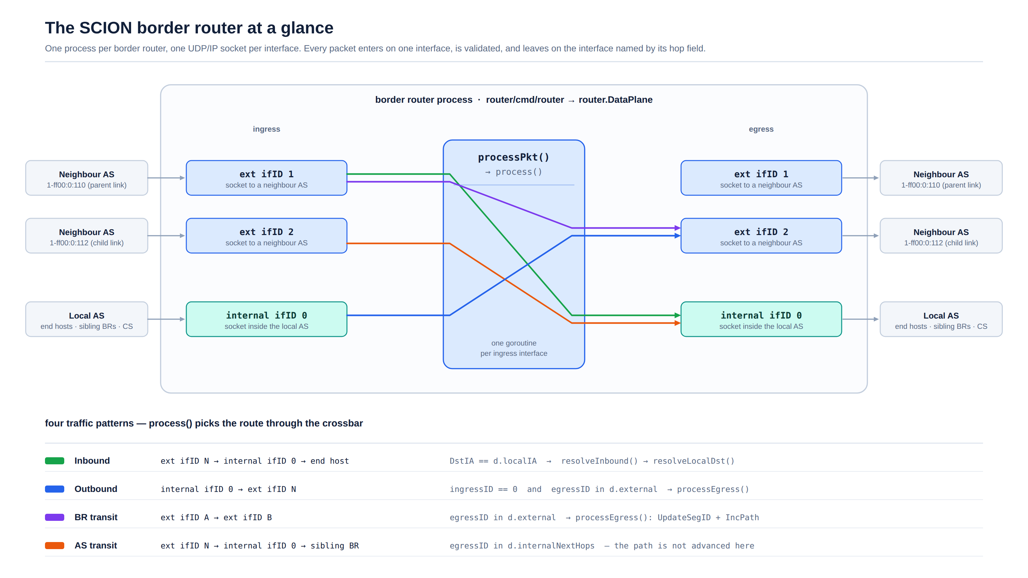
Notes:
One border router = one process. It opens one UDP/IP socket per external interface plus one internal socket toward the local AS. Everything funnels through the same per-packet pipeline, which then switches the packet onto an egress socket. The four traffic patterns (inbound, outbound, BR transit, AS transit) are just four routes through that crossbar, chosen by process().

Slide 2
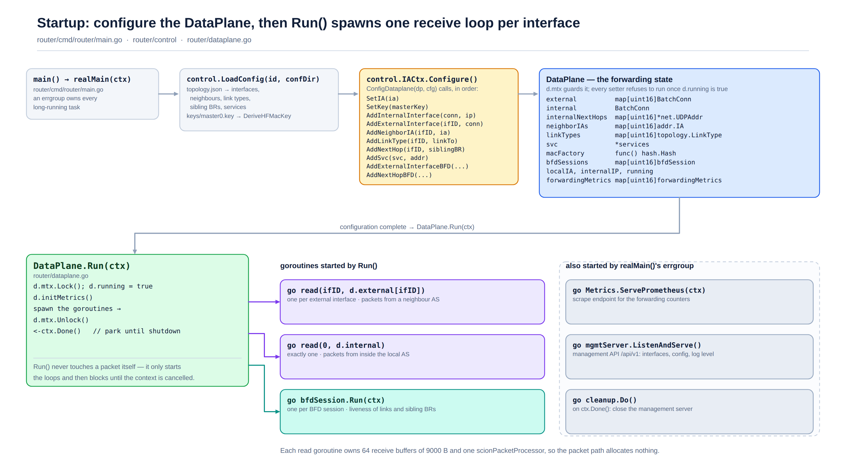
Notes:
Configuration is a one-off phase: topology.json and the master key are loaded, then control.IACtx.Configure() drives a sequence of setters that populate the DataPlane. Every setter refuses to run once d.running is true, so the forwarding state is effectively immutable while packets are flowing. Run() then starts one read goroutine per interface plus the BFD sessions, and blocks on ctx.Done().

Slide 3
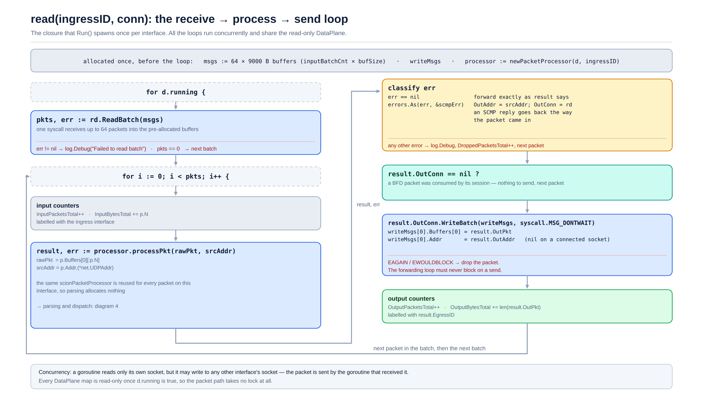
Notes:
The hot loop. ReadBatch pulls up to 64 packets in one syscall into buffers allocated before the loop started. Each packet goes through processPkt, the error is classified (SCMP errors are turned around and sent back to the sender), and the result is written with MSG_DONTWAIT so a slow output socket can never stall the receive loop.

Slide 4
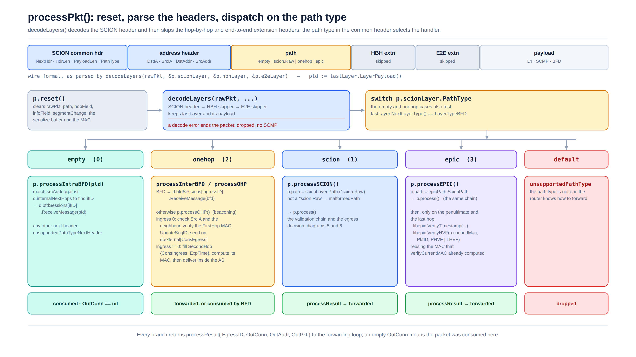
Notes:
processPkt resets the reusable processor, then decodeLayers walks the SCION header and skips the hop-by-hop and end-to-end extension headers. The path type in the common header selects the handler: BFD control packets are consumed by their session, one-hop paths take the beaconing route, and scion/epic paths go into the main process() chain.

Slide 5
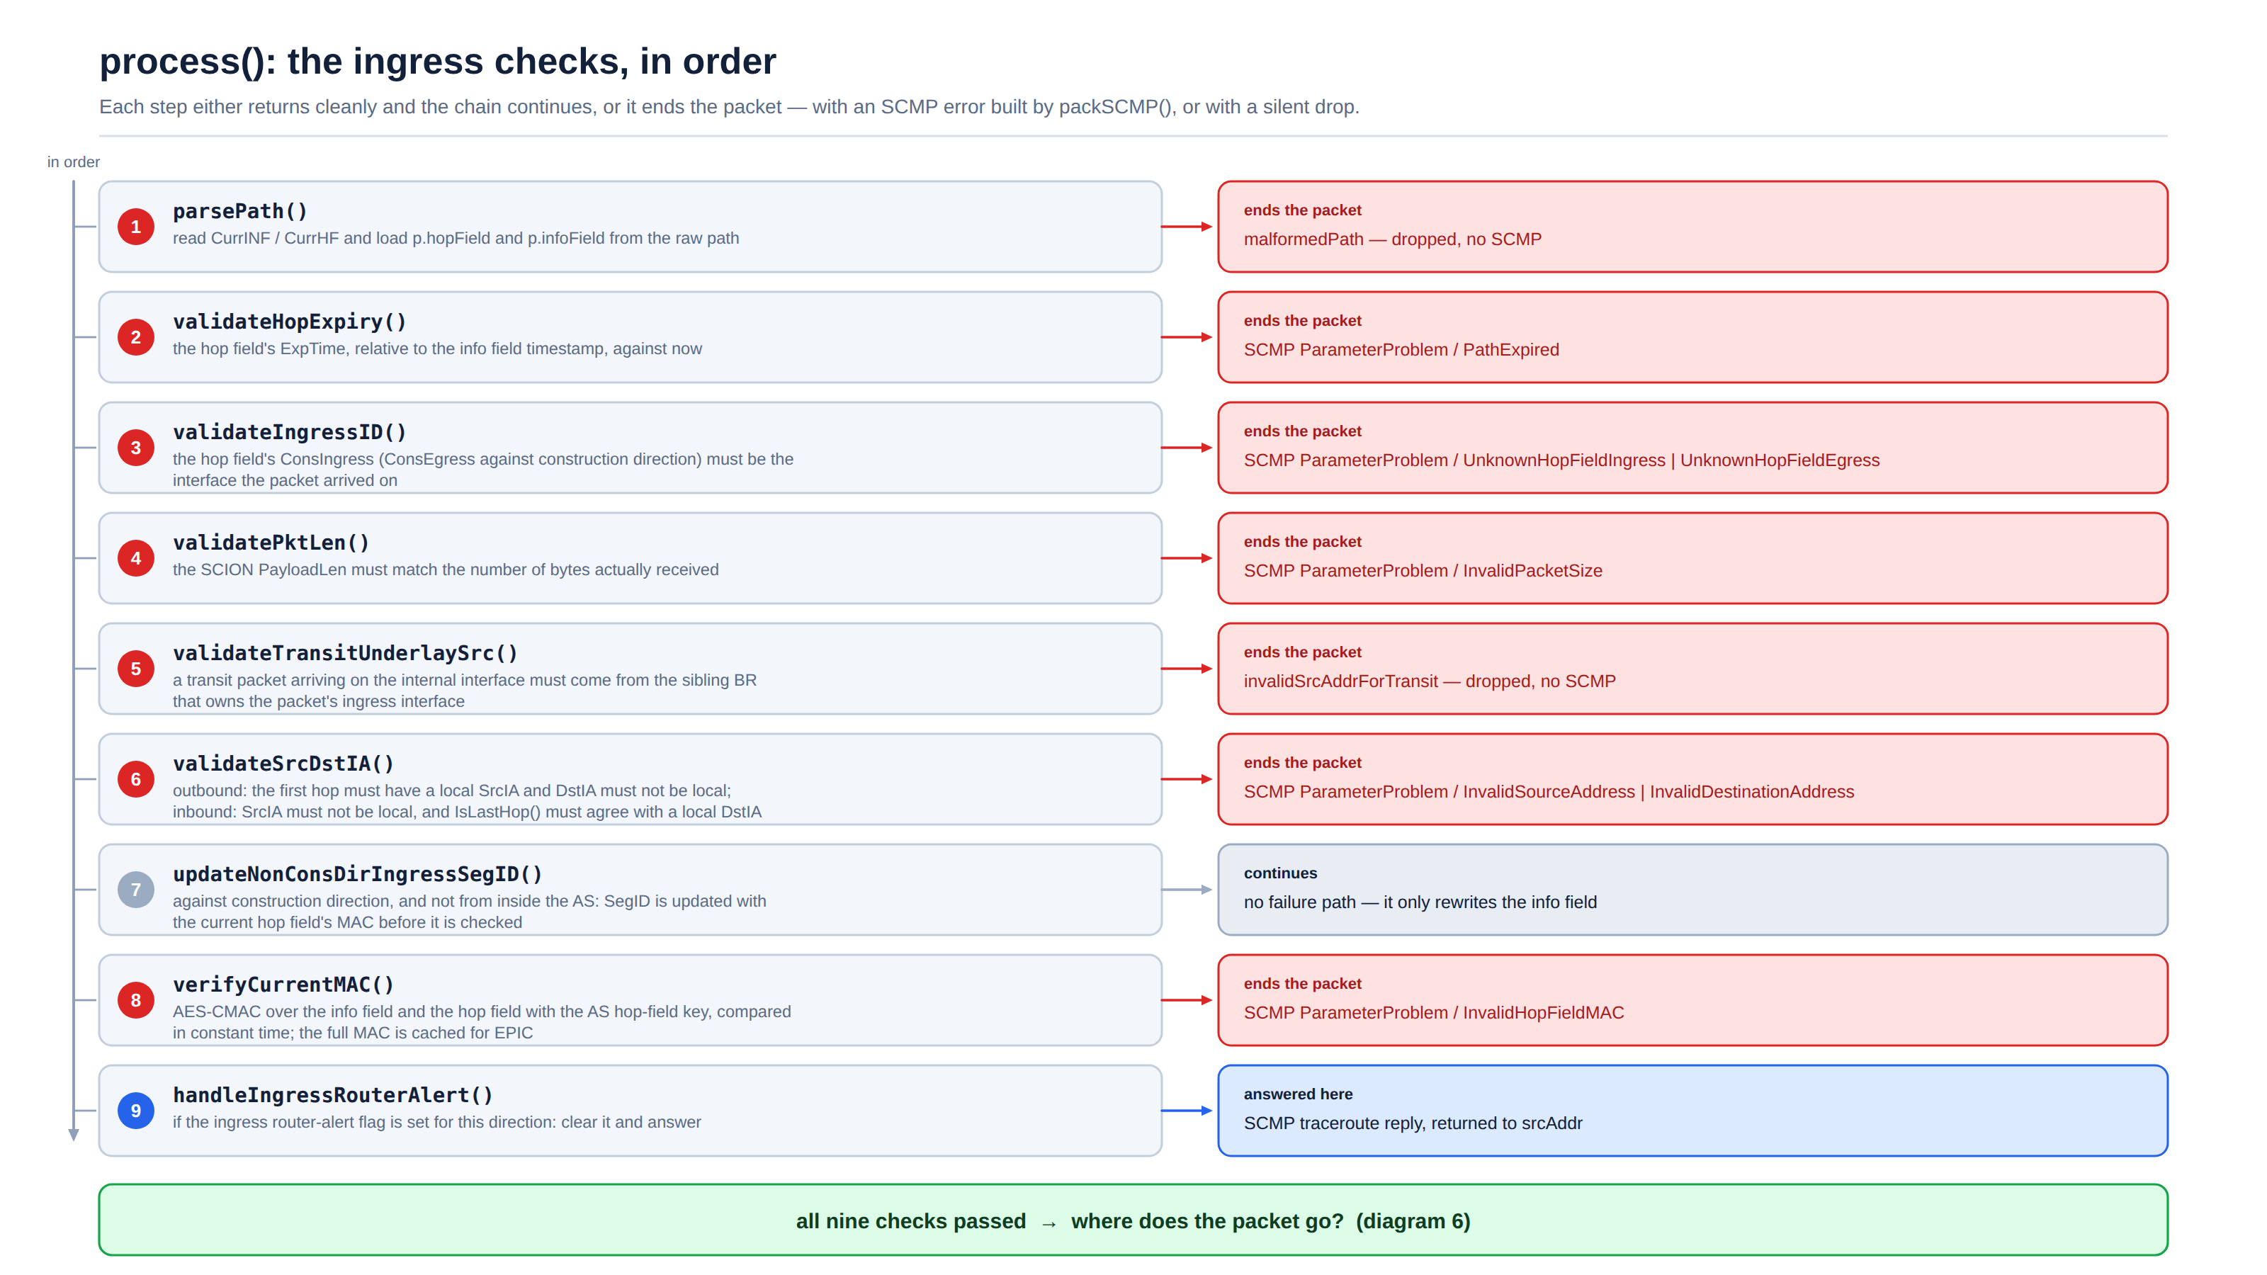
Notes:
Nine ordered checks. Note the ordering: cheap structural checks come first and the AES-CMAC verification comes late, after expiry, ingress interface, length and ISD-AS checks have already rejected the obvious garbage. Most failures produce a specific SCMP error; two of them (malformed path, bad transit source) drop the packet silently.

Slide 6
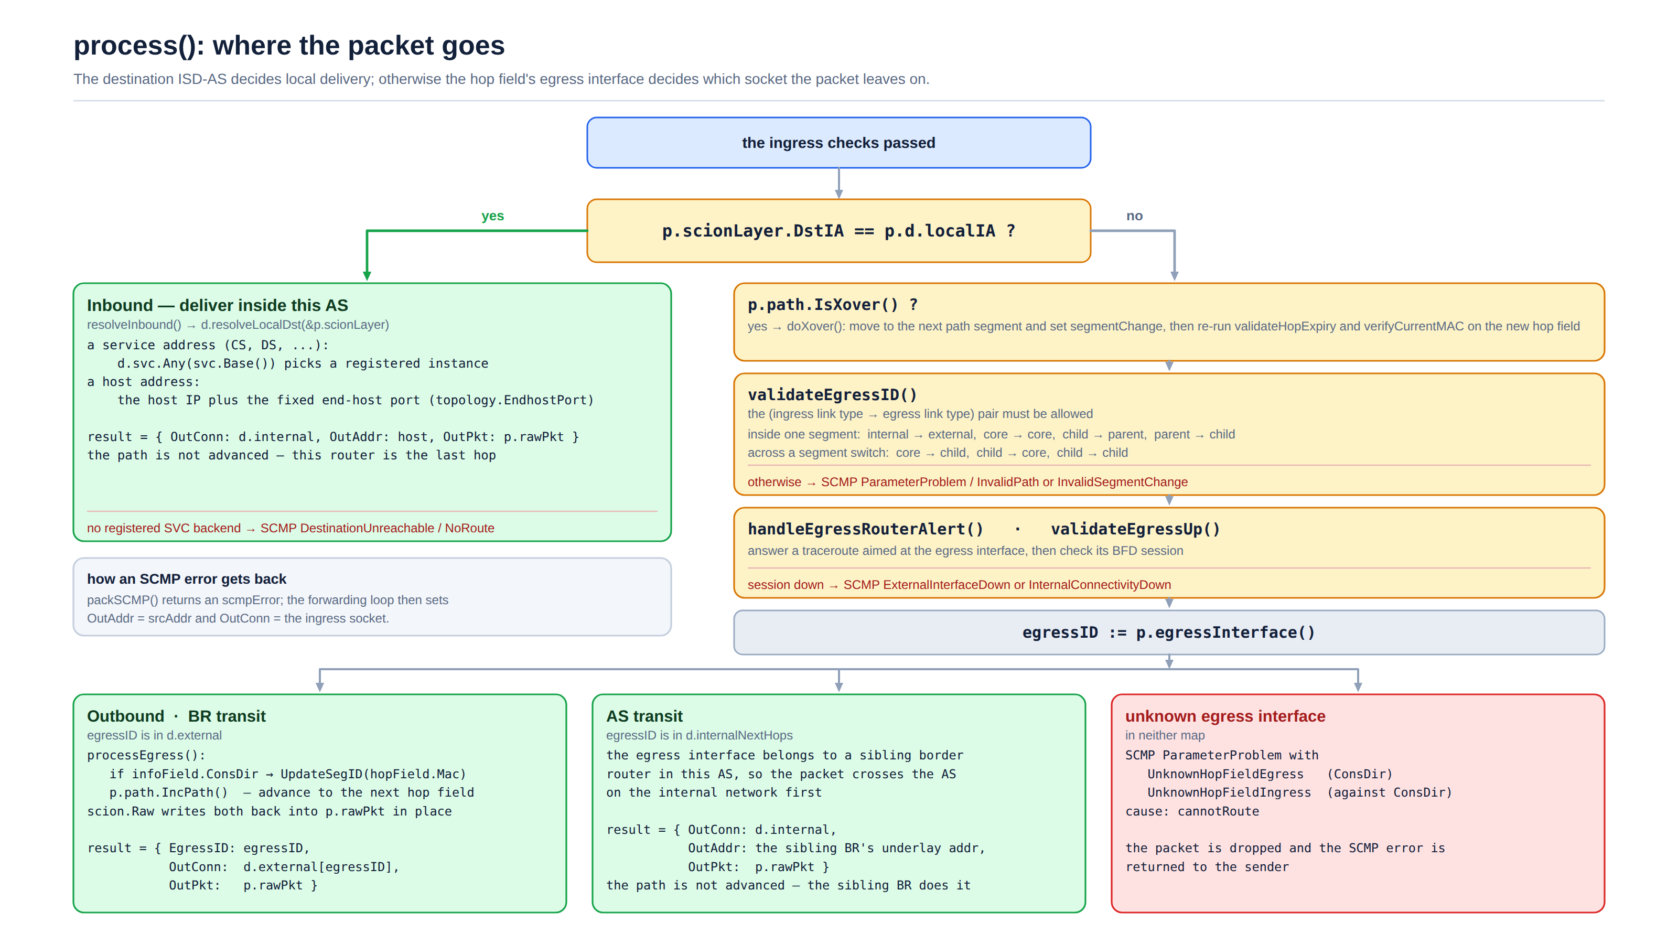
Notes:
Two questions decide everything. Is the destination ISD-AS us? Then resolve the local destination and hand the packet to the internal socket. Otherwise validate the cross-over and the egress link, then look the egress interface up: in d.external it goes straight out (and the path is advanced here); in d.internalNextHops it goes to a sibling border router over the internal network, which advances the path instead.

