Slide 1
Translating Chalice into SIL
Bachelor’s Thesis
Christian Klauser
Supervisor: Dr. Alex Summers

Slide 2
Chalice2SIL
Translate from Chalice
to Semper Intermediate Language
Chalice
relatively feature-rich
major influence on design of SIL
Notes:
First front-end for SIL

Slide 3

The Semper Project
Long term project
Automatic program verifier for Scala
verify concurrent programs
reduce annotation overhead
deal with functional features (e.g., closures)

Slide 4
Semper Architecture
Chalice
“Tuner”
Sample
“SIL-PL”
SIL
Silicon
Scala
“Slicer”
Z3

Slide 5
Semper Intermediate Language (SIL)
Not a programming language
A program representation for verification
Not all constructs are executable
High-level
Aimed at OO
method C::m(this : ref) : (y:int)
requires this ≠ null
requires acc(this.C::f,write)
ensures acc(this.C::f,write)
ensures y == this.f
implementation C::m {
entry:{
y := this.f;
}
}
Notes:
No textual representation, syntax loosly based on .toString methods on AST nodes.

Slide 6
SIL Program Structure
Method Signatures
Method Bodies
Domains (data types)
predicates
functions
Fields
method C::m(this :ref)
requires …
ensures …
implementation C::m {
…
}
field C::f : Integer;
Notes:
Multiple return values

Slide 7
Permissions
Tracking (Thread×Field×Object) → Permission
Permission can be
None ⇒ cannot access at all “0”
Some ⇒ can only read “]0,1[“
Full ⇒ can read and write “1”
Neatly supports fork-join
job1
job2
main
main
job3

Slide 8
Permission Transfer
Permissions
passed to callee on method entry
returned to caller on method exit
passed to other threads on fork
received from other threads on join
C::perform
C::update
C::process
C::listen
Notes:
Transfer from caller to callee
Modular verification

Slide 9
Permission Transfer (Simplification)
C::perform
C::update
Simplification #1:
Method Call
=
Fork + Join
Simplification #2:
Contracts make transfer unnecessary
C::update
exhale
C::update
inhale
C::process
exhale
C::listen
inhale
Notes:
Transfer from caller to callee
Modular verification

Slide 10
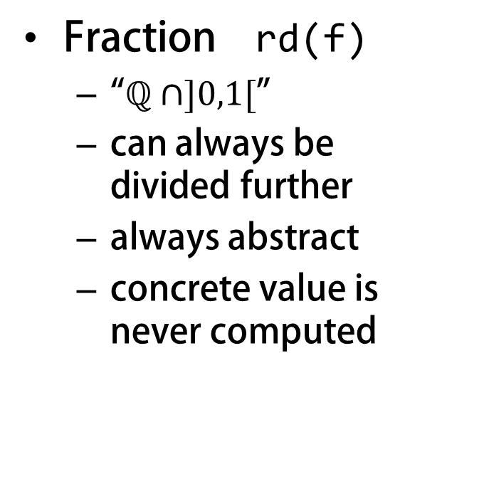
Fractional Read Permissions in Chalice
Read-only permissions
Percent acc(f,10)
intuitive
not composable
limited to 100
Epsilon
small, indivisible
still not composable
Natively supported in SIL
How does that work?
Fraction rd(f)
“$ℚ∩]0,1[$”
can always be divided further
always abstract
concrete value is never computed
Notes:
Explain what fractional read permissions do
and that there is no direct SIL-equivalent

Slide 11
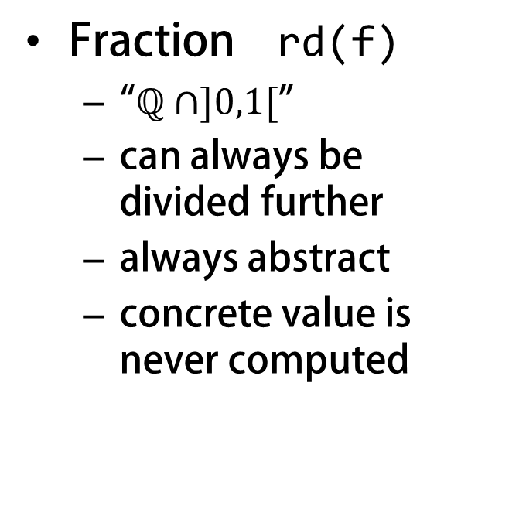
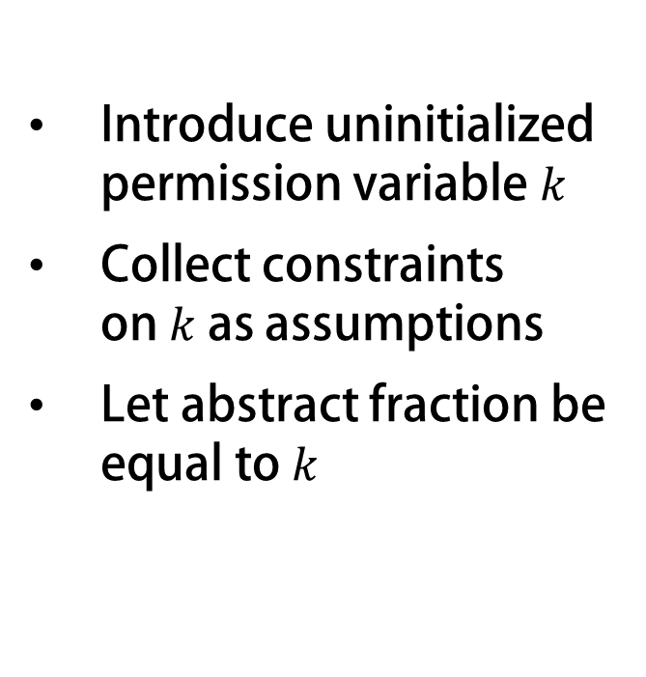
Fractional Read Permissions in Chalice
Introduce uninitialized permission variable $k$
Collect constraints on $k$ as assumptions
Let abstract fraction be equal to $k$
How does that work?
Fraction rd(f)
“$ℚ∩]0,1[$”
can always be divided further
always abstract
concrete value is never computed
Not natively supported in SIL
Notes:
Explain what fractional read permissions do
and that there is no direct SIL-equivalent

Slide 12
Implementing Fractional Permissions
Explain the basic idea behind the implementation.
→ select new fraction for every call-site
→ collect constraints from current amount of permissions held

Slide 13
Implementing Fractional Permissions #2
Show naïve translation without using map
Explain how rd(f) && rd(f) makes translation more complicated

Slide 14
Implementing Fractional Permissions #3
Explain translation using Map[(ref,int),Permission]

Slide 15
Implement Fork-Join
Another Chalice feature not present in SIL
Show how token object is assembled
→ Trick: how shadow field permissions are always linked to token.joinable
→ Current limitation: join mostly useless when not in same method as fork

Slide 16
Quick Demo

Slide 17
Conclusion
?

Slide 18
Questions?
Thank you

Slide 19
Backup/Scrap

Slide 20
Chalice
Annotated Methods
class Cell {
var v: int;
method inc(d: int)
requires 0 < d;
requires acc(v);
ensures v == old(v) + d;
{ v := v + d; }
}

Slide 21
Chalice
Annotated Methods
Monitors
class Cell {
var v: int;
invariant acc(v) && 0 <= c;
}
class Program {
method main() {
var c:Cell := new Cell;
c.v := 3;
share c;
acquire c; call c.inc(2); release c;
}
}

Slide 22
Chalice
Annotated Methods
Monitors
Predicates/Functions
class Cell {
var v: int;
predicate valid
{ acc(this.v) && 0 <= this.v }
function add(d:int) requires valid;
{ unfolding valid in this.v + d; }
…
}

Slide 23
Chalice
Annotated Methods
Monitors
Predicates/Functions
Fork-Join
class Cell { … }
class Program {
method main() {
var c1:Cell := new Cell;
var c2:Cell := new Cell;
c1.v := 0; c2.v := 5;
fork tk1 = c1.inc(3);
fork tk2 = c2.inc(1);
join f1 := tk1;
join f2 := tk2;
}
}

Slide 24
Chalice2SIL
First front-end for SIL
Help establish and test the tool chain
Ideally no changes to Chalice
If enough time is left
Predicates and functions
Deadlock avoidance
Channels (Actor model)

Slide 25
SIL Program Structure
Method Signatures
Method Bodies
Domains (data types)
predicates
functions
Fields
Functions
Predicates
implementation C::cmpexc
{
entry:{
o := this.C::f;
} if(this.C::f = c) goto exc
if(this.C::f ≠ c) goto end
exc:{
this.C::f := v;
} goto end
end:{
}
}
entry
exc
end

Slide 26
SIL Program Structure
Method Signatures
Method Bodies
Domains (data types)
predicates
functions
Fields
Functions
Predicates
domain Pair[A,B]{
function create(A,B) : Pair[A,B];
function getFirst(Pair[A,B]) : A;
axiom getFirst = ∀ a:A,b:B ::
getFirst(create(a,b)) = a;
}
domain Permission{
function
+(Permission,Permission)
: Permission
predicate
<(Permission,Permission);
}
Notes:
Custom data types, predicates

Slide 27
SIL Program Structure
Method Signatures
Method Bodies
Domains (data types)
predicates
functions
Fields
Functions
Predicates
field C::f : int;
field L::value : int;
field L::next : ref;
function C::fGreater(a : int)
: bool
requires acc(this.C::f,write)
= C::f>a
predicate L::valid = acc(this.L::value,write) && acc(this.L::next,write) && this.L::next≠null ⇒ acc((this.L::next).L::inv,
write)
Notes:
Custom data types, predicates

