Slide 1
Translating Chalice into SIL
Bachelor’s Thesis
Christian Klauser
Supervisor: Dr. Alex Summers

Slide 2
Chalice2SIL
Translate from Chalice
to Semper Intermediate Language
Chalice
verification of concurrent programs
uses “permissions” to control access
relatively feature-rich
major influence on design of SIL
Notes:
First front-end for SIL

Slide 3

The Semper Project
Long term project
Automatic program verifier for Scala
verify concurrent programs
reduce annotation overhead
deal with functional features (e.g., closures)

Slide 4
Semper Architecture
Chalice
“Tuner”
Sample
“SIL-PL”
SIL
Silicon
Scala
“Slicer”
Z3

Slide 5
Semper Intermediate Language (SIL)
Not a programming language
A program representation for verification
Not all constructs are executable
Aimed at OO
High-level
method C::m(this : ref) : (y:int)
requires this ≠ null
requires acc(this.C::f,write)
ensures acc(this.C::f,write)
ensures y == this.f
implementation C::m {
entry:{
y := this.f;
}
}
Notes:
No textual representation, syntax loosly based on .toString methods on AST nodes.

Slide 6
SIL Program Structure
Method Signatures
Method Bodies
Domains (data types)
predicates
functions
axioms
Fields
method C::m(this :ref)
requires …
ensures …
implementation C::m {
…
}
field C::f : Integer;
Notes:
Multiple return values

Slide 7
Permissions
Tracking (Thread×Field×Object) → Permission
Permission can be
None ⇒ cannot access at all “0”
Some ⇒ can only read “]0,1[“
Full ⇒ can read and write “1”
Neatly supports fork-join
job1
job2
main
main
job3

Slide 8
Permission Transfer
Permissions
passed to callee on method entry
returned to caller on method exit
passed to other threads on fork
received from other threads on join
C::perform
C::update
C::process
C::listen
Notes:
Transfer from caller to callee
Modular verification

Slide 9
Permission Transfer (Simplification)
C::perform
C::update
Simplification #1:
Method Call
=
Fork + Join
Simplification #2:
Contracts make transfer unnecessary
C::update
exhale
C::update
inhale
C::process
exhale
C::listen
inhale
Notes:
Transfer from caller to callee
Modular verification

Slide 10
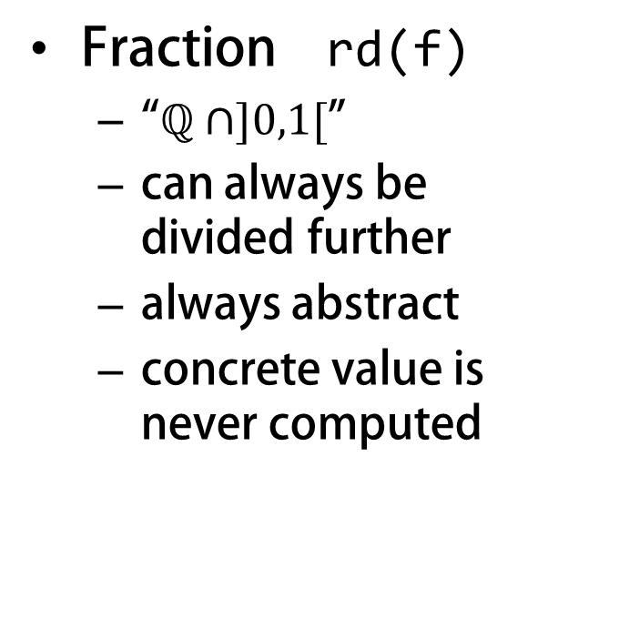
Fractional Read Permissions in Chalice
Read-only permissions
Percent acc(f,10)
intuitive
not composable
limited to 100
Epsilon
small, indivisible
still not composable
Natively supported in SIL
How does that work?
Fraction rd(f)
“$ℚ∩]0,1[$”
can always be divided further
always abstract
concrete value is never computed
Notes:
Explain what fractional read permissions do
and that there is no direct SIL-equivalent

Slide 11
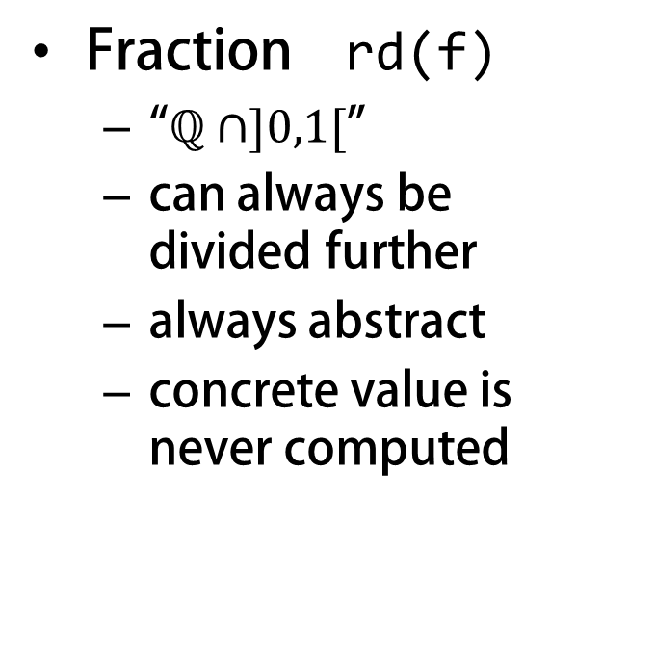
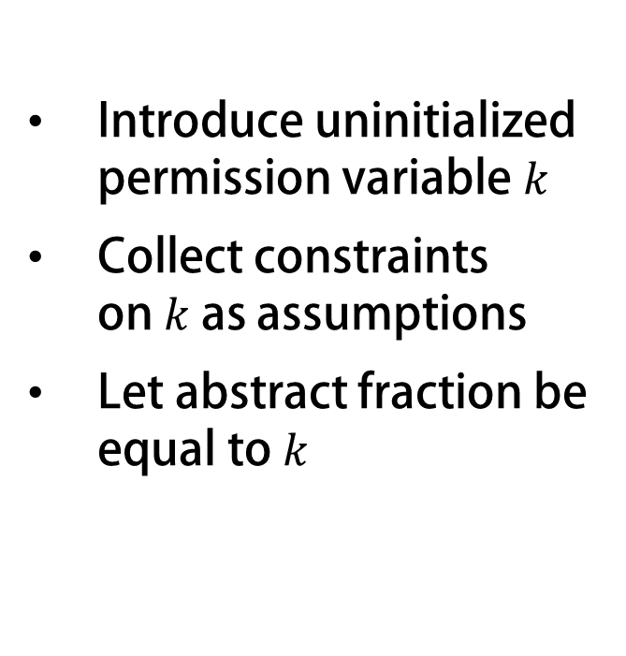
Fractional Read Permissions in Chalice
Introduce uninitialized permission variable $k$
Collect constraints on $k$ as assumptions
Let abstract fraction be equal to $k$
How does that work?
Fraction rd(f)
“$ℚ∩]0,1[$”
can always be divided further
always abstract
concrete value is never computed
Not natively supported in SIL
Notes:
Explain what fractional read permissions do
and that there is no direct SIL-equivalent

Slide 12
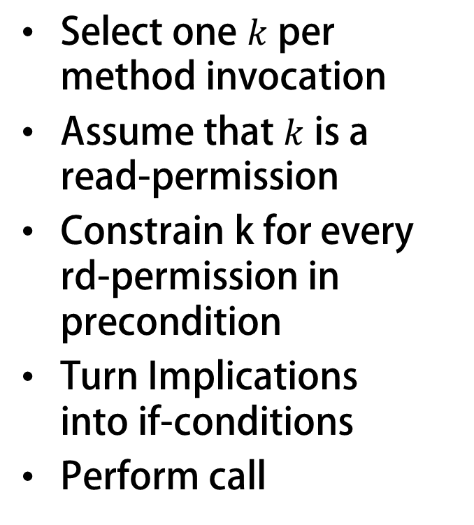
Implementing Fractional Permissions
method C::m(this:ref, x:ref, method_k:Permission)
requires 0 < k && k < write
requires acc(this.C::f, method_k)
var k : Permission;
Select one $k$ per method invocation
Assume that $k$ is a read-permission
Constrain k for every rd-permission in precondition
Turn Implications into if-conditions
Perform call
inhale 0 < k && k < method_k;
// rd(f) becomes
inhale k < perm(this.f);
// x != null ⇒ rd(x.g) becomes
if(x ≠ null) {
inhale k < perm(x.g);
}
Easy, Right?
call C::m(this,x,k);
Notes:
Explain the basic idea behind the implementation.
→ select new fraction for every call-site
→ collect constraints from current amount of permissions held

Slide 13
Implementing Fractional Permissions #2
Not correct for rd(f) && rd(f) !
Option 1:
Don’t use call
Option 2:
“Simulate” exhale
without access to permission mask
inhale k < perm(this.f);
inhale k < perm(this.f);
inhale k < perm(this.f);
exhale acc(this.f,k)
Notes:
Explain how rd(f) && rd(f) makes translation more complicated
Explain translation using Map[(ref,int),Permission]

Slide 14
Implementing Fractional Permissions #3
Build a map
(ref×field) → Permission
Use map for inhale
Simulate exhale on map
inhale k < map[this,f];
map := update(map,(this,f),
map[this,f] – k);

Slide 15
Implementing Fractional Permissions #3
Build a map
(ref×field) → Permission
Add “default value” to map?
First build then simulate?
Learn about the past!
var map : Map[(ref,field),Permission];
var map0 : Map[(ref,field),Permission];
inhale map = map0;
…
if(x ≠ null){
inhale map0[x,f] = perm(x.f)
…
}
Use map for inhale
Simulate exhale on map
inhale k < map[this,f];
map := update(map,(this,f),
map[this,f] – k);

Slide 16
Implement Fork-Join
No direct equivalent in SIL
Use exhale for fork
And inhale for join
Not so fast!
Postcondition might refer to this, args
tk := fork m(x);
…
join tk;
Solution:
Store this and args in token
Link permissions to .joinable
Notes:
Another Chalice feature not present in SIL
Show how token object is assembled
→ Trick: how shadow field permissions are always linked to token.joinable
→ Current limitation: join mostly useless when not in same method as fork

Slide 17
Limitations of Fork-Join in Chalice2SIL
Cross-method join
Invalid old expressions
Don’t know what tk.__this means in target method
Chalice’s eval expression slated for replacement
But: Chalice2SIL captures everything it can
Chalice2SIL captures any old(_) into tk.__old#n
method parallel(d : Dell, b : bool) returns (r: bool)
requires b ==> rd(d.cell)
&& rd(d.cell.f)
ensures r ==> old(d.cell.f == 5)
&& r == (d != null)

Slide 18
Quick Demo

Slide 19
State of Chalice2SIL
Implemented
Not Implemented (yet)
synchronous calls
some fork-join scenarios
predicates
functions
testing framework
good infrastructure
monitors* (class invariants, locking)
deadlock avoidance*
informative error messages*
cross-method join
channels (actor-based model)
stepwise refinement

Slide 20
Conclusion
SIL and Silicon: a viable backend for Chalice
SIL conveniently high-level
Fractional read permissions
felt more like fighting SIL
direct access to permission mask?
permission model plugins?
other form of extensibility?

Slide 21
Questions?
Thank you

Slide 22
Backup/Scrap

Slide 23
Chalice
Annotated Methods
class Cell {
var v: int;
method inc(d: int)
requires 0 < d;
requires acc(v);
ensures v == old(v) + d;
{ v := v + d; }
}

Slide 24
Chalice
Annotated Methods
Monitors
class Cell {
var v: int;
invariant acc(v) && 0 <= c;
}
class Program {
method main() {
var c:Cell := new Cell;
c.v := 3;
share c;
acquire c; call c.inc(2); release c;
}
}

Slide 25
Chalice
Annotated Methods
Monitors
Predicates/Functions
class Cell {
var v: int;
predicate valid
{ acc(this.v) && 0 <= this.v }
function add(d:int) requires valid;
{ unfolding valid in this.v + d; }
…
}

Slide 26
Chalice
Annotated Methods
Monitors
Predicates/Functions
Fork-Join
class Cell { … }
class Program {
method main() {
var c1:Cell := new Cell;
var c2:Cell := new Cell;
c1.v := 0; c2.v := 5;
fork tk1 = c1.inc(3);
fork tk2 = c2.inc(1);
join f1 := tk1;
join f2 := tk2;
}
}

Slide 27
Chalice2SIL
First front-end for SIL
Help establish and test the tool chain
Ideally no changes to Chalice
If enough time is left
Predicates and functions
Deadlock avoidance
Channels (Actor model)

Slide 28
SIL Program Structure
Method Signatures
Method Bodies
Domains (data types)
predicates
functions
Fields
Functions
Predicates
implementation C::cmpexc
{
entry:{
o := this.C::f;
} if(this.C::f = c) goto exc
if(this.C::f ≠ c) goto end
exc:{
this.C::f := v;
} goto end
end:{
}
}
entry
exc
end

Slide 29
SIL Program Structure
Method Signatures
Method Bodies
Domains (data types)
predicates
functions
Fields
Functions
Predicates
domain Pair[A,B]{
function create(A,B) : Pair[A,B];
function getFirst(Pair[A,B]) : A;
axiom getFirst = ∀ a:A,b:B ::
getFirst(create(a,b)) = a;
}
domain Permission{
function
+(Permission,Permission)
: Permission
predicate
<(Permission,Permission);
}
Notes:
Custom data types, predicates

Slide 30
SIL Program Structure
Method Signatures
Method Bodies
Domains (data types)
predicates
functions
Fields
Functions
Predicates
field C::f : int;
field L::value : int;
field L::next : ref;
function C::fGreater(a : int)
: bool
requires acc(this.C::f,write)
= C::f>a
predicate L::valid = acc(this.L::value,write) && acc(this.L::next,write) && this.L::next≠null ⇒ acc((this.L::next).L::inv,
write)
Notes:
Custom data types, predicates

