Slide 1
Semester Thesis:
Translating Java bytecode to a simple language
Roman Scheidegger
supervised by Pietro Ferrara
Notes:
Y:\eth\bachelorthesis\documentation\project-presentation\javatosimple.odp

Slide 2
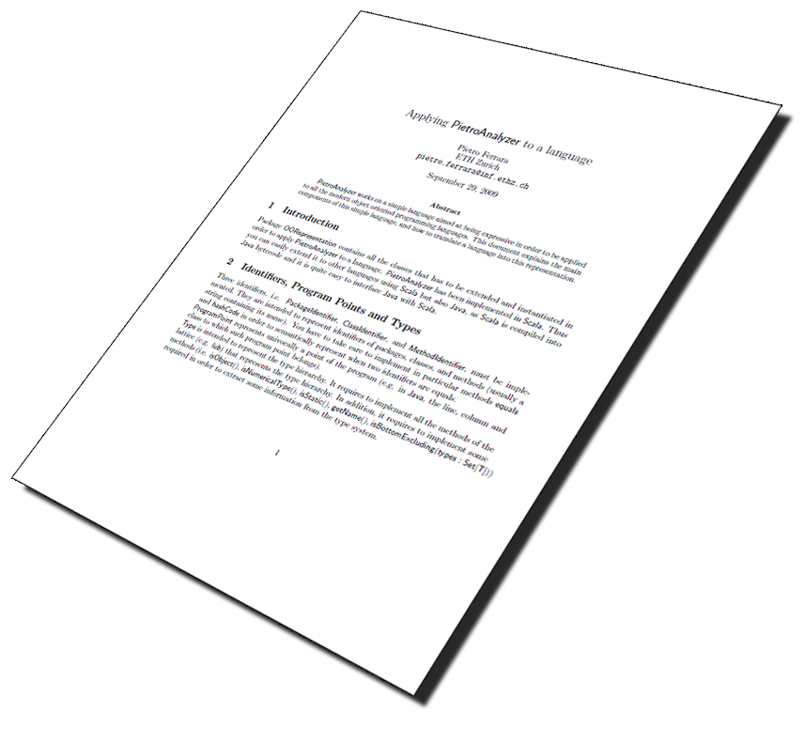
Aim & Motivation
Given Static Code Analyzer
Sample
Static Analyzer of Multiple Programming LanguagEs
Works on a simple language
Scala → Simple
Java bytecode → Simple
D-INFK / Chair of Programming Methodology

Slide 3
Overview
Simple
Java bytecode
JavaToSimple
Conclusions
D-INFK / Chair of Programming Methodology

Slide 4
Simple : Statements(1)
Consists of 8 basic Statements
  Variable(ID)
  NumericalConstant(Value, Type)
  VariableDeclaration(Variable, Type, Right)
  FieldAccess(Object/s, Field, Type)
  MethodCall(Method, Parameters, Returntype)
  Assignment(Left, Right)
  New(Type)
  Throw(Expression)
Everything is an object!
x
1
int = ;
x=
x.+( );
y.f
throw
new IOException()
;
D-INFK / Chair of Programming Methodology

Slide 5
Simple : Statements(2)
Each Statement carries a ProgramPoint object
Nested Statements
Again a Statement
Basic components of ControlFlowGraph
int x = 1;
VariableDeclaration( , , )
Variable(x)
int
NumericalConstant(1, int)
D-INFK / Chair of Programming Methodology

Slide 6
Simple : ControlFlowGraph
Sequential list of Statements
Execution order missing
Weighted Graph
  Nodes → List of Statements
  Edges → No weight
  Boolean weight
This is desired Output
Statement1
Statement2
Statement3
Statement4
true
false
Statement1
Statement2
Statement3
Statement4
Statement1
Statement2
Statement3
Statement4
D-INFK / Chair of Programming Methodology

Slide 7
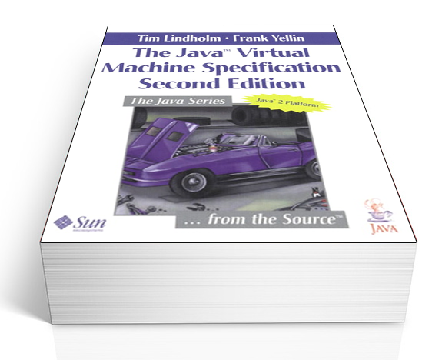
Java bytecode : class files
Input: Java class files
Rough Structure
  General Information
  Constant Pool
  Interfaces
  Fields
  Methods
  Attributes
Opcodes
D-INFK / Chair of Programming Methodology

Slide 8
Java bytecode : Opcodes
Opcodes → one byte
Different Categories
  Loading and storing istore, aload_0
  Arithmetic and logic iadd, fcmpl
  Type conversion i2b, d2i
  Object creation and manipulation new, putfield
  Control transfer ifeq, goto
  Method invocation and return invokespecial,ireturn
  Special jsr, monitorenter
Type pre-/suffixes: i,l,s,b,c,f,d,a
D-INFK / Chair of Programming Methodology

Slide 9
Java Bytecode : Opcodes(2)
LV0 Lv1
OS
JVM
  Operand Stack
  Local Variables
Example
5
1
this
1
5
4
int x = 1;
x = x + 4;
0: iconst_1
1: istore_1
2: iload_1
3: iconst_4
4: iadd
5: istore_1
D-INFK / Chair of Programming Methodology

Slide 10
JavaToSimple
Input: Java bytecode
  low level
  unstructured
Desired Output: Simple
  HighLevel
  Weighted Graph
Solution: JavaToSimple
  Written in Java
  Uses Javassist to read Bytecode
D-INFK / Chair of Programming Methodology

Slide 11
JavaToSimple : 1st Stage parsing the opcodes(1)
Sequentally parse bytecode and build Statements
No 1-1 mapping
  Use a Virtual Operand Stack
Flushs & Flush-causing opcodes
Jump related opcodes
  We need to store this information
D-INFK / Chair of Programming Methodology

Slide 12
JavaToSimple : 1st Stage parsing the opcodes(2)
// aconst_null
case 1: …
opsta.push(new Statement(..));
break;
// istore_0
case 59: …;
__flushids(new Statement(..),false);
break;
// goto
case 167: …;
unconditionaljumps.put(from,to);
break;
while(nextOp = iterator.getNextOpcode()) {
InstructionIDs.push(nextOp.getID());
switch(nextOp.getOpcode()) {
...
}
}
D-INFK / Chair of Programming Methodology

Slide 13
JavaToSimple : 1st Stage parsing the opcodes(3)
__flushids
  Adds Statement to list of parsed Statements
  Uses InstructionIDs to generate mapping
    InstructionIDs ↔ StatementID
  If necessary adds conditional jumps
D-INFK / Chair of Programming Methodology

Slide 14
JavaToSimple : 1st Stage parsing the opcodes(4)
Virtual Operand Stack
Simple example
NC(1,int)
0: iconst_1
1: istore_1
InstructionIDs
0
1
List of parsed Statements
Flush causing!
1:A(V(v1),NC(1,int))
StaID ↔ InsID
1 ↔ 1
1 ↔ 0
D-INFK / Chair of Programming Methodology

Slide 15
JavaToSimple : 2nd Stage building nodes(1)
So far all bytecode instructions transformed to Statements
Now build nodes as large as possible
  Remember which Statement was added to which Node
Jumps causes node splits → So use jump information
Loop sequentally through parsed Statements
  If current Statement jump-target → begin a new node
  Add current statement to current node
  If current Statement jump-source → begin a new node
D-INFK / Chair of Programming Methodology

Slide 16
JavaToSimple : 2nd Stage building nodes(2)
Sometimes we need to insert new edges
0,1
0: iconst_1
1: istore_1
2: iload_1
3: iconst_4
4: iadd
5: istore_1
6: goto 2
This edge actually missing!
2,3,4,5,6
D-INFK / Chair of Programming Methodology

Slide 17
JavaToSimple : 3rd Stage adding edges(1)
Given node list
  Guaranteed that Nodes have no jumps inside
Given jumps in bytecode addresses (Instruction IDs)
  unconditionaljumps, truejumps, falsejumps
Given jumps in node addresses
  insertedjumps
Given Mappings
  InstructionIDs ↔ StatementID ↔ NodeID
D-INFK / Chair of Programming Methodology

Slide 18
JavaToSimple : 3rd Stage adding edges(2)
Now straightforward process
Loop through all edges stored
  Use mappings to determine NodeIDs to connect
  Weight is given implicitly
  Add Edges
Successfully built the ControlFlowGraph
D-INFK / Chair of Programming Methodology

Slide 19
JavaToSimple : Putting it alltogether
Other information extracted
  Access modifiers
  Superclass
  Package
  Field declarations
CFG used to build Method declarations
All put together to a ClassDefinition ready for Sample
D-INFK / Chair of Programming Methodology

Slide 20
JavaToSimpe : Some difficulties(1)
Side effects of function calls (e.g invokeinterface)
  Pushes result onto operand stack
Naive way:
Push a MethodCall Statement onto virtual operand stack
  Put this could actually delay the execution of the function
Simple Solution: Introduce a new Variable
  Push the Variable on the virtual operand stack
D-INFK / Chair of Programming Methodology

Slide 21
JavaToSimpe : Some difficulties(2)
JVM Local Variables
  Compiler may use same local variable twice
  They may be implicitly redeclared
  Not supported in Simple
Solution: Keep Track of types
  First time access → VariableDeclaration
  Remember the type
  If access with new type → introduce variable with new name
    val0#rev2
D-INFK / Chair of Programming Methodology

Slide 22
JavaToSimple : Testing & Debugging
Simple examples used while implementing
Then used Java Class Library
  Containing more than 16k classes
Iteratively improved
In the end all Classes parsed without errors
D-INFK / Chair of Programming Methodology

Slide 23
Conclusions
Open Issues
  Implementation of JavaType
  No speed optimization
  Mabye datastructure could be optimized
Successfully implemented all opcodes
  At least all in the VM Spec
Capable of parsing most of classes
D-INFK / Chair of Programming Methodology

Slide 24
Impressions as a student
Didn't know Scala or Java bytecode
Excellent support
  Mostly per E-Mail
D-INFK / Chair of Programming Methodology

Slide 25
Questions?
D-INFK / Chair of Programming Methodology

Slide 26
JavaToSimpe : Some difficulties(3)
Java Subroutine Calls (jsr, ret)
  another feature not available in SimpleLanguage
  Execution continues at given location and jumps back
Solution : Code Inlining
  Continue parsing at given jsr-location
  Problems with addressing and instruction Ids
Solution : Use String IDs with suffixes 14JSR2:5
  Easily integrated by using a function
D-INFK / Chair of Programming Methodology

Slide 27
JavaToSimpe : Some difficulties(4)
Using String IDs
String __getactualindex(int index) {
if(jsrcalls.empty())
return Integer.toString(index);
else
return Integer.toString(index)
+ (String)jsrcalls.peek();
}
D-INFK / Chair of Programming Methodology

Slide 28
JavaToSimpe : Some difficulties(5)
Interoperating Scala and Java
  Theoretically absolutely possible
  Practically some problems
Scala Lists != Java Lists
Unable to use None or Nil
  Had to implement a Nil- and None-factory in scala
D-INFK / Chair of Programming Methodology

