Slide 1
Interfacing
TVLA & Sample
Raphael Fuchs
August 4, 2011

Slide 2
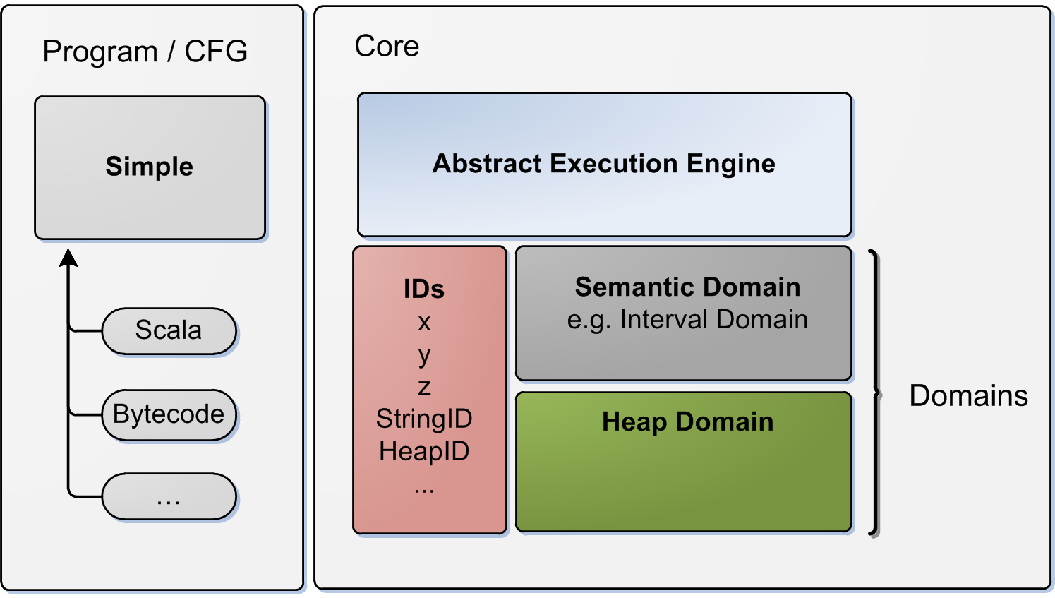
Sample: Architecture
Notes:
- bottom right part: my work
- note the ID space shared between domains!

Slide 3
Approach (1)
Simple statements result in calls on heap domain
For every heap operation, invoke TVLA
E.g.
assignVariable(x,y)
%action assignVariable(target,source) {
%f { source(v) }
{ target(v) = source(v) }
}
x = y

Slide 4
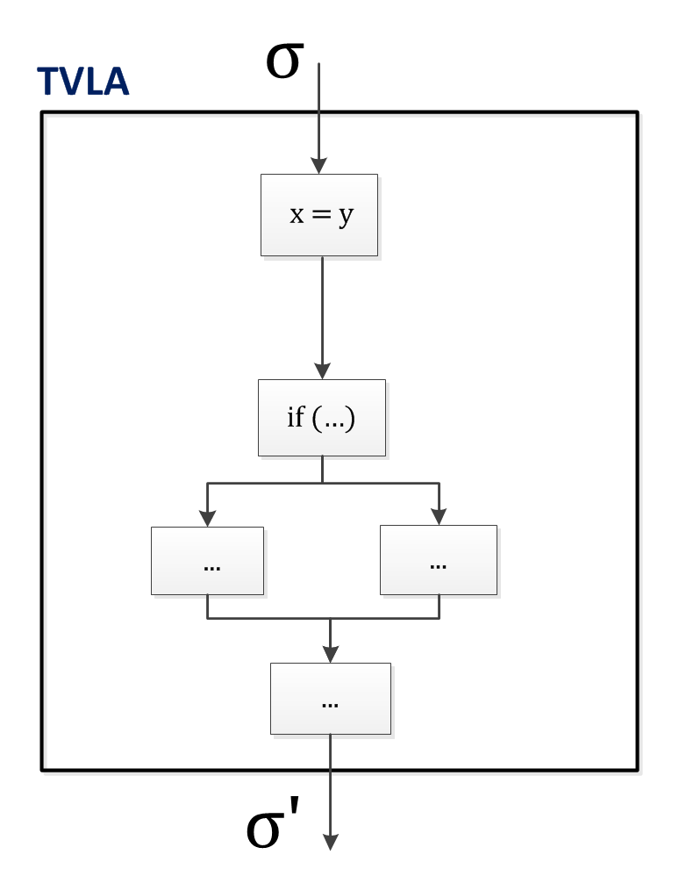
Approach (2)
Notes:
Why not just translate the whole Simple program to TVP? Indeed it's possible. However, TVLA is like a black box to us.

Slide 5
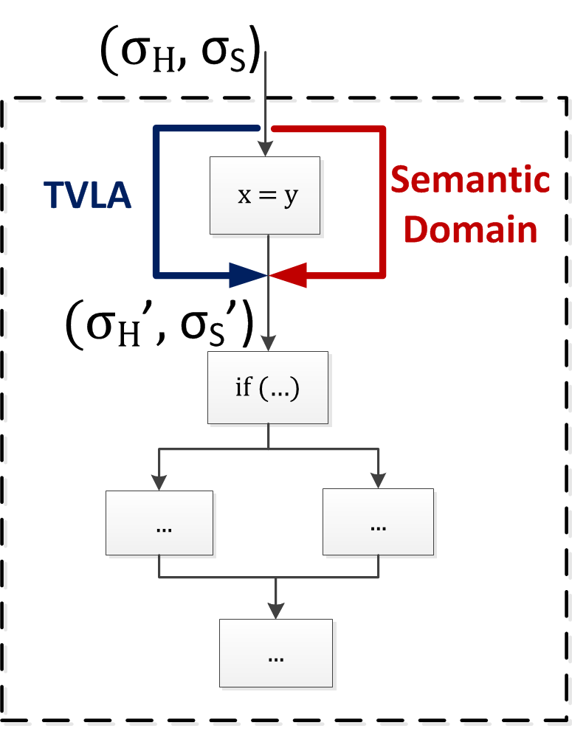
Approach (2)
Notes:
We not only have a heap state, but also state from another semantic domain
blocks are single statements

Slide 6
Differences in Abstraction
Simple
High-level language
Object-oriented
Lacks distinction:
expressions vs. Statements
Types
TVP (TVLA)
Quite low-level
Usually C-like programs encoded
Semantics encoded using FOL with TC
Untyped
Translation not straightforward...
Notes:
Unfortunately it's not that easy. I cheated a bit. The CFGs above should not look the same!
Compromises: No types tracked :(

Slide 7
Heap Operations
TVP Actions for:
Object Creation new Foo()
Variable assignment (reference copy) x = y
Field assignment x.n = y
Field access x.n
Assumptions if (x != null) ... else ...
Least upper bound on heap states

Slide 8
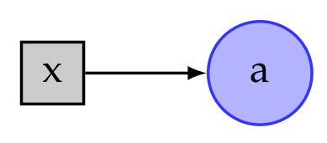
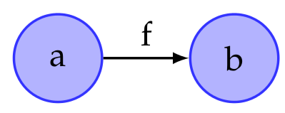
Heap State
State = Set of 3-valued logical structures
Each structure defined by:
Individuals: Blocks of allocated memory
Unique unary predicates for program variables, e.g.
x(a) = true
Binary function predicates for fields, e.g.
f(a,b) = true

Slide 9
Instrumentation Predicates
Our analysis supports lists precisely
Standard set of predicates
  For every field f
    t[f](v1,v2)
    Transitive reflexive reachability: Can v2 be reached from v1 by following f-fields?
    is[f](v)
    Shared-ness: Is there more than one object whose f-field references v?
  For every field f and variable x
    r[f,x](v)
    Reachability: Can v be reached from x along f-fields?

Slide 10
Numerical Information
Only heap (shape) analyzed, so far
What about numerical information?
  E.g. Integer fields
  TVLA does not support this
Idea:
  Let every heap node be an identifier and associate some numerical info with it
  More generally, any information from a semantic domain, for instance strings and access permissions
Notes:
Of course, most heap nodes are not numerical (actually right now just integers are).

Slide 11
Heap Identifiers (1)
Heap identifiers (names of nodes) are not static. We have to consider
  Summarization: Due to abstraction, nodes are merged into a summary node.
  Materialization: Nodes can be extracted again from a summary node.
  Merging due to heap isomorphism
Update ID space according to these events

Slide 12
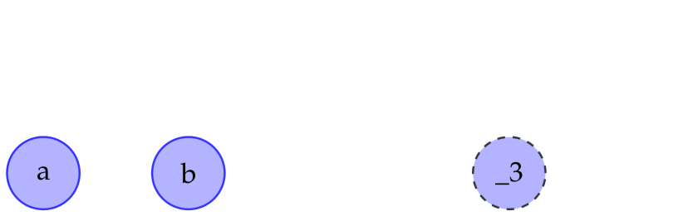
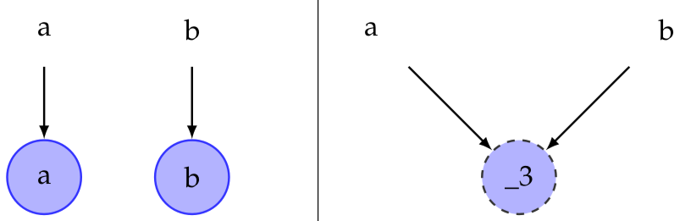
Heap Identifiers (2)
Problem: TVLA drops all names of individuals
  We do not obtain any information what happened
  We cannot update ID space and semantic domain
Trick: Use unary non-abstraction predicates to track identifiers (names of nodes)

Slide 13
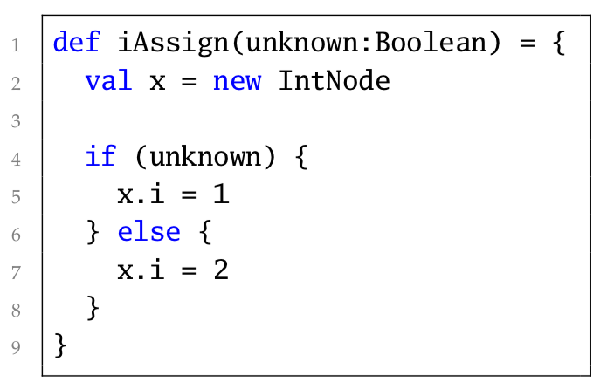
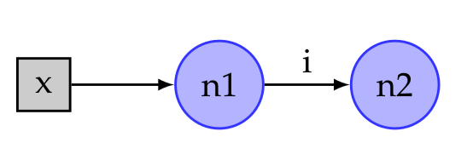
Example: Intervals
Interval domain end-state:
Interval domain end-state:
n1 -> ⊤
n2 -> [1..2]

Slide 14
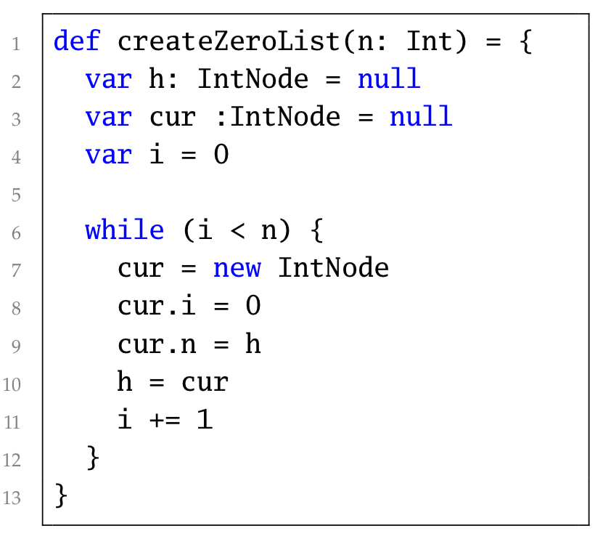
Example: Initializing a List
Heap Entry-State

Slide 15
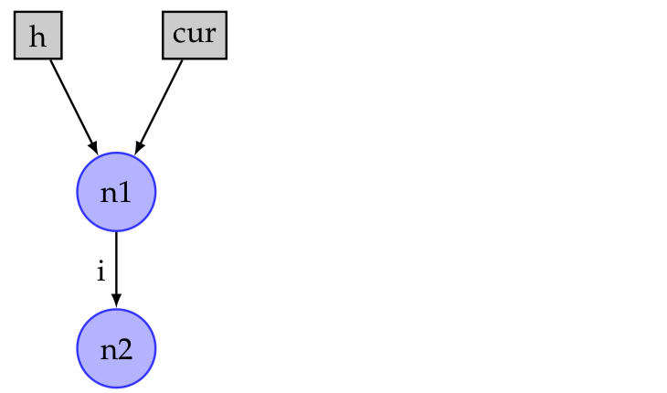
Example: Initializing a List
After first iteration:

Slide 16
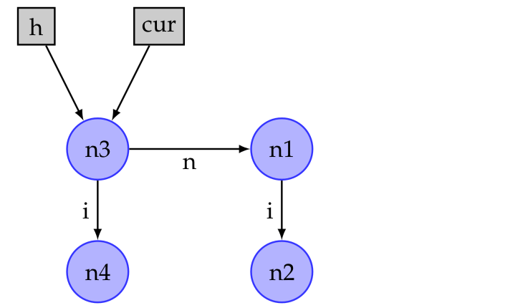
Example: Initializing a List
After second iteration:

Slide 17
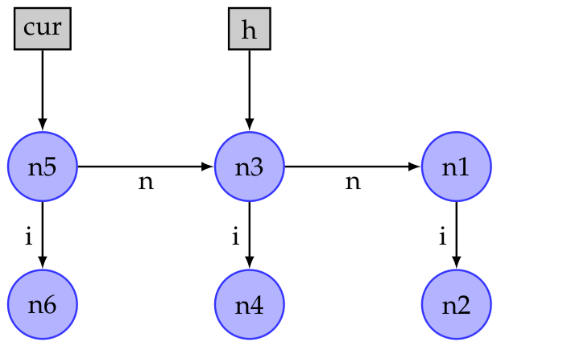
Example: Initializing a List
Before h = cur
(third iteration)

Slide 18
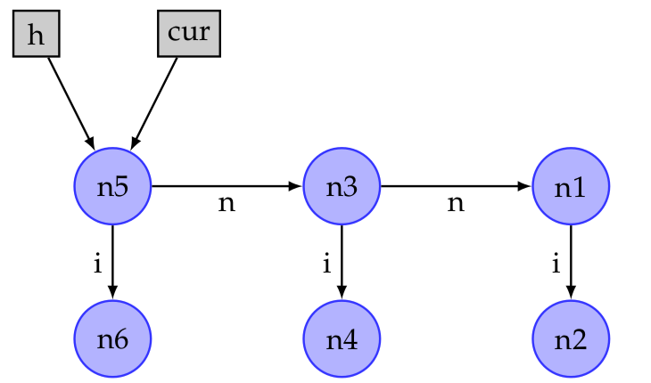
Example: Initializing a List
After h = cur
(third iteration)
n1 and n3
n2 and n4
look the same to TVLA!

Slide 19
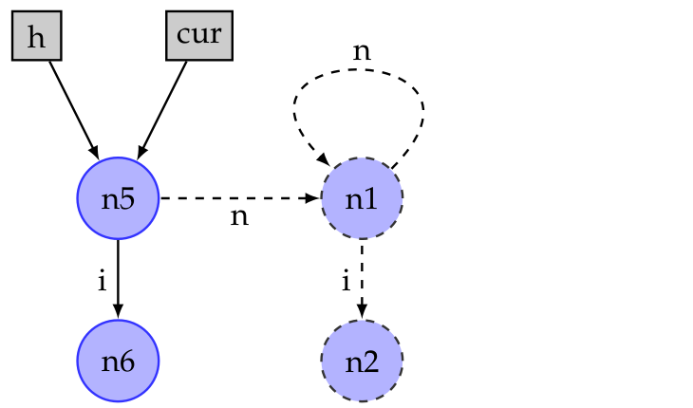
Example: Initializing a List
Summarization of n1, n3 and n2, n4
{n1, n3} -> {n1}
{n2, n4} -> {n2}
Heap ID | Semantic Domain
n2 | [0..0]
n4 | [0..0]
n6 | [0..0]
n2 ⊔ n4
Heap ID | Semantic Domain
n2 | [0..0]
n6 | [0..0]

Slide 20
Example: Initializing a List
Resulting Structures

Slide 21
Testing & Performance
Developed test suite with ~ 40 tests to evaluate our domain.
Total execution time: ~5 min (previously: 45)
Calls to TVLA a severe performance bottleneck
  JVM start-up time:
    => ~ 5x speed-up
  Inefficiency of CFG iteration: Caching!
  => ~ 2x speed-up
Notes:
performance: not strength of TVLA
Obtained customized TVLA to execute in same process
Cached results of TVLA invocations.

Slide 22
Questions?

