Slide 1
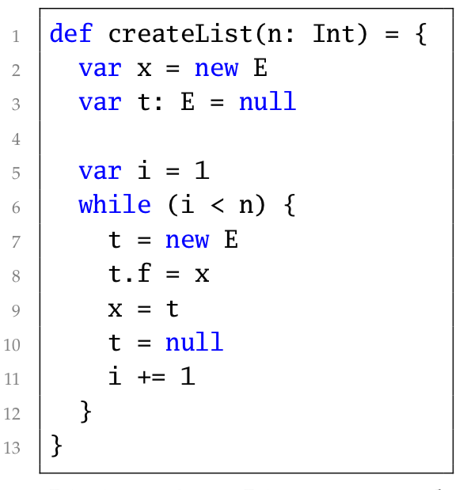
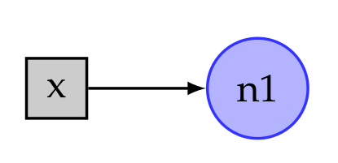
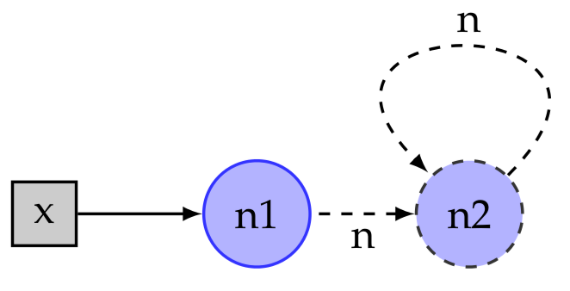
Example 1: List Creation
Heap End-State
Structure 1:
Structure 2:

Slide 2
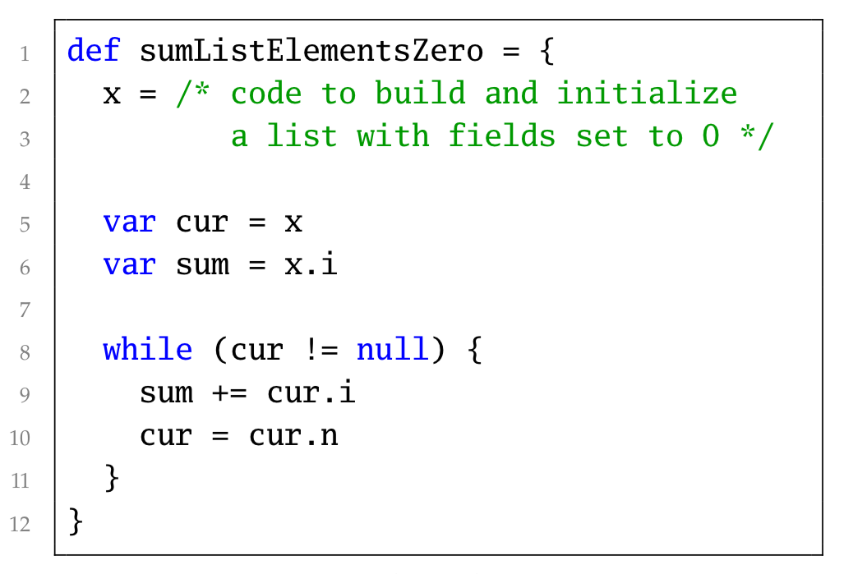
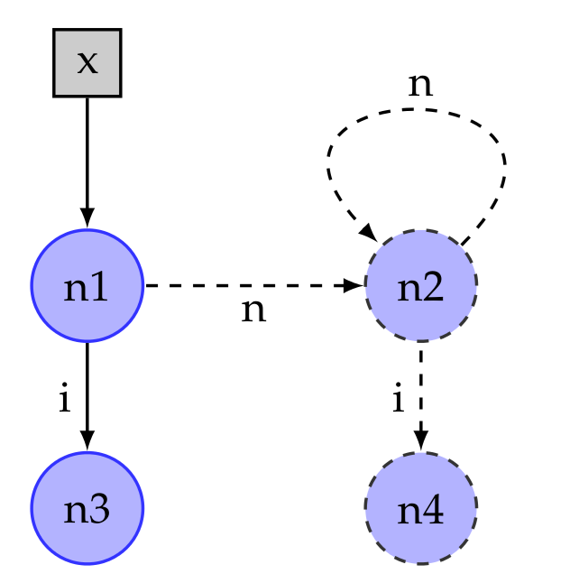
Example 3: Initialized List
Heap ID | Semantic Domain
n1 | ⊤
n2 | ⊤
n3 | [0..0]
n4 | [0..0]
sum | [0..0]
Heap ID | Semantic Domain
n1 | ⊤
n2 | ⊤
n3 | [0..0]
n4 | [0..0]
Notes:
- list of nodes with n-field: next element, i-field: some integer.
- heap representation changes throughout execution but start and end-state are exactly the same.\
- BUT semantic domain changed (sum)

