Slide 1
Overapproximating the Cost of Loops
Master‘s Thesis final presentation Daniel Schweizer, 28 March 2013
Supervisors: Dr. Pietro Ferrara, Prof. Dr. Peter Müller

Slide 2
Goal
Develop a cost analysis that overapproximates the cost of all loops in a program (according to some cost model)

Slide 3
Cost Model
Assume every loop is denoted by a unique number (e.g. „Loop 2“)
C(i): cost of Loop i
n_{i}: number of times Loop i is iterated
c_{i:}: cumulative cost of all statements in Loop i that are not a loop themselves
loops(i) = { j | Loop j is a statement directly contained in the body of Loop i }
C(i) = n_{i} (c_{i} + ∑ C(j) )
j ∈ loops(i)

Slide 4
Cost Model
action nested (a: Number, b: Number) returns r: Number {
$r := 0;
for 0 ≤ i < $a do { // Loop 1
for 0 ≤ j < $b do { // Loop 2
$r := $r + 1;
}
}
}
C(i) = n_{i} (c_{i} + ∑ C(j) )
C(1) = a*(c₁+b*c₂)
C(2) = b*c₂
j ∈ loops(i)

Slide 5
Loop Cost Analysis step by step
input: a method m
compile m
this gives us an augmented control flow graph cfg

Slide 6
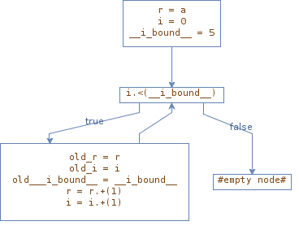
Loop Cost Analysis step by step
action for1(a: Number)
returns r: Number {
$r := $a;
for 0 ≤ i < 5 do {
$r := $r + 1;
}
}
„augmented“ Control Flow Graph

Slide 7
Loop Cost Analysis step by step
input: a method m
compile m
this gives us an augmented control flow graph cfg
run a numerical analysis (TouchDevelop analysis with APRON) on cfg
this gives us a control flow graph execution cfge

Slide 8
Loop Cost Analysis step by step
input: a method m
compile m
this gives us an augmented control flow graph cfg
run a numerical analysis (TouchDevelop analysis with APRON) on cfg
this gives us a control flow graph execution cfge
find all control structures in cfg (including nesting)

Slide 9
Loop Cost Analysis step by step
input: a method m
compile m
this gives us an augmented control flow graph cfg
run a numerical analysis (TouchDevelop analysis with APRON) on cfg
this gives us a control flow graph execution cfge
find all control structures in cfg (including nesting)
for each loop in cfg
compose its Cost Equation System (CES) using cfge
solve the CES using PUBS

Slide 10
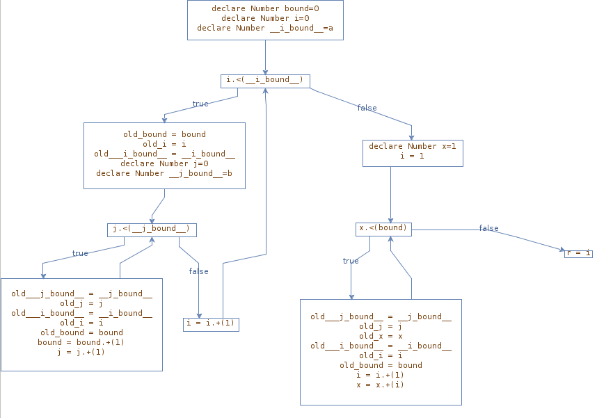
Find all control structures
﻿﻿action demo(a: Number, b: Number) returns r: Number {
$bound := 0;
for 0 ≤ i < $a do {
for 0 ≤ j < $b do {
$bound := $bound + 1;
}
}
$x := 1;
$i := 1;
while ($x < $bound) do {
$i := $i + 1;
$x := $x + $i;
}
$r := $i;
}
1
2
3
4
5
8
10
loop 5
loop 2 (contains loop 5)
loop 8
6
9
7

Slide 11
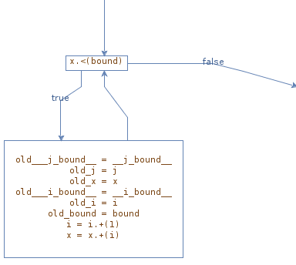
Types of loops
3 different types of loops in TouchDevelop (while / foreach / for)
in the CFG: only one type of loop
Loop Cost Analysis handles all loops in the same way
while ($x < $bound) do {
$i := $i + 1;
$x := $x + $i;
}

Slide 12
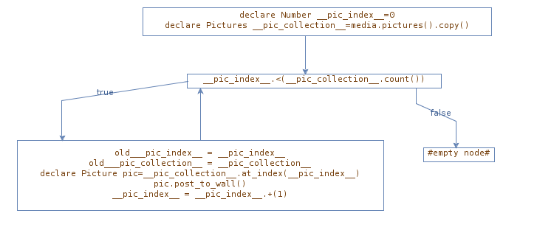
What about foreach loops?
﻿action foreachPic() {
foreach pic in media→pictures do {
$pic→post_to_wall;
}
}
﻿action foreachPic() {
$pic_index = 0;
$pic_collection = media→pictures→copy;
while $pic_index < $pic_collection→count do {
$pic = $pic_collection→at($pic_index)
$pic→post_to_wall;
$pic_index = $pic_index + 1;
}
}

Slide 13
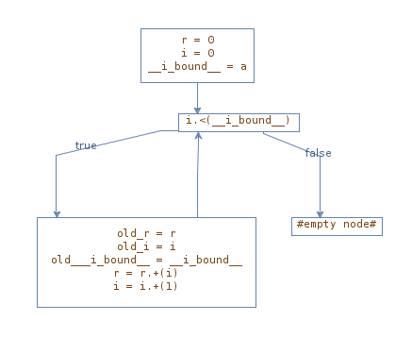
What about for loops?
﻿﻿action sum(a: Number) returns r: Number {
$r := 0;
for 0 ≤ i < $a do {
$r := $r + $i;
}
}
﻿action sum(a: Number) returns r: Number {
$r := 0;
$i := 0;
while $i < $a do {
$r := $r + $i;
$i := $i + 1;
}
}

Slide 14
Loop Cost Analysis step by step
input: a method m
compile m
this gives us an augmented control flow graph cfg
run a numerical analysis (TouchDevelop analysis with APRON) on cfg
this gives us a control flow graph execution cfge
find all control structures in cfg (including nesting)
for each loop in cfg
compose its Cost Equation System (CES) using cfge
solve the CES using PUBS

Slide 15
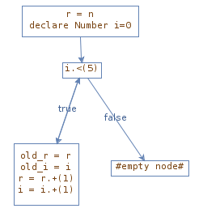
C = L(0) {true}
L(i) = 1 + L(i+1) {i ≥ 0, i < 5}
L(i) = 0 {i < 0}
L(i) = 0 {i ≥ 5}
Cost Equation System (CES)

Slide 16
C = L(0) {true}
L(i) = 1 + L(i+1) {i ≥ 0, i < 5}
L(i) = 0 {i < 0}
L(i) = 0 {i ≥ 5}
PUBS
Cost Equation System (CES)
Practical Upper Bound Solver
(E. Albert, P. Arenas, S. Genaim, G. Puebla. Closed-Form Upper Bounds in Static Cost Analysis. Journal of Automated Reasoning, 46 (2), pp. 161–203, 2011.)

Slide 17
CRS $pubs_aux_entry$ -- THE MAIN ENTRY
* Non Asymptotic Upper Bound: 5
* LOOPS $pubs_aux_entry$ -> $pubs_aux_entry$
* Ranking function: N/A
* Invariants $pubs_aux_entry$ -> $pubs_aux_entry$
entry : []
non-rec: []
rec : [0=1]
inv : []
PUBS
Practical Upper
Bound Solver

Slide 18
Loop Cost Analysis step by step
input: a method m
compile m
this gives us an augmented control flow graph cfg
run a numerical analysis (TouchDevelop analysis with APRON) on cfg
this gives us a control flow graph execution cfge
find all control structures in cfg (including nesting)
for each loop in cfg
compose its Cost Equation System (CES) using cfge
solve the CES using PUBS

Slide 19
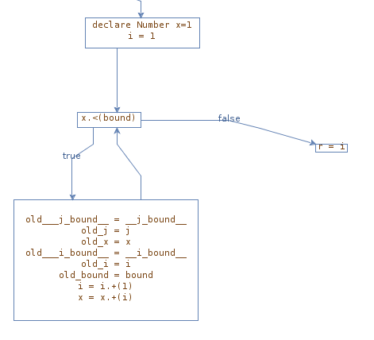
Composing the CES
handle all loops in the same way
loop condition
while ($x < $bound) do {
$i := $i + 1;
$x := $x + $i;
}
block of statements
(loop body)

Slide 20
Composing the CES
use the result of the numerical analysis to
get the loop condition
try to find an update rule for each variable in the loop (
try to find an initial value for each variable in the loop
using 1) to 3), write down the Cost Equation System (CES)

Slide 21
1) Loop condition
while ($x < $bound) do {
$i := $i + 1;
$x := $x + $i;
}
available as an Expression from the numerical analysis
must be a valid condition
true
false
expr1 op expr2 expr1 and expr2 are linear expressions, op ∈ {=, ≠, <, ≤, >, ≥}
not c c is a valid condition
c1 and c2 c1 and c2 are valid conditions
c1 or c2 c1 and c2 are valid conditions
examples: true, x < bound, (x ≤ 2*a+b) or (y > 0 and y ≤ 3)

Slide 22
2) Variable update rules
while ($x < $bound) do {
$i := $i + 1;
$x := $x + $i;
}
old_bound = bound
bound ≥ old_x + 1
i = old_i + 1
x = old_x + i
bound‘ = bound
i‘ = i + 1
x‘ = x + i
derived from linear constraints we get from the numerical analysis
can be in terms of other variables (e.g. x‘ = x + i)
for each variable, using its update rule, try to detect if its value
„increases“ (doesn‘t become smaller in any loop iteration)
„decreases“ (doesn‘t become larger in any loop iteration)
is constant
i increases
x increases (because i increases)

Slide 23
3) Initial values
while ($x < $bound) do {
$i := $i + 1;
$x := $x + $i;
}
x = 1
i = 1
initial values:
x: 1
i: 1
bound: unknown
(simple) linear constraints that we get from the numerical analysis
together with the „decreasing“/“increasing“ information from the previous step, can now find constraints about the range of variables.
i increases, i initially 1 i ≥ 1
x increases, x initially 1 x ≥ 1

Slide 24
Writing down the CES
while ($x < $bound) do {
$i := $i + 1;
$x := $x + $i;
}
loop condition: x < bound
initial values: i: 1
x: 1
update rules: bound‘ = bound
i‘ = i + 1
x‘ = x + i
range constraints: i ≥ 1
x ≥ 1
nat(bound-x)*nat(c₈)
nat(bound-1)*nat(c₈)
1 C(c₈, bound) = L(c₈, 1, bound, 1)
L(c₈, x, bound, i) =
...
{true}
{...}

Slide 25
Writing down the CES
while ($x < $bound) do {
$i := $i + 1;
$x := $x + $i;
}
loop condition: x < bound
initial values: i: 1
x: 1
update rules: bound‘ = bound
i‘ = i + 1
x‘ = x + i
range constraints: i ≥ 1
x ≥ 1
1 C(c₈, bound) = L(c₈, 1, bound, 1)
L(c₈, x, bound, i) =
nat(c₈) + L(c₈, x’, bound, i’)
{true}
{x’ = x + i, i’ = i + 1,
x ≥ 1, i ≥ 1, x < bound}

Slide 26
In reality ...
1 C(c₈, bound) = L(c₈, 1, bound, 1)
L(c₈, x, bound, i) =
nat(c₈) + L(c₈, x’, bound, i’)
{true}
{x’ = x + i, i’ = i + 1,
x ≥ 1, i ≥ 1, x < bound}
eq(c2(I_c2,L_bound),0,[l2x1(I_c2,(1),L_bound,(1))],[]).
eq(l2x1(I_c2,L_x,L_bound,L_i),nat((1*I_c2) + (0)),[l2x1(I_c2,L_x_prime,L_bound,L_i_prime)],[1*L_x_prime = (1*L_x) + (1*L_i) + (0),1*L_i_prime = (1*L_i) + (1),L_x>=(1),L_i>=(1),(-1*L_i_prime) + (1*L_i) + (1) = (0),(-1*L_i_prime) + (-1*L_x) + (1*L_x_prime) + (0) = (0),(1*L_x) + (0) +1 =< (1*L_bound) + (0)]).

Slide 27
Nested loops
outer loop inner loop
(Loop 2) (Loop 5)
for 0 ≤ i < $a do {
for 0 ≤ j < $b do {
$bound := $bound + 1;
}
}
loop condition: i < a j < b
initial values: i: 0 j: 0
update rules: i‘ = i + 1 j‘ = j + 1
range constraints: i ≥ 0 j ≥ 0
C(c₂, c₅, b) = L(c₂, c₅, 0, a, b)
2 L(c₂, c₅, i, a, b) = nat(c₂) +
L(c₂, c₅, i‘, a, b) + D(c₅, b)
{true}
{i’ = i + 1, i ≥ 0, i < a}
3
4
{true}
{j’ = j + 1, j ≥ 0, j < b}
D(c₅, b) = M(c₅, 0, b)
2 M(c₅, j, b) = nat(c₅) + M(c₅, j’, b)

Slide 28
Experimental results
ran the analysis on 596 real scripts from the TD cloud
successfully computed the cost of 583 loops
failed („no upper bound found“) in other 575 loops, because
missing semantics
bottom state in the loop
loop doesn‘t terminate (e.g. while true, while „user gives wrong input“, ...)

Slide 29
TouchDevelop Samples
representative set of sample scripts written by the TD team
ran the analysis on the scripts with loops
got precise results (where the semantics are defined)

Slide 30
Overapproximating the Cost of Loops
Master‘s Thesis final presentation Daniel Schweizer, 28 March 2013
Supervisors: Dr. Pietro Ferrara, Prof. Dr. Peter Müller

