Slide 1


Multiple Disease detection
Guide name: prof prabjeet kaur
Team members details:
Name:
ERP
Roll no:
Vipin jaiswal 6602105 301311322024
V.Krisnashree 6604020 301311322107
Praveen saxena 6602743 301311322080

Slide 2
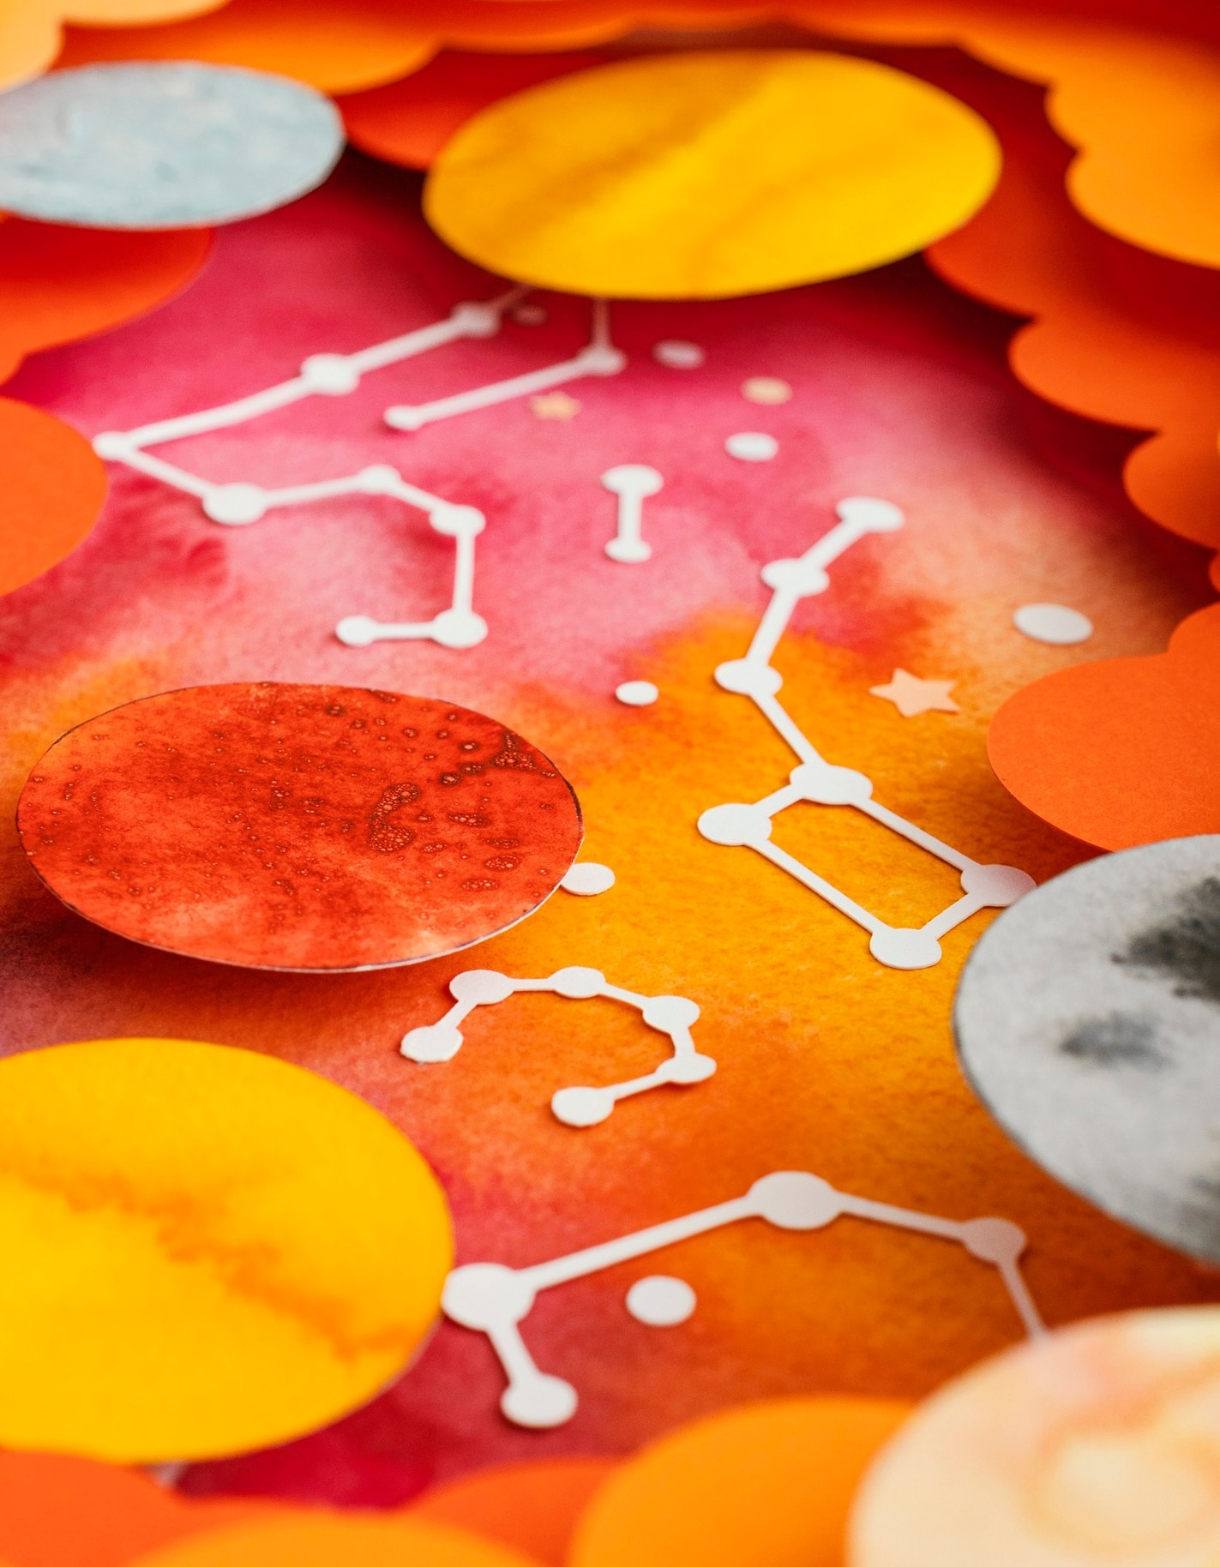
Introduction to Disease detection
In today's world, advancements in technology and data analytics have transformed disease detection . By utilizing vast amounts of health data, we can identify patterns and risk factors, leading to improved health outcomes and proactive healthcare strategies.

Slide 3
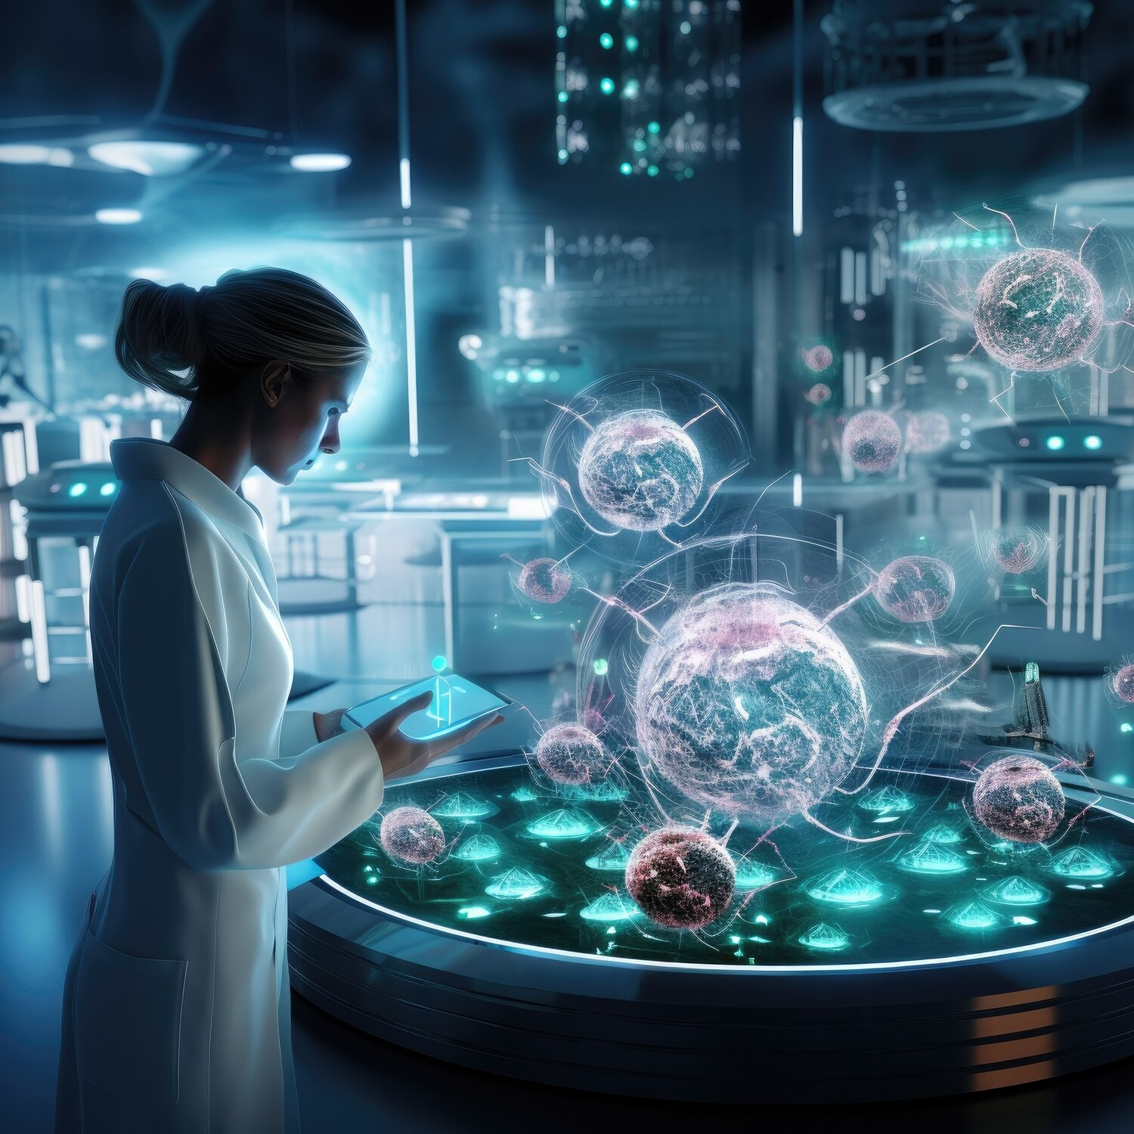
The Role of Big Data
The integration of big data in healthcare allows for the analysis of diverse datasets, including electronic health records, genetic information, and social determinants. This enables more accurate risk assessments and tailored treatment plans for patients.

Slide 4
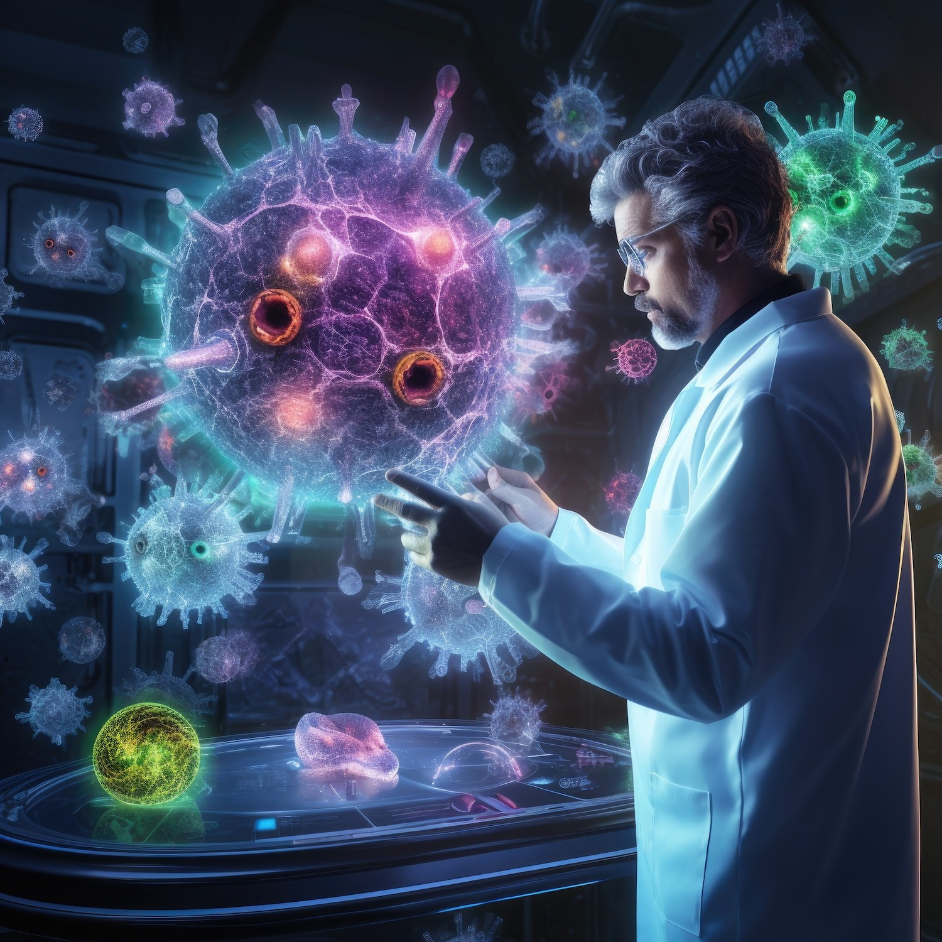
Machine Learning Techniques
Machine learning algorithms play a crucial role in Detecting diseases. By analyzing historical data, these algorithms can identify patterns that humans might overlook, leading to earlier detection and intervention for various health conditions.

Slide 5
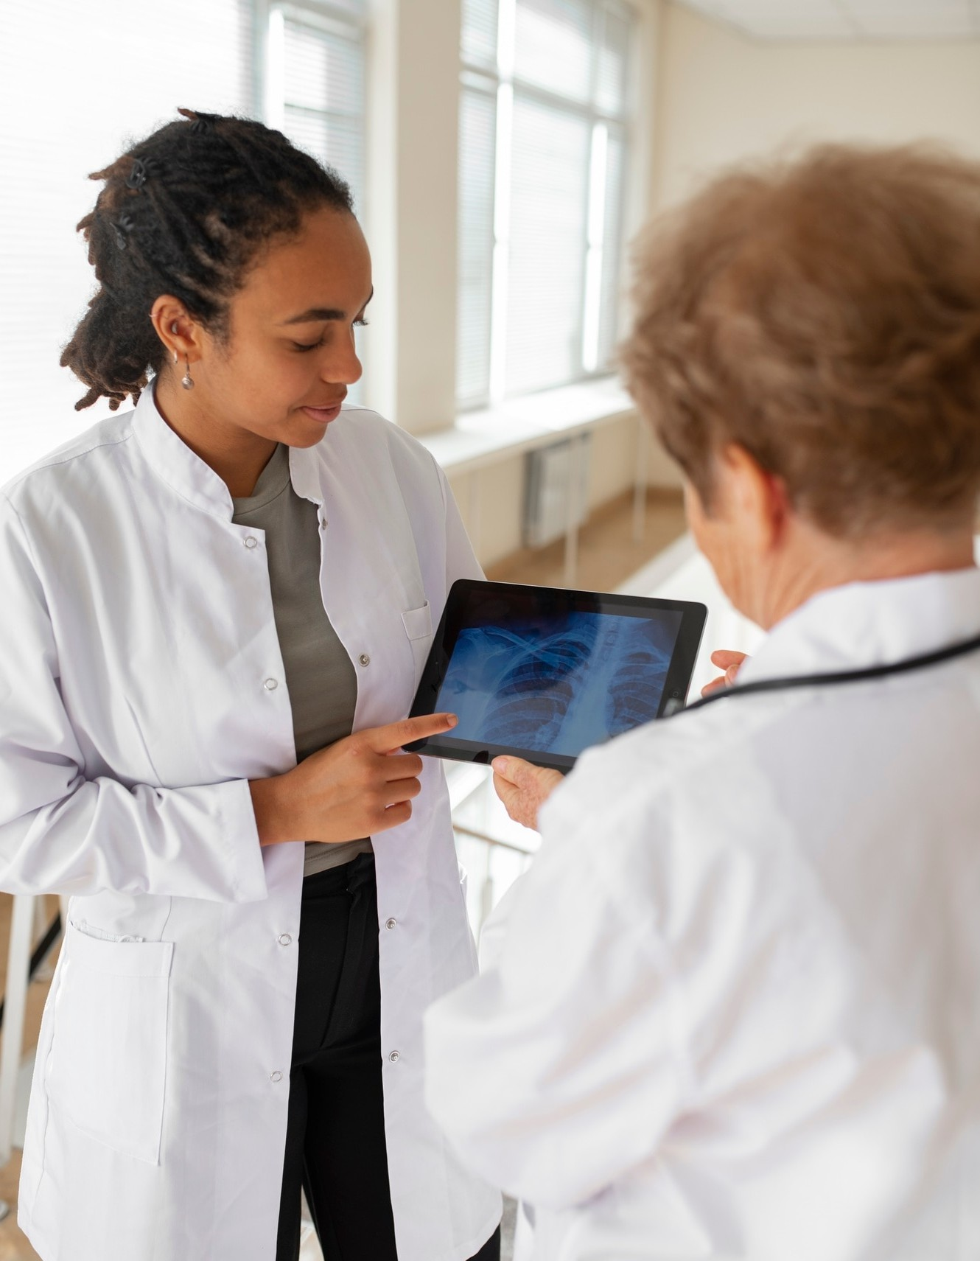
Predictive Analytics in Action
Real-world applications of predictive analytic include early detection of chronic diseases like diabetes and heart conditions. By leveraging data, healthcare providers can implement preventive measures , ultimately reducing healthcare costs and improving patient outcomes.

Slide 6

Ethical Considerations
While advancements in disease detection are promising, ethical considerations must be addressed. Issues such as data privacy , informed consent, and potential biases in algorithms can impact the effectiveness and fairness of health interventions.

Slide 7

Conclusion: Future of Health Prediction
The future of disease detection lies in
harnessing advanced technologies and data analytics. By focusing on ethical practices and collaboration among stakeholders, we can achieve better health outcomes and a healthier society.

Slide 8
Thank you

