Slide 1

Speech Emotion Recognition (SER)
FINAL YEAR FINAL REVIEW DATE OF REVIEW : 31-03-2021
Team Members:
Prashant Mishra
Nafees Ahmad
Naresh Kumar
Guided By:
Mr. A. Anandaraj, M.E. (Ph.D.)
Assistant Professor , Department of CSE
1

Slide 2
Outline
Abstract
Introduction
Literature Survey
Objective of the System
Existing Scenario
Modules
Dataset
Proposed Solution
Block Diagram
System Requirements
Result
Conclusion
Screenshots
References

Slide 3
ABSTRACT
This project represents an important and efficient method of Speech Emotion Recognition (SER).
We have used Deep Neural Multilayer Perceptron.
Speech Emotion Recognition has now become a necessity for human life.
Various graphs perform feature extraction from the speech signals which is used for training different classifiers and retrieving data.
3

Slide 4
INTRODUCTION
Emotions – They play an important role in our daily life. This could lead us to take intelligent decisions.
Researchers have shown that emotions play a powerful role in shaping human social relations.
SER aims to identify the emotional state of the speaker from his voice.
There are many applications to explore a person’s emotions in interfaces such as robots, audio surveillance, web-based e-learning, commercial expressions, clinical studies, etc.
4

Slide 5
LITERATURE SURVEY
Over the last ten years, an excessive investigation has been completed to recognize emotions by speech statistics.
Different types of information include acoustic, lexical, and discourse are used for emotion recognition.
We assured a multi-dimensional model by utilising emotion primitives for speech emotion recognition.
Three-Dimensions were made by composing of different value of emotion primitive: Valence, Activation, and Domincance.

Slide 6
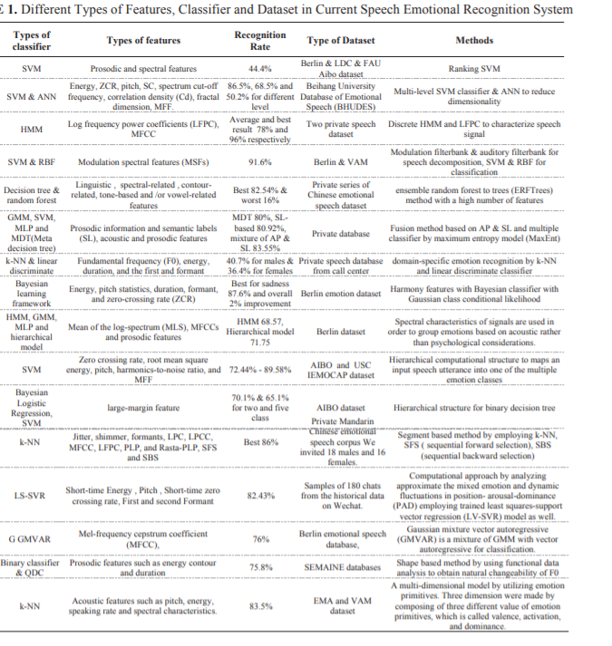

Slide 7
OBJECTIVE
Discrete Classification: Classifying emotions in discrete labels like anger, happiness, boredom, etc.
To enable users to use in a wide variety of application areas like interactive voice based-assistant or caller-agent conversation analysis.
To avoid the extra cost of the application from Managed service of SER.

Slide 8
EXISTING SCENARIO
EXISITNG SYSTEM:
Existing system for SER records voice and tells feeling/emotions of him/her at different tone level.
Announces the results telling current mood.
DRAWBACKS OF EXISTING SYSTEM
Accuracy of the project is very low.
Not able to record voice properly.
Dataset is not accurate.

Slide 9
MODULES
PRE-PROCESSING:
The expression of emotions is incorporated into synthesized speech so that the computer is able to convey emotions in speech.
Voice conversion technology aims to automatically transform the voice with a source speaking style.
The system for converting neural speech to emotional speech can be broken down into two stages: 1) Training 2) Transformation

Slide 10
MODULES
Feature Extraction:
Emotions can be expressed by speech, because speech contains the characteristic parameters that can reflect emotion information.
The quality of feature extraction directly affects the accuracy of SER.

Slide 11
MODULES
Emotion Recognition
Modulation spectral features are extracted from an auditory-inspired long-term spectro-temporal representation.
The speech signal is first decomposed by an auditory filterbank, then the energy graph is formed.
The mean of energy, taken all over frames in every spectral band provides a feature.

Slide 12
DATASET
We have used the RAVDESS dataset, This is Ryerson Audio-Visual Dataset of Emotional Speech.
This dataset has 7356 files rated by 247 individuals 10 times on emotional validity.

Slide 13
PROPOSED SYSTEM
We have used the Librosa, Soundfile, & sklearn to build a model using an MLPClassifier. This enables system to recognize emotion from sound files.
Benefits:
Reliable & Accurate
Able to distinguish the level of different moods in mixed emotions.
Try to detect the emotions cause.

Slide 14
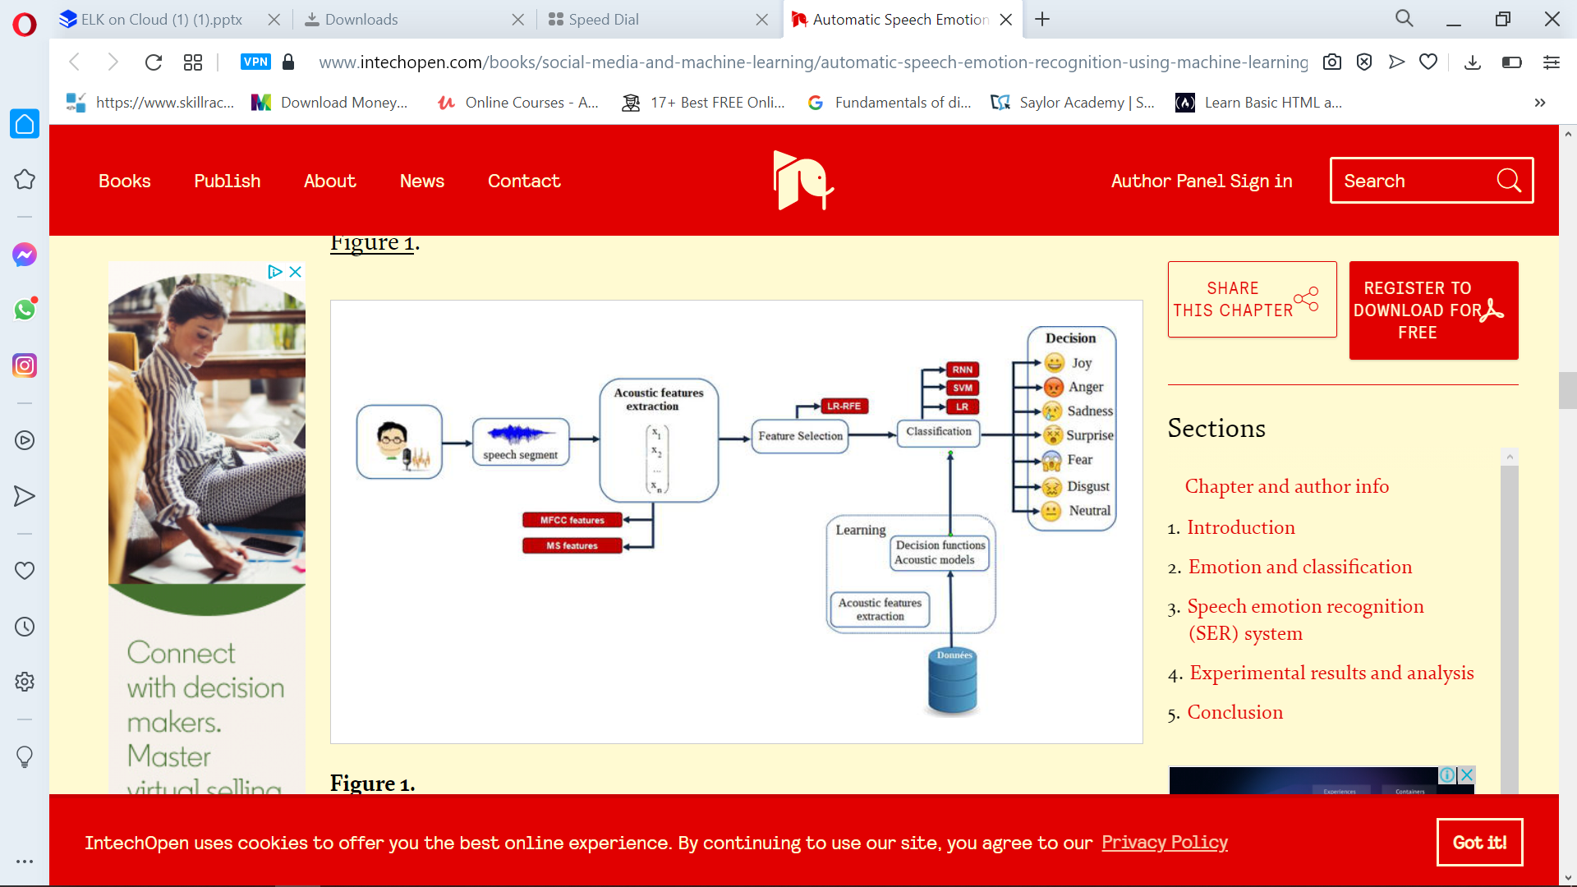
BLOCK DIAGRAM

Slide 15
System Specification
Hardware Specification
System: Intel(R) core i7 Processor
Hard Disk: 1TB
Monitor: Dell
Ram: 8GB
Software Specifications
OS: Windows 10
Coding Lang: Python
Tools: VS Code

Slide 16
Result
In this current study, we presented an automatic speech emotion recognition (SER) system using three machine learning algorithms (MLR, SVM, and RNN) to classify seven emotions.
The machine learning models were trained and evaluated to recognize emotional states from these features.

Slide 17
Conclusion
Through this project, we showed how we can leverage Machine learning to obtain the underlying emotion from speech audio data and some insights on the human expression of emotion through voice.
This system can be employed in a variety of setups like Call Centre for complaints or marketing, in voice-based virtual assistants or chatbots, in linguistic research, etc.

Slide 18
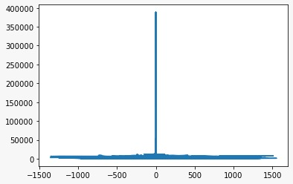
Screen Shots

Slide 19
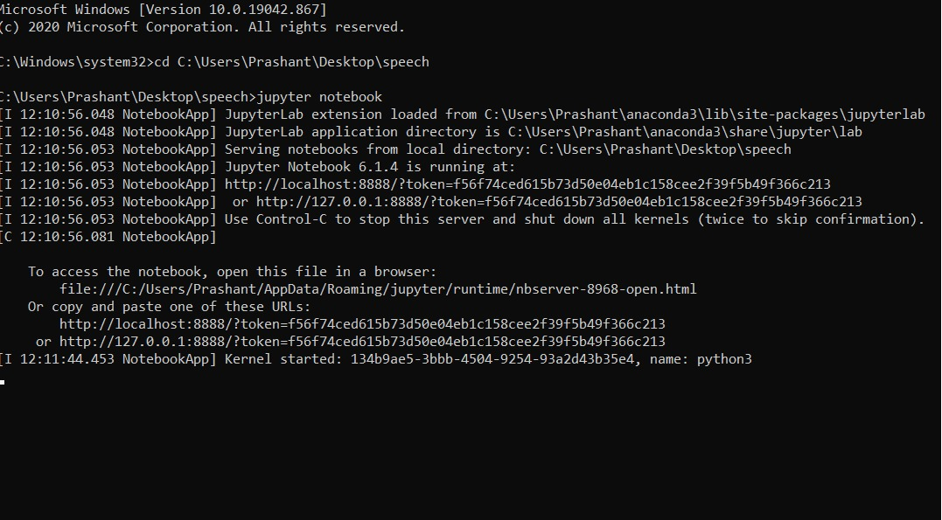
Screen Shots
jupyterLab extension loaded

Slide 20
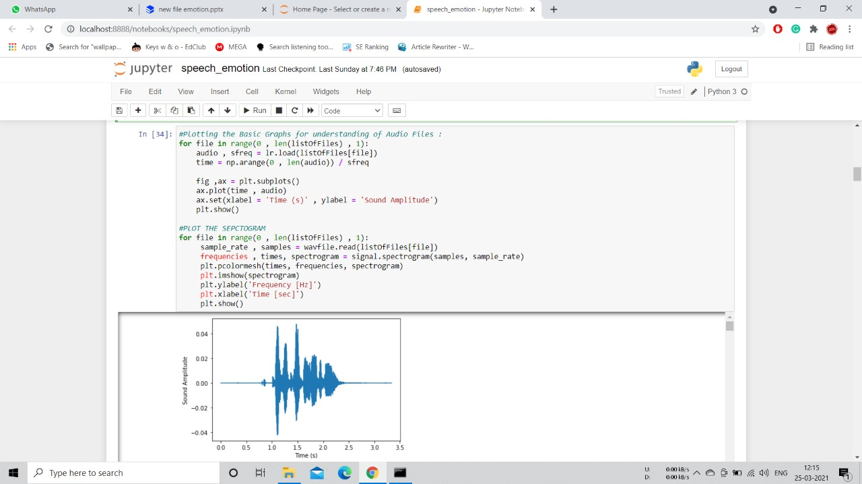
Screen Shots

Slide 21
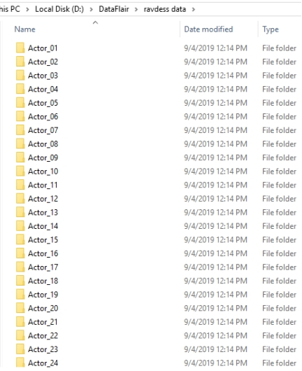
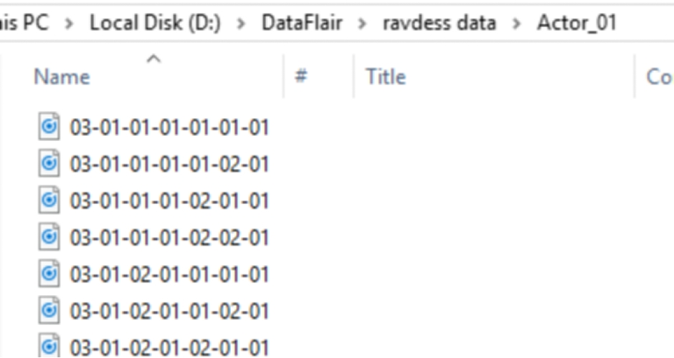
Screen Shot

Slide 22
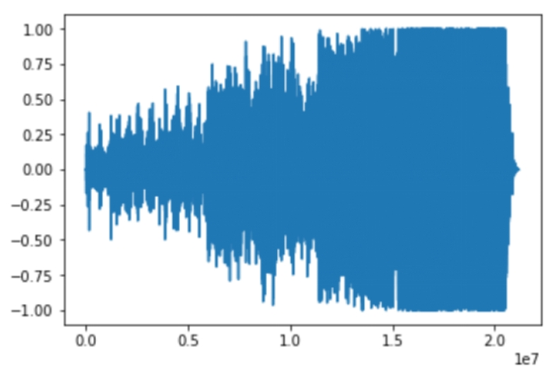
Screen Shot (Result)

Slide 23
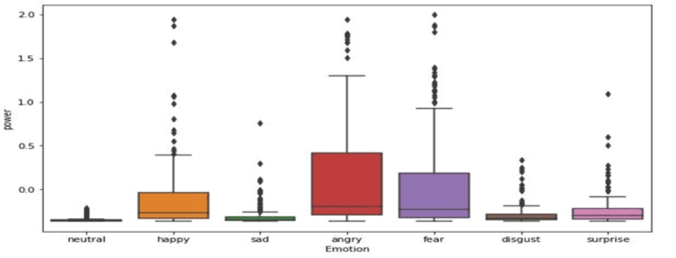
Screen Shots

Slide 24
References
M. El Ayadi, M. S. Kamel, and F. Karray, “Survey on speech emotion recognition: Features, classification schemes, and databases,”
R. Banse and K. R. Scherer, “Acoustic profiles in vocal emotion.
V. Hozjan and Z. Kačič, “Context-Independent Multilingual Emotion Recognition from Speech Signals,” Int. J. Speech Technol.

Slide 25
Thank You

