Slide 1

Speech Emotion Recognition using MLPClassifier
Team Members:
Saket Kumar
Vipin Kumar Yadav
Manikant
Sudhanshu Gupta
Guided By:
Mr. S. Yuvaraj M.E., (Ph.D.)
Assistant Professor, Dept. of CSE

Slide 2
Outline
ABSTRACT
INTRODUCTION
OBJECTIVE OF THE SYSTEM
EXISTING SCENARIO
PROPOSED SOLUTION
PROJECT MODULES
SYSTEM REQUIREMENTS
EXPLANATION OF EACH MODULES
SCREENSHOT
CONCLUSION
FUTURE ENHANCEMENTS
REFERENCES

Slide 3
ABSTRACT
This project represents an important and efficient
method of Speech Emotion Recognition (SER).
Speech Emotion Recognition has now become a
necessity for human life.
Various graphs perform feature extraction from the
speech signals which is used for training different
classifiers and retrieving data using multiple datasets.

Slide 4
INTRODUCTION
Emotions – They play an important role in our daily life. This could lead us to take intelligent decisions.
Researchers have shown that emotions play a powerful
role in shaping human social relations.
SER aims to identify the emotional state of the speaker
from his voice.
There are many applications to explore a person’s
emotions in interfaces such as robots, audio surveillance, web-based e-learning, commercial expressions, clinical
studies, etc.

Slide 5
OBJECTIVE
Discrete Classification: Classifying emotions in
discrete labels like anger, happiness, boredom, etc.
To enable users to use in a wide variety of application areas like interactive voice based-assistant or
caller-agent conversation analysis.
To avoid the extra cost of the application from
Managed service of SER.

Slide 6
EXISTING SCENARIO
EXISITNG SYSTEM:
Existing system for SER records voice and tells feeling/emotions of him/her at different tone level.
Announces the results telling current mood.
DRAWBACKS OF EXISTING SYSTEM
Accuracy of the project is very low.
Not able to record voice properly.
Dataset is not accurate and use of only single dataset.

Slide 7
PROPOSED SYSTEM
We have used the Librosa, Soundfile, & sklearn to
build a model using an MLPClassifier. This enables
system to recognize emotion from sound files.
Benefits:
Reliable & Accurate
Able to distinguish the level of different moods
in mixed emotions.
Try to detect the emotions cause.
Multiple dataset to train the model

Slide 8
DATASET
We have used the RAVDESS and TESS datasets
RAVDESS (Ryerson Audio-Visual Database of Emotional Speech and Song) contains 1440 speech files and 1012 Song files.
This dataset includes recordings of 24 professional actors (12 female, 12 male), vocalizing two lexically-matched statements in a neutral North American accent.

Slide 9
DATASET (RAVDESS )
RAVDESS (Ryerson Audio-Visual Database of Emotional Speech and Song) contains 1440 speech files and 1012 Song files.
This dataset includes recordings of 24 professional actors (12 female, 12 male), vocalizing two lexically-matched statements in a neutral North American accent.

Slide 10
DATASET (TESS )
Toronto emotional speech set (TESS) dataset contains 2800 files.
A set of 200 target words were spoken in the carrier phrase "Say the word _____' by two actresses (aged 26 and 64 years) and recordings were made of the set portraying each of seven emotions.

Slide 11
MODULES
PRE-PROCESSING:
The expression of emotions is incorporated into
synthesized speech so that the computer is able to convey emotions in speech.
Voice conversion technology aims to automatically transform the voice with a source speaking style.
The system for converting neural speech to
emotional speech can be broken down into two
stages: 1) Training 2) Transformation

Slide 12
MODULES
Feature Extraction:
Emotions can be expressed by speech,
because speech contains the characteristic
parameters that can reflect emotion information.
The quality of feature extraction directly affects the accuracy of SER.

Slide 13
MODULES
Emotion Recognition
Modulation spectral features are extracted from an auditory-inspired long-term spectro-temporal representation.
The speech signal is first decomposed by an
auditory filterbank, then the energy graph is
formed.
The mean of energy, taken all over frames in every spectral band provides a feature.

Slide 14
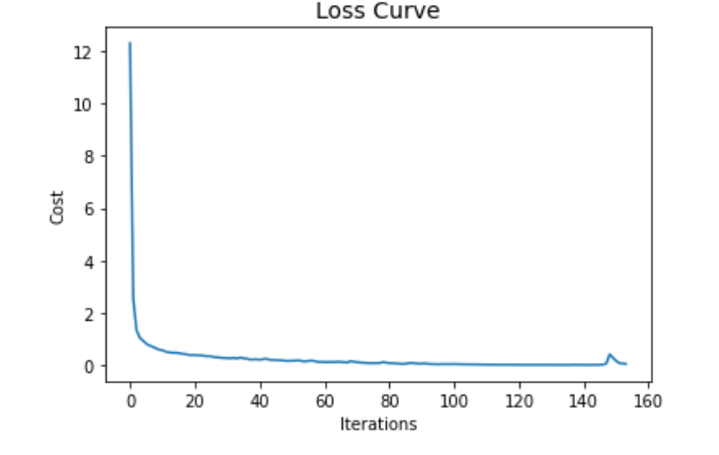
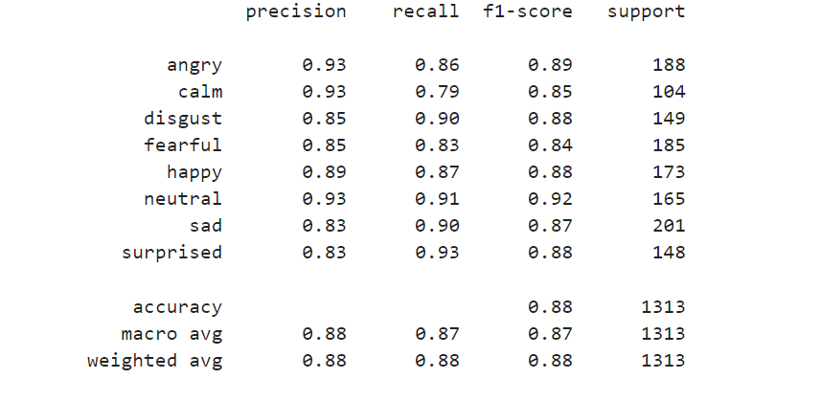
Screenshots
Classification report

Slide 15
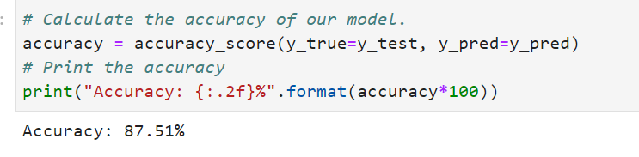
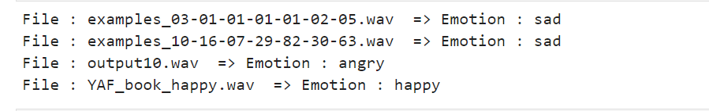
Screenshots
Example file predictions

Slide 16
System Specification
Hardware Specification
System: Intel(R) core i7 Processor
Hard Disk: 1TB
Monitor: Dell
Ram: 8GB
Software Specifications
OS: Windows 10
Coding Lang: Python
Tools: VS Code, Jupyter notebok

Slide 17
Conclusion
Through this project, we showed how we can leverage Machine learning to obtain the underlying emotion from speech audio data and some insights on the human expression of emotion through voice.
This system can be employed in a variety of setups like Call Centre for complaints or marketing, in voice-based virtual assistants or chatbots, in linguistic research, etc.

Slide 18
Future Enhancements
Different type of audio files can be supported (currently supports only .wav files.
Accuracy can further be increased by using other different datasets
Real time emotion prediction can be implemented.

Slide 19
References
M. El Ayadi, M. S. Kamel, and F. Karray, “Survey on speech emotion recognition: Features, classification schemes, and databases,”
R. Banse and K. R. Scherer, “Acoustic profiles in vocal emotion.
V. Hozjan and Z. Kačič, “Context-Independent Multilingual Emotion Recognition from Speech Signals,” Int. J. Speech Technol.

Slide 20
Thank You

