Slide 1
Convolutional Neural Networks¹
Convolutional Neural Networks (CNNs) are neural networks that use convolution in place of general matrix multiplication in at least one of their layers
CNNs are usually employed for processing data that has a grid-like topology
image data → each image can be thought as a 2D grid of pixels
timeseries data → each timeseries can be thought as a 1D grid taking samples at regular time intervals

Slide 2
The Convolution operation¹
Assume a 6x6 matrix M as input. The 2D convolution of M with filter (or kernel) F and stride 1 is a 4x4 matrix CM (sometimes called feature map) computed as follows:
3 | 0 | 1 | 2 | 4 | 7
1 | 5 | 8 | 9 | 3 | 1
2 | 7 | 2 | 5 | 1 | 3
0 | 1 | 3 | 1 | 7 | 8
4 | 2 | 1 | 6 | 2 | 8
2 | 4 | 5 | 2 | 3 | 9
1 | 0 | -1
1 | 0 | -1
1 | 0 | -1
=
*
F
CM
M
convolution operator

Slide 3
The Convolution operation¹
Assume a 6x6 matrix M as input. The 2D convolution of M with filter (or kernel) F and stride 1 is a 4x4 matrix CM (sometimes called feature map) computed as follows:
3 | 0 | 1 | 2 | 4 | 7
1 | 5 | 8 | 9 | 3 | 1
2 | 7 | 2 | 5 | 1 | 3
0 | 1 | 3 | 1 | 7 | 8
4 | 2 | 1 | 6 | 2 | 8
2 | 4 | 5 | 2 | 3 | 9
-5
1 | 0 | -1
1 | 0 | -1
1 | 0 | -1
=
*
F
CM
M
3*1 + 1*1 + 2*1 + 0*0 + 5*0 + 7*0 + 1*(-1) + 8*(-1) + 2*(-1)

Slide 4
The Convolution operation¹
Assume a 6x6 matrix M as input. The 2D convolution of M with filter (or kernel) F and stride 1 is a 4x4 matrix CM (sometimes called feature map) computed as follows:
3 | 0 | 1 | 2 | 4 | 7
1 | 5 | 8 | 9 | 3 | 1
2 | 7 | 2 | 5 | 1 | 3
0 | 1 | 3 | 1 | 7 | 8
4 | 2 | 1 | 6 | 2 | 8
2 | 4 | 5 | 2 | 3 | 9
-5 | -4
1 | 0 | -1
1 | 0 | -1
1 | 0 | -1
=
*
F
CM
M
0*1 + 5*1 + 7*1 + 1*0 + 8*0 + 2*0 + 2*(-1) + 9*(-1) + 5*(-1)

Slide 5
The Convolution operation¹
Assume a 6x6 matrix M as input. The 2D convolution of M with filter (or kernel) F and stride 1 is a 4x4 matrix CM (sometimes called feature map) computed as follows:
3 | 0 | 1 | 2 | 4 | 7
1 | 5 | 8 | 9 | 3 | 1
2 | 7 | 2 | 5 | 1 | 3
0 | 1 | 3 | 1 | 7 | 8
4 | 2 | 1 | 6 | 2 | 8
2 | 4 | 5 | 2 | 3 | 9
-5 | -4 | 0
1 | 0 | -1
1 | 0 | -1
1 | 0 | -1
=
*
F
CM
M
1*1 + 8*1 + 2*1 + 2*0 + 9*0 + 5*0 + 4*(-1) + 3*(-1) + 1*(-1)

Slide 6
The Convolution operation¹
Assume a 6x6 matrix M as input. The 2D convolution of M with filter (or kernel) F and stride 1 is a 4x4 matrix CM (sometimes called feature map) computed as follows:
3 | 0 | 1 | 2 | 4 | 7
1 | 5 | 8 | 9 | 3 | 1
2 | 7 | 2 | 5 | 1 | 3
0 | 1 | 3 | 1 | 7 | 8
4 | 2 | 1 | 6 | 2 | 8
2 | 4 | 5 | 2 | 3 | 9
-5 | -4 | 0 | 8
1 | 0 | -1
1 | 0 | -1
1 | 0 | -1
=
*
F
CM
M
2*1 + 9*1 + 5*1 + 4*0 + 3*0 + 1*0 + 7*(-1) + 1*(-1) + 3*(-1)

Slide 7
The Convolution operation¹
Assume a 6x6 matrix M as input. The 2D convolution of M with filter (or kernel) F and stride 1 is a 4x4 matrix CM (sometimes called feature map) computed as follows:
3 | 0 | 1 | 2 | 4 | 7
1 | 5 | 8 | 9 | 3 | 1
2 | 7 | 2 | 5 | 1 | 3
0 | 1 | 3 | 1 | 7 | 8
4 | 2 | 1 | 6 | 2 | 8
2 | 4 | 5 | 2 | 3 | 9
-5 | -4 | 0 | 8
-10
1 | 0 | -1
1 | 0 | -1
1 | 0 | -1
=
*
F
CM
M
1*1 + 2*1 + 0*1 + 5*0 + 7*0 + 1*0 + 8*(-1) + 2*(-1) + 3*(-1)

Slide 8
The Convolution operation¹
Assume a 6x6 matrix M as input. The 2D convolution of M with filter (or kernel) F and stride 1 is a 4x4 matrix CM (sometimes called feature map) computed as follows:
3 | 0 | 1 | 2 | 4 | 7
1 | 5 | 8 | 9 | 3 | 1
2 | 7 | 2 | 5 | 1 | 3
0 | 1 | 3 | 1 | 7 | 8
4 | 2 | 1 | 6 | 2 | 8
2 | 4 | 5 | 2 | 3 | 9
-5 | -4 | 0 | 8
-10 | -2
1 | 0 | -1
1 | 0 | -1
1 | 0 | -1
=
*
F
CM
M
5*1 + 7*1 + 1*1 + 8*0 + 2*0 + 3*0 + 9*(-1) + 5*(-1) + 1*(-1)

Slide 9
The Convolution operation¹
Assume a 6x6 matrix M as input. The 2D convolution of M with filter (or kernel) F and stride 1 is a 4x4 matrix CM (sometimes called feature map) computed as follows:
3 | 0 | 1 | 2 | 4 | 7
1 | 5 | 8 | 9 | 3 | 1
2 | 7 | 2 | 5 | 1 | 3
0 | 1 | 3 | 1 | 7 | 8
4 | 2 | 1 | 6 | 2 | 8
2 | 4 | 5 | 2 | 3 | 9
-5 | -4 | 0 | 8
-10 | -2 | 2 | 3
0 | -2 | -4 | -7
-3 | -2 | -3 | -16
1 | 0 | -1
1 | 0 | -1
1 | 0 | -1
=
*
F
CM
M
1*1 + 6*1 + 2*1 + 7*0 + 2*0 + 3*0 + 8*(-1) + 8*(-1) + 9*(-1)

Slide 10
Larger Strides
Assume a M, a 7x7 matrix. The 2D convolution of M with filter F and stride 2 is a 3x3 matrix CM computed as follows:
2 | 3 | 7 | 4 | 6 | 2 | 9
6 | 6 | 9 | 8 | 7 | 4 | 3
3 | 4 | 8 | 3 | 8 | 9 | 7
7 | 8 | 3 | 6 | 6 | 3 | 4
4 | 2 | 1 | 8 | 3 | 4 | 6
3 | 2 | 4 | 1 | 9 | 8 | 3
0 | 1 | 3 | 9 | 2 | 1 | 4
3 | 4 | 4
1 | 0 | 2
-1 | 0 | 3
=
91
*
F
CM
M
2*3 + 6*1 + 3*(-1) + 3*4 + 6*0 + 4*0 + 7*4 + 9*2 + 8*3

Slide 11
Larger Strides
Assume a M, a 7x7 matrix. The 2D convolution of M with filter F and stride 2 is a 3x3 matrix CM computed as follows:
2 | 3 | 7 | 4 | 6 | 2 | 9
6 | 6 | 9 | 8 | 7 | 4 | 3
3 | 4 | 8 | 3 | 8 | 9 | 7
7 | 8 | 3 | 6 | 6 | 3 | 4
4 | 2 | 1 | 8 | 3 | 4 | 6
3 | 2 | 4 | 1 | 9 | 8 | 3
0 | 1 | 3 | 9 | 2 | 1 | 4
3 | 4 | 4
1 | 0 | 2
-1 | 0 | 3
=
91 | 100
*
F
CM
M
7*3 + 9*1 + 8*(-1) + 4*4 + 8*0 + 3*0 + 6*4 + 7*2 + 8*3

Slide 12
Larger Strides
Assume a M, a 7x7 matrix. The 2D convolution of M with filter F and stride 2 is a 3x3 matrix CM computed as follows:
2 | 3 | 7 | 4 | 6 | 2 | 9
6 | 6 | 9 | 8 | 7 | 4 | 3
3 | 4 | 8 | 3 | 8 | 9 | 7
7 | 8 | 3 | 6 | 6 | 3 | 4
4 | 2 | 1 | 8 | 3 | 4 | 6
3 | 2 | 4 | 1 | 9 | 8 | 3
0 | 1 | 3 | 9 | 2 | 1 | 4
3 | 4 | 4
1 | 0 | 2
-1 | 0 | 3
=
91 | 100 | 88
*
F
CM
M
6*3 + 7*1 + 8*(-1) + 2*4 + 4*0 + 9*0 + 9*4 + 3*2 + 7*3

Slide 13
Larger Strides
Assume a M, a 7x7 matrix. The 2D convolution of M with filter F and stride 2 is a 3x3 matrix CM computed as follows:
2 | 3 | 7 | 4 | 6 | 2 | 9
6 | 6 | 9 | 8 | 7 | 4 | 3
3 | 4 | 8 | 3 | 8 | 9 | 7
7 | 8 | 3 | 6 | 6 | 3 | 4
4 | 2 | 1 | 8 | 3 | 4 | 6
3 | 2 | 4 | 1 | 9 | 8 | 3
0 | 1 | 3 | 9 | 2 | 1 | 4
3 | 4 | 4
1 | 0 | 2
-1 | 0 | 3
=
91 | 100 | 88
57
*
F
CM
M
3*3 + 7*1 + 4*(-1) + 4*4 + 8*0 + 2*0 + 8*4 + 3*2 + 1*3

Slide 14
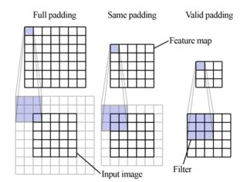
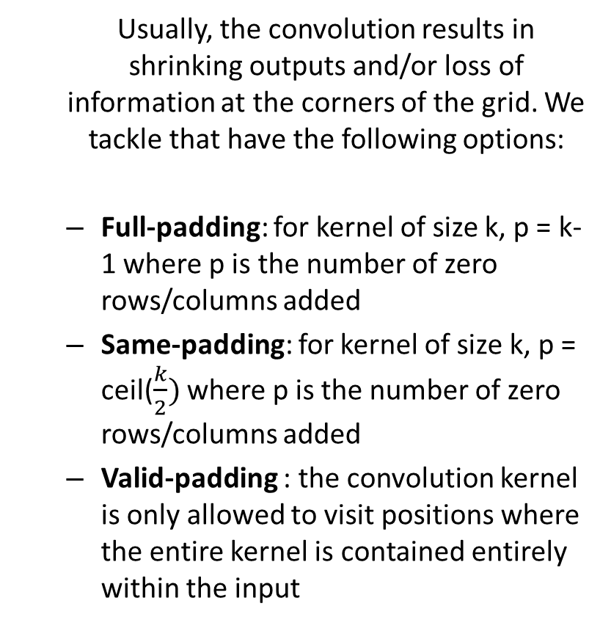
Padding
Usually, the convolution results in shrinking outputs and/or loss of information at the corners of the grid. We tackle that have the following options:
Full-padding: for kernel of size k, p = k-1 where p is the number of zero rows/columns added
Same-padding: for kernel of size k, p = ceil($\frac{k}{2})$ where p is the number of zero rows/columns added
Valid-padding : the convolution kernel is only allowed to visit positions where the entire kernel is contained entirely within the input

Slide 15
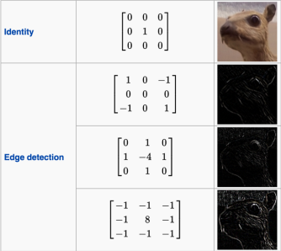
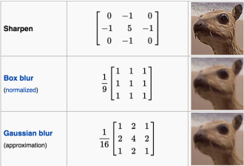
The Convolution operation on Images³
Convolutions are frequently used in image processing, to manipulate the image or detect different features in the image

Slide 16
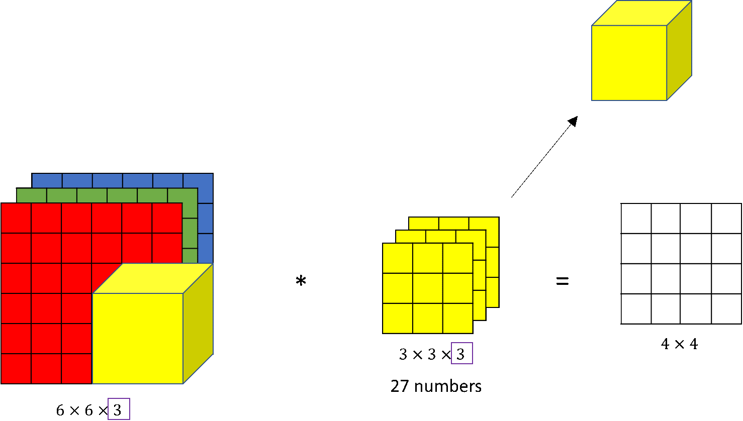
The Convolution operation on RBG Images⁵
An RGB image is represented with a 3D tensor: (x, y, 3), where x, y are the pixel dimensions and 3 corresponds to the 3 color channels. The filter will also be 3 channels.

Slide 17
The Convolution operation on RBG Images⁵
The channel dimension in the kernel permits to detect features in only a subset of the dimensions, e.g.
vertical edges only in the red dimension
set all cells in the blue and green channels to zero
horizontal edges in the red and blue dimensions
vertical edges no matter the color dimension

Slide 18
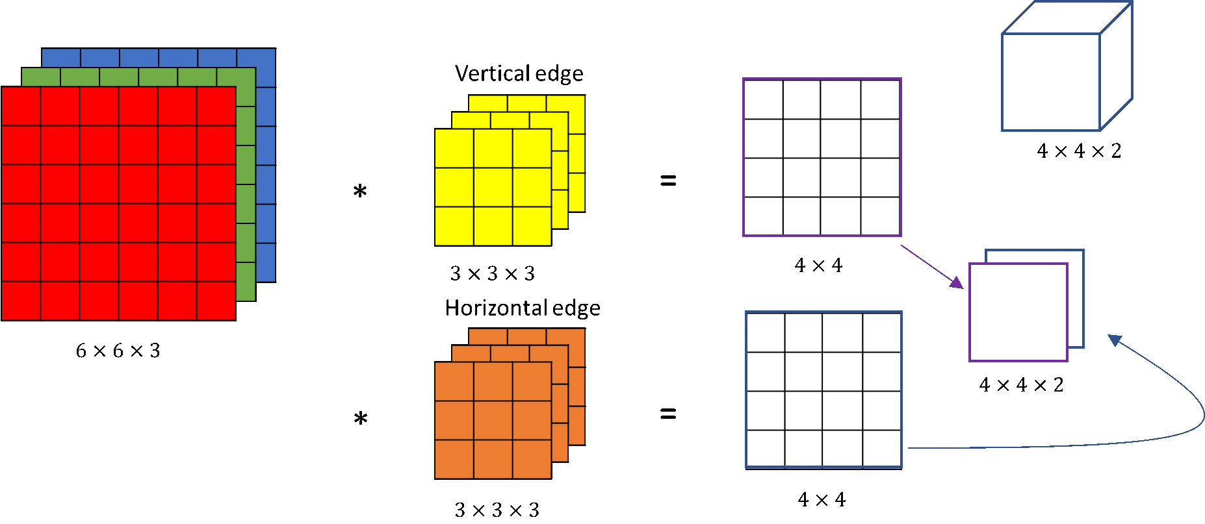
The Convolution operation on RBG Images⁵
We can also detect different features at the same time, by employing multiple filters
The output will have a number of channels equal to the number of features we are trying to detect

Slide 19
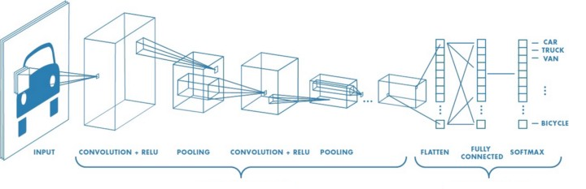
Typical CNN model architecture³
Typically, a CNN model consists of convolution layers, for feature selection, followed by fully connected layers that perform the prediction task
Feature Learning
Prediction Task

Slide 20
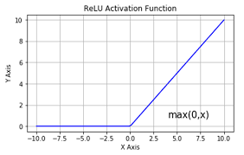
RELU (Rectified linear unit) activation function
What does ReLU stand for?
ReLU, short for rectified linear unit, is a non-linear activation function used for deep neural networks in machine learning. It is also known as the rectifier activation function.
What is ReLU used for?
The ReLU activation function is used to introduce nonlinearity in a neural network, helping mitigate the vanishing gradient problem during machine learning model training and enabling neural networks to learn more complex relationships in data.
If a model input is positive, the ReLU function outputs the same value. If a model input is negative, the ReLU function outputs zero.

Slide 21
Pooling Layer
In Convolutional Neural Networks (CNNs), pooling layers reduce the spatial dimensions of feature maps, decreasing computational complexity and parameter count while also improving the model's robustness to variations in input.
Here's a more detailed explanation:
Dimensionality Reduction:
Pooling layers, also known as downsampling layers, reduce the spatial dimensions (width and height) of feature maps generated by convolutional layers.
Computational Efficiency:
By reducing the size of the feature maps, pooling layers decrease the number of parameters the network needs to learn and the amount of computation required in subsequent layers.

Slide 22
Pooling Layer
Feature Summarization:
Pooling layers summarize the features within a region of a feature map, extracting the most important information
while discarding less relevant details.
Translation Invariance:
Pooling layers help make the network more robust to small shifts or translations in the input image.
Types of Pooling:
Max Pooling: Selects the maximum value within each region of the feature map.
Average Pooling: Calculates the average value within each region of the feature map.

Slide 23
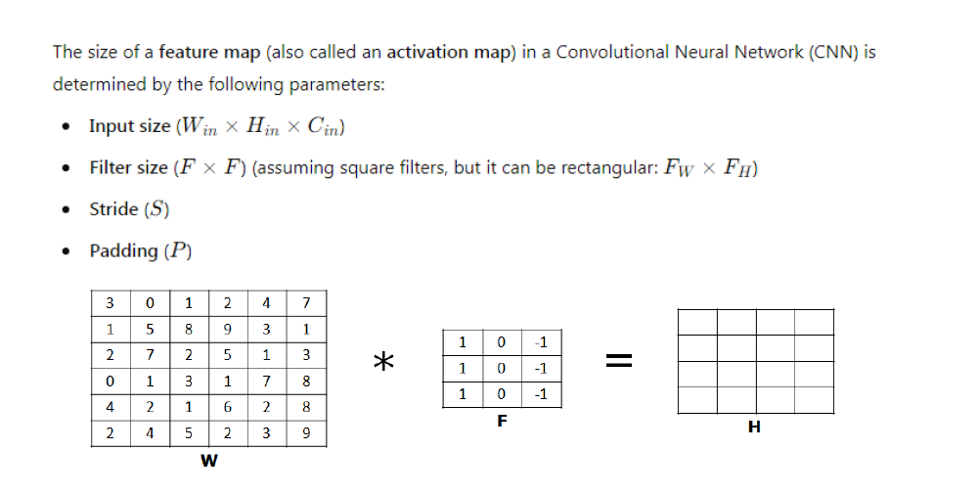

Slide 24
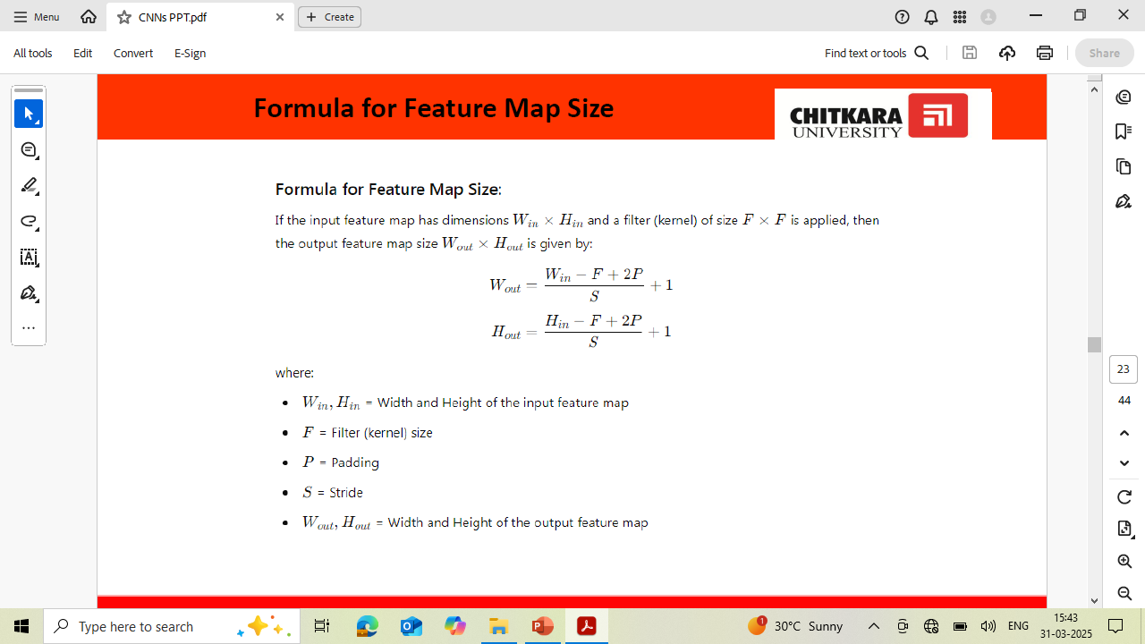

Slide 25
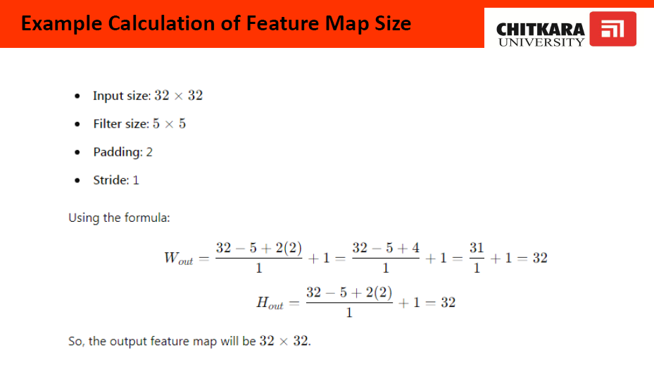

Slide 26


Slide 27
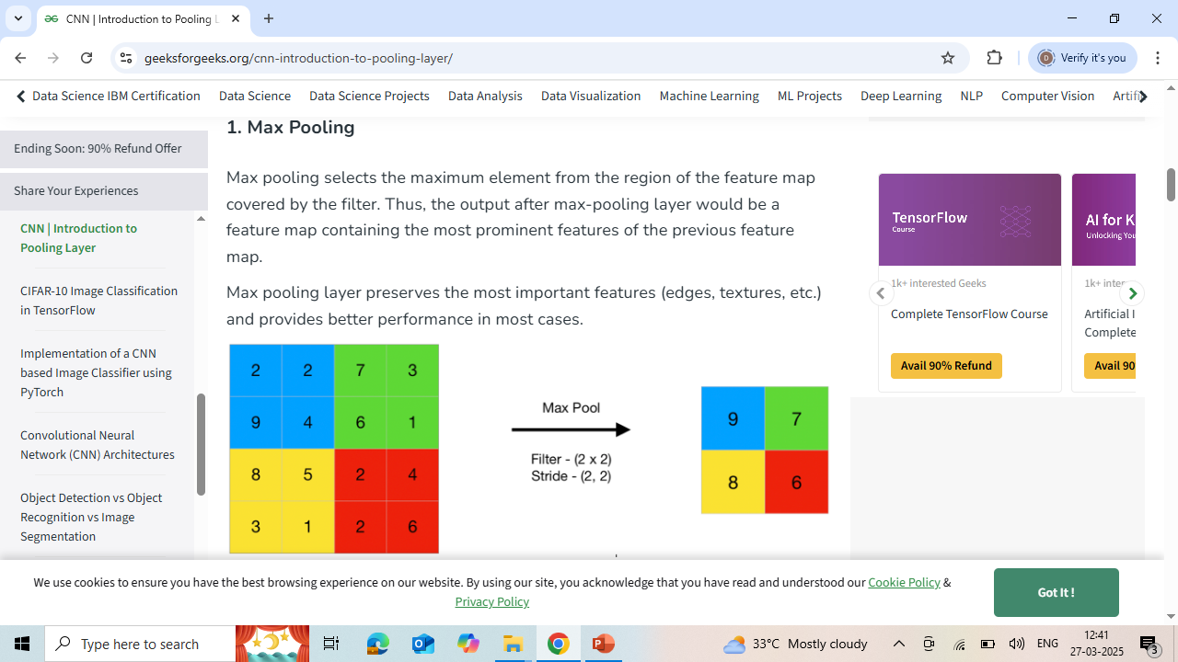
Types of pooling layers

Slide 28
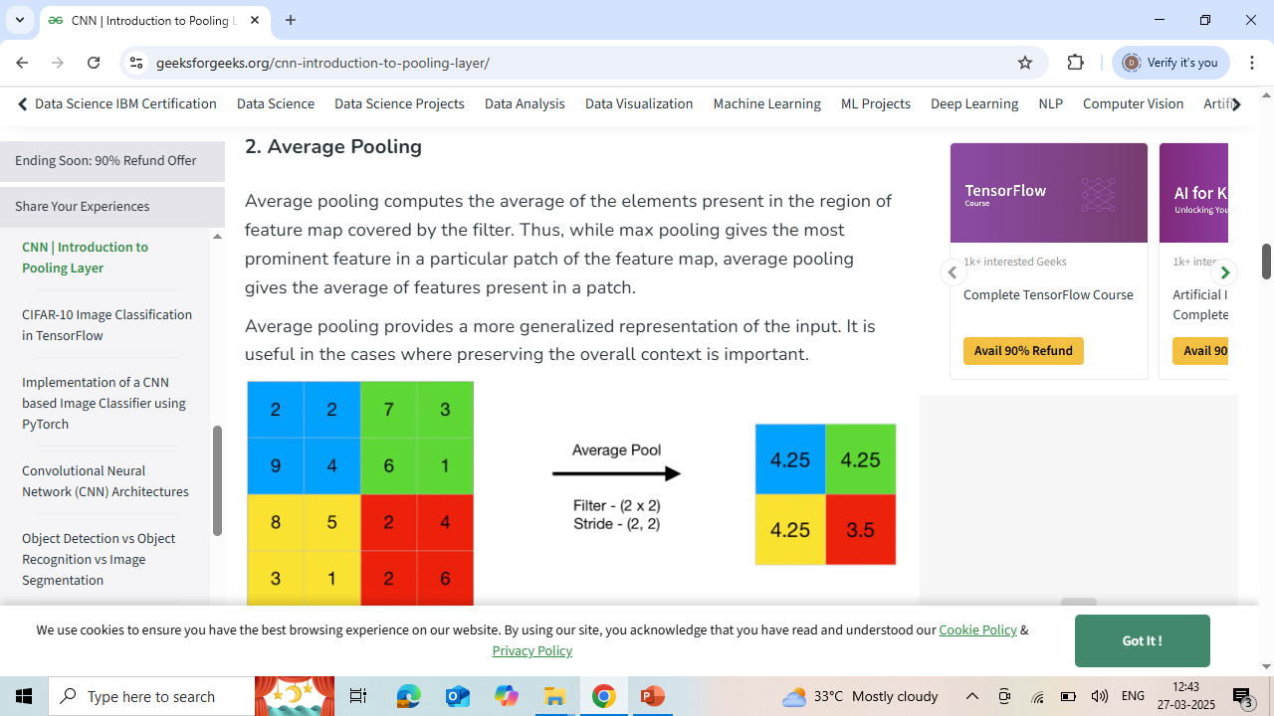

Slide 29


Slide 30


Slide 31
Flatten layer
A neural network flatten layer is used to convert the multi-dimensional output from the previous layer into a one-dimensional array, typically before feeding it into a fully connected layer for further processing.
A neural network flatten layer is commonly used in deep learning architectures to transform multi-dimensional input data into a one-dimensional array. Here's a detailed explanation:
Purpose:
The flatten layer serves the purpose of reshaping the output of the preceding layer into a one-dimensional vector, which can then be fed into subsequent fully connected layers.

Slide 32
Fully connected Layer
In a Convolutional Neural Network (CNN), a fully connected layer (also known as a dense layer) connects every neuron in one layer to every neuron in the next, allowing the network to learn complex, global relationships from the features extracted by convolutional and pooling layers, ultimately leading to classification or prediction.
Connection Pattern:
Unlike convolutional layers that learn local features, fully connected layers establish a global connection, ensuring that every input neuron influences every output neuron.
Classification/Prediction:
The fully connected layers then process this flattened vector to make predictions or
classifications, often using a softmax activation function for classification tasks.

Slide 33
Typical CNN model architecture¹
A typical feature learning layer of a convolutional network consists of three stages:
the first stage performs several convolution operations in parallel to produce a set of linear activations
each convolution employs a different kernel to learn different features
the input is usually a grid of vector-valued observations
in the second stage, each linear activation is run through a nonlinear activation function (e.g., ReLU)
In the third stage, a pooling function is employed to modify the output of the layer further.

Slide 34
Applications of CNN models^{6,7}
Image Processing
image classification
object detection
image segmentation
object tracking
visual saliency recognition
face recognition
Histopathology
Speech Processing
Text Detections and Recognition (OCR)

Slide 35
Applications of CNN models^{6,7}
Natural Language Processing
Drug Discovery
Timeseries Analysis
Health risk assessment and biomarkers of aging discovery
Forecasting
Electromyography (EMG) recognition

Slide 36
Notable CNN models^{11, 12}
LeNet
AlexNet
VGG-16
Inception-based architectures
Xception
ResNet

Slide 37
References
I. GoodFellow, Y. Bengio, A. Courniville: Deep Learning (Adaptive Computation and Machine Learning series), 2016
https://colah.github.io/posts/2014-07-Understanding-Convolutions/2018
https://medium.com/@RaghavPrabhu/understanding-of-convolutional-neural-network-cnn-deep-learning-99760835f148
https://ai.stackexchange.com/questions/17004/convolutional-neural-network-does-each-filter-in-each-convolution-layer-create
http://datahacker.rs/convolution-rgb-image/
https://en.wikipedia.org/wiki/Convolutional_neural_network#Applications
J. Gua, Z. Wang, J. Kuen, L. Ma, A. Shahroudy, B. Shuai, T. Liu, X. Wang, G. Wang, J. Cai, T. Chen: Recent advances in convolutional neural networks, Pattern Recognition, May 2018
Y. LeCun, L. Bottou, Y. Bengio and P. Haffner: Gradient-Based Learning Applied to Document Recognition, Proceedings of the IEEE, 86(11):2278-2324, 1998
A. Krizhevsky, I. Sutskever and G. F Hinton: ImageNet Classification with Deep Convolutional Neural Networks, NIPS 2012
K. Simonyan and A. Zisseman: Very Deep Convolutional Networks for Large-Scale Image Recognition: arXiv preprint, 2014
https://towardsdatascience.com/illustrated-10-cnn-architectures-95d78ace614d
https://medium.com/analytics-vidhya/cnns-architectures-lenet-alexnet-vgg-googlenet-resnet-and-more-666091488df5

