Slide 1
KNN
K-Nearest Neighbor

Slide 2
KNN (K-Nearest Neighbor)
What is KNN (K-Nearest Neighbor) Algorithm?
The K-Nearest Neighbors (KNN) algorithm is a popular machine learning technique used for classification and regression tasks. It relies on the idea that similar data points tend to have similar labels or values. KNN finds intense application in pattern recognition, data mining, and intrusion detection. intense application in pattern recognition,
When Do We Use the KNN Algorithm?
KNN Algorithm can be used for both classification and regression predictive problems. However, it is more widely used in classification problems in the industry. To evaluate any technique, we generally look at 3 important aspects:
1. Ease of interpreting output
2. Calculation time
3. Predictive Power

Slide 3
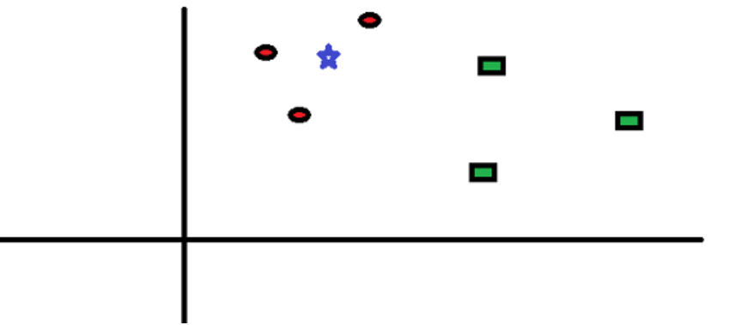
KNN (K-Nearest Neighbor)
How Does the KNN Algorithm Work?
Let’s take a simple case to understand this algorithm. Following is a spread of red circles (RC) and green squares (GS):
You intend to find out the class of the blue star (BS). BS can either be RC or GS and nothing else. The “K” in KNN algorithm is the nearest neighbor we wish to take the vote from. Let’s say K = 3. Hence, we will now make a circle with BS as the center just as big as to enclose only three data points on the plane.

Slide 4
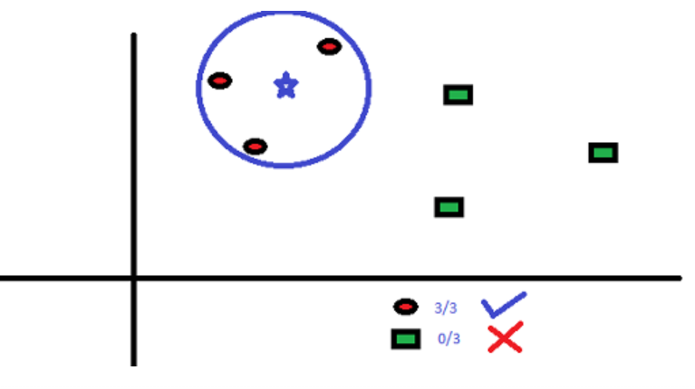
KNN (K-Nearest Neighbor)
The three closest points to BS are all RC. Hence, with a good confidence level, we can say that the BS should belong to the class RC. Here, the choice became obvious as all three votes from the closest neighbor went to RC. The choice of the parameter K is very crucial in this algorithm.

Slide 5
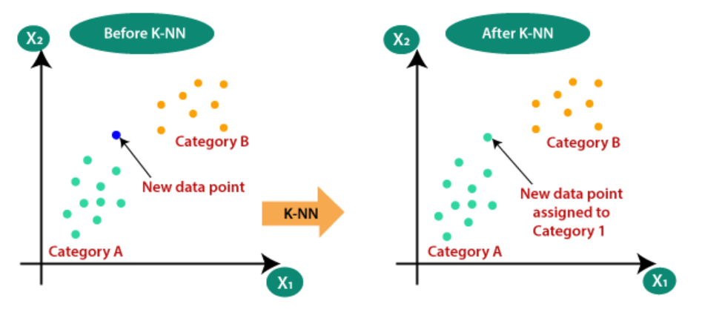
Why do we need a K-NN Algorithm?
Suppose there are two categories, i.e., Category A and Category B, and we have a new data point x1, so this data point will lie in which of these categories. To solve this type of problem, we need a K-NN algorithm. With the help of K-NN, we can easily identify the category or class of a particular dataset. Consider the below diagram:

Slide 6
How does K-NN work?
The K-NN working can be explained on the basis of the below algorithm:
Step-1: Select the number K of the neighbors
Step-2: Calculate the Euclidean distance of K number of neighbors
Step-3: Take the K nearest neighbors as per the calculated Euclidean distance.
Step-4: Among these k neighbors, count the number of the data points in each category.
Step-5: Assign the new data points to that category for which the number of the neighbor is maximum.

Slide 7
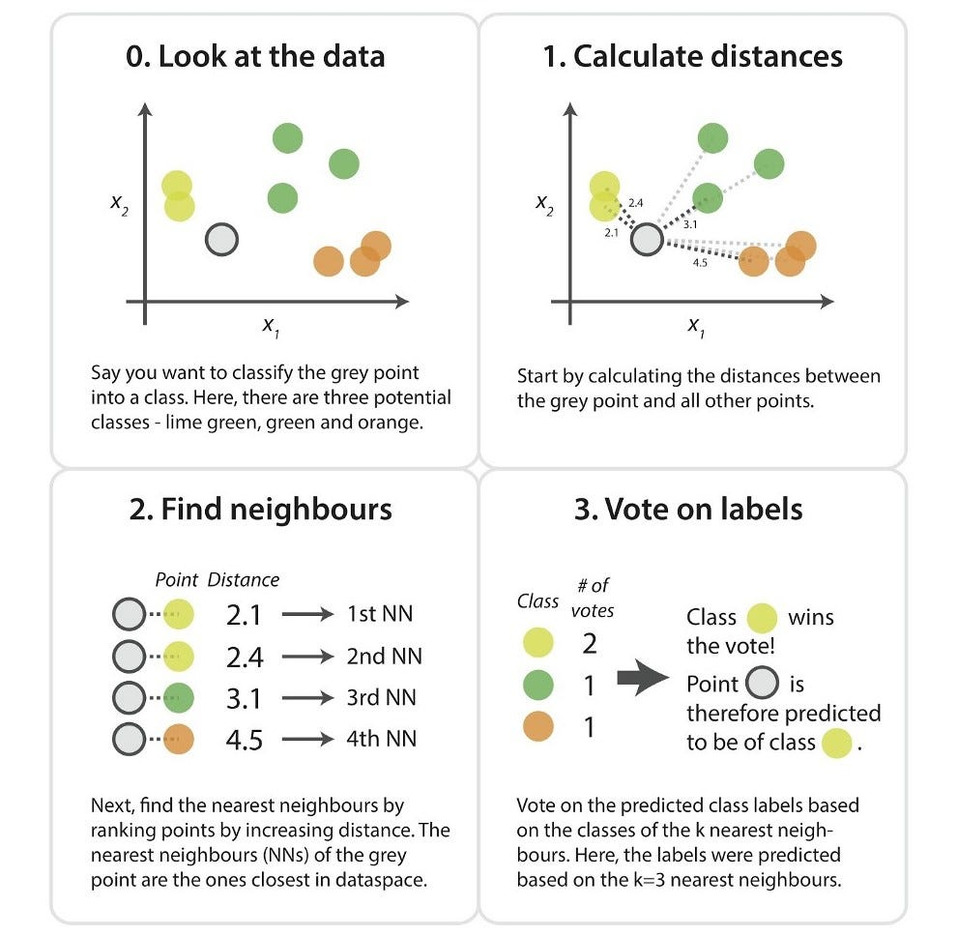
How does K-NN work?

Slide 8
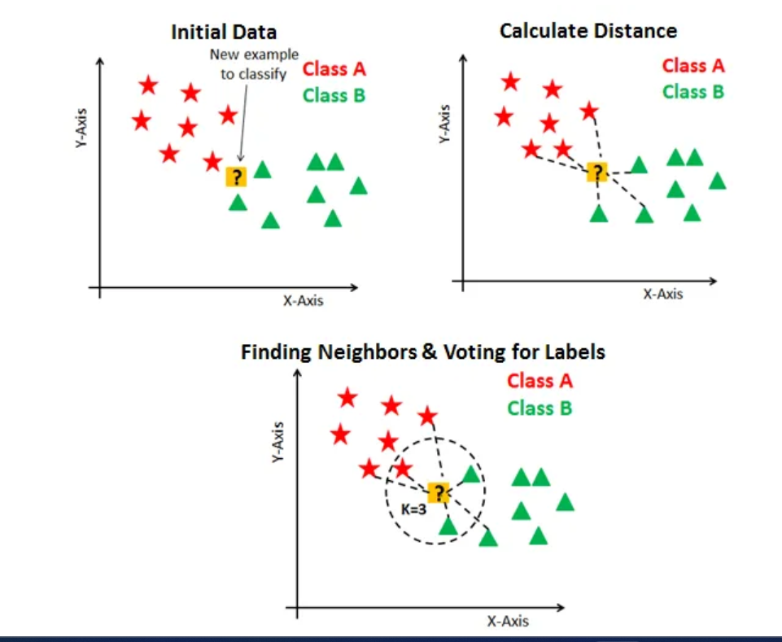

Slide 9
KNN(K-Nearest Neighbor)
How Do We Choose the Factor K?
First, let us try to understand the influence of the K-nearest neighbors (KNN) in the algorithm. If we consider the last example, keeping all 6 training observations constant, a given K value allows us to establish boundaries for each class. These decision boundaries effectively segregate, for instance, RC from GS. Similarly, let’s examine the impact of the value “K” on these class boundaries. The following illustrates the distinct boundaries that separate the two classes, each corresponding to different values of K.

Slide 10
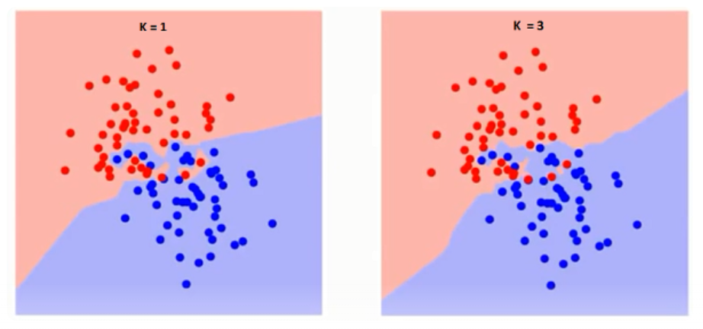
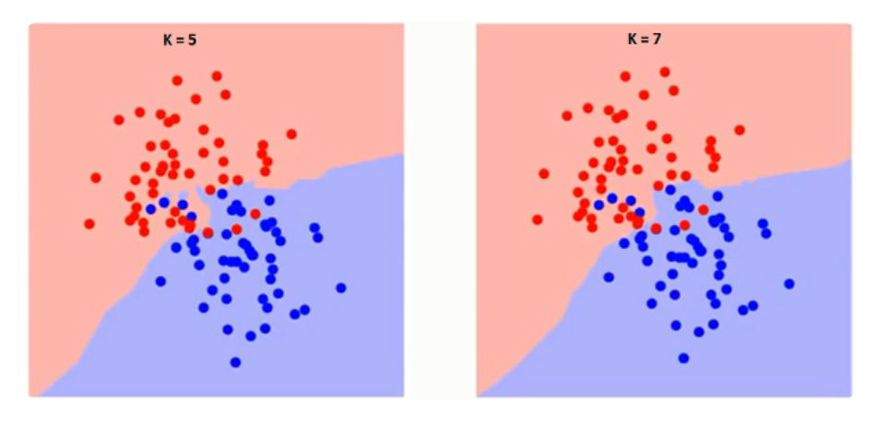
KNN(K-Nearest Neighbor)
Boundary become smoother with increase value of K

Slide 11
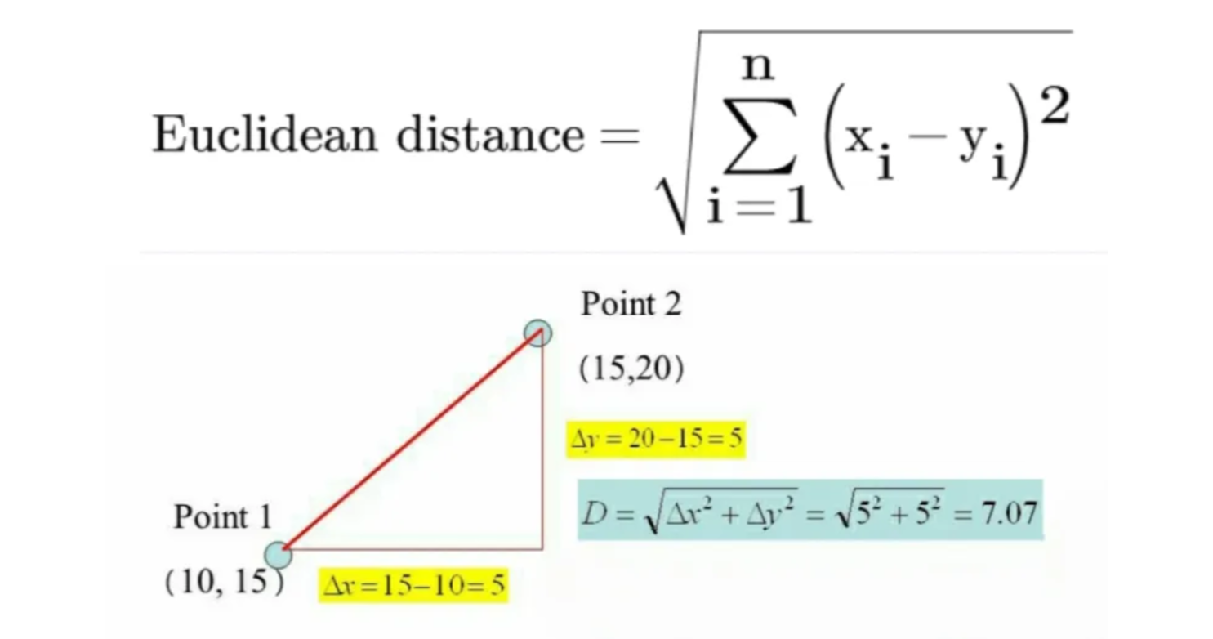
Euclidean Distance
Usually, the Euclidean approach, which is the most widely used distance measure to calculate the distance between test samples and trained data values. We measure the distance a long a straight line from point (x1, y1) to point (x2, y2).

Slide 12
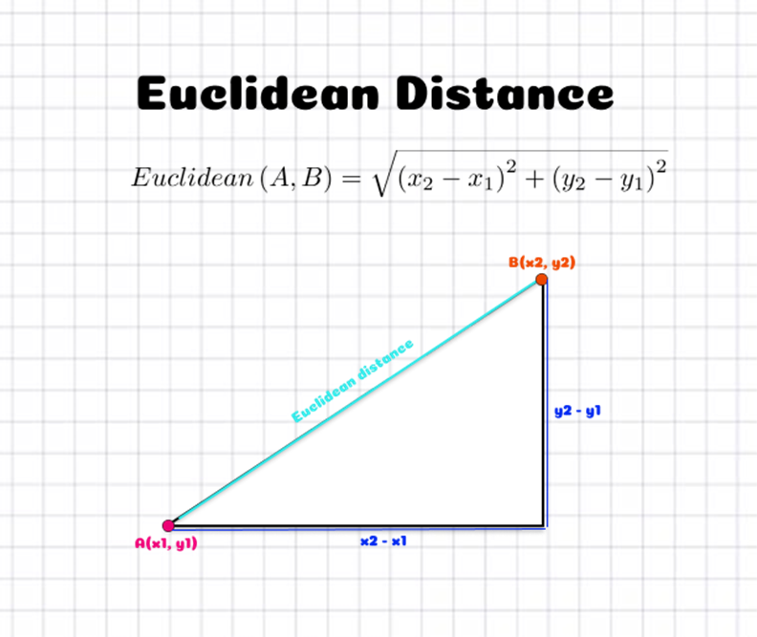
Euclidean Distance

Slide 13
Manhattan Distance
Euclidean distance, which measures the shortest possible line between two points, Manhattan distance measures the sum of the absolute differences between the coordinates of the points. This method is called "Manhattan distance" because, like a taxi driving through the grid-like streets of Manhattan, it must travel along the grid lines.
2D example
Consider two points: A(1, 1) and B(4, 5):
Calculate |x₁ - x₂| = |1 - 4| = 3
Calculate |y₁ - y₂| = |1 - 5| = 4
Sum the results: 3 + 4 = 7

Slide 14
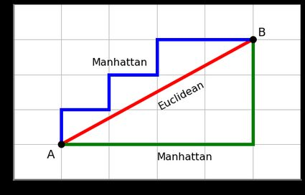
Manhattan Distance

Slide 15
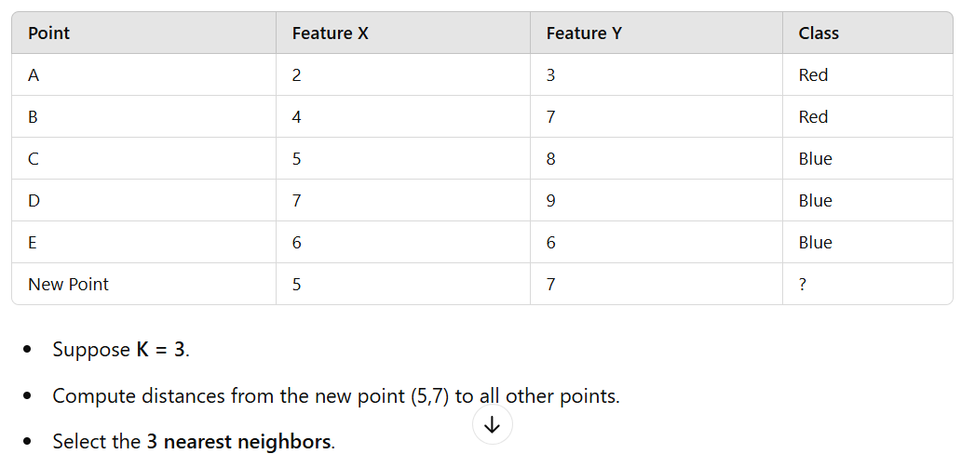
EXAMPLE 1: Classification using KNN
The new point (5,7) is surrounded by two blue points and one red point → It will be classified as Blue.

Slide 16
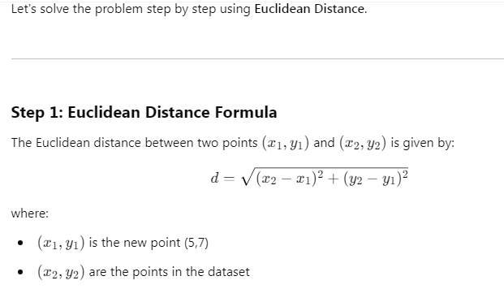
Solution: Example 1

Slide 17
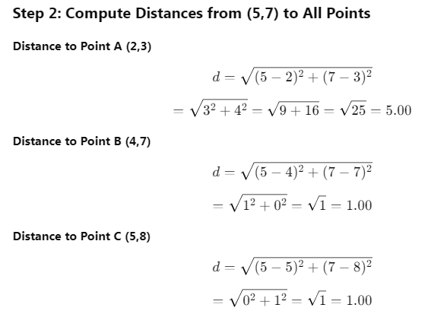
Solution: Example 1

Slide 18
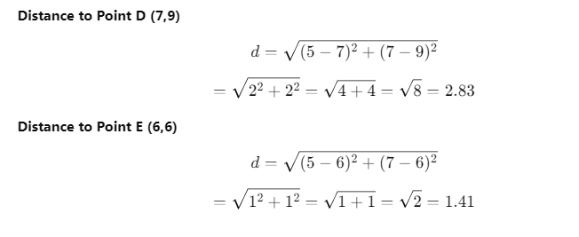
Solution: Example 1

Slide 19
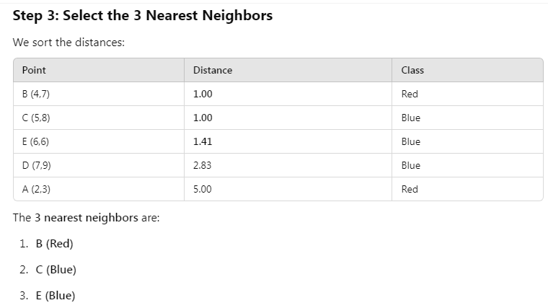
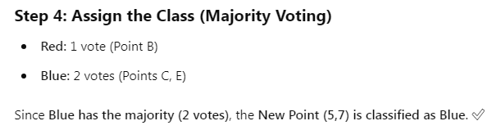
Solution: Example 1

Slide 20
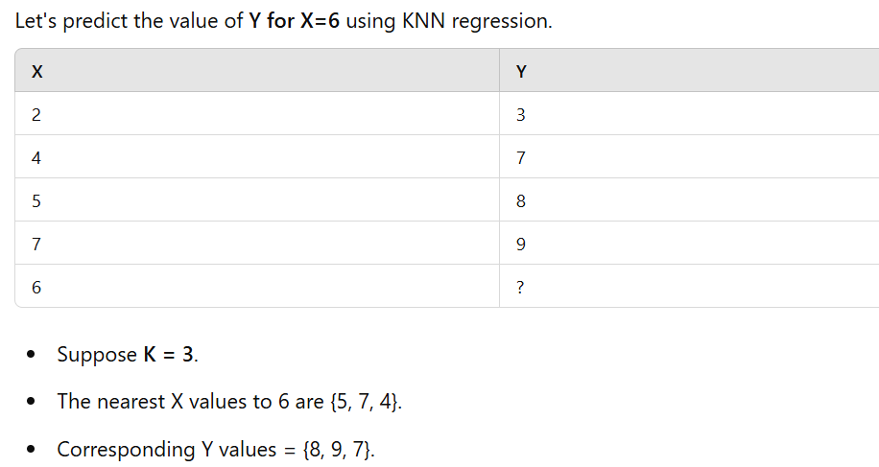
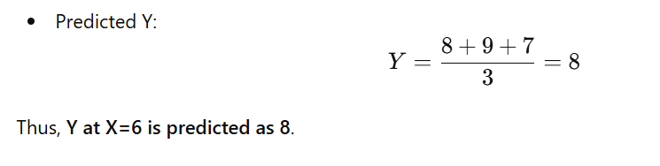
EXAMPLE 2: Regression using KNN

Slide 21
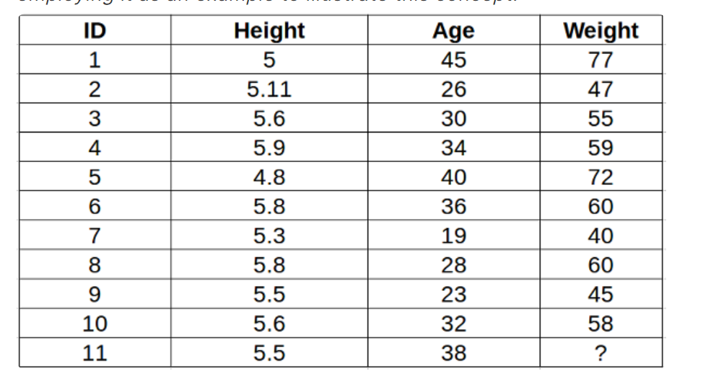
KNN Example 3

Slide 22
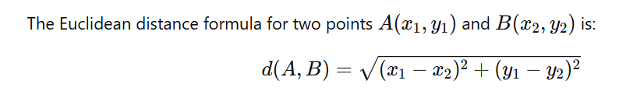
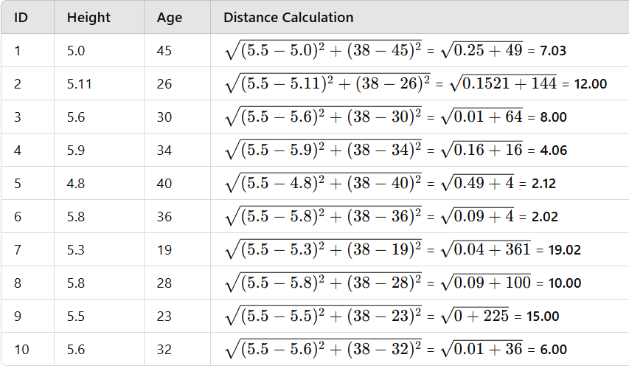
Solution: KNN Example 3

Slide 23
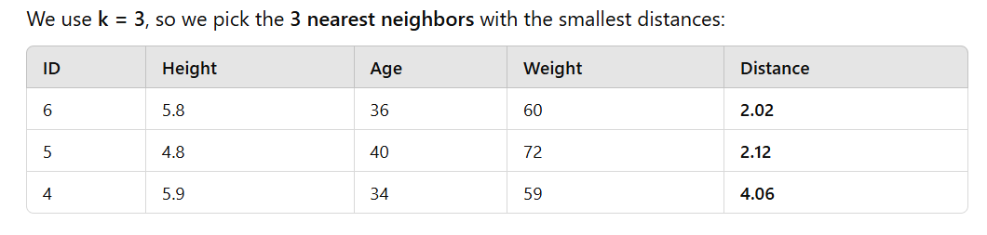
Solution: KNN Example 3
Selecting the Nearest Neighbors

Slide 24
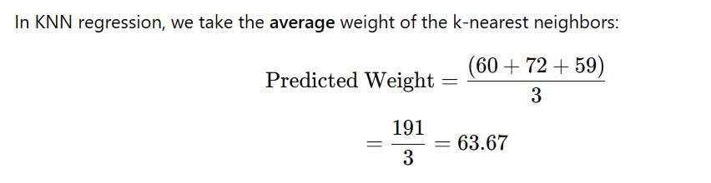
Solution: KNN Example 3
Compute Predicted Weight

Slide 25
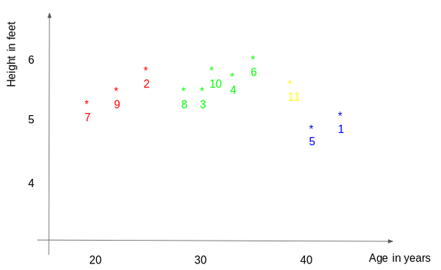

Slide 26
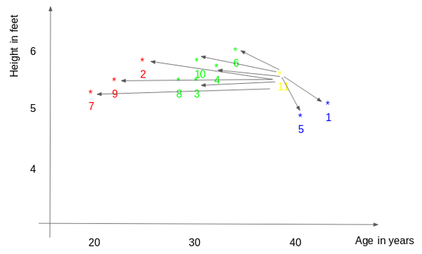

Slide 28
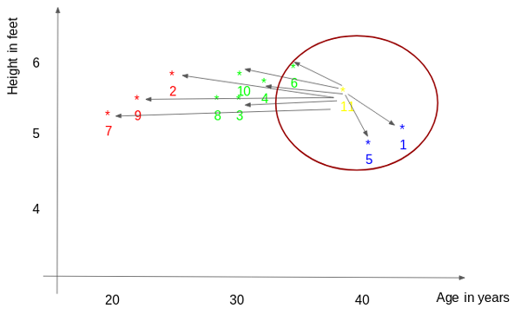

Slide 29
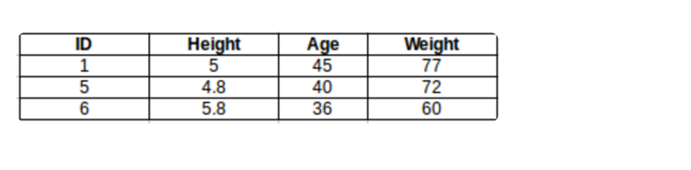

Slide 30
Advantages & Disadvantages of KNN
Advantages
Simple and easy to implement.
No training phase required.
Can be used for classification and regression.
Works well with small datasets.
Disadvantages
Computationally expensive for large datasets.
Sensitive to irrelevant or redundant features.
Performance depends on the choice of K and distance metric.
Imbalanced data can affect results.

Slide 31
How to select the optimal K value?
There are no pre-defined statistical methods to find the most favorable value of K.
Initialize a random K value and start computing.
Choosing a small value of K leads to unstable decision boundaries.
The substantial K value is better for classification as it leads to smoothening the decision boundaries.
Derive a plot between error rate and K denoting values in a defined range. Then choose the K value as having a minimum error rate.

Slide 32
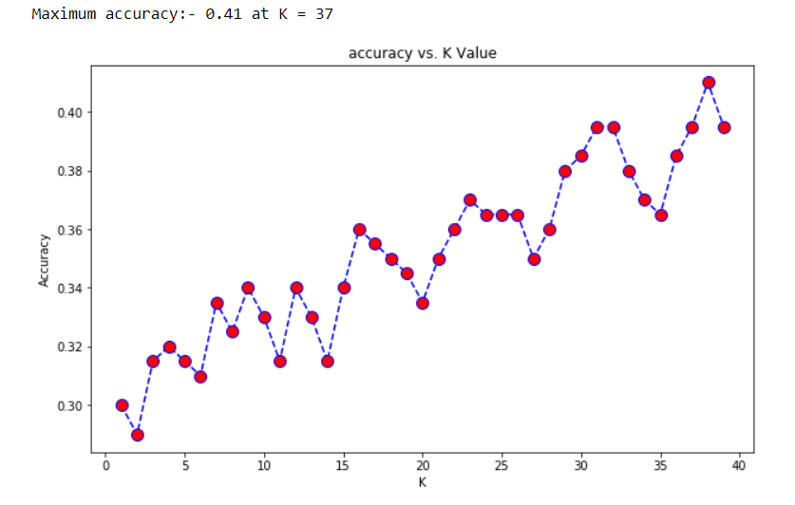

Slide 33
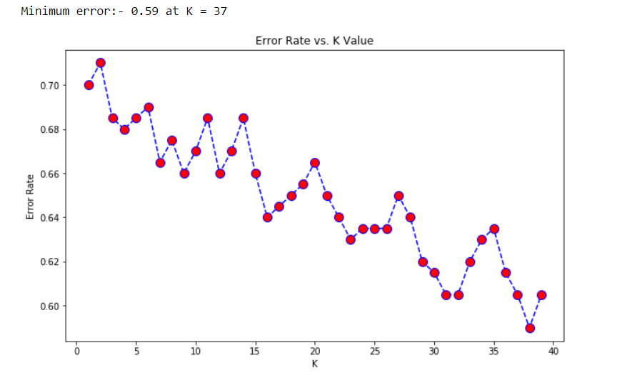

Slide 34
Implementation of KNN
import numpy as np
import matplotlib.pyplot as plt
from matplotlib.ticker import NullFormatter
import pandas as pd
import matplotlib.ticker as ticker
%matplotlib inline
df = pd.read_csv('Telecustomers.csv')
df.head()
X = df.drop(['custcat'], axis = 1)
y = df['custcat']
from sklearn import preprocessing
X = preprocessing.StandardScaler().fit(X).transform(X.astype(float))
from sklearn.model_selection import train_test_split
X_train, X_test, y_train, y_test = train_test_split( X, y, test_size=0.2, random_state=4)

Slide 35
Implementation of KNN
from sklearn.neighbors import KNeighborsClassifier
from sklearn import metrics
#Train Model and Predict
k = 4
neigh = KNeighborsClassifier(n_neighbors = k).fit(X_train,y_train)
Pred_y = neigh.predict(X_test)
print("Accuracy of model at K=4 is",metrics.accuracy_score(y_test, Pred_y))
error_rate = []
for i in range(1,40):
knn = KNeighborsClassifier(n_neighbors=i)
knn.fit(X_train,y_train)
pred_i = knn.predict(X_test)
error_rate.append(np.mean(pred_i != y_test))
plt.figure(figsize=(10,6))
plt.plot(range(1,40),error_rate,color='blue', linestyle='dashed',
marker='o',markerfacecolor='red', markersize=10)

Slide 36
Implementation of KNN
plt.title('Error Rate vs. K Value')
plt.xlabel('K')
plt.ylabel('Error Rate')
print("Minimum error:-",min(error_rate),"at K =",error_rate.index(min(error_rate)))

Slide 37
References
https://www.analyticsvidhya.com/blog/2018/08/k-nearest-neighbor-introduction-regression-python/
https://towardsdatascience.com/how-to-find-the-optimal-value-of-k-in-knn- 35d936e554eb#:~:text=The%20optimal%20K%20value%20usually, be%20aware%20of%20the%20outliers.

