Slide 1
SUPPORT VECTOR MACHINE
(SVM)

Slide 2
Support Vector Machine (SVM) Algorithm
SVM is a powerful supervised algorithm that works best on smaller datasets but on complex ones. Support Vector Machine, abbreviated as SVM can be used for both regression and classification tasks, but generally, they work best in classification problems.
It is a supervised machine learning problem where we try to find a hyperplane that best separates the two classes.
Now the question is which hyperplane does it select? There can be an infinite number of hyperplanes passing through a point and classifying the two classes perfectly. So, which one is the best?
SVM does this by finding the maximum margin between the hyperplanes that means maximum distances between the two classes.

Slide 3
What is Hyperplane
An hyperplane is a generalization of a plane.
in one dimension, a hyperplane is called a point
in two dimensions, it is a line
in three dimensions, it is a plane
in more dimensions you can call it an hyperplane
This point is the separating hyperplane in one dimension.

Slide 4
Types of Support Vector Machine (SVM) Algorithms
Linear SVM: When the data is perfectly linearly separable only then we can use Linear SVM. Perfectly linearly separable means that the data points can be classified into 2 classes by using a single straight line(if 2D).
Non-Linear SVM: When the data is not linearly separable then we can use Non-Linear SVM, which means when the data points cannot be separated into 2 classes by using a straight line (if 2D) then we use some advanced techniques like kernel tricks to classify them. In most real-world applications we do not find linearly separable datapoints hence we use kernel trick to solve them.

Slide 5
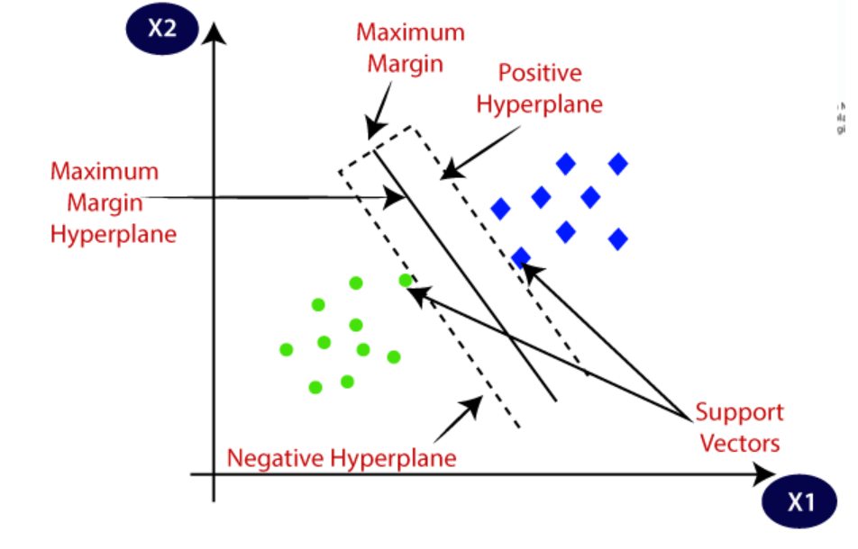
Important Terms
Support Vectors: These are the points that are closest to the hyperplane. A separating line will be defined with the help of these data points.
Margin: it is the distance between the hyperplane and the observations closest to the hyperplane (support vectors). In SVM large margin is considered a good margin.

Slide 6
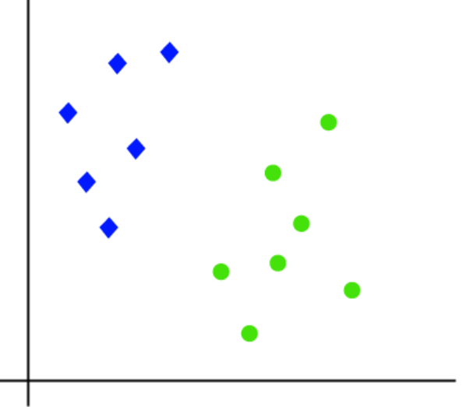
How Does Support Vector Machine Work?
Suppose we have a dataset that has two classes (green and blue). We want to classify that the new data point as either blue or green.
To classify these points, we can have many decision boundaries, but the question is which is the best and how do we find it?

Slide 7
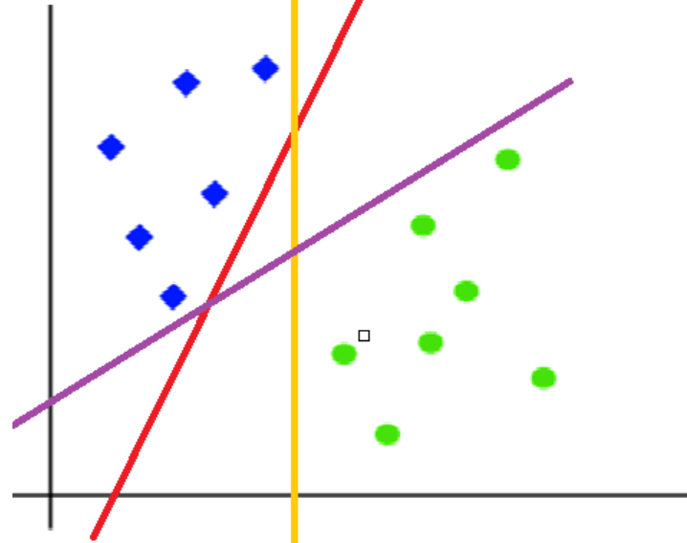
NOTE: Since we are plotting the data points in a 2-dimensional graph we call this decision boundary a straight line but if we have more dimensions, we call this decision boundary a “hyperplane”.
A hyper-plan is a plane in space that is used to separate the two data points classes. The main task of the SVM model is to find the best hyper-plan to classify data points.

Slide 8
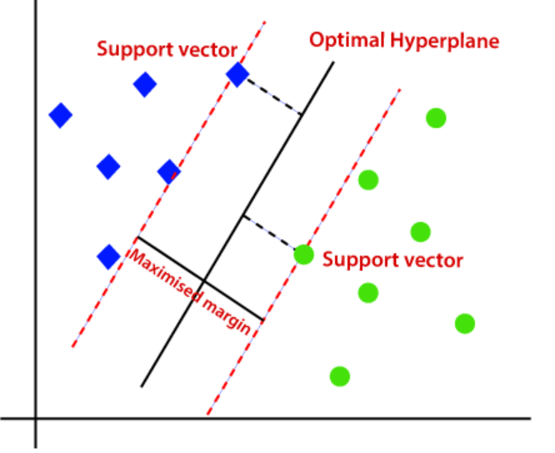
The best hyperplane is that plane that has the maximum distance from both the classes, and this is the main aim of SVM. This is done by finding different hyperplanes which classify the labels in the best way then it will choose the one which is farthest from the data points or the one which has a maximum margin.

Slide 9
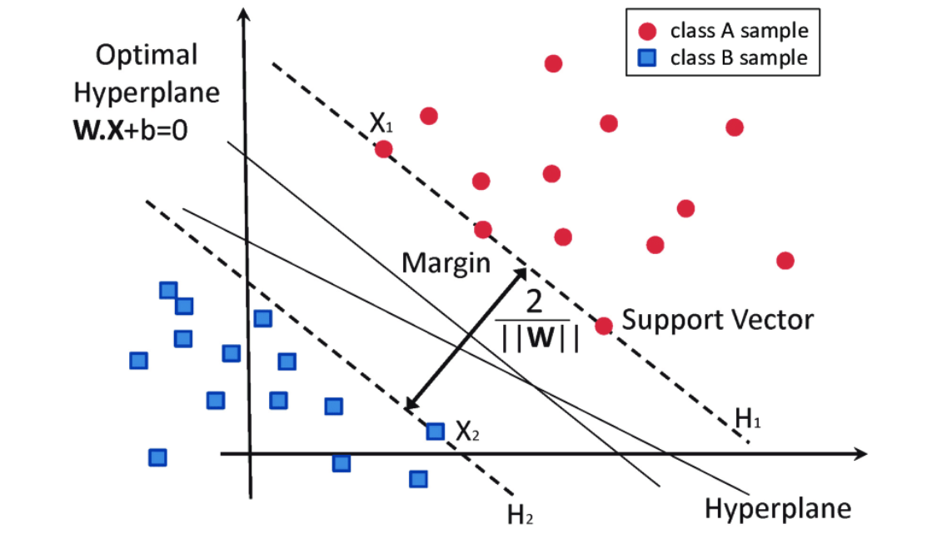

Mathematical intuition behind SVM
The hyper-plan can be expressed by the following equation.
W is a vector of constants that represent the slopes of the plan. In this example, the vector can be represented with two constants [-1 and 0]. Now, let’s take two data points, one from each class, and find the projection of them to the hyper-plan. Assuming that the hyper-plan is passing through origin so, b = 0.

Slide 10
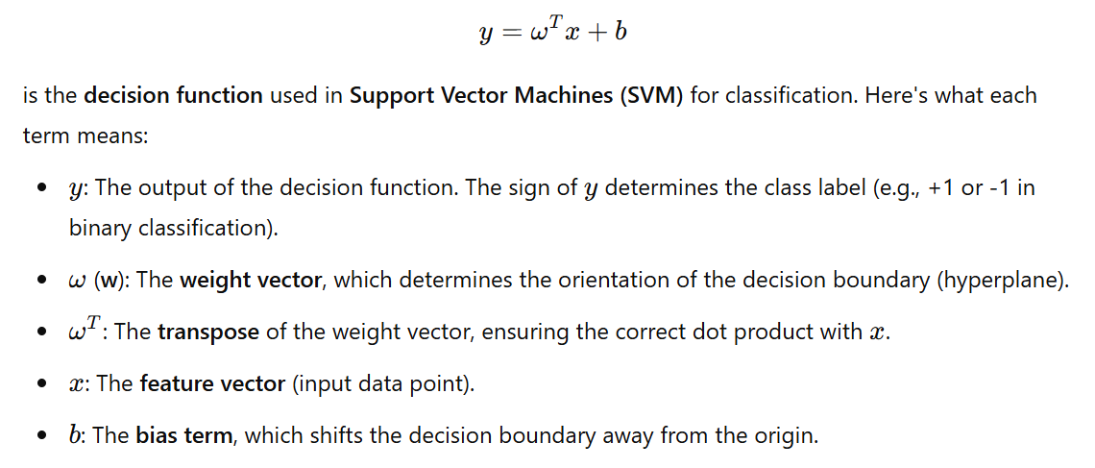

Slide 11
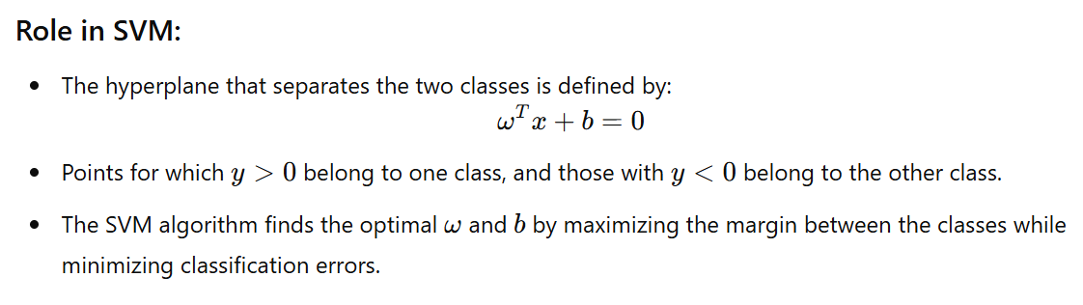

Slide 12
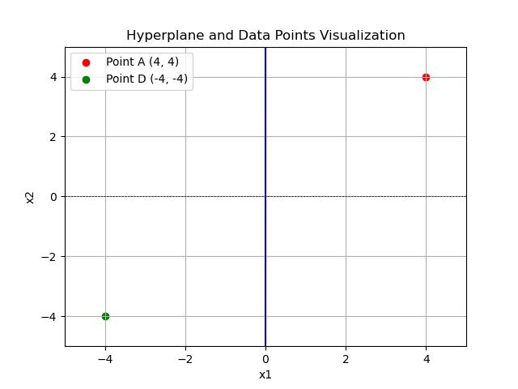

Slide 13


Mathematical intuition behind SVM
For the first data point ( 4, 4), after substituting it to the hyper-plan equation, we find that the value of y is negative.
y = -1 * 4 + 0* 4 = -4 → negative
For the second data point ( -4, -4), the value of y will be positive.
y = -1 * -4 + 0* -4 = 4 → positive
We see that the projection of any data point at one side of the hyper-plan is always positive and at the other side is always negative

Slide 14
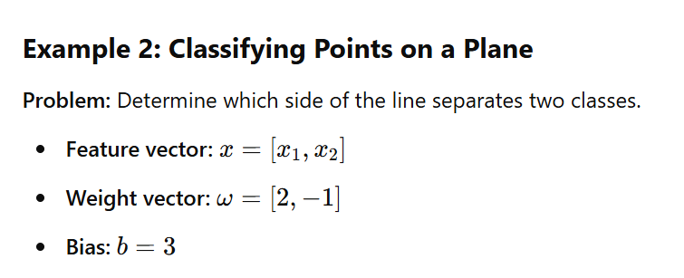
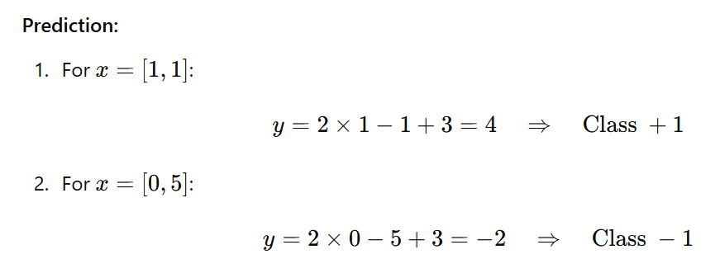

Slide 15
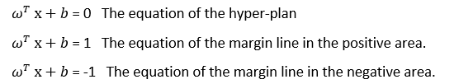
Mathematical intuition behind SVM
Now, we need to find the equation of the hyper-plan and the margin at the two sides of the hyper-plan in order to classify the data points.
To find the margin lines, we will assume that the margin lines are passing through the nearest points in each class. so, the equations of the margin lines (or plans) are as follows.

Slide 16

Mathematical intuition behind SVM
To find the distance between two margin lines, we subtract the two data points, and hence, we find the following equation.
From the equation shown above, we need to maximize this function in order to find the best margin plans which guarantee that no data points are misclassified (this means that the minimum number of data points should be located in the margin areas and no data points are located in the other class).

Slide 17
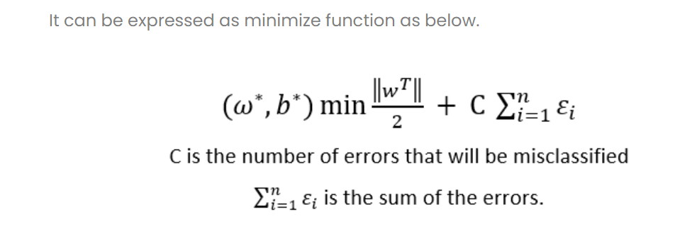
From the equation shown below, we need to minimize the function in order to find the best margin plans which guarantee that no data points are misclassified.
Note that, the term of error summation has been added to the optimization function to overcome the over-fitting problem.

Slide 18
In real-life data sets, the data points cannot be classified using simple hyper-plans, but more complex classifiers are used. The kernel trick and soft margin technique are used to determine the equation of the classifier and the threshold.
References
Andreas C. Miiller and Sarah Guido. Introduction to Machine Learning with $rthon. O'Reilly Media, Inc' United States of America.
https://www.analyticsvidhya.com/blog/2021/10/support-vector-machinessvm-a-complete-guide-for-beginners/
https://towardsai.net/p/l/mathematics-behind-support-vector-machine
https://www.youtube.com/watch?v=H9yACitf-KM
https://www.youtube.com/watch?v=9iD8DMF6odw

