Slide 1


ACPR2017
4th Asian Conference on Pattern Recognition
Learning Sparse Adversarial Dictionaries For Multi-Class Audio Classification
Paper ID: 307
Vaisakh Shaj, Puranjoy Bhattacharya
Indian Institute Of Space Science And Technology, Intel
Nanjing, China
Novemeber 26-29, 2017

Slide 2

Part 1
Motivation
Audio events are quite often over-lapping in nature and more prone to noise than visual signals.
Sparse Representations have been often proven effective for tasks like audio de-noising, source separation etc
Learnt by minimizing reconstructive loss with a sparsity constraint
Is it a good approach for classification tasks ?
Atoms that has the most energy contribution with respect to reconstruction of signals might not be the atoms that are important for classification. (K Huang 2007)
Add an adversarial loss in addition to reconstructive loss.
ACPR 2017
Notes:
文字

Slide 3
Part 2
Contribution
We will be learning class specific dictionaries that are adversarial in nature and has following advantages:
New regularization strategy that allows for the reconstruction error associated with each class can be used for classification and hence can act as a stand-alone classifier. (many of the previous approaches rely on expensive classifiers like RBF-SVM)
designed to capture interclass differences in a much better manner even for multiclass problem instances. (often many of the previous methods deal with multiclass problem into multiple independent binary classification tasks)
ACPR 2017
Notes:
文字
3

Slide 4
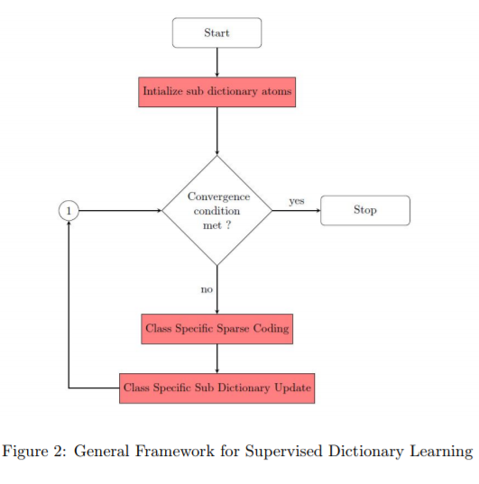
Part 2
Supervised Dictionary Learning
Learn class specific dictionaries / structured dictionaries / dictionaries in which atoms has correspondence to the labels
ACPR 2017
Notes:
文字
4

Slide 5



Part 2
Traditional Reconstructive Dictionaries
Consists of 2 stages:
Sparse Coding (l0 / l1 norm based methods)
Dictionary update
Objective:
Alternative Representation:
1
2
Block Coordinate Descent (Mairal
2010)
put
2
in
1
ACPR 2017
Notes:
文字
5

Slide 6
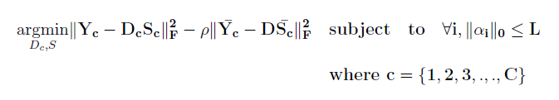
Part 2
Idea !! (Binary Classification)
Add an adversarial loss(maximize) in addition to the reconstruction loss(minimize)
c
1
Class 1
Class 2
2
put
2
in
1
ACPR 2017
Notes:
文字
6

Slide 7


Part 2
Similar form as Reconstructive Dictionary Learning Objective
Reconstructive Learning
Discriminative Learning
Y – Signal
S – Sparse Code
ACPR 2017
Notes:
文字
7

Slide 8
Part 2
Not Guaranteed to be convex
Worst case – concave
Convex modification possible – under a unity norm constraint for each column of the class specific dictionaries being learnt.
Minimum Eigen Value Technique(Tiep 2016)
ACPR 2017
Notes:
文字
8

Slide 9
Part 2
Multi-Class Classification – Mini Batch in Each Iteration
Illustration : 4 class classification
Epoc 1 – Update D1, dictionary corresponding to class 1 signals in 3 steps(feeding mini batches of complementary class signals) instead on 1
Reconstruction
Loss
Adversarial
Loss
Class 4
Class 2
Class 4
Class 1
Class 2
Class 3
Class 3
ACPR 2017
Notes:
文字
9

Slide 10
Part3
Results
Experiments were conducted on 2 datasets:
IEEE DCASE 2013 Dataset
GTZAN Dataset
Preprocessing
Magnitude Spectrogram , Log magnitude spectrogram
Overlapping windows of length 50 frames with overlap of 5 frames
ACPR 2017
Notes:
文字
10

Slide 11
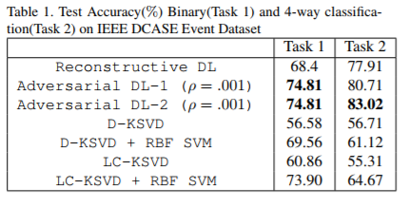
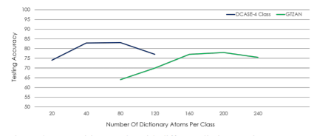
Part3
Results
IEEE DCASE 2013 DATASET – Binary Vs 4 Class Classification
Much better classification performance than popular Discriminative Dictionary Learning methods which were successfully tested for Image Classification eg: LC - KSVD
ACPR 2017
Notes:
文字
11

Slide 12
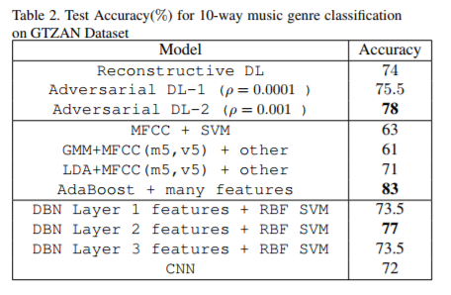
Part3
Results
GTZAN DATASET – 10 Class Classification
Signal Processing Feature Extractors
Deep Learning Techniques
ACPR 2017
Notes:
文字
12

Slide 13
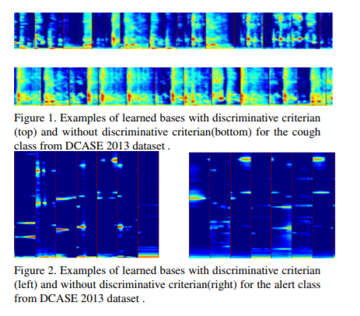
Part3
Results
ACPR 2017
Notes:
文字
13

Slide 14
Thank You
Courtesy: McAfee, Intel

