Slide 1
Azure Databricks Overview
V1.2
16 October 2018

Slide 2
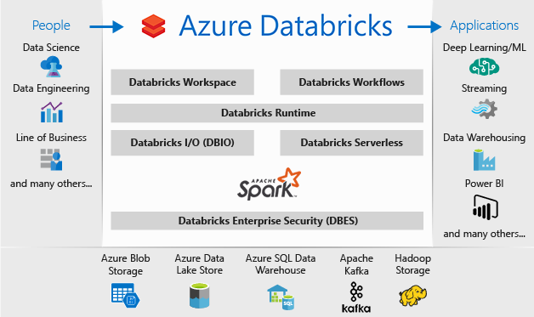
Azure Databricks (Apache Spark-based analytics platform optimized for the Microsoft Azure cloud services platform)
What is Azure Databricks?
https://docs.microsoft.com/en-us/azure/azure-databricks/what-is-azure-databricks

Slide 3
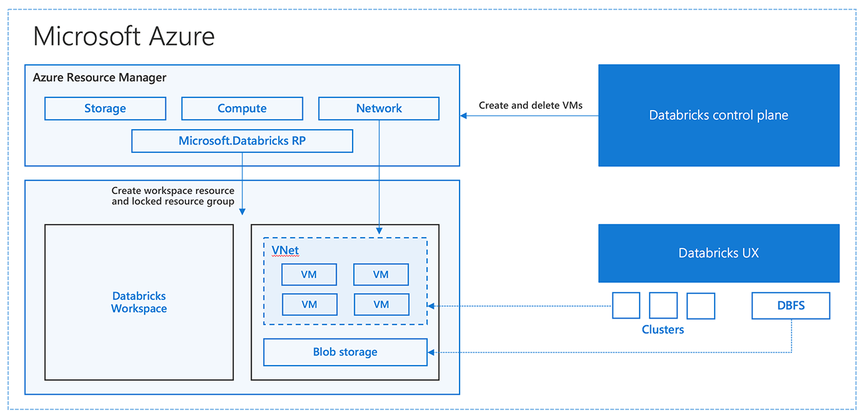
Azure Databricks (A Technical Overview of Azure Databricks)
A Technical Overview of Azure Databricks
https://databricks.com/blog/2017/11/15/a-technical-overview-of-azure-databricks.html

Slide 4
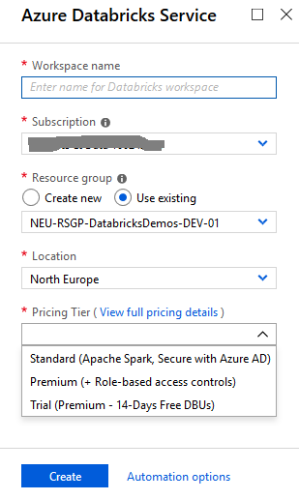
Azure Databricks (Create a workspace)
The Azure Databricks workspace is available with two pricing options:
Standard
Premium
Note: We can upgrade an Azure Databricks workspace from Standard to Premium or downgrade from Premium to Standard.
Features not available in the Standard option:
Workspace Access Control is not available.
Cluster and Jobs Access Control is not available.
Table Access Control is not available
Azure Data Lake Storage credential passthrough is not available
Note: Meaning that in the Standard option, we are not able to enforce Role Based Access Control for Notebooks, Clusters, Jobs, and Tables.
Create an Azure Databricks workspace (Azure portal)
https://docs.azuredatabricks.net/getting-started/try-databricks.html#trial-workspace

Slide 5
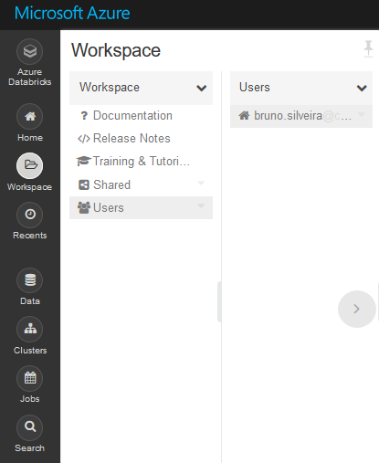
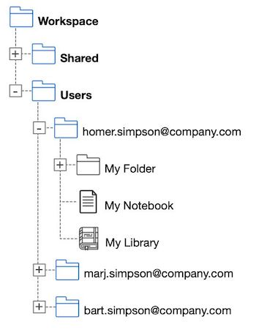
Azure Databricks (Workspace Standard & Premium)
We can create/upload three types of objects:
Notebooks
Libraries
Folders
Three special folders:
Workspace (root folder)
Shared
Users.
Note: These folders cannot be deleted, moved, or renamed.
Workspace
https://docs.azuredatabricks.net/user-guide/workspace.html#workspace

Slide 6
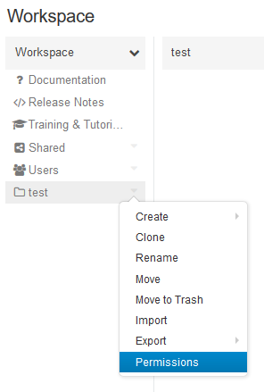
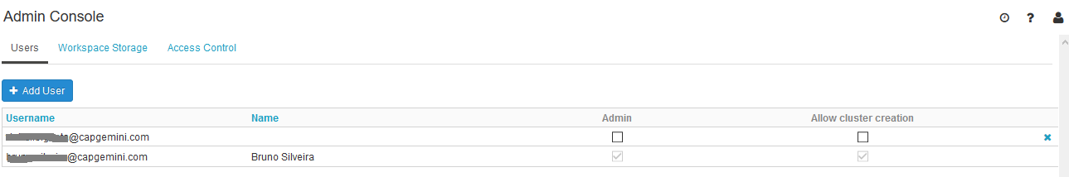
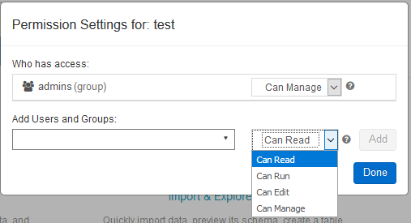
Azure Databricks (Workspace Premium Role Based Access Control)
Admin Console
https://docs.azuredatabricks.net/administration-guide/admin-settings/index.html

Slide 7
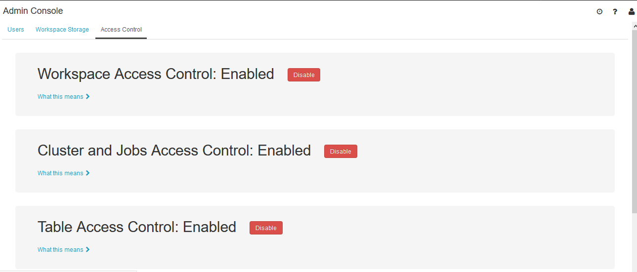
Azure Databricks (Workspace Premium Role Based Access Control)
Azure Databricks Service Plans
https://databricks.com/product/azure-pricing

Slide 8
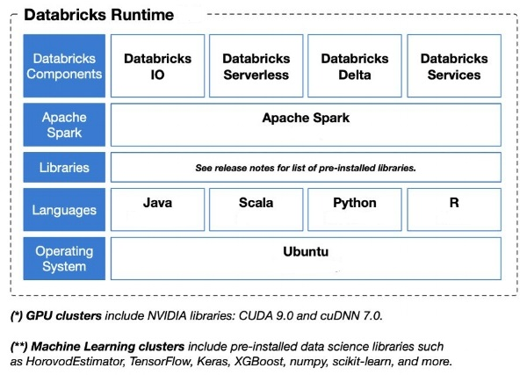
Azure Databricks (Databricks Runtime)
The set of core components that run on the clusters managed by Databricks.
Consists of the underlying Ubuntu OS, pre-installed languages and libraries (Java, Scala, Python, and R), Apache Spark, and various proprietary Databricks modules (e.g. DBIO, Databricks Serverless, etc).
Note: GPU and Machine Learning variants include additional pre-installed libraries geared towards data science.
Runtime components
https://docs.azuredatabricks.net/release-notes/runtime/databricks-runtime-ver.html#runtime-components

Slide 9
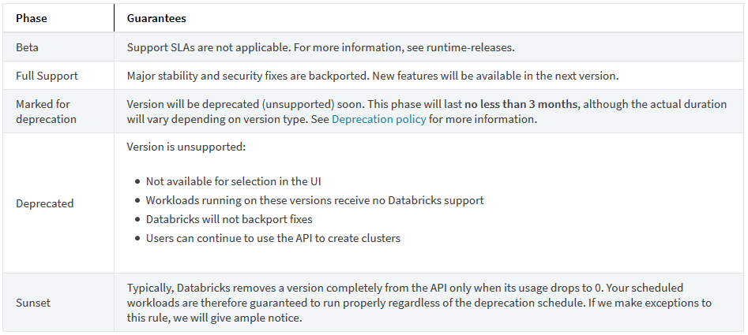
Azure Databricks (Databricks Runtime - Phases of a version)
Databricks Runtime Versioning and Deprecation Policy
https://docs.azuredatabricks.net/release-notes/runtime/databricks-runtime-ver.html

Slide 10
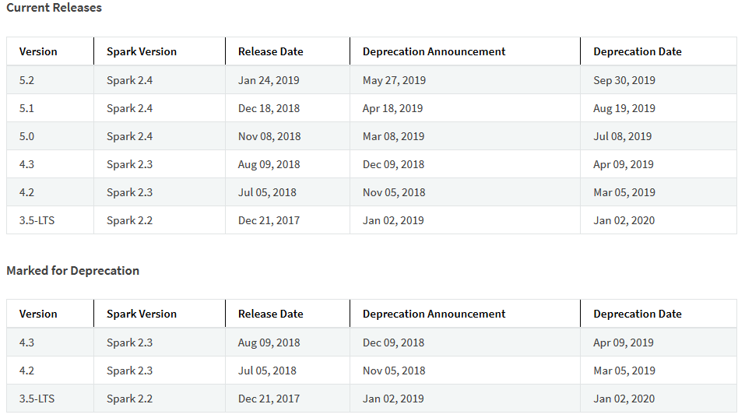
Azure Databricks (Databricks Runtime – Current Releases)
List of releases
https://docs.azuredatabricks.net/release-notes/runtime/databricks-runtime-ver.html#list-of-releases

Slide 11
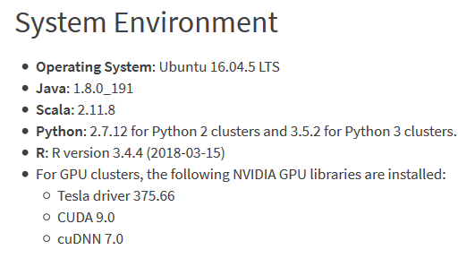
Azure Databricks (Databricks Runtime 5.2)
New Features:
Databricks Advisor
Databricks Delta features
Notebook-scoped libraries
Improvements:
Databricks Delta
Table history now shows the snapshot version read and the isolation level used by a write to the Delta table.
Added support for ALTER TABLE SET LOCATION.
Added support for nested fields in UPDATE clause of MERGE INTO Delta table (for example, MERGE INTO table ON ... WHEN MATCHED THEN UPDATE SET topLevel.nestedField = ...).
Improved performance of approx_count_distinct aggregate function.
Upgraded Java from 1.8.0_181 to 1.8.0_191.
Upgraded Janino Java compiler from 3.0.9 to 3.0.10.
Removed Java library com.mchange.c3p0 and com.mchange.mchange-commons-java.
Upgraded setuptools in Python frmo 40.6.2 to 40.6.3.
Upgraded several installed R libraries.
Databricks Runtime 5.2
https://docs.azuredatabricks.net/release-notes/runtime/5.2.html

Slide 12
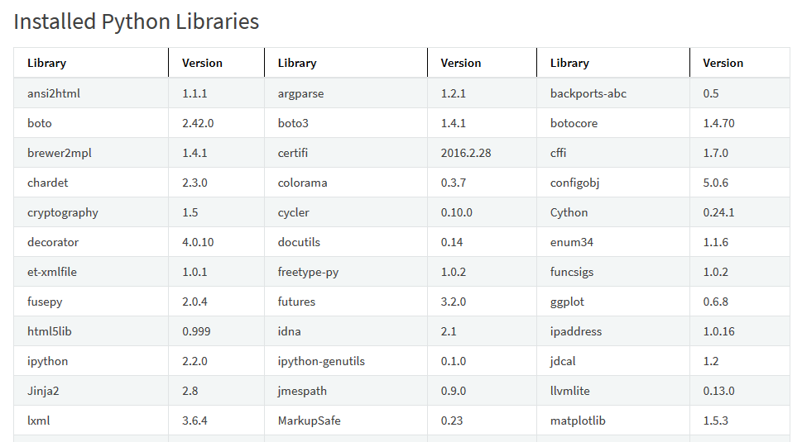
Azure Databricks (Databricks Runtime 5.2- Python Libraries)
Installed Python Libraries
https://docs.azuredatabricks.net/release-notes/runtime/5.2.html#installed-python-libraries

Slide 13
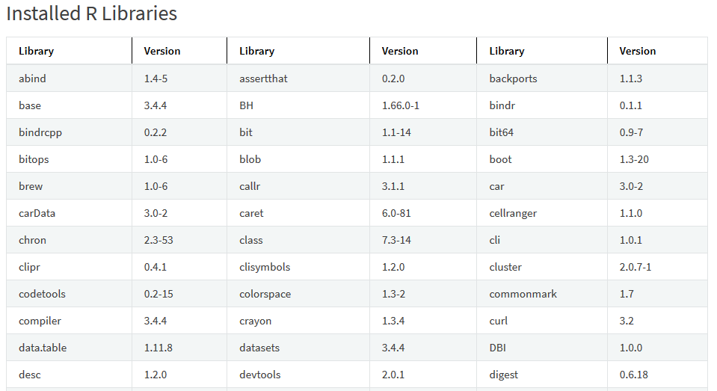
Azure Databricks (Databricks Runtime 5.2- R Libraries)
Installed R Libraries
https://docs.azuredatabricks.net/release-notes/runtime/5.2.html#installed-r-libraries

Slide 14
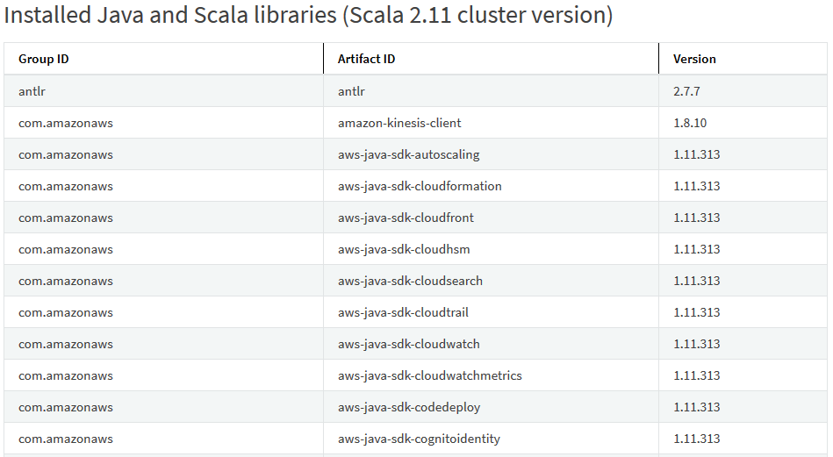
Azure Databricks (Databricks Runtime 5.2- Java and Scala Libraries)
Installed Java and Scala libraries (Scala 2.11 cluster version)
https://docs.azuredatabricks.net/release-notes/runtime/5.2.html#installed-java-and-scala-libraries-scala-2-11-cluster-version

Slide 15
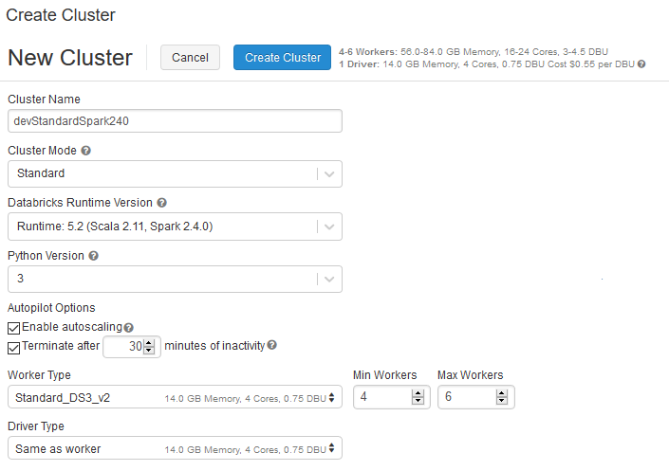
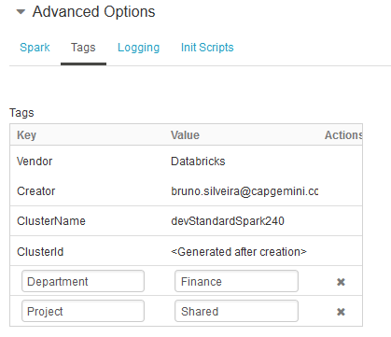
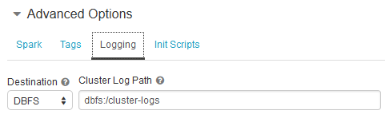
Azure Databricks (Typical Cluster for data engineer workload using the standard workspace. Scala, SQL and Python)
Standard Clusters
https://docs.azuredatabricks.net/user-guide/clusters/high-concurrency.html#standard-clusters

Slide 16
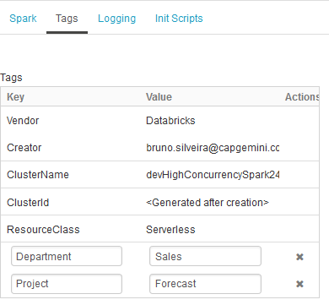
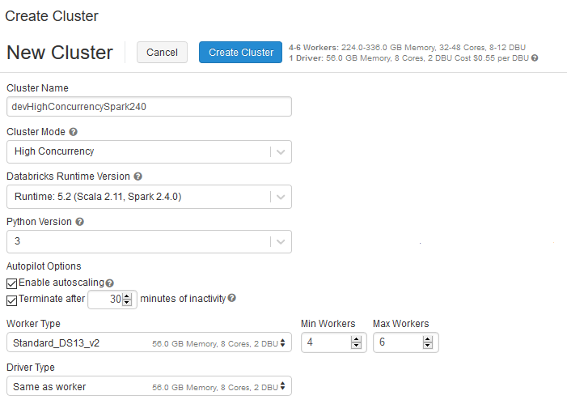
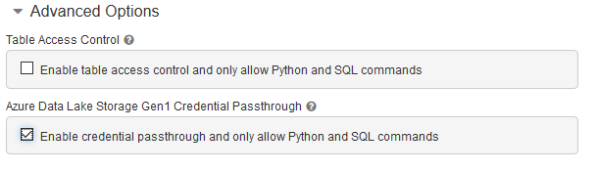
Azure Databricks (Typical Cluster for data science workload using the premium workspace. Python, R and SQL)
High Concurrency Clusters
https://docs.azuredatabricks.net/user-guide/clusters/high-concurrency.html#high-concurrency-clusters

Slide 17
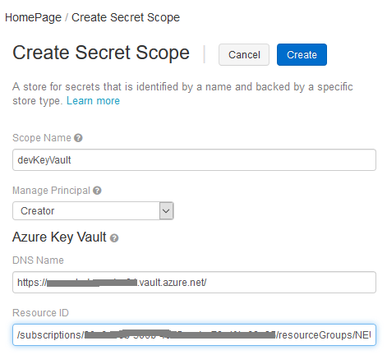
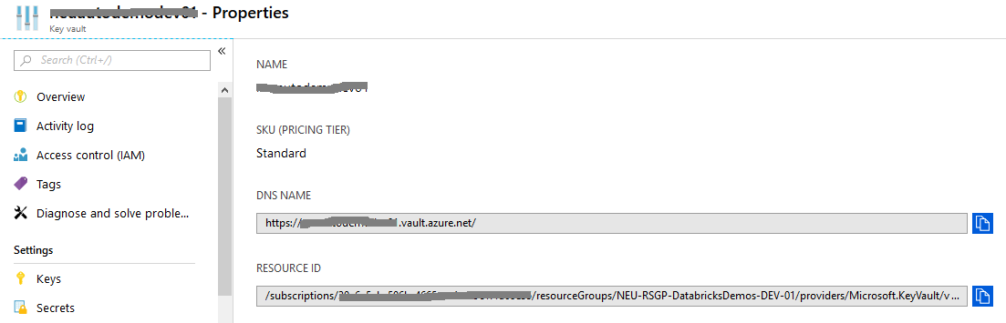
Azure Databricks (Secret scopes)
Create a scope:
Verify that you have Owner permission on the Azure Key Vault instance that you want to use to back the secret scope.
Go to https://<your_azure_databricks_url>#secrets/createScope
Secret Scopes
https://docs.azuredatabricks.net/user-guide/secrets/secret-scopes.html

Slide 18
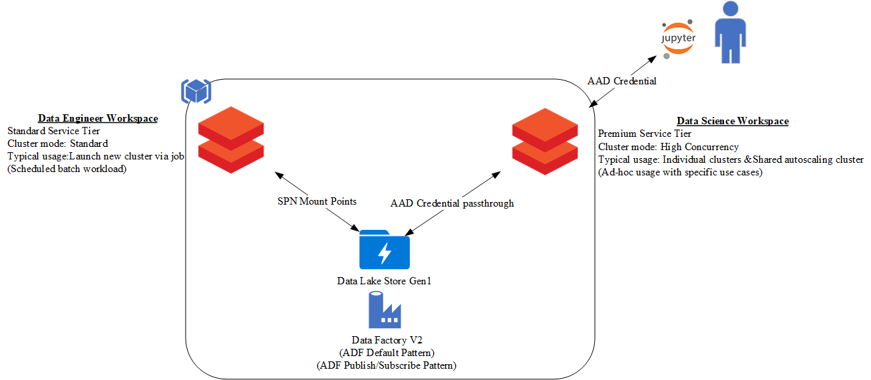
Azure Databricks (Generic Usage Scenario for Data Engineer/Data Science workload)
Scenarios
https://docs.databricks.com/administration-guide/cloud-configurations/aws/cmbp.html#scenarios

Slide 19
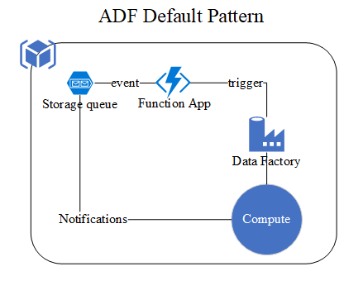
Azure Databricks (Azure Data Factory Default Pattern)
Azure Data Factory Documentation
https://docs.microsoft.com/en-us/azure/data-factory/

Slide 20
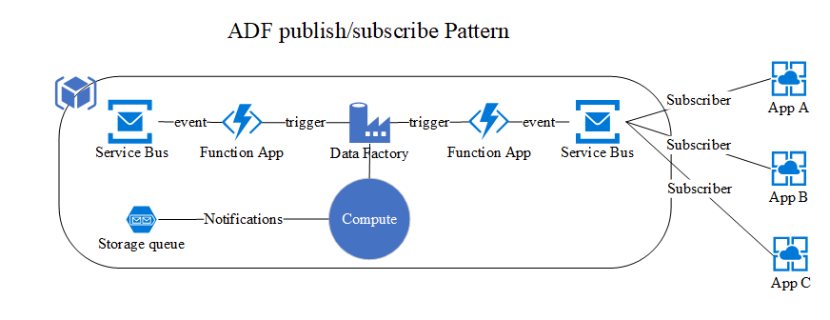
Azure Databricks (Azure Data Factory Publish/Subscribe Pattern)
Get started with Service Bus topics
https://docs.microsoft.com/en-us/azure/service-bus-messaging/service-bus-dotnet-how-to-use-topics-subscriptions

