Slide 1
Custom Coding To Create HDInsight Cluster

Slide 2
Objective
Objective of this presentation is to explain the steps involved in creating the HDInsight on-demand cluster using ADF Custom activity/C#.
ADF Pipeline would use the Batch Service – Custom Activity to run the C# executable. Here are the components involved.
C# Console application.
Azure Blob storage Container.
Batch Account with VM.
ADF Pipeline – Batch Service Custom Activity
Batch Linked Service
Storage Linked Service

Slide 3
C# Console application
C# Console application would read credentials from existing Linked Services and KeyVault, and creates the Cluster with Azure SQL Server DB as a Metastore, Blob storage as a default storage. Code also configure the Access to Azure DataLake using SPN and certificate.
Here are the steps.
Read SPN from existing Linked Service which is attached to the pipeline.
Read the Azure Storage and Key from existing Linked Service.
Get all the required Meta data from Parameter file.
Read all required Secrets from Azure Key vault.
Create HDInsight management objects.
Configure Core-site, gateway, hive-site, hive-env, ClusterIdentity objects and add to Cluster configurations.
Configure Head Node and Worker Node.
Create the Cluster.

Slide 4
C#-Read SPN from existing Linked Service
C# Console application would read SPN credentials from existing Linked Services , but we should attach them in the Batch service. Please refer the batch service slide for the screenshot.
Once we attach the Linked service(s), we can access the credentials stored in them from C#. Please see the code example bellow.
dynamic linkedServices = JsonConvert.DeserializeObject(File.ReadAllText("linkedServices.json"));
string clientSecret = Convert.ToString(linkedServices[1].properties.typeProperties.servicePrincipalKey.value);
string appSvcApplicationId = Convert.ToString(linkedServices[1].properties.typeProperties.servicePrincipalId);
Using the above statements, we can read the SPN and its Key from the existing Linked service(s) and those can be used to create the cluster and to access the Key vault.
Please make sure that SPN has Contributor role on the resource group where we are creating the cluster.

Slide 5
C#- Read the Azure Storage and Key from existing Linked Service
C# Console application would read storage info from existing Linked Services , but we should attach them in the Batch service. Please refer the batch service slide for the screenshot.
Once we attach the Linked service(s), we can access the credentials stored in them from C#. Please see the code example bellow.
string storageConnString = Convert.ToString(linkedServices[0].properties.typeProperties.connectionString.value);
string[] storageConnStringAr = storageConnString.Split(';');
string ExistingStorageName = storageConnStringAr[1].Replace("AccountName=", "") + ".blob.core.windows.net";
string ExistingStorageKey = storageConnStringAr[2].Replace("AccountKey=", "");
Using the above statements, we can read the storage name and its Key from the existing Linked service(s) and those can be used to set the default storage for cluster.

Slide 6
C#- Get all the required Meta data from Parameter file.
C# Console application would read all the required meta data from the parameter.json file. For example metadata like Clustername, version, username, metastore db information Etc. This file should be placed in the Blob container along with the executable and Dlls.
dynamic parametersEnv = JsonConvert.DeserializeObject(File.ReadAllText("Parameters.json"));
string SubscriptionIdstr = parametersEnv.SubscriptionId;
string tenantID = parametersEnv.tenantID;
string sqlServerName = parametersEnv.sqlServerName;
string dbname = parametersEnv.sqlDatabaseName;
string user_name = parametersEnv.sqlServerAdminLogin;

Slide 7
C#- Read all required Secrets from Azure Key vault.
C# Console application would read all the secrets from Azure Key Vault. Like passwords and certificates.
string applicationIdentityCertificateName = parametersEnv.applicationIdentityCertificateName;
string applicationIdentityCertificatePassword = parametersEnv.applicationIdentityCertificateName + "-Password";
string key_vault = Convert.ToString(parametersEnv.keyvault);
var secretCERT = client.GetSecretAsync(key_vault, applicationIdentityCertificateName).Result;
byte[] identityCertificate = Convert.FromBase64String(secretCERT.Value);
var secretCERTPASSWORD = client.GetSecretAsync(key_vault, applicationIdentityCertificatePassword).Result;
var identityCertificatePassword = secretCERTPASSWORD.Value;

Slide 8
C#- Create HDInsight management objects
C# Console application would create the HDInsight management objects from the name space Microsoft.Azure.Management.HDInsight. Once all the information gathered , we create the cluster using HDInsight client object.
In the next slided you would see example on how to build the configurations for the cluster.
_hdiManagementClient = new Microsoft.Azure.Management.HDInsight.HDInsightManagementClient(subCloudCredentials);
_hdiManagementClient.Clusters.Create(ExistingResourceGroupName, NewClusterName, extendedParameters);

Slide 9
C#- Core-site, gateway, hive-site, hive-env, ClusterIdentity
Core-Site Object – To set the default storage account, it could be blob storage or ADLS.
Gateway Object – To configure the admin credentials.
Hive-site Object – To set the meta store and other acid related dependent properties.
Hive-Env Object – To set the environment properties like meta store, ACID enable/disable property.
ClusterIdentity Object – To configure SPN and Certificate for ADLS access.
var configurations = new Dictionary<string, Dictionary<string, string>>
{
{"core-site", coreConfigs},
{"gateway", gatewayConfigs},
{"hive-site", hiveConfigs},
{"hive-env",hiveEnvCong},
{"clusterIdentity",clusterIdentityCong}
};
Please check the detailed properties and configuration in the code.

Slide 10
C#- Configure Head Node and Worker Node.
var headNode = new Role {
Name = "headnode",
TargetInstanceCount = 2,
HardwareProfile = new HardwareProfile
{
VmSize = "Large"
},
OsProfile = new OsProfile
{
LinuxOperatingSystemProfile = new LinuxOperatingSystemProfile
{
UserName = NewClusterSshUserName,
Password = NewClusterSshPassword //,
// When use a SSH pulbic key, make sure to remove comments, headers and trailers, and concatenate the key into one line
//SshProfile = new SshProfile
//{
// SshPublicKeys = sshPublicKeys
//}
}
}
};
var workerNode = new Role
{
Name = "workernode",
TargetInstanceCount = NewClusterNumNodes,
HardwareProfile = new HardwareProfile
{
VmSize = "Large"
},
OsProfile = new OsProfile
{
LinuxOperatingSystemProfile = new LinuxOperatingSystemProfile
{
UserName = NewClusterSshUserName,
Password = NewClusterSshPassword //,
//SshProfile = new SshProfile
//{
// SshPublicKeys = sshPublicKeys
//}
}
}
};

Slide 11
C#- Create the Cluster
Once the required objects, parameters are configured , please run the create cluster statement using the HDInsight management client object.
extendedParameters.Properties.ComputeProfile = new ComputeProfile();
extendedParameters.Properties.ComputeProfile.Roles.Add(headNode);
extendedParameters.Properties.ComputeProfile.Roles.Add(workerNode);
_hdiManagementClient.Clusters.Create(ExistingResourceGroupName, NewClusterName, extendedParameters);

Slide 12
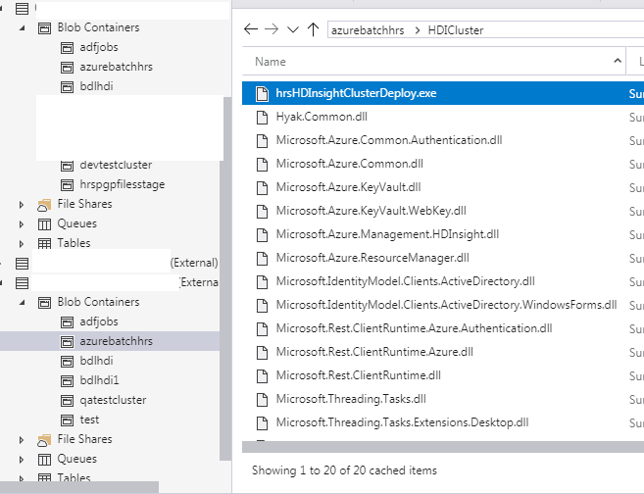
Azure Blob storage Container
C# Console application would be compiled to build executable and Dlls. Once the build/compile is completed, please upload Exe, All Dlls and Parameters.json file to the Blob container. The files in the Container would picked up by Batch Service in ADF through storage linked service pointing to the above container.

Slide 13
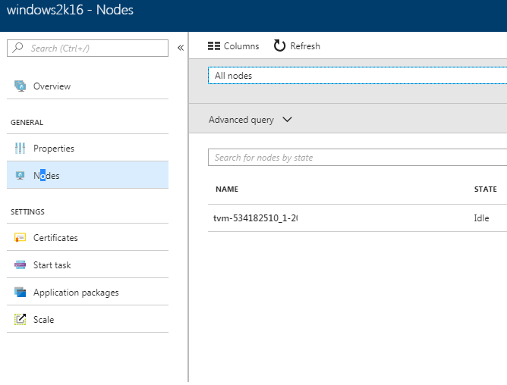
Batch Account
Please create the Batch account and Batch Pool. OS Should be Windows, as we are writing the C# console application, which would run only on Windows OS. Preferably Windows 2016 Server.
Batch pool consists of the node, to where ADF is going push the files from BLOB container to node and then get executed there.

Slide 14
Storage Linked Service
Create the storage linked service using the Storage name and Key to point to storage where we have executables, Dlls and Parameter Files.
Please note that we have compiled the C# Console application and it would create all the above mentioned file.
{
"name": "LS_Storage",
"properties": {
"type": "AzureStorage",
"typeProperties": {
"connectionString": {
"type": "SecureString",
"value": "**********"
}
}
}
}
Connection string contains the Storage name and storage Key.

Slide 15
Batch Linked Service
Create the batch Linked service to point to the batch pool where we have configured the node to execute our custom code.
{
"name": "AzureBatch",
"properties": {
"type": "AzureBatch",
"typeProperties": {
"accountName": “xxxxxxxxxxxxx",
"accessKey": {
"type": "SecureString",
"value": "**********"
},
"batchUri": "https://xxxxxxxxxx.northeurope.batch.azure.com",
"poolName": “xxxxxxxxxxxxxxxxxxxxxx",
"linkedServiceName": {
"referenceName": "LS_Storage",
"type": "LinkedServiceReference"
}
}
}
}

Slide 16
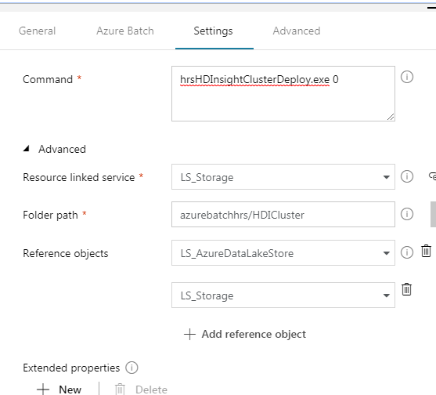
ADF Pipeline – Batch Service Custom Activity
Create the Custom activity and configure the properties as per below.
Azure Batch – Select the Linked Service that you created for the Batch.
Settings
Command - hrsHDInsightClusterDeploy.exe 0 ( 0 – create, 1- Delete)
Resource Linked Service – Select the Linked service for storage
FolderPath – Select the Blob container where we have Exe and other files
Reference Objects – We need to refer DataLakestore (for SPN) and Storage ( To have name and Key)

