Slide 1

Microservices
Overview –Decoupling of enterprises apps
Autor: Vipin Johar,
Solution Architect,
Droisys.
January 21, 2021
Ver 1.0

Slide 2
Agenda
Monolith Vs Microservice
Solution of challenges Microservices
Implementation idea Architecture
Benefits and Drawback
Is it future ?

Slide 3
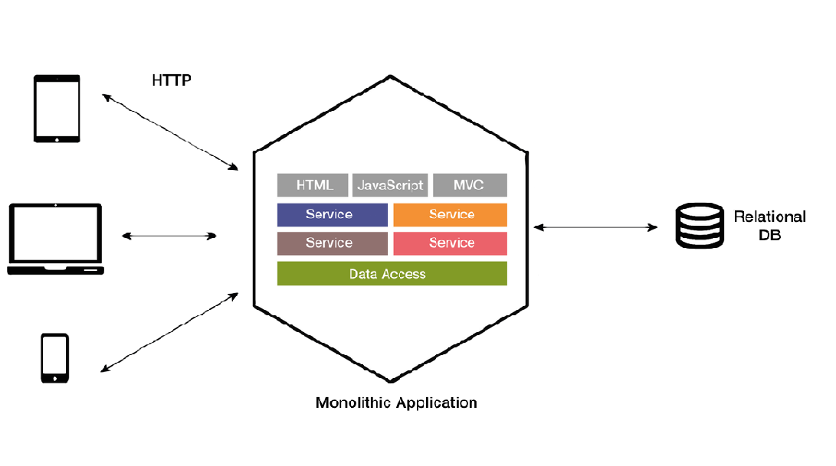
Legacy way to technical solution of business problem
Monolithic Architecture –Single logical executable
Successful app will grow, new components, features and scalability will be added on time.
Monolith application is built as a single, autonomous unit.
Every release for the new version will need more cautious development , regression testing, and deployment.
New developed feature may impact existing component , slow development and multiple rounds of testing.

Slide 4
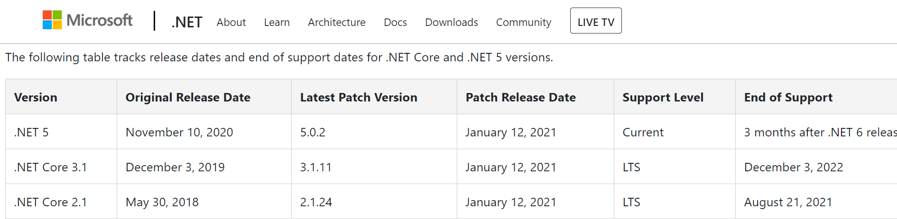
Challenges
Technology is changing and obsolete like never before.
Business must innovate faster, deliver software rapidly, frequently and reliably– Adaptation of CI/CD model
Amalgam of multiple technologies to minimize the limitations of a single programming language.
Versatility of data required different data storage techniques.
Discrete deployment for different component.

Slide 5
Solution-Microservices
“fine grained SOA”
Microservice Architectural style is an approach to developing a single application as a suite of small services, each running in its own process and communicating with the lightweight mechanism.
Brief
Solve the Challenges of monolith system by modular as much as possible.
Every service is built around business capabilities and independently deployable by capability automated deployment machinery –supporting CI/CD
Bare minimum of centralized management of these services.
Services used in a single application may have different technologies and data repos
Services communicate with each other via various protocol HTTP,TCP under choregraphed in REST

Slide 6
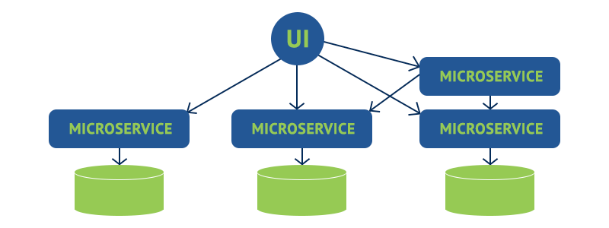
Architecture style of Microservices

Slide 7
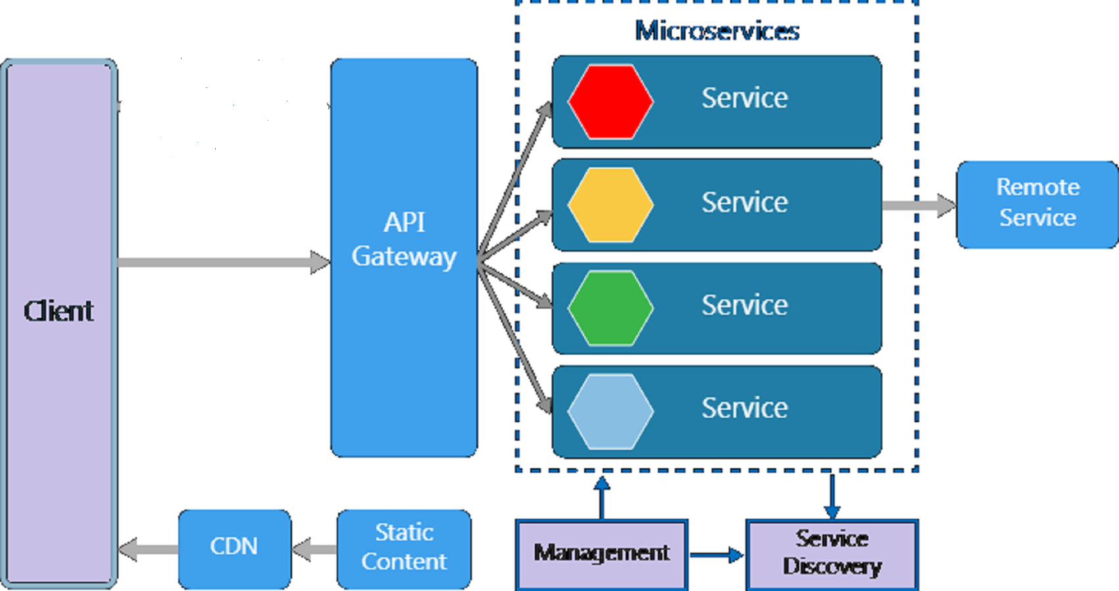
Loosely coupled components

Slide 8
Benefits Of Microservices
Simpler To Deploy | Deploy in literal pieces without affecting other services.
Simpler To Understand | Follow code easier since the function is isolated and less dependent.
Reusability Across Business | Share small services like payment or login systems across the business.
Faster Defect Isolation | When a test fails or service goes down, isolate it quickly with microservices.
Minimized Risk Of Change | Avoid locking in technologies or languages - change on the fly without risk.

Slide 9
Microservice != Silver bullet
All this benefits are free ?
No !
Good things comes along with some drawbacks also.

Slide 10
Solution comes with new issues-Drawbacks of Microservices
Having microservices architecture tends to expose communication, teamwork, and other problems that may have been previously implicit but are now forced out into the open.
The architecture brings additional complexity as the developers have to mitigate fault tolerance, network latency, and deal with a variety of message formats.
Being a distributed system, it can result in duplication of effort
When number of services increases, integration and managing whole products can become complicated
Developers have to put additional effort into implementing the mechanism of communication between the services
Handling use cases that span more than one service without using distributed transactions is not only tough but also requires communication and cooperation between different teams

Slide 11
Are Microservices the Future ?
In this cutting-edge technology era more and more companies are migrating their complete ecosystem from Monolith to Microservices and getting the benefit of rapid delivery to the end-users.
Below are few tech companies who migrated into the ecosystem of Microservices.
Netflix
Amazon
Guardian
Ebay
Uber
SoundCloud
Groupon
Twitter….

Slide 12
Thank You!

