Slide 1
MICROSERVICES

Slide 2
MOTIVATION FOR MICROSERVICES
Back in 2005, the applications for each of Expedia’s travel sites were too difficult to modify.
Don’t let this happen to you (any more)!
WHY?
Due to monolithic architecture.

Slide 3
MONOLITHIC ARCHITECTURE
A monolithic architecture is the traditional unified model for the design of a software program.
Monolithic software is designed to be self-contained; components of the program are interconnected and interdependent rather than loosely coupled as is the case with modular software programs. In a tightly-coupled architecture, each component and its associated components must be present in order for code to be executed or compiled.

Slide 4
SERVICE -ORIENTED ARCHITECTURE (SOA)
A service-oriented architecture is essentially a collection of services.
These services communicate with each other. The communication can involve either simple data passing or it could involve two or more services coordinating some activity.
Some means of connecting services to each other is needed.

Slide 5
MICROSERVICES
DEFINITION:
Microservice Architecture is a special design pattern of Service-oriented Architecture(SOA). In this type of service architecture, all the processes will communicate with each other with the smallest granularity to implement a big system or service.
It deals with system of services that communicate over a network.

Slide 6
COMPARING SOA WITH MICROSERVICES
EXAMPLE:
Let us consider on online CAB booking application. The software units if we want to build that application using:
SOA
GetPayments and DriverInformation and MappingDataAPI
AuthenticateUsers and DriversAPI
MICROSERVICES
SubmitPaymentService
GetDriverInfoService
GetMappingDataService
AuthenticateUserService
AuthenticateDriverService

Slide 7
COMPARING MONOLITHIC AND MICROSERVICES BLOCK DIAGRAM

Slide 8
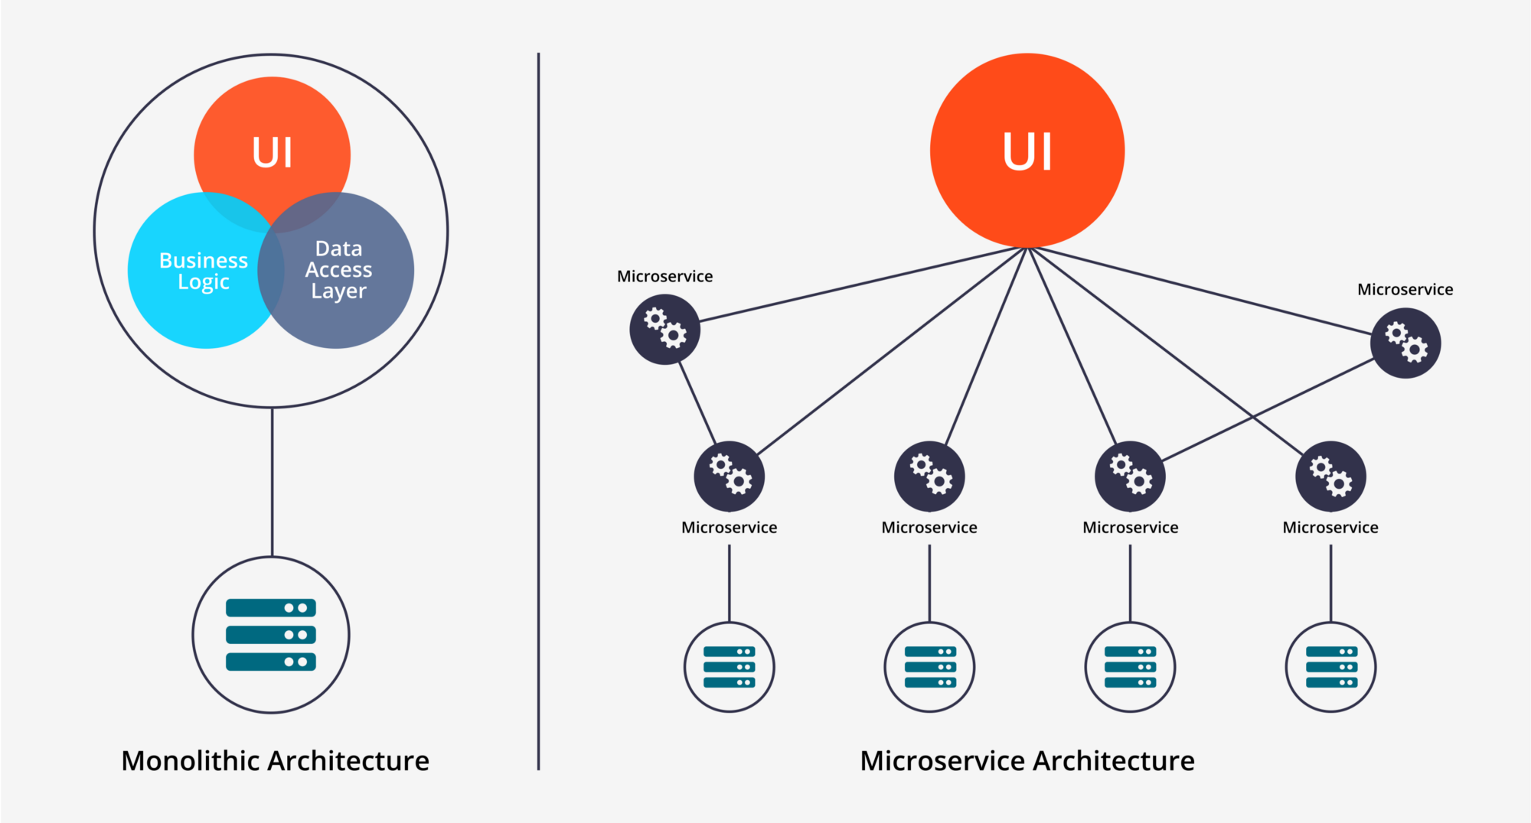

Slide 9
DISADVANTAGES OF MONOLITHIC ARCHITECTURE
Scalability:
To accommodate more customers, the instances of the same application need to be created, but the resources utilized in other services are wasted, since they don’t need have a need to scale. This leads to decrease in agility of application.
Fault tolerance:
When one component fails, the entire system goes down.

Slide 10
FEATURES OF MICROSERVICES
Open source methodology
Variant of SOA architectural style
Independent/componentization − Each microservice should be independently deployable.
Coupling − All microservices should be loosely coupled with one another such that changes in one will not affect the other.
Business capability − Focus on single capability
Autonomous − Teams work independently

Slide 11
ADVANTAGES OF MICROSERVICES
Autonomous (Independent)
Developed on its own timetable
Small in size
Focused
Technology heterogeneity (supports many languages and platforms)
Manages its own data
Higher Resilience
Easy deployment
Scales and fails independently (isolation of the problem)

Slide 12
DISADVANTAGES OF MICROSERVICES
Distributed system
Cost
Enterprise readiness

Slide 13
WHEN TO USE MICROSERVICE ARCHITECTURE ?
Need of scaling up and down
When every module needs to be handled individually.
Example: If one module, say PassengerManagement goes down, what would happen to other modules like Payments or DriverManagement, etc.

Slide 14
DESIGN AND DEVELOPMENT OF MICROSERVICES
Microservices Inter communication :
Lightweight protocols are used such as JSON or HTTP for REST and Kafka for Messaging.
Goal:
Decoupling of all the microservices. To achieve that,
Messaging is done wherever required.
Communication is done in a single language (language neutral) but services can be in different languages.

Slide 15
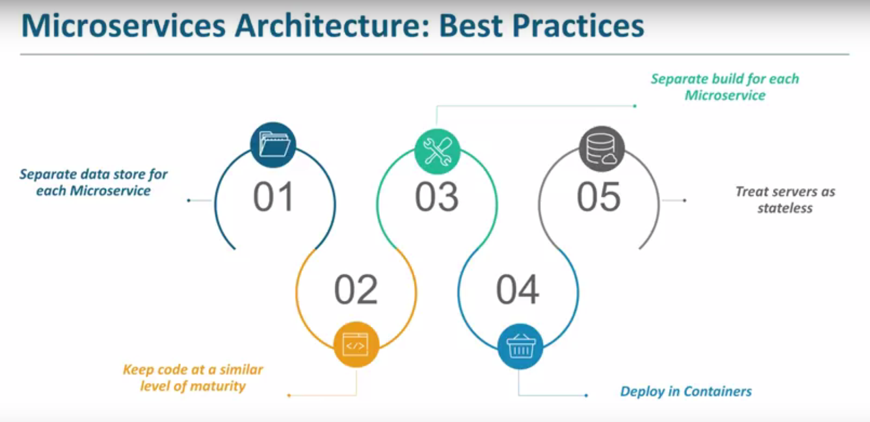
MICROSERVICES: BEST PRACTICES

Slide 16
OTHER ARCHITECTURES FOR S/W DEVELOPMENT
Client- Server Pattern
MVC Pattern
Peer- to- Peer Pattern
Master- Slave Pattern

Slide 17
WHAT’S BEYOND MICROSERVICES?

Slide 18
SERVERLESS ARCHITECTURE
Serverless architectures are application designs that incorporate third-party “Backend as a Service” (BaaS) services, and/or that include custom code run in managed, ephemeral containers on a “Functions as a Service” (FaaS) platform.

Slide 19
MICROSERVICES VS SERVERLESS

Slide 20
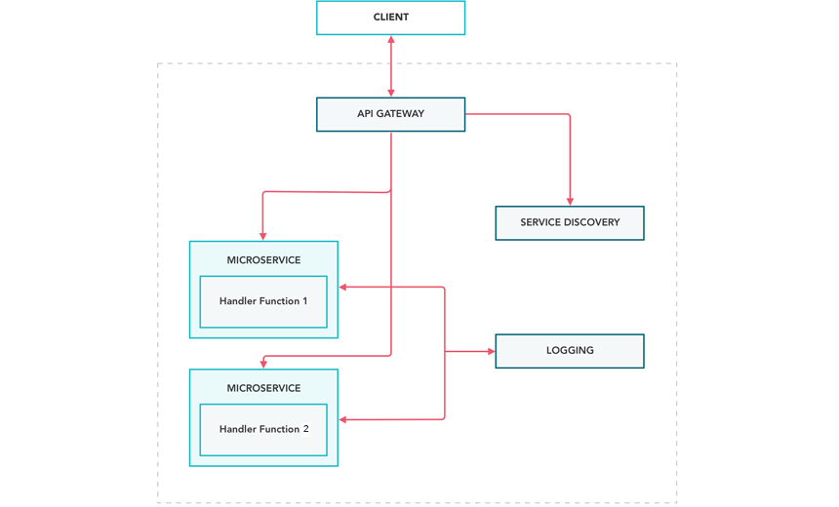
BLOCK DIAGRAM OF MICROSERVICES ARCHITECTURE

Slide 21
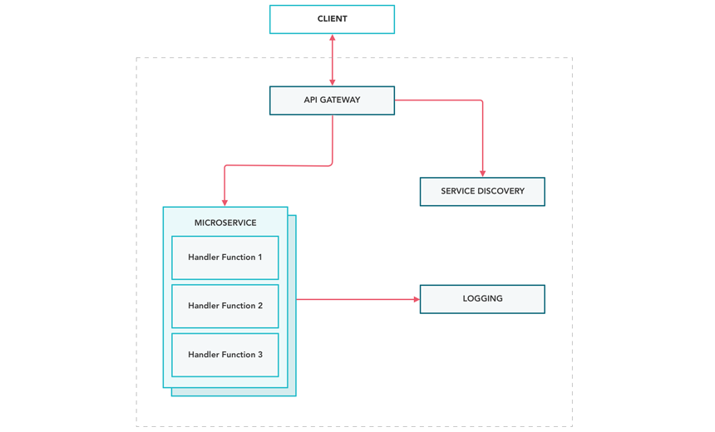
BLOCK DIAGRAM FOR SERVERLESS ARCHITECTURE

Slide 22
ADVANTAGES OF SERVERLESS
Deployment Simplicity
Scalability
Efficiency

Slide 23
DISADVANTAGES OF SERVERLESS
Complexity
Vendor lock- in
Flexibility
Tooling

Slide 24
SUMMARY
Monolithic
SOA
Microservices
Serverless

Slide 25
THANK YOU!

