Slide 1
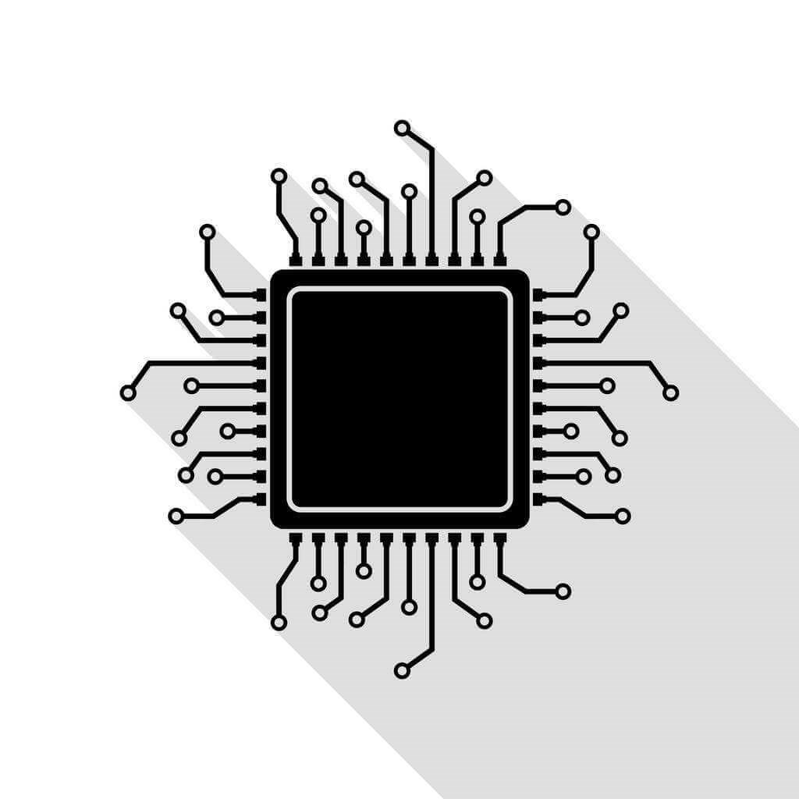
FPGA Programming

Slide 2
Programming
When you start using FPGAs, you will often come across the term FPGA programming
This nomenclature causes many misconception in the beginners
This gives a kind of feeling that FPGAs are some kind of processors since you are very familiar with the term programming associated with processors
But here what is happening is totally different

Slide 3
Processor Programming
Latch
0
2
4
6
8
10
12
14
16
18
20
0020H
XX
XX
XX
XX
0130H
Reg0
Reg1
Reg2
Reg3
Reset#
0240H
MUX
0350H
ALU
XX
F
1000H
Address Bus
1101H
Control logic
24XXH
Data Bus
XXXX
XXXX
PC
0
XXXX
CPU
XXXX
Memory

Slide 4
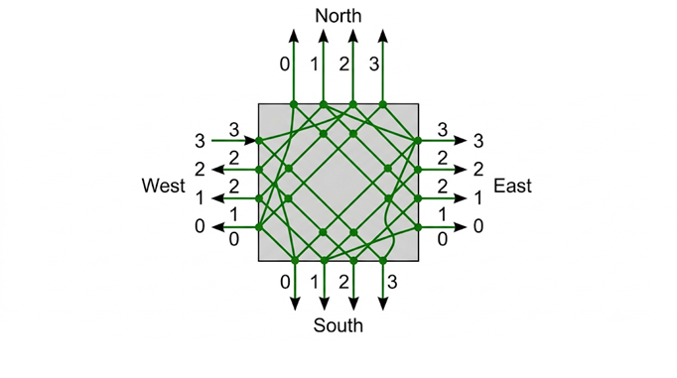
FPGA Programming
Remember the configuration options that we discussed in the introduction
0
0
0
1
LUT
I₀
FF
o
O
I₁

Slide 5
Bitstreams
An FPGA program contains all these configuration bits
This program is often called a bitstream or a bitfile
Conceptually you can think the FPGA is composed of 2 layers
One layer implementing all LUTs, FFs, SBs etc called logic layer
Another layer which stores all the configuration bits called the configuration memory
These two layers are connected and the behavior of logic layer is controlled by the configuration memory

Slide 6
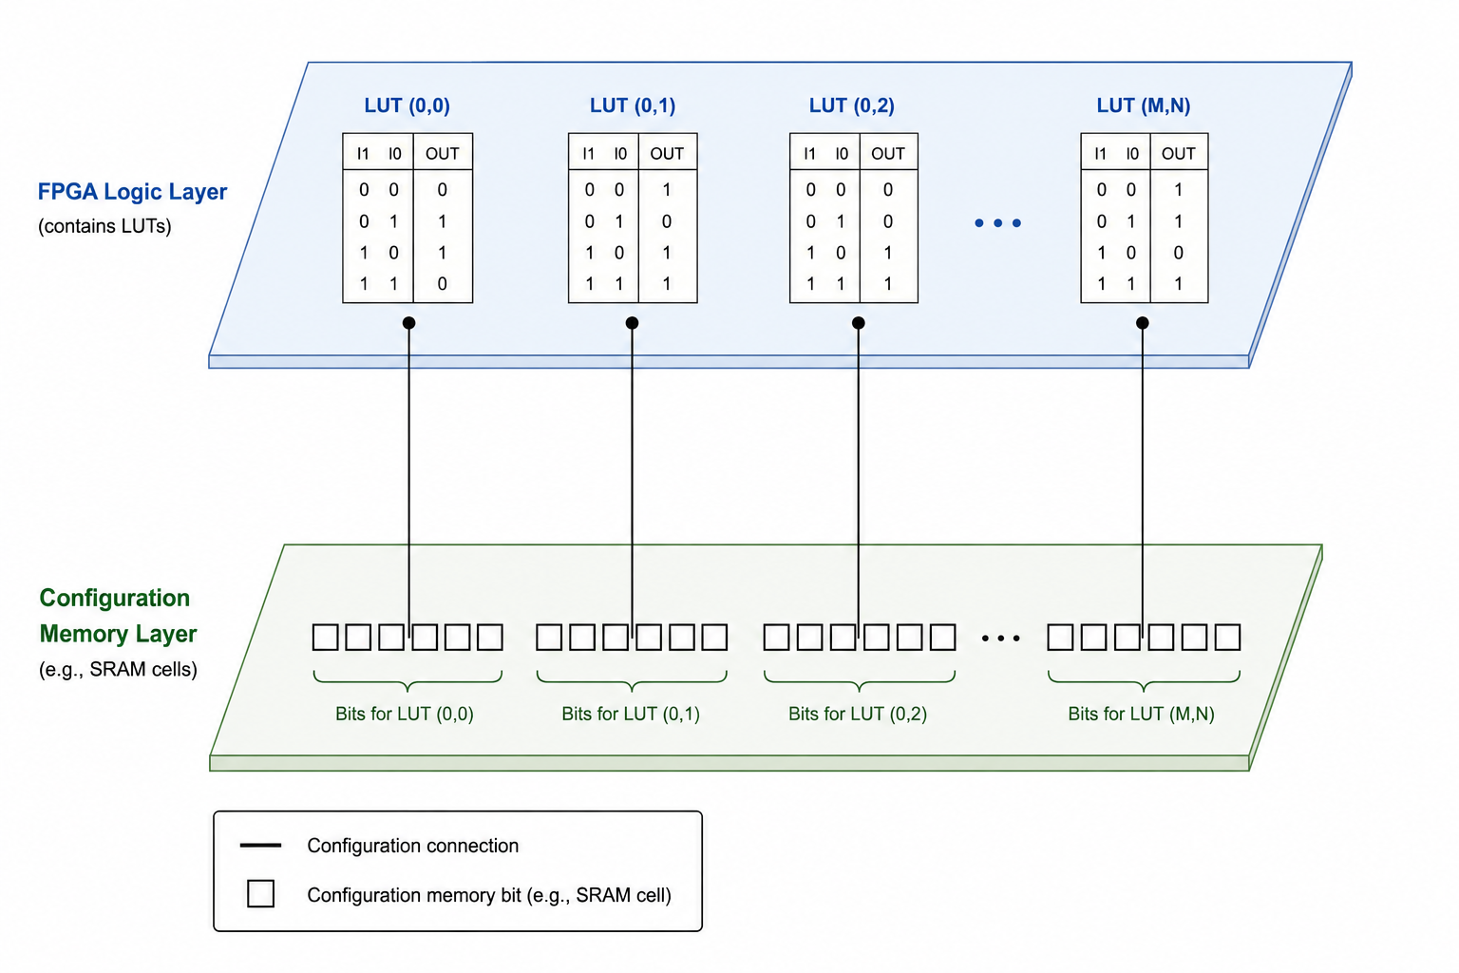
Configuration Memory
Logic Layer
Configuration Memory

Slide 7
Configuration Memory
For most of the FPGAs the configuration memory is built using SRAM cells
These SRAM cells do not store instructions, they store configuration bits that define logic functions and routing paths
Unlike processors, there are no instructions or instruction execution here
The entire FPGA logic operates concurrently
FPGAs directly realize hardware circuits rather than executing instructions

Slide 8
Firmware
In embedded industries this sometimes creates some confusion
For many hardware design is circuit design and their PCB implementation
Software is for processors
So many a times we find a middle ground and call FPGA designs as firmware designs

Slide 9
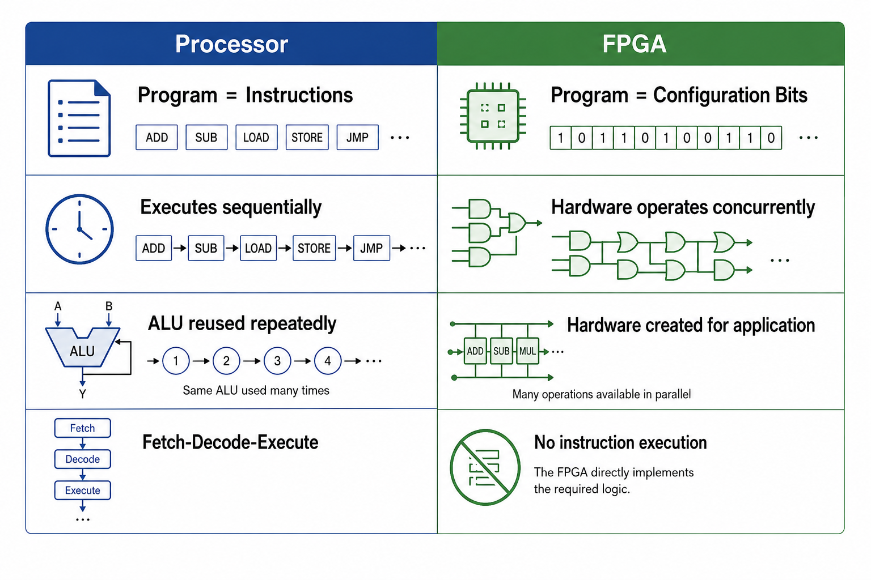
CPU vs FPGA Programming

Slide 10
FPGA Programming
Since the configuration memory is SRAM based, it is volatile → once power to the FPGA is lost, the contents are lost
During development we will use JTAG interface to program the FPGA with the bitstream
When going for production, the bitstream is stored in non-volatile memory (such as SPI flash) and loaded to FPGA at power on
There are FPGAs which configuration memory built using flash memory (less popular)
They don’t lose their configuration during power cycle
Very rarely antifuse-based FPGAs are also used, which are one time programmable (Microchip Radiation tolerant FPGAs)

Slide 11
Bitstream
One interesting feature of FPGA bitstream is its size is independent of the complexity of the circuit
It only depends on the FPGA part number
This makes sense since the bitstream always configures entire configuration memory
FPGA design software usually support bitstream compression which effectively reduces bitstream size depending on the circuit complexity
This helps in reducing the programming time and memory requirement for storing bitstream
The internal programming circuit of FPGAs handles the compressed bitstream to properly configure the entire memory

Slide 12
Key Takeaways
FPGA programming is fundamentally different from processor programming
A processor program consists of instructions that are executed sequentially
An FPGA program consists of configuration bits stored in configuration memory
Configuration bits define the behavior of LUTs, routing resources, and flip-flops
FPGAs implement hardware circuits directly rather than executing instructions
Hardware in an FPGA operates concurrently (in parallel)

