Slide 1
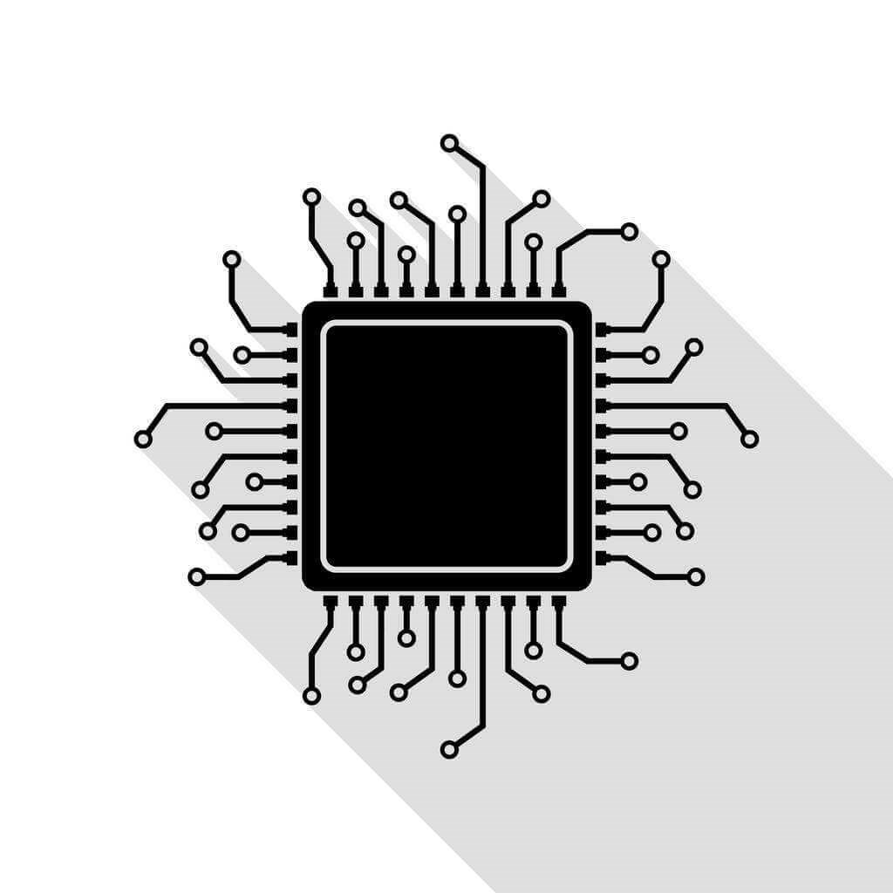
Introduction

Slide 2
Prerequisites
Basics of Digital Electronics
Verilog HDL
C programming

Slide 3
Where are FPGAs
https://www.amd.com/en/solutions/aerospace-and-defense/space.html
https://www.altera.com/fpga-solutions/aerospace-defense-government
https://www.latticesemi.com/en/Solutions/SolutionCategories/Automotive
https://www.microchip.com/en-us/products/fpgas-and-plds/radiation-tolerant-fpgas

Slide 4















Where are FPGAs

Slide 5
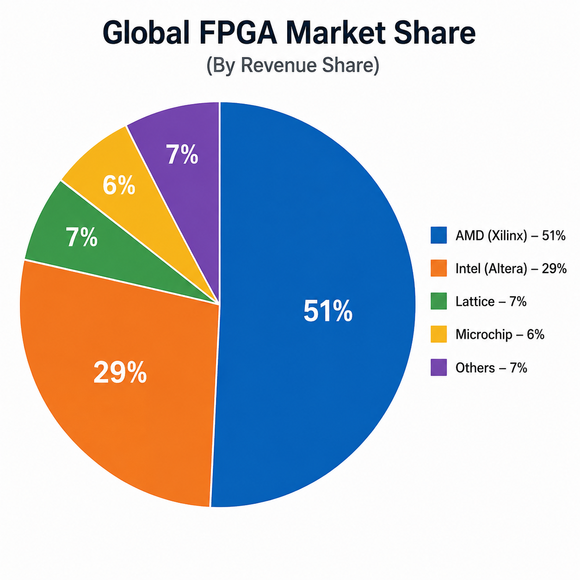
FPGA Market size
Global market size ~12B US$ (2025)
CAGR ~10.5 (2025-2030)
Design services ~2B US$
Microprocessor market size ~90B – 130B US$
Semiconductor industry ~700 B US$

Slide 6
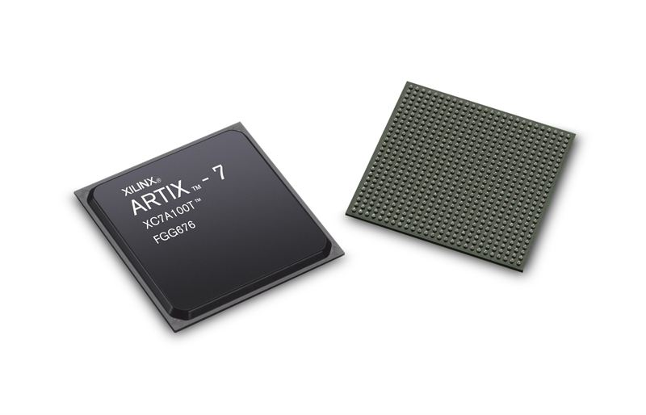
What are FPGAs
FPGAs are integrated circuits (ICs)
In principle, they can implement any digital circuit
Unlike conventional ICs, the final hardware logic is not fixed during manufacturing
Instead, it is configured later by the user
Hence Field-Programmable
The gate array part comes due to historical reasons

Slide 7
What are FPGAs
Programmable Logic Arrays (PLAs) were predecessor to FPGAs
They literally contained arrays of AND and OR logic gates
You can implement Boolean expressions in SoP format by blowing unwanted fuses
PLA (https://en.wikipedia.org/wiki/Programmable_logic_array)

Slide 8
What are FPGAs
F = AB’+BC
FPGAs do not have 2D array of discrete gates
It uses other building blocks arranged in 2D grid
But the general idea of generating different Boolean functions using flexible interconnect remains the same
Thus the name Gate Array
A B C
AB’
BC
F

Slide 9
FPGA Architecture
The fundamental idea behind FPGA architecture is ‘a memory with n inputs (address lines) can implement any n input Boolean expression’
I₀
O
I₁

Slide 10
FPGA Architecture
0
0
1
0
0
0
1
0
0
I₀
I₀
0
O
O
I₁
0
I₁
0
0
0
1
1
0
0
0
1
1
I₀
I₀
0
0
1
O
O
0
I₁
1
I₁
1

Slide 11
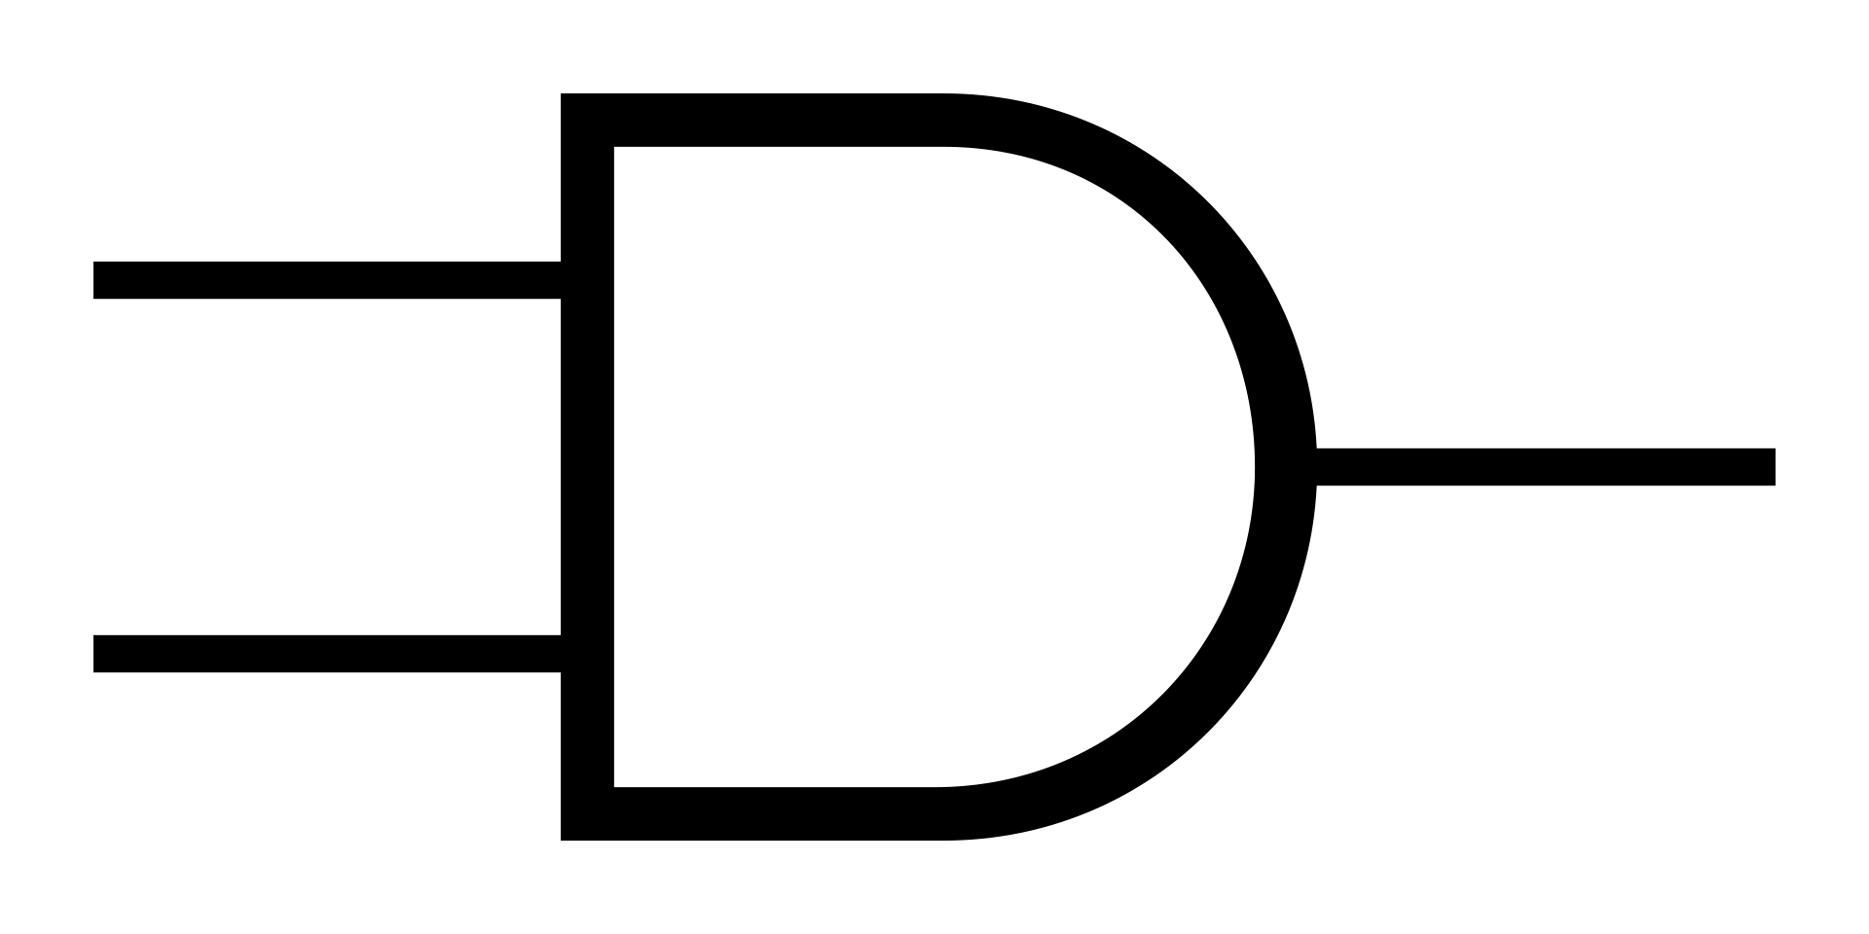
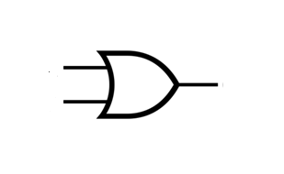

FPGA Architecture
0
0
0
1
I₀
O
I₁
0
1
1
1
I₀
O
I₁
1
1
0
1
F(A,B)=A→B
I₀
O
I₁

Slide 12
FPGA Architecture
We will call these small memory elements look-up table (LUTs)
They are one of the basic building blocks of all FPGAs
The size of the actual LUTs depend on the specific FPGA that you are using
For a long time LUTs used be 4 input one output (16-bit deep)
Most modern FPGAs use 6 input 2 output LUTs, which can be used either as a single 6 input 1 output LUT or two 5 input 1 output LUTs
Those finer architecture details we will see later

Slide 13
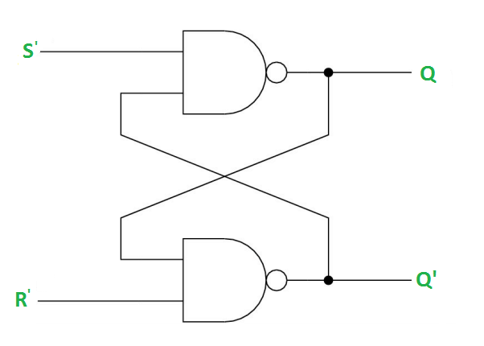
FPGA Architecture
Modern FPGAs contain a few thousand to millions of LUTs
As you can figure out, for implementing larger circuits (gate count), we need FPGAs with larger LUTs
But LUTs alone can implement only combinational circuits
You may argue since latches can be built using basic gates, same can be applied here and can build memory elements
SR latch (https://www.geeksforgeeks.org/digital-logic/latches-in-digital-logic/)

Slide 14
FPGA Architecture
It is a very bad idea for FPGA design to have such feedback loops(you will understand it as we progress)
The idea is so bad that the FPGA design tools will warn you about such loops (referred as combinational loops)
Still there are cases where you may use it to generate uncertainties (such as in design of random number generation)

Slide 15
FPGA Architecture
To implement sequential logic, FPGAs provide flip-flops (FFs)
Like LUTs, again there could be a few thousand to millions of flip-flops in an FPGA
Their smart arrangement allows implementing both combinational and sequential circuits
LUT
FF
o

Slide 16
FPGA Architecture
You should be now starting to appreciate the flexibility FPGAs provide
They allow to use same LUTs to implement different logic
They support combinational and sequential logic
In short, they are quite configurable
So let’s call this LUT+FF+Mux as configurable logic block (CLB) and now they will be acting as the basic building block of FPGA

Slide 17
FPGA Architecture
SB
CLB
SB
CLB
SB
CLB
SB
CLB
SB
CLB
SB
CLB
SB
CLB
SB
CLB
SB
CLB
SB
CLB
SB
CLB
SB
CLB

Slide 18
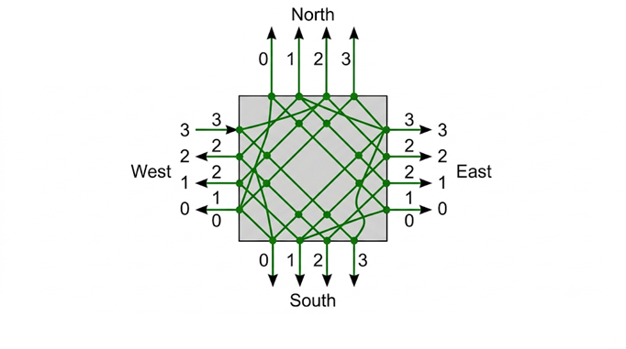
FPGA Architecture

Slide 19
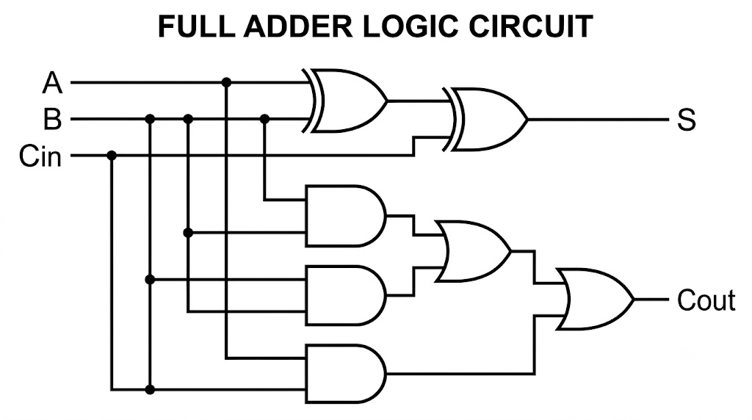
FPGA Architecture
SB
CLB
SB
CLB
SB
CLB
SB
CLB
SB
CLB
SB
CLB
SB
CLB
SB
CLB
SB
CLB
SB
CLB
SB
CLB
SB
CLB

Slide 20
FPGA Architecture
SB
CLB
SB
CLB
SB
CLB
SB
CLB
SB
CLB
SB
CLB
SB
CLB
SB
CLB
SB
CLB
SB
CLB
SB
CLB
SB
CLB

Slide 21
FPGA Architecture
SB
CLB
SB
CLB
SB
CLB
SB
CLB
SB
CLB
SB
CLB
SB
CLB
SB
CLB
SB
CLB
SB
CLB
SB
CLB
SB
CLB

Slide 22
FPGA Architecture
SB
CLB
SB
CLB
SB
CLB
SB
CLB
SB
CLB
SB
CLB
SB
CLB
SB
CLB
SB
CLB
SB
CLB
SB
CLB
SB
CLB

Slide 23
FPGA Architecture
SB
CLB
SB
CLB
SB
CLB
SB
CLB
SB
CLB
SB
CLB
SB
CLB
SB
CLB
SB
CLB
SB
CLB
SB
CLB
SB
CLB

Slide 24
FPGA Architecture
SB
CLB
SB
CLB
SB
CLB
SB
CLB
SB
CLB
SB
CLB
SB
CLB
SB
CLB
SB
CLB
SB
CLB
SB
CLB
SB
CLB

Slide 25
Key Takeaways
FPGA = Field Programmable Gate Array
Hardware functionality is configured after manufacturing
Can implement any digital circuit (provided enough LUTs and FFs)
LUTs implement combinational logic
Flip-Flops (FFs) implement sequential logic
LUT + FF + Routing form the basis of FPGA architecture
FPGA consists of thousands to millions of CLBs, Switch Boxes, Routing Resources
They provide Massive parallelism and reconfigurable hardware

