Slide 1

Apache Kafka

Slide 2
Agenda
Introduction
Concepts
Installation/Setup
Integration of Kafka with SpringBoot

Slide 3
Introduction
Kafka is a distributed event streaming platform that lets you read, write, store, and process events (also called records or messages in the documentation) across many machines.
These events are organized and stored in topics. Very simplified, a topic is similar to a folder in a filesystem, and the events are the files in that folder.

Slide 4
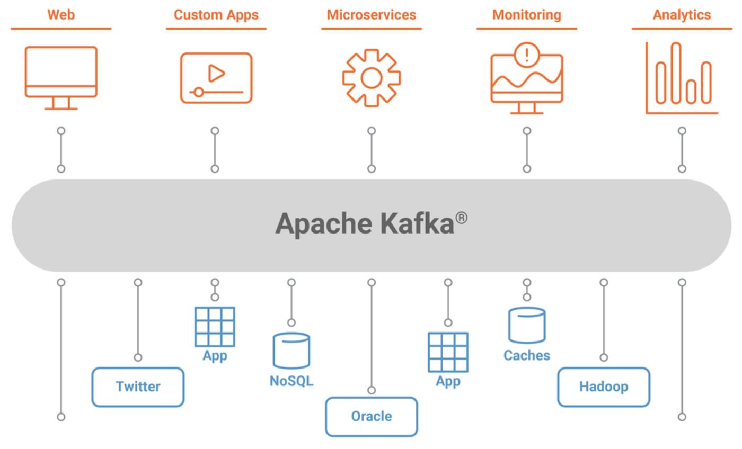

Slide 5
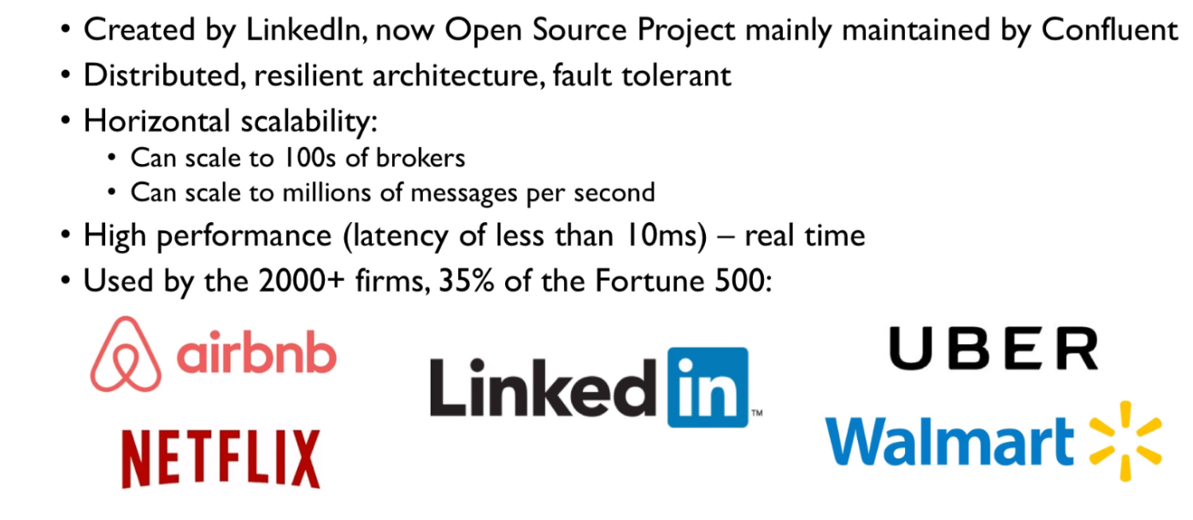
Why Apache Kafka

Slide 6
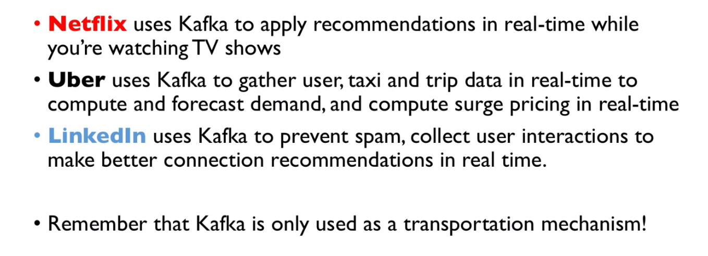
Example of Kafka

Slide 7
Core Components of Kafka
Records/Messages: Data is stored in the form of key value pair with time stamp which is called Record. Kafka Records are immutable.
{
"level" : "ERROR",
"message" : "NullPointerException"
}
Topic: Topics are a stream of records and are subscribed to by multiple consumers. It’s the highest level of abstraction that Kafka provides.
Topics in Kafka are always multi-producer and multi-subscriber: a topic can have zero, one, or many producers that write events to it, as well as zero, one, or many consumers that subscribe to these events.
Partition (A Structured commit log): It’s an ordered, immutable sequence of messages that are continually appended to. It can’t be divided across brokers or even disks. The memory needs to be contiguous. The records in the partitions are each assigned a sequential id number called the offset that uniquely identifies each record within the partition.

Slide 8
Core Concepts of Kafka
Producer: Kafka producers send records to topics. The records are sometimes referred to as messages. Also Responsible for which partition message will go.
a. No Key Specific :- When no key is specified in the message the producer will randomly decide partition and would try to balance the total number of messages on all partitions
b. Key Specified :- When a key is specified with the message, then the producer uses Consistent Hashing to map the key to a partition.
“bin/kafka-console-producer.sh --topic quickstart --bootstrap-server localhost:9092 –property keyName”
c. Partition Specified :- We can specify the partition

Slide 9
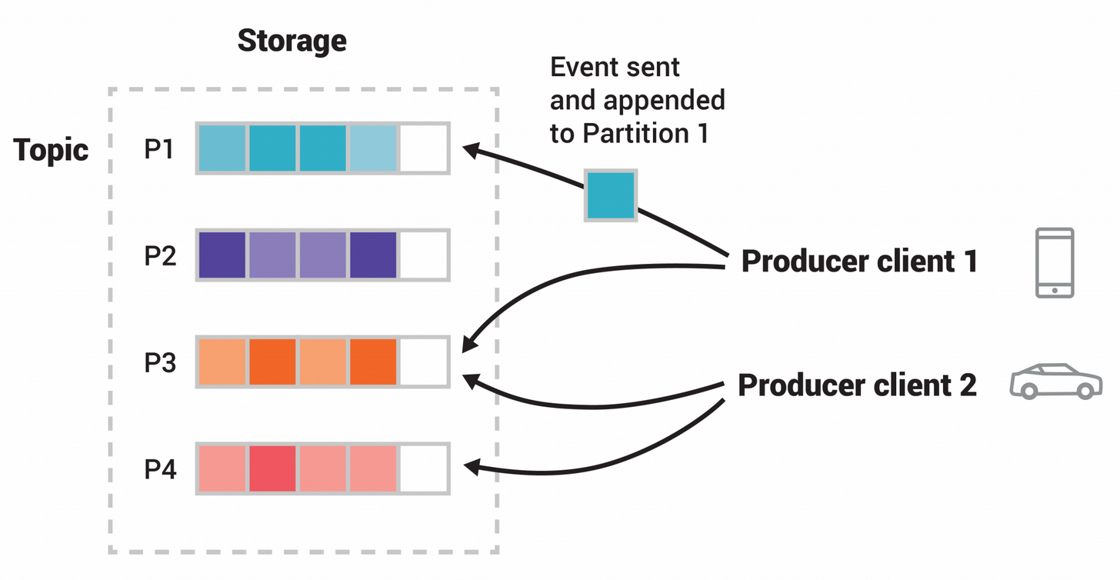
Core Concepts of Kafka

Slide 10
Core concepts of Kafka
Consumer : Kafka consumers read from Topics. Kafka consumer maintains the partition offset to consume messages or data from topic, since Kafka brokers are stateless. The consumers can rewind or skip to any point in a partition simply by supplying an offset value.
Consumers Group : Multiple consumers who are interested in the same topic join to form a Consumer group which is uniquely identified by group.id. Each consumer group is a subscriber to one or more topics and maintains its offset per topic.

Slide 11
Core Concept of Kafka
Broker: A broker is a single Kafka server. Brokers receive messages from producers, assigns offset to them, and then commit them to the partition log, which is basically writing data to disk, and this gives Kafka its durable nature.
Cluster: A Kafka cluster is a group of broker nodes working together to provide, scalability, availability, and fault tolerance. One of the brokers in a cluster works as the Controller, which basically assigns partitions to brokers, monitors for broker failure to do certain administrative stuff
In a cluster, partitions are replicated on multiple brokers depending on the replication factor of the topic to have failover capability
Zookeeper: Kafka does not function without zookeeper( at least for now, they have plans to deprecate zookeeper in near future). Zookeeper works as the central configuration and consensus management system for Kafka. It tracks the brokers, topics, and partition assignment, leader election, basically all the metadata about the cluster.

Slide 12
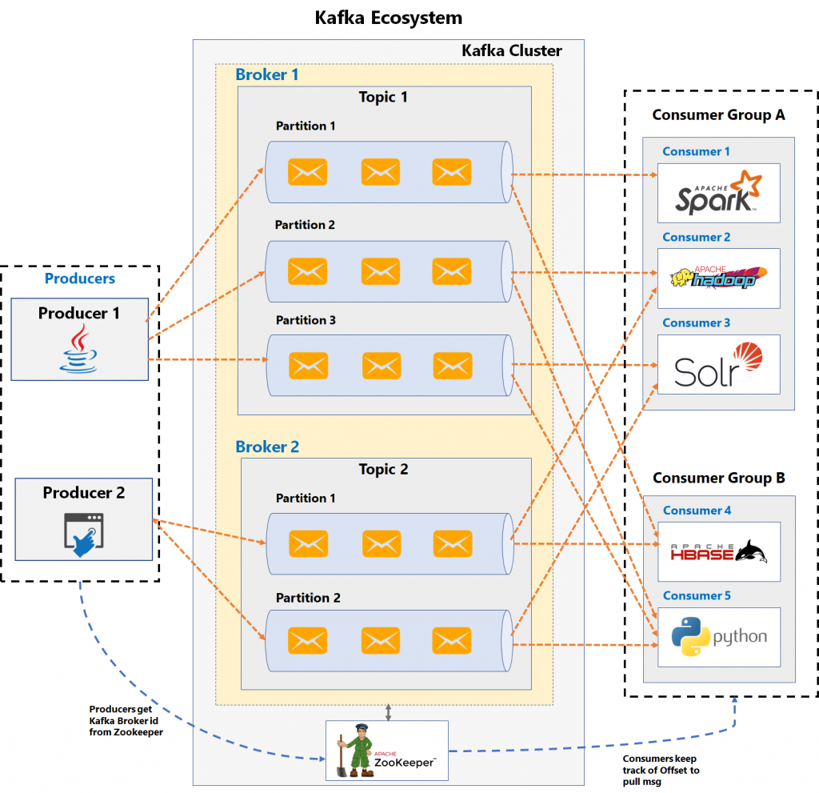

Slide 13
Thank You

