Slide 1
Deployment Strategies
A deployment strategy determines the deployment process, and is defined by the deployment configuration. Each application has different requirements for availability (and other considerations) during deployments. OpenShift Container Platform provides strategies to support a variety of deployment scenarios.
A deployment strategy uses readiness checks to determine if a new pod is ready for use. If a readiness check fails, the deployment configuration will retry to run the pod until it times out. The default timeout is 10m, a value set in TimeoutSeconds in dc.spec.strategy.*params

Slide 2
Rolling Strategy
A rolling deployment slowly replaces instances of the previous version of an application with instances of the new version of the application. A rolling deployment typically waits for new pods to become ready via a readiness check before scaling down the old components. If a significant issue occurs, the rolling deployment can be aborted.
When you want to take no downtime during an application update.
When your application supports having old code and new code running at the same time.

Slide 3
Recreate Strategy
The Recreate strategy has basic rollout behavior and supports lifecycle hooks for injecting code into the deployment process.
When you must run migrations or other data transformations before your new code starts.
When you do not support having new and old versions of your application code running at the same time.
When you want to use a RWO volume, which is not supported being shared between multiple replicas.
A recreate deployment incurs downtime because, for a brief period, no instances of your application are running. However, your old code and new code do not run at the same time.

Slide 4
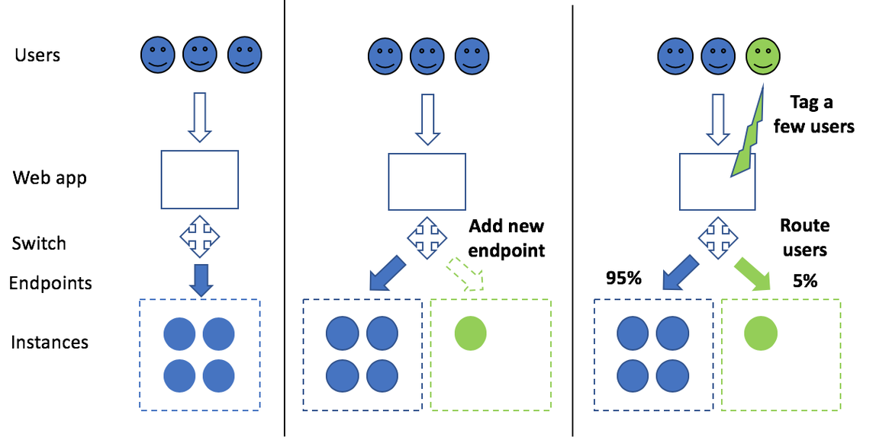
Canary Deployment

Slide 5
Blue-Green Deployment
Blue-green deployments involve running two versions of an application at the same time and moving production traffic from the old version to the new version. There are several ways to implement a blue-green deployment in OpenShift Container Platform.
Use a blue-green deployment when you want to test a new version of your application in a production environment before moving traffic to it.
Blue-green deployments make switching between two different versions of your application easy.

Slide 6
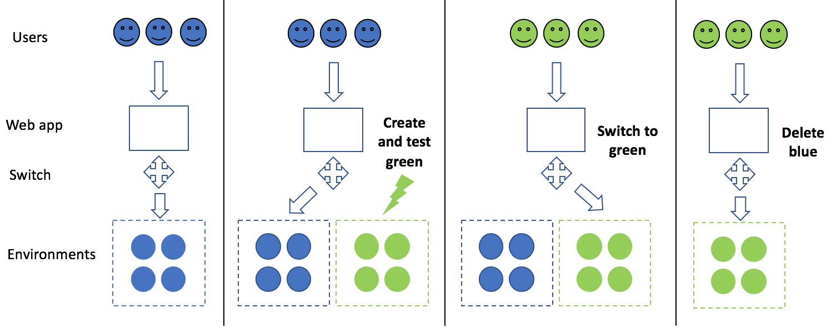

Slide 7
A/B Deployment
A/B deployments generally imply running two (or more) versions of the application code or application configuration at the same time for testing or experimentation purposes.
The simplest form of an A/B deployment is to divide production traffic between two or more distinct shards — a single group of instances with homogeneous configuration and code.
When you want to test multiple versions of code or configuration, but are not planning to roll one out in preference to the other.
When you want to have different configuration in different regions.

Slide 8
Installing Jenkins on OpenShift for Continous Integration and Deployment
1. oc new-app jenkins-persistent --param MEMORY_LIMIT=2Gi --param DISABLE_ADMINISTRATIVE_MONITORS=true --param ENABLE_OAUTH=true –as-deployment-config=true

Slide 9
Sample Jenkins Pipeline
node {
stage('Build Tasks') {
openshift.withCluster() {
openshift.withProject("nameSpace") {
openshift.selector("bc", "buildConfigName").startBuild("--wait=true")
}
}
}
stage('Tag Image') {
openshift.withCluster() {
openshift.withProject("nameSpace") {
openshift.tag("DCConfigName:latest", "springbootgit:${BUILD_NUMBER}")
}
}
}
stage('Deploy new image') {
openshift.withCluster() {
openshift.withProject("nameSpace") {
openshift.selector("dc", "DCConfigName").rollout().latest();
}
}
}
}

