Slide 1
SURICATA with DPDK & HW offload – session-1
How to run smartly for IDS|IPS on edge, cloud or bare metal for performance and efficiency?
Presented by
Vipin Varghese

Slide 2
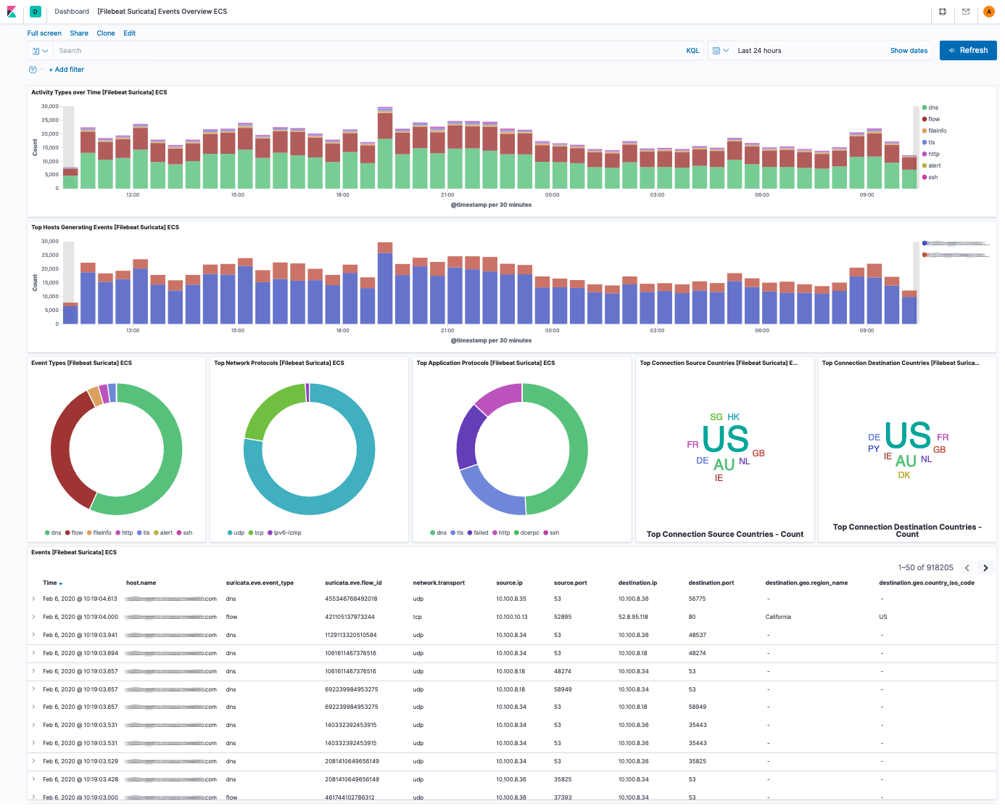
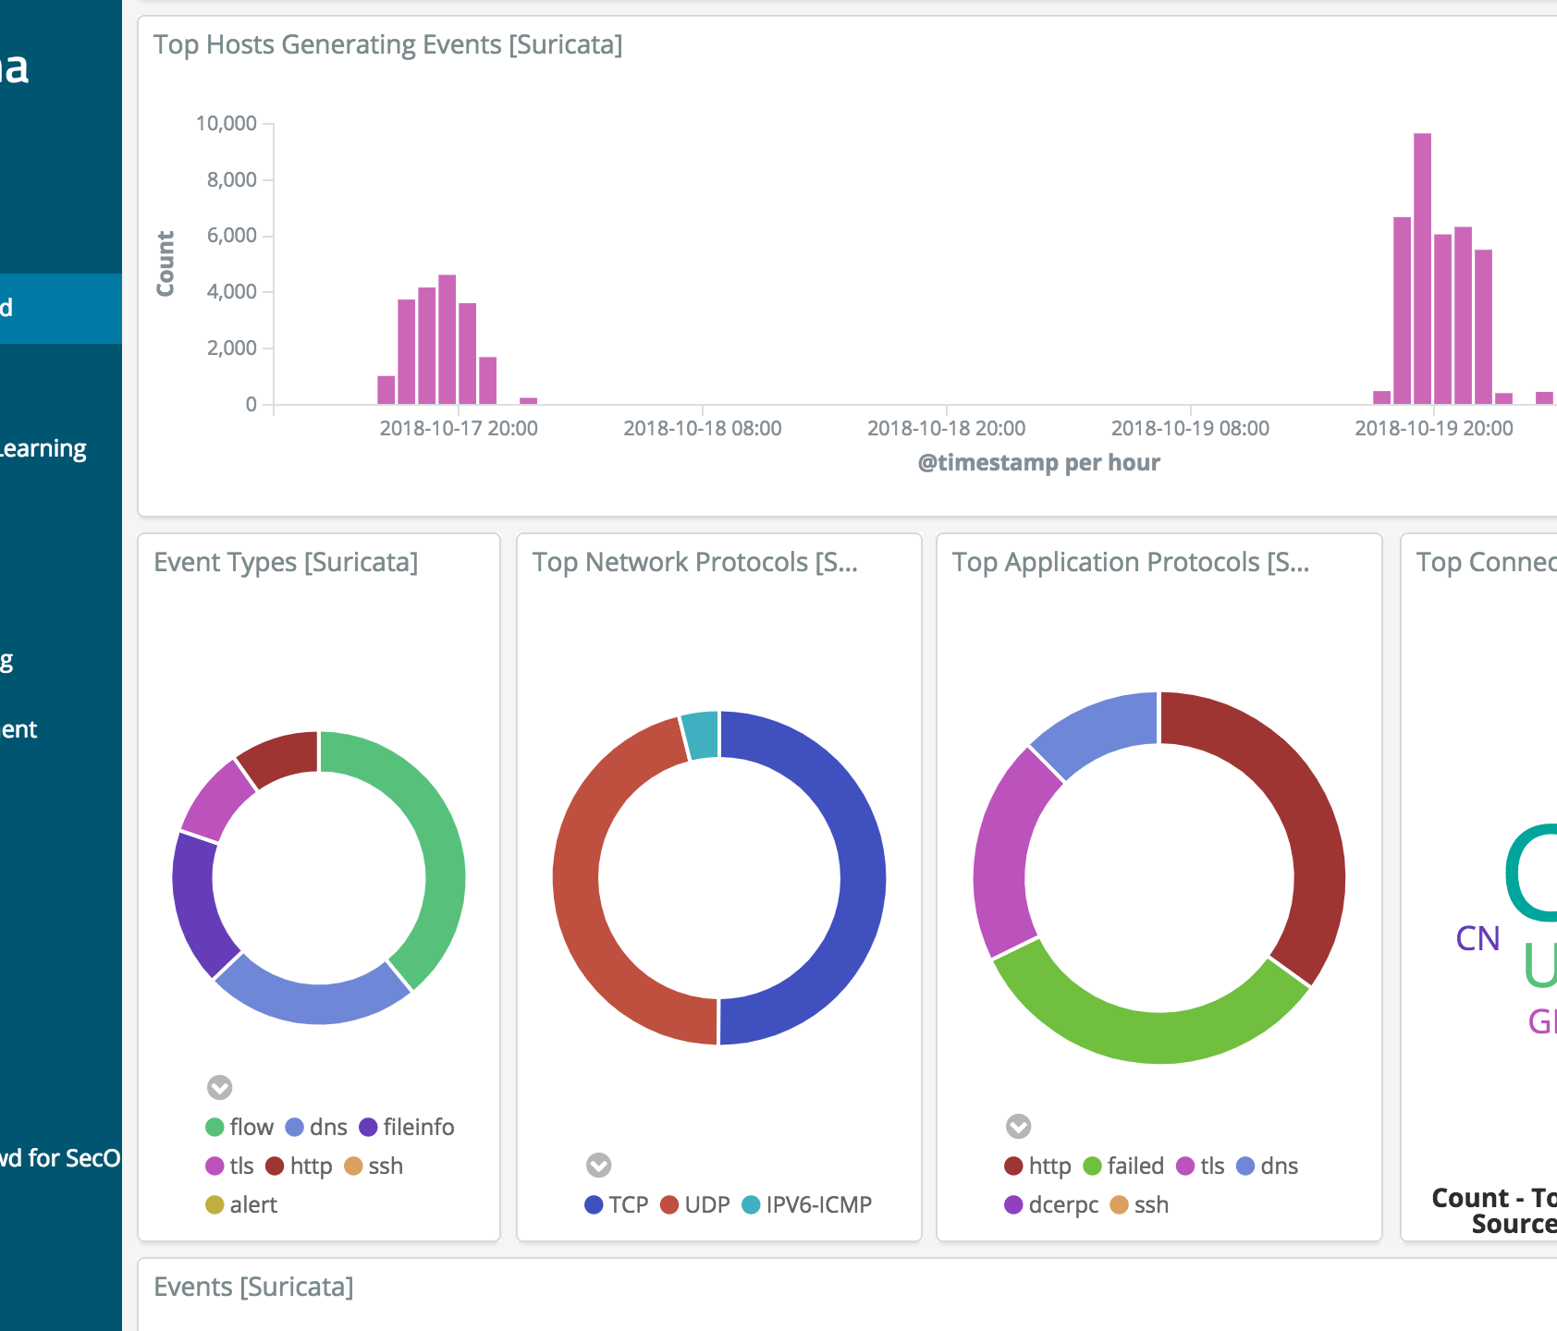
What is Firewall for us!

Slide 3
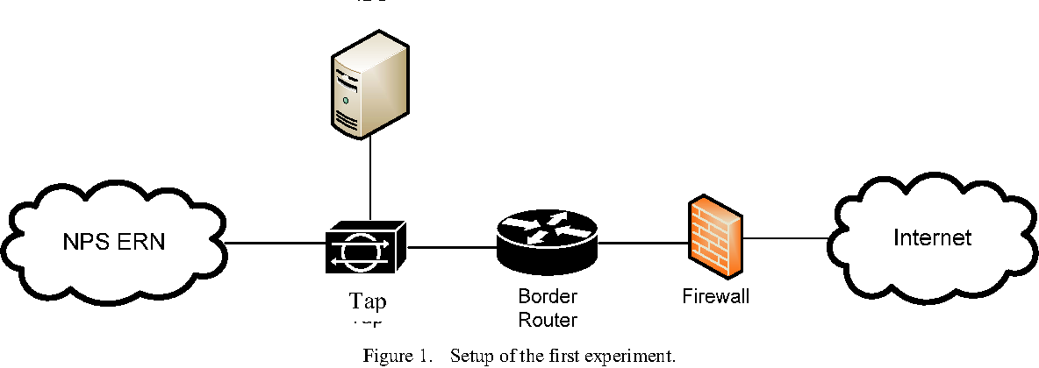
How does it work today?

Slide 4
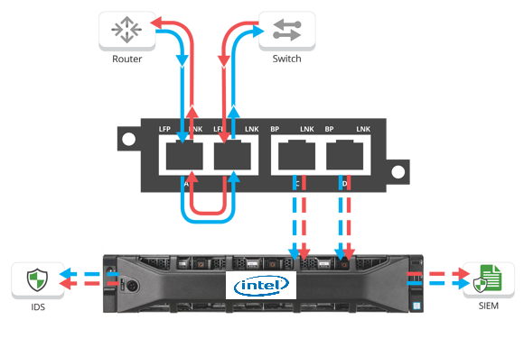
Create TAP allow mirroring of packets from desired direction Ingress/Egress
In case of IDS mirror traffic.
In case of IPS redirect to Inspection Engine
In case of BYPASS, simply allow port Forwarding

Slide 5
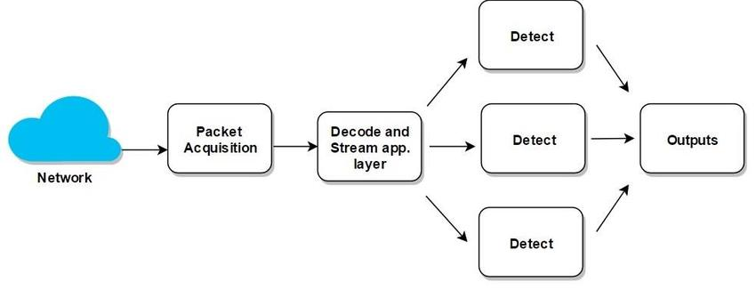
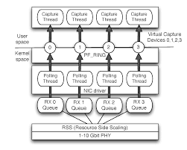
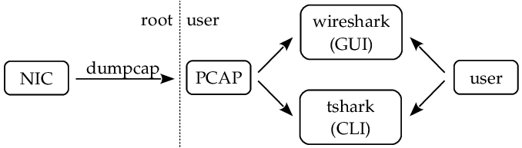
Capture methods

Slide 6
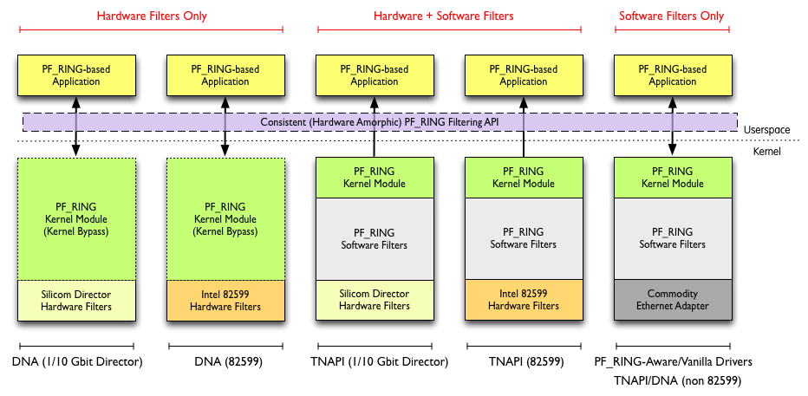
ALTERNATIVE APPROACHES?
PF_RING alternative with HW or SW offload.
Similar functionality can be achieved with XDP and eBPF.

Slide 7
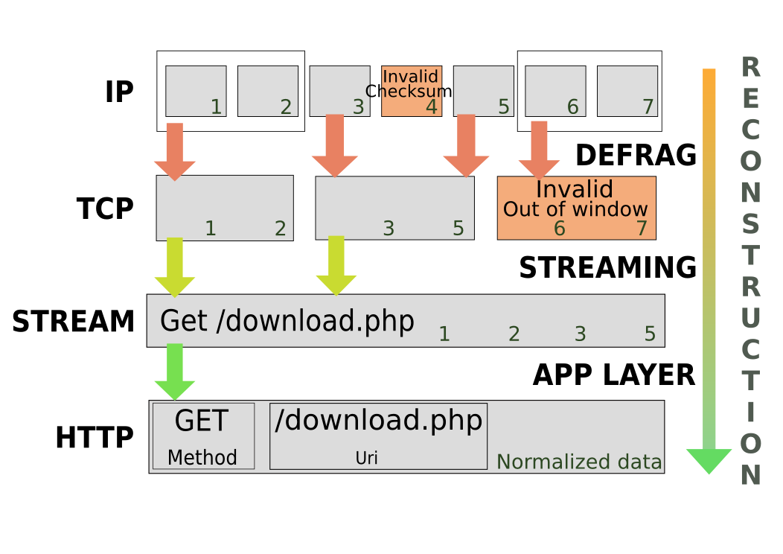

Slide 8
Offload Suricata to HW

Slide 9


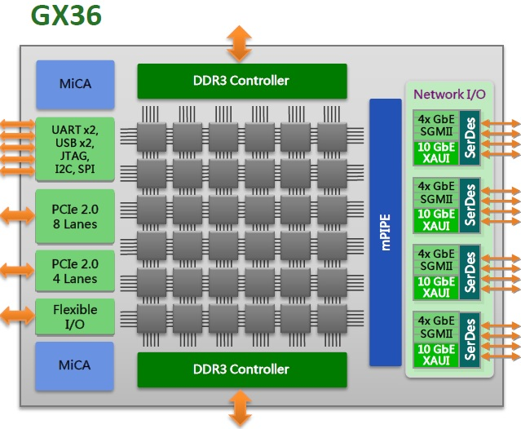


SSL Inspection with IPS-IDS
Suricata running IPS/IDS mode on Xeon (2P)
Tilera Gx36/72 running proxy SSL for intercepting and decoding frames for interested connection.
LAN: client side
WAN: server side
3

Slide 10
Local bypass
The concept of local bypass is simple: Suricata reads a packet, decodes it, checks it in the flow table. If the corresponding flow is local bypassed then it simply skips all streaming, detection and output and the packet goes directly out in IDS mode and to verdict in IPS mode.
Once a flow has been local bypassed it is applied a specific timeout strategy. Idea is that we can't handle cleanly the end of the flow as we are not doing the streaming reassembly anymore. So Suricata can just timeout the flow when seeing no packets. As the flow is supposed to be really alive we can set a timeout which is shorter than the established timeout. That's why the default value is equal to the emergency established timeout value.
Suricata is now implementing two bypass methods:
A suricata only bypass called local bypass
A capture handled bypass called capture bypass
The idea is simply to stop treating packets of a flow that we don't want to inspect anymore as fast as possible. Local bypass is doing it internally and capture bypass is using the capture method to do so.
Test with iperf on localhost with a MTU of 1500:
standard IPS mode: 669Mbps
IPS with local bypass: 899Mbps
IPS with NFQ bypass: 39 Gbps

Slide 11
Capture bypass
In capture bypass, when Suricata decides to bypass it calls a function provided by the capture method to declare the bypass in the capture. For NFQ this is a simple mark that will be used by the ruleset. For AF_PACKET this will be a call to add an element in an eBPF hash table stored in kernel.
If the call to capture bypass is successful, then we set a short timeout on the flow to let time of already queued packets to get out of suricata without creating a new entry and once timeout is reached we remove the flow from the table and log the entry.
If the call to capture bypass is not successful then we switch to local bypass.
The difference between local and capture bypass
When Suricata is used with capture methods that do not offer the bypass functionality of eBPF/NFQ mark - pcap, netmap, pfring - it will switch to local bypass mode. Bypass is available for Suricata's IDS/IPS and NSM modes alike.
Handling capture bypass failure
Due to misconfiguration or to other unknown problems it is possible that a capture bypassed flow is sending us packets. In that case, suricata is switching back the flow to local bypass so we handle it more correctly.

Slide 12
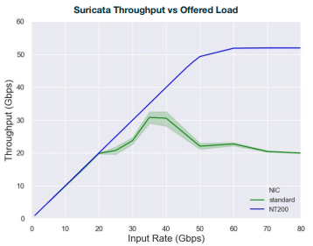
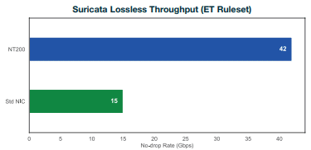
AutoFP mode (Speedup <= 1.13)
Trivial to no speedup with increased number of PAQ or decoder threads.
Exhibits linear CPU usage increase, however, by wasting most of CPU cycles in polling.
Workers mode (Speedup <= 1.28)
Exhibits worse performance than AutoFP mode but uses less resource.
Hardly uses more than two CPU cores due to mutex contention.
And neither modes scale to the number of NICs.
The multi-thread design does not give Suricata the scalability it wants. To improve performance, redesigning and benchmarking a new thread model is imperative and contentions must be reduced by as much as possible.

Slide 13
Actual Facts

Slide 14
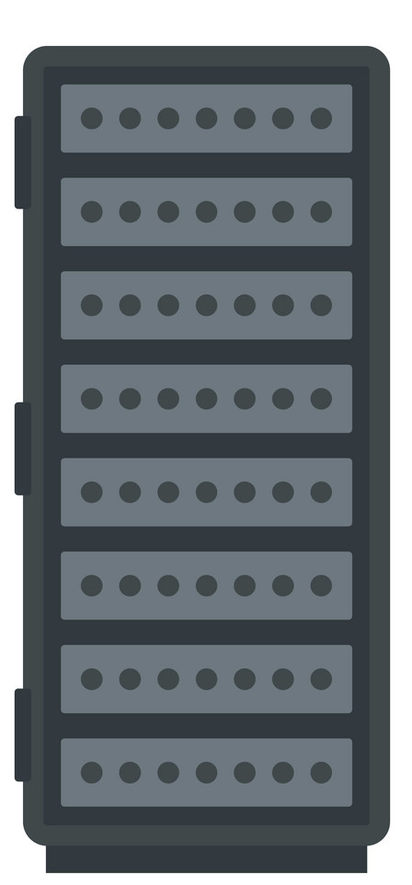
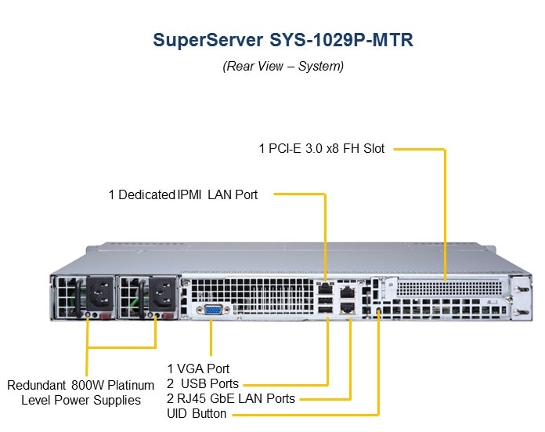
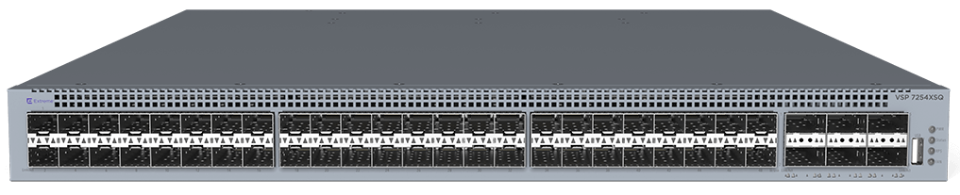

Slide 15
TCO for Infrastructure workload
Category | (2 NUMA) Cores | Power | Performance | Price | Operational Cost
Foundational NIC | 16C/32T | 30W * 2 | 50G*2 | 350$ * 2 | NIL
Smart NIC (Mellanox) | 4C/8T + 1C | 65W * 2 | 50G * 2 | 2500$ * 2 | Maintenance/programming
FPGA (Vista Creek) | 4C/8T + 1C | 95W * 2 | 25G * 2 | 2000$ * 2 | OVS RTL template from Intel
Foundational NIC + COF | NIL | 30W * 2 + 75W | 50G * 2 | 350$ * 2 + 500$ (TBD) | NIL
SNR as COF can run parallel function on Tremont cores too**
Notes:
Functional OVS on
Xeon
P4/eBPF
RTL
COF

Slide 16
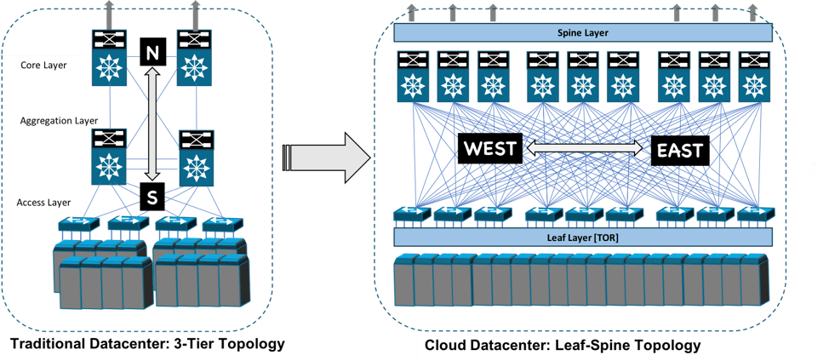
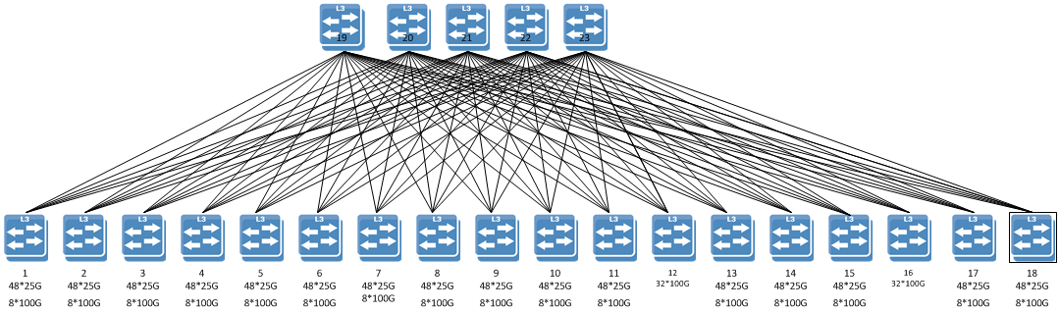
Better fabric performance through ECMP tuning
Non-disruptive failover
Hitless upgrades
Automated provisioning
Stretching VLANS & multi-tenant security
Simple IP Mobility
Decrease optics spend
Eliminate licenses for basic features

Slide 17
Typical Customer Usage Model
Networking Infrastructure overheads consume cores; loss of service revenue.
Foundational NIC doesn't support stateful offload and cross UPI flow, affecting performance and negate the DDIO
TOR traffic – intf-0
TOR traffic – intf-1
Foundational-0
Foundational-1
PCIe
PCIe
Accelerator-0
Accelerator-1
UPI|QPI
NUMA-0
NUMA-1
Notes:
https://www.microsoft.com/en-us/research/uploads/prod/2018/03/Azure_SmartNIC_NSDI_2018.pdf
https://www.silicom.dk/product-details/packetmover-fpga-acceleration/

Slide 18
Typical Customer Usage Model (smart-NIC)
limited programming and only few stateful functions offload
Doesn't solve cross NUMA flows problem*
Mellanox is leading in smartNIC and takes away the foundational NIC play
TOR traffic – intf-0
TOR traffic – intf-1
Smart NIC-0
Smart NIC-1
PCIe
PCIe
Accelerator-0
Accelerator-1
UPI|QPI
NUMA-0
NUMA-1
*Multi-host solves with additional PCIe lanes
Notes:
https://www.microsoft.com/en-us/research/uploads/prod/2018/03/Azure_SmartNIC_NSDI_2018.pdf
https://www.silicom.dk/product-details/packetmover-fpga-acceleration/

Slide 19
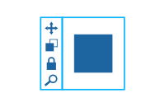
DDoS – 20G Usage
2 thread for Management
Infrastructure
ECMP ingress to Core pinning
Geo Tagging based Flow segregation
Ingress-Egress Rate limit
Transport and Service Layer
Tunnel Termination
Reassembly
Flow Pinning – TCP/UDP
SSL decrypt
Specific
Packet-Flow Inspection
Regex on clear text
Deep Packet Inspection
Admission Control
ADMINISTRATION
12 Threads
RX + RSS Pipeline: 6
Admission Control + Geo Tagging : 4
Ingress + Egress Rate Limiters: 2
6 Threads
Reassembly: 2
Flow Pinning : 4
4 Threads
Regex: 4
Packet Inspection: 0
Notes:
https://www.microsoft.com/en-us/research/uploads/prod/2018/03/Azure_SmartNIC_NSDI_2018.pdf
https://www.silicom.dk/product-details/packetmover-fpga-acceleration/

Slide 20

Customer DDoS – 40G**
TOR traffic – intf-1
TOR traffic – intf-2
Foundational NIC-1
Foundational NIC-3
PCIe
Flow Tables & Counters
PCIe
QAT-2
QAT-1
Foundational NIC-2
Foundational NIC-4
UPI|QPI
NUMA-0
NUMA-1
40G Bidirectional Transfer
Notes:
https://www.microsoft.com/en-us/research/uploads/prod/2018/03/Azure_SmartNIC_NSDI_2018.pdf
https://www.silicom.dk/product-details/packetmover-fpga-acceleration/

Slide 21
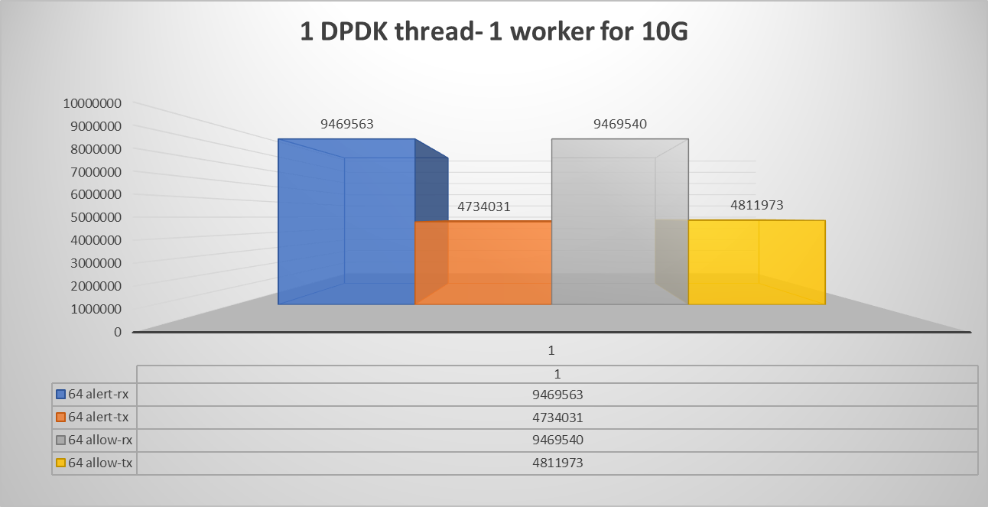

Slide 22
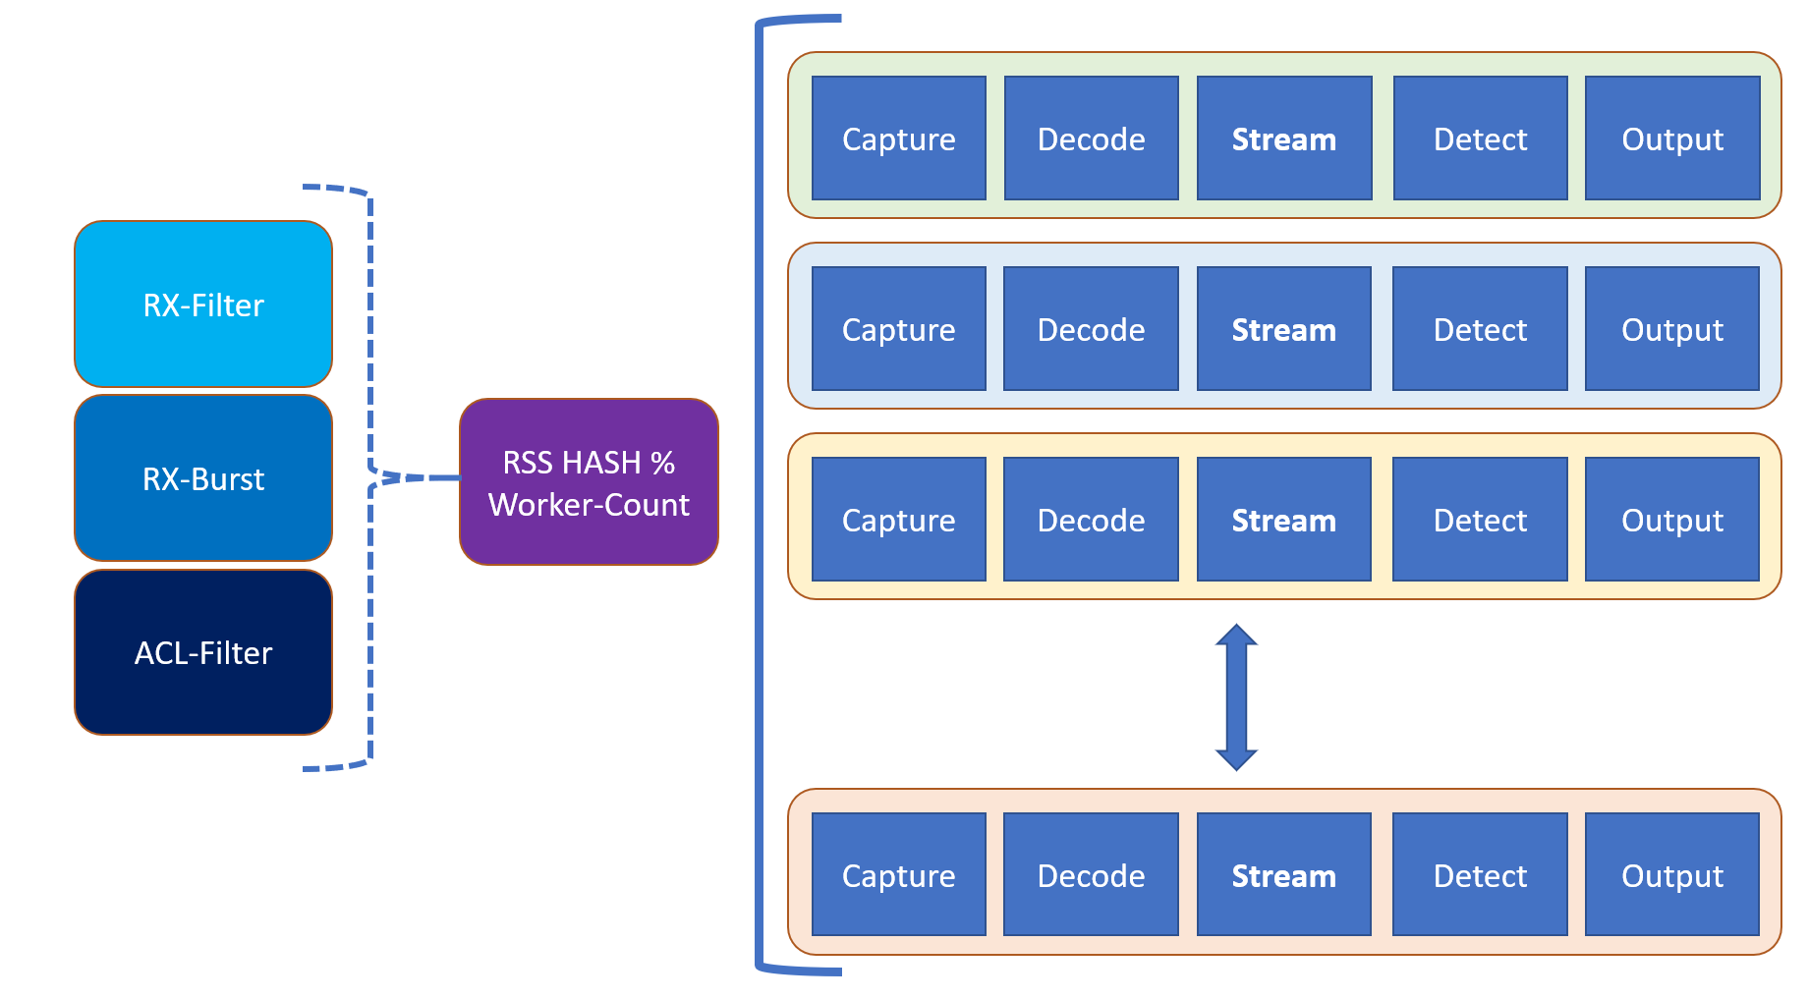
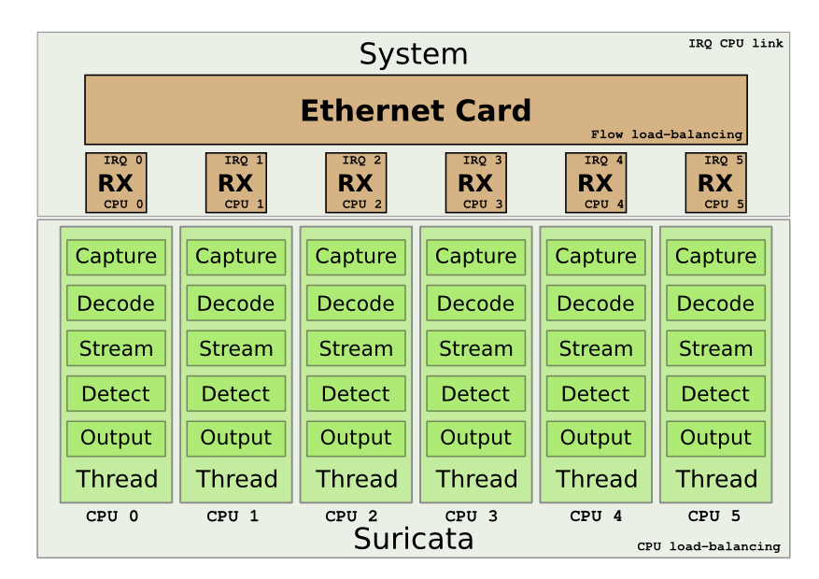
Suricata Worker Mode

Slide 23
references
https://www.stamus-networks.com/blog/2016/09/28/suricata-bypass-feature
https://home.regit.org/2012/07/suricata-to-10gbps-and-beyond/
https://suricata.readthedocs.io/en/suricata-4.1.2/setting-up-ipsinline-for-linux.html
https://www.neox-networks.com/en/solutions/suricata-performance-increase/
https://xbu.me/article/performance-characterization-of-suricata-thread-models/
https://www.researchgate.net/figure/Percentage-of-alerts-detected_tbl2_220307667
https://suricon.net/wp-content/uploads/2016/11/SuriCon2016_MichalPurzynsk
https://docs.nubeva.com/en/latest/tools/suricata.htmli_PeterManev.pdf
https://www.wwt.com/lab/napatech-suricata-ids-ips-and-nsm-lab
https://www.hurricanelabs.com/docs/idsguide.pdf

