Slide 1
The IPO Process: the Prysmian Case
Notes:
FOCUSITALY\Bocconi\Presentation 17-oct-07\IPO\08 IPO Presentation.ppt

Slide 2
The Process of Going Public
Notes:
FOCUSITALY\Bocconi\Presentation 17-oct-07\IPO\08 IPO Presentation.ppt

Slide 3
Why Companies Go Public?
Finance Growth
Gain Visibility
Obtain an
Acquisition
Currency
Public
Market
Align Management Incentives
with Shareholders’ Objectives
Crystallise an
Objective Valuation
Give Liquidity
to Existing
Shareholders

Slide 4
What Do Investors Look for in an IPO?
  Market Leadership
  Strong Management
  Solid Financial Position
  Corporate Governance
  High Level of Visibility and Disclosure
  Liquidity
  Interesting Valuation
Successful IPO

Slide 5
The IPO Process
Macro Investor Constituencies
Domestic
Institutional
Foreign
Institutional
Hedge
Funds
Retail

Slide 6
The IPO Process
Main Phases of an IPO
Preparation
(~4-6 months
prior to IPO launch)
Pre-Launch
(~3-4 months
prior to IPO)
Execution
(1-2 months
prior to IPO)
Advisors
Transaction management
Key issues to be addressed
Valuation methodologies
Due diligence
Legal documentation
Legal process
Offering structure
Marketing
Price determination
Investor relations

Slide 7
Timetable of Prysmian IPO
Speed of Execution
Documen-tation and Due Diligence
Financial information preparation
Prospectus/Offering circular drafting
Drafting/Respond to comments
QMAT and Business Plan preparation
Underwriting Agreement
Sponsorship and related documentation
Due diligence
Due diligence update
Bring down
due diligence
Marketing
and
Valuation
Equity Story definition/Valuation updates
Pre-marketing
Roadshow presentation
preparation
Roadshow/OPV
Key
Events
Meeting with Borsa/Consob
  Strategic review
  Advisor selection
  Committee creation
  Internal preparation
Complete
Filing
Kick off
meeting
Shareholder meeting
Prospectus publication
Pricing
Filing Borsa/Consob
Price range finalised
Closing
Oct/Dec 2006
Jan/Mar 2007
Mar/Apr 2007
Apr/May 2007
Preparation
Pre-launch
Execution
Notes:
FOCUSITALY\Bocconi\Presentation 17-oct-07\IPO\08 IPO Presentation.ppt

Slide 8

Structuring the Syndacate for Prysmian
Joint Global Coordinators
Goldman
Sachs
+
JPMorgan
+
Mediobanca
Global Institutional Offering (80% of Underwriting)
Italian Retail Offering (20% of Underwriting)
Joint Bookrunners
“Responsabile del Collocamento”
Goldman
Sachs
Mediobanca
Mediobanca
Co-Lead Managers
“Collocatori e Garanti”
ABN AMRO
Banca Aletti
Banca Caboto
BNP Paribas
Pool of 21 Banks (and Subsidiaries)
+ further 4 banks “Collocatori non garanti”

Slide 9
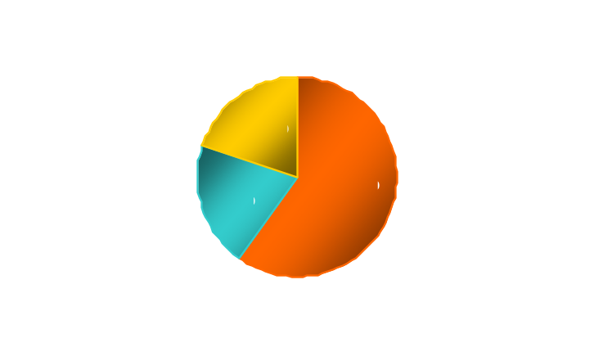
Syndicate Structure and Remuneration
What are the Roles?
Typical Breakdown of Gross Spread
Global Coordinator/s
  Oversees the entire process, from Kick-off to closing. Co-ordinates the various workstreams (documentation, marketing etc.)
  Often (but not always) active as bookrunner in the offering
  Charged on total offering, including greenshoe
Underwriting Commission
Selling Concession
Bookrunners
  Actively involved in the preparation of the documentation and responsible for the entire marketing effort (analyst pres, roadshow, management of the syndicate)
  Control the order book, gather feedback from investors, give recommendations on final price, size of the offering, and allocations
  Shared among the banks pro-rata to underwriting commitments
  Performance based on actual allocations/designations received
  Or based on pre-agreed level
Co-Lead Managers
Management Commission
  Complement the research coverage and overall marketing effort in the transaction
  Shared among the banks pro-rata to underwriting commitments
Italian
Lead-Manager
  Generally one of the bookrunners with direct responsibility for the retail offering
Fee Precedents
  Recent precedents have seen fees being structured with a fixed component and a variable component (“incentive fee”)
  In addition to the typical breakdown of the gross spread described above , it has become market practice in large syndicates for the GCs to retain a fee out of the gross spread (indicatively 10%)
  Historically, IPO fees since 2002 for offers above €100m have been in the range of 1.5% to 7% with an average of 3%
  Offer size is the main factor which influences the overall fee in % terms; generally, larger the size and lower is the % fee

Slide 10
Executing Prysmian’s IPO
Equity
Story
Setting the Price Range
Marketing and
Book-building
Pre-Marketing
Pricing
26-Mar-2007
-
13-Apr-2007
13-Apr-2007
16-Apr-2007
-
27-Apr-2007
27-Apr-2007

Slide 11
How We Sold Prysmian
A leader in its reference markets
Attractive market fundamentals with continued growth
High level of diversification (by product, client and geography) and hence resilience
High barriers to entry in high value-added segments
R&D effort to develop Hi-Tech products and advanced production processes
Industrial efficiency, production flexibility and operating leverage
Solid management track record
A unique platform to capture end-markets growth through excellence of execution, best-in-class operating leverage and cash generation
Notes:
FOCUSITALY\Bocconi\Presentation 17-oct-07\IPO\08 IPO Presentation.ppt

Slide 12
Execution of an IPO
Pre-Marketing
Use
  Pre-marketing was introduced with large privatisation offerings in Europe
  Standard practice on European and Asian offerings, with scope depending on size of offering
Period
  Official period typically lasts for 7 to 10 business days prior to determination and announcement of price range and offering size (official launch of offering)
  Pre-marketing period can be as short as one week
Purpose
  Familiarise investors with equity story
  Preliminary demand assessment may be used to fix initial offering size
  Investors’ views on valuation may be used to determine initial price range
  Through coverage of target investor base
  Identify issues to better position story during roadshow
  Identify investors whom management should see on roadshows

Slide 13
How did Investor Perceive the Story?
Positives
Concerns
  Good business diversification and exposure, supported by client and regional diversification
  Investors appreciate the positioning towards higher margin segments within the various end markets
  Attractive sector trends for both the energy and the telco. Businesses. The investment in the transmission and distribution infrastructure is seen as particularly attractive
  High level of profitability in terms of margins and ROIC
  High management credibility following the implementation of a sustainable recovery over the last 3 years
  Top line and earnings growth as one of the drivers of the Prysmian equity story
  Positive environment overall for an IPO of Prysmian
  Cable business is highly cyclical and some believe that the sector is currently trading at its peak
  Restructuring benefits already materialised vs. peers with limited exposure to further operational improvements
  Concerns on future sustainability of margins achieved post restructuring
  Concerns on the future sustainability of current R&D expense level and on possible future increase in Capex
  Focus on IPO valuation as future upside is seen as uncertain despite growth potential
  Some investors where disappointed that management is selling at IPO
  Concerns on an opportunistic exit by PE
Notes:
FOCUSITALY\Bocconi\Presentation 17-oct-07\IPO\08 IPO Presentation.ppt

Slide 14
Extensive Marketing Activity
Price Range: Euro 13.25-16.75
Pre-Marketing (26-Mar – 13-Apr-2007)
  7 Analysts
  11 Countries Visited
  187 Accounts Covered
UK
Germany
Institutions 67
Institutions 9
France
Italy
Institutions 22
Institutions 30
Other Countries
Institutions 59
Roadshows (16-Apr – 27-Apr-2007)
  7 Countries Visited
  >270 Investors Met
  73 in One-on-Ones
No. of
Boston Investors
No. of
London Investors
Rotterdam/ No. of
Amsterdam Investors
One-on-ones 7
One-on-ones 25
Group Meeting 3
One-on-ones 8
No. of
New York Investors
Frankfurt/ No. of
Zurich Investors
One-on-ones 10
Group Meeting 2
One-on-ones 6
Group Meeting 1
No. of
Paris Investors
No. of
Milan Investors
One-on-ones 8
Group Meeting 1
One-on-ones 9
Group Meeting 2
Notes:
FOCUSITALY\Bocconi\Presentation 17-oct-07\IPO\08 IPO Presentation.ppt

Slide 15
Execution of an IPO
Setting the Price Range
Market Conditions
DCF Valuation
Company Objectives
Comparable Companies
Price Range
Investor Feedback
  Price range is usually the result of the combination of factors and of different (and often diverging) views
  Global Coordinators try to set a price range which is:
    Challenging/close to fully valued at the top end
    Attractive at the bottom

Slide 16
How did we Set the Price Range for Prysmian?
Market Conditions
DCF Valuation
Company Objectives
Comparable Companies
Price Range
Investor Feedback
Prysmian Price Range
Bottom Top
Price €13.25 €16.75
EV/EBITDA 2008E 6.7 x 8.0 x
Sector Average EV/EBITDA 2008E 8.1x (Nexans: 8.1x)

Slide 17
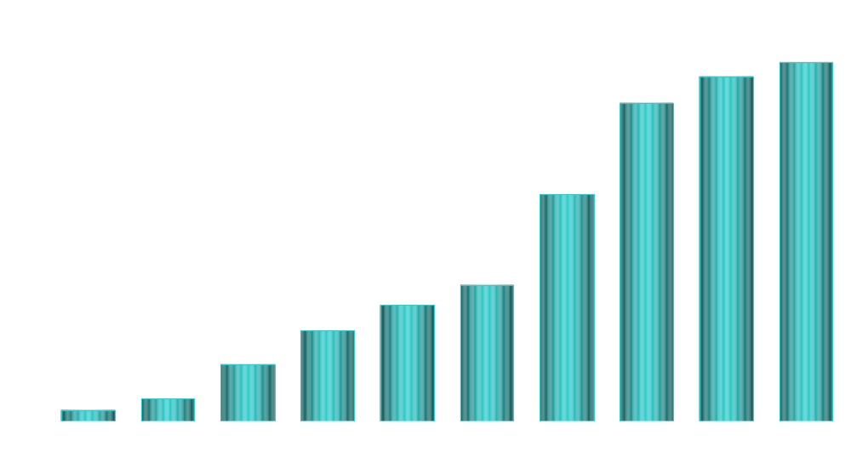
Execution of an IPO
Marketing and Bookbuilding
Deal Size
500
0
  Demand evolves during the bookbuilding period.
  Institutional investors can place orders in variable sizes and prices depending on their interest

Slide 18
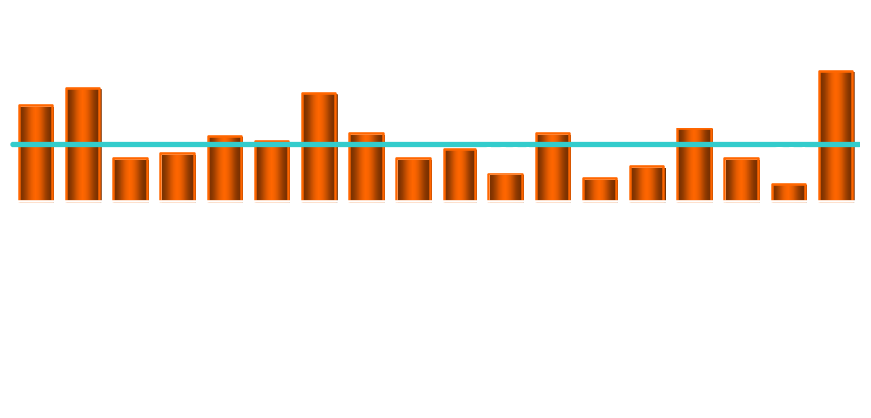
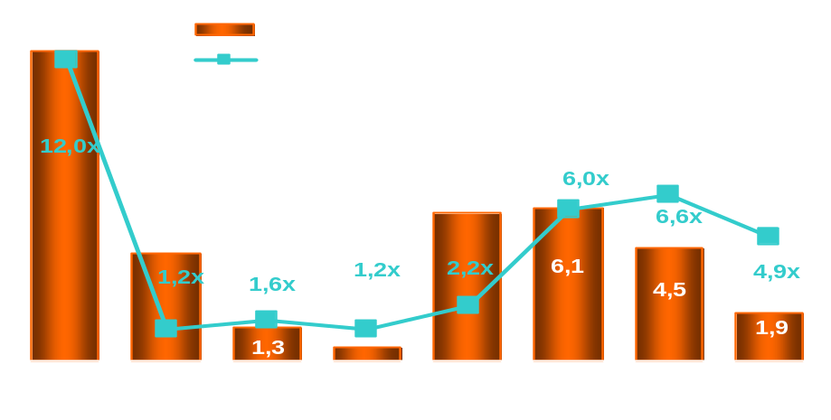
The Importance of Retail
Retail Allocations in % of Total Allocations^{(a)}
Considerations on Retail in Italy
  The retail constituency is price insensitive as their orders are only limited by the top of the range i.e. the maximum price
  Retail demand creates momentum in the book
  Interest by the public is mainly driven by factors such as:
    Brand Name
    Press Reaction/Exposure
    General Market Environment
    Presence of Incentives
Evolution of Retail Activity
Deals above €200m, since 2003.
Notes:
FOCUSITALY\Bocconi\Presentation 17-oct-07\IPO\08 IPO Presentation.ppt

Slide 19
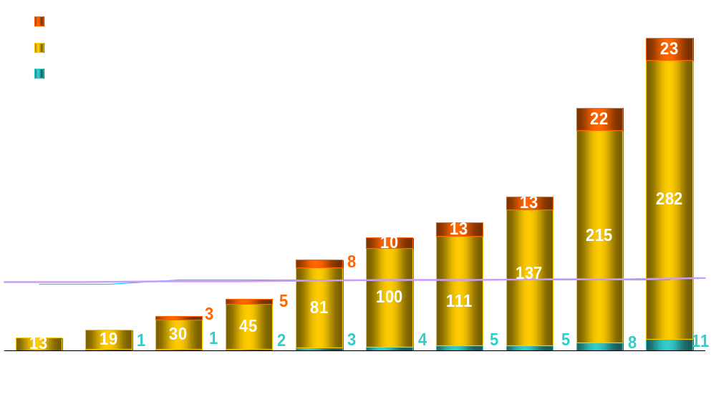
The Marketing and Bookbuilding
72.0
  Sector Investors and Mid Cap specialist are first to put orders into the book, assuming the role of key opinion makers driving demand
  As momentum builds up the other investor constituency come in the book. Press coverage increase attracts retail demand
  Final marketing effort focused on reducing price sensitivity to the book, maximizing valuation at pricing

Slide 20
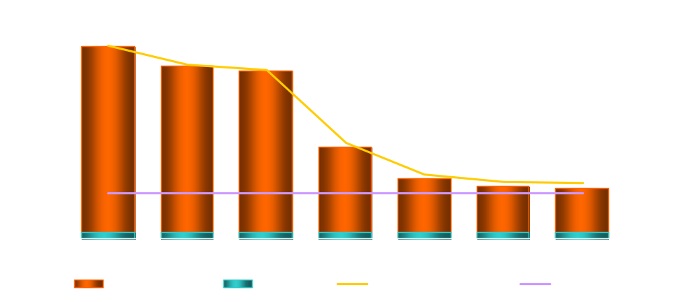
Summary of Overall Demand
 | Demand (000s Shares) | Num. of Orders | Average Order (000s Shares)
Institutional | 304,344 | 241 | 1,262.8
Retail | 10,100 | 18,219 | 0.6
Price Sensitivity
€15.00 per share, €2,730m equity value.

Slide 21
Execution of an IPO
Pricing
  Ideal pricing is at a reasonable discount to trading value of the company
  Book of demand is the most important tool in discussing pricing
  Limits from anchor orders and from investors that have been heavily involved in the process are key
  Often a long and difficult discussion with the Company and its shareholders
Pricing should achieve the Company’s objectives
whilst ensuring a stable aftermarket

Slide 22
Prysmian - Valuation at IPO
Enterprise Value Multiples
Equity Value Multiples
Closing
Price
26-Arp-2007
EBITDA
EBIT
P/E Multiples
Company
2007
2008
2007
2008
2007
2008
Key Comparable Cables Manufacturers
Draka €27.99 8.8x 7.5x 12.8x 10.5x 16.2x 13.2x
General Cable US$57.62 10.0 8.6 12.2 11.1 17.1 15.4
Nexans €106.42 9.2 8.1 13.1 11.2 17.1 15.2
Mean 9.3x 8.1x 12.7x 10.9x 16.8x 14.6x
Median 9.2x 8.1x 12.8x 11.1x 17.1x 15.2x
Other Comparable Cable Manufacturers
Belden CDT US$56.94 12.7x 10.4x 15.1x 12.1x 22.2x 18.2x
Commscope US$45.45 10.7 9.7 11.8 10.0 20.2 18.7
Leoni €33.26 6.1 5.9 8.8 8.4 11.6 10.5
Superior Essex US$35.99 7.6 6.8 9.5 8.4 14.1 11.8
Mean 9.3x 8.2x 11.3x 9.7x 17.0x 14.8x
Median 9.2x 8.3x 10.7x 9.2x 17.2x 15.0x
Prysmian €15.00 8.2x 7.6x 9.8x 8.8x 16.6x 13.3x
Notes:
FOCUSITALY\Bocconi\Presentation 17-oct-07\IPO\08 IPO Presentation.ppt

Slide 23
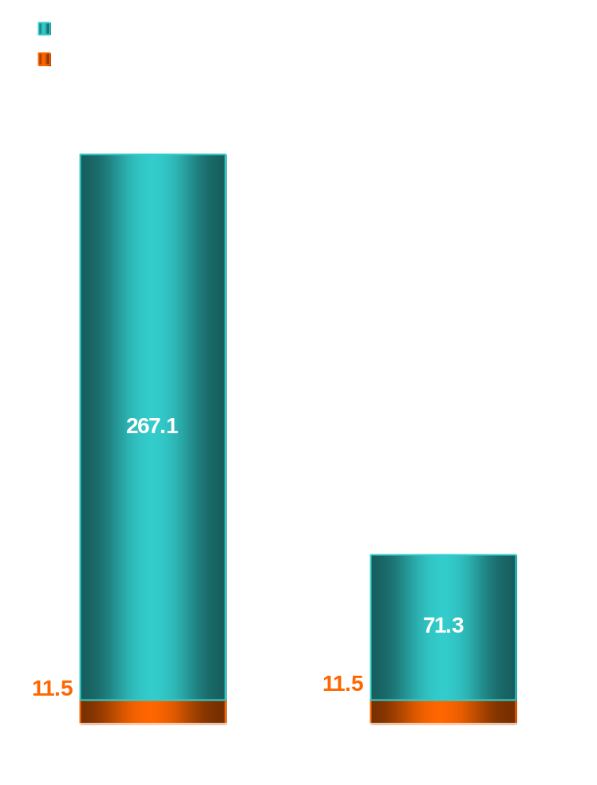
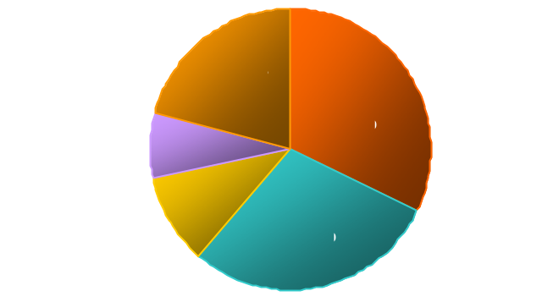
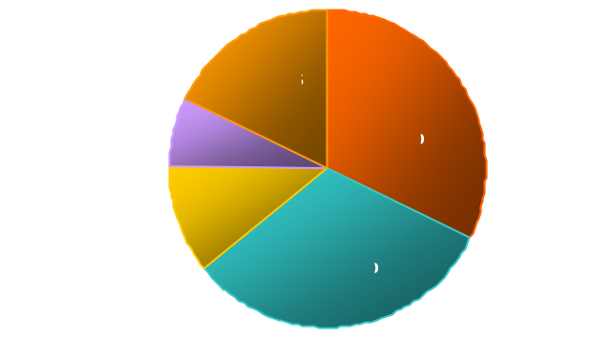
Final Demand and Allocation
Demand at €15.0 (Data in Million Shares)
Institutional Demand and Allocation Breakdown
Demand
Institutional Allocation
86%
14%
Notes:
FOCUSITALY\Bocconi\Presentation 17-oct-07\IPO\08 IPO Presentation.ppt

Slide 24
Execution of an IPO
Allocation
  Allocation is always a difficult process of negotiation with the Company
  Main objective are
    Create a base of stable shareholders that believe in the stock
    Provide sufficient liquidity in the market
    Ensure a positive aftermarket
  Criteria of allocation
    Obvious ones
      Price limit
      Timing of order
      Participation to roadshow
      Track record in previous IPOs
  And less obvious one
    Work done to understand company
    Insight provided during process
  N.B.: the Global Coordinator proposes an allocation, the company decides

Slide 25
Allocating the Right Investors
Top 10 Orders Allocation
Investor | Country | Order in Shares | Allocation in Shares
Long Money | US | 15,000,000 | 5,500,000
Long Money | France | 7,144,249 | 2,800,000
Long Money | UK | 4,431,340 | 2,100,000
Hedge Fund | UK | 6,600,000 | 2,000,000
Long Money | UK | 5,636,380 | 2,000,000
Long Money | Netherlands | 4,061,000 | 1,600,000
Long Money | US | 4,539,280 | 1,550,000
Long Money | UK | 3,747,880 | 1,500,000
Hedge Fund | US | 3,700,500 | 1,500,000
Long Money | Switzerland | 4,000,000 | 1,400,000
Total as % of the Offer |  | 71.1% | 26.5%

Slide 26
Stabilization & Greenshoe
  Trading post IPO is key for the longer term performance of the stock. Bookrunners usually support the immediate after market via the greenshoe or over-allotment option
Greenshoe Mechanics
Illustrative Example
  Bookrunners over-allocate shares to investors as part of the IPO
    Greenshoe shares are provided either by selling shareholders (secondary shares) or by the issuer (primary shares)
    The over-allocation creates a short position and to be covered by the end of the stabilization period (30 days post IPO)
    This short position will be covered by either market purchases if the price falls or the exercise of the Greenshoe if the price rises
Share Price Rises in Aftermarket
Stabilization manager exercises Greenshoe option to cover over-allotment
Issue Price
As shares rise vendors/company do not want to sell shares back to the managers at issue price
Share Price Falls in Aftermarket
Total
allocation
Stock of Trading
108
Over
allotment
Short
Position
100
Greenshoe
option
(30 days)
Offering
size (excluding over allotment)
Base
Offer
Eventual offer
size if
Greenshoe not exercised
Eventual offer
size if
Greenshoe exercised
Issue Price
When selling is exhausted stabilization ends and shares trade with market
Offering (%)
Stabilization manager buys back loose stock from the market to cover over-allotment

Slide 27
The Prysmian ABO
Notes:
FOCUSITALY\Bocconi\Presentation 17-oct-07\IPO\08 IPO Presentation.ppt

Slide 28
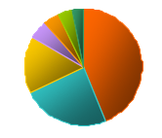
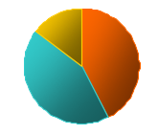
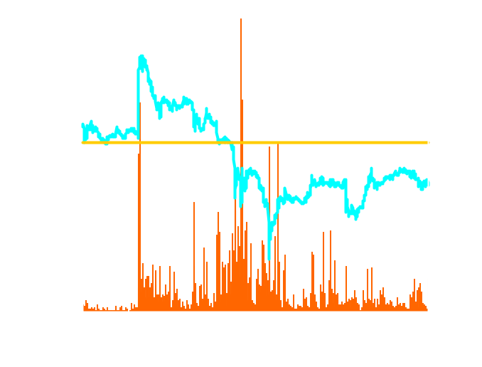
Prysmian €429 ABO1
Priced on 6-Nov-2007
By Nationality
By Type
Demand Split
France 4.0%
Others 3.0%
Others 4.1%
Switzerland 4.4%
UK 44.0%
Long Money 56.6%
Netherlands 5.4%
Italy 15.5%
Hedge Fund 39.3%
US 23.7%
Transaction Summary
Summary Observations
Size of Offering
  €429.2m (approx US$621.0m)
    12.3% of company
    26.8% of free float
    34.9x 6 month average daily traded volume
  On November 6th, 2007, Bottom LuxCo, owner of 54.0% of Prysmian, sold 40.0m shares of Prysmian for a total consideration of €821.2m (US$1,188.2m), of which:
    22.2m shares, €429.2m (US$621.0m) or 12.3% of the capital were sold in the market via an accelerated bookbuilt offering
    17.8m shares, €392.0m (US$567.2m) or 9.9% of the capital were sold at €22 per share, a 13.1% premium to market close, to Taihan Electric Wire, a South Korean company that also operates a cable business in Asia
Deal Type
  Accelerated Bookbuilt Offering (“ABO”)
Selling Shareholder
  Prysmian (Lux) II (“Bottom LuxCo”), indirectly held by
    Goldman Sachs Capital Partners (79.8%)
    Management (7.8%)
    Apollo (7.8)%
    Goldman Sachs International (4.6)%
Trading Around the Transaction
Shares Offered
  22,180,000
Security Type
  Ordinary Shares (100% secondary)
Price
  €19.35
Share Price (EUR)
Volume (000’ Shares)
Sole Bookrunner
  Goldman Sachs International
Offer Price (0.56)%
Listing
  Milan Stock Exchange
Pricing and
Allocations
  06-Nov-2007
Settlement
  09-Nov-2007
Discount to
Last Close
  (0.56)%
  (Last close of €19.46 on 05-Nov)
Market Cap
  €3,503m (05-Nov)
Lock-up
  90 days
05-Nov
06-Nov
07-Nov
08-Nov
Source: Bloomberg, GS Syndicate as of 09-Nov-2007
Notes:
FOCUSITALY\Bocconi\Presentation 17-oct-07\IPO\08 IPO Presentation.ppt

Slide 29
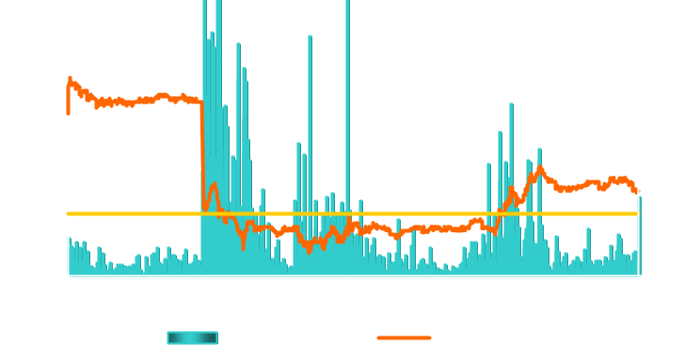
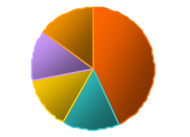
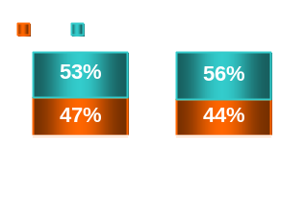
Prysmian €312m ABO2
Priced on 10-Nov-2009
Offering Details
Tranasaction Highlights
Issuer | Prysmian S.p.A (”Prysmian”)
Offering Size | €312m
Offering Price | €12.0 per share
No. of shares | 26,000,000 or 14.3% of total share capital 16.5x the 6m ADTV
Market Cap | €2,322m
Free Float | 59.7% pre-placing, c. 74% post-placing
Shares | 100% ordinary shares
Selling Shareholders | Goldman Sachs Capital Partners through Prysmian (Lux) II S.à r.l. decreasing from 30.1% to 16.2% of the share capital Goldman Sachs Intl., managed by Goldman Sachs PIA decreasing from 1.1% to 0.6% of the share capital
Listings | London Stock Exchange (Borsa Italiana)
Lock-up | 60 days
Timing | Placement announced on 9-Nov, post-closing Priced on 10-Nov, shortly after market opening
Sole Bookrunner | Goldman Sachs
  Accelerated placement of shares executed during closed-market hours in Europe: launch on 9-Nov afternoon, pricing & allocations shortly after opening on 10-Nov
  The deal benefited from investors' appetite immediately since announcement, leading the book of demand to cover in less than 2 hours
  Tuesday, before the opening, the deal was upsized from 21.4m (11.8% of the share capital) to 26.0m shares (14.3% of the share capital)
  The level of overall demand left significant room to adapt allocations of the deal and create a solid base of long-only investors, representing 10 of the top 15 allocations or approx. 55% of the deal
  Following the disposal, Goldman Sachs Capital Partners and Goldman Sachs International control a combined stake of 16.8% in Prysmian
Breakdown of Institutional Investors’ Demand
Intra-day Share Price Patterns
By Country
By Type
€
‘000 Shares
Breakdown
RoW 15%
Pricing
Switz.
13%
UK
43%
US
15%
€12.82
Italy
14%
Offer Price
Details
Orders
Allocations
# Orders 97 Top 10 45% 38%
Avg. Order 307k (1.2%) Top 50 108% 90%
Avg. % Allocated 77% Top 100 124% 100%
Source: Bloomberg, Goldman Sachs Equity Syndicate
Notes:
FOCUSITALY\Bocconi\Presentation 17-oct-07\IPO\08 IPO Presentation.ppt

