Slide 1

Cornell Consulting Team Kickoff:
Sensor Projects
Captos Technologies Corp
16 February 2012

Slide 2
Project 2
Unleashing the Innovator

Slide 3
Agenda for Today’s Project Kickoff
1. Introductions and Personal Background
  a. Cornell team
  b. Mike & Anil
2. Introduction to the project (Mike and Anil)
  a. Review objectives
  b. Review thinking to date
  c. Discuss deliverables and scope (Mike & Anil and team)
3. Discussion of the project structure
  a. Discuss major workstreams
  b. Discuss key milestones
  c. Discuss process going forward
4. Any other open items

Slide 4
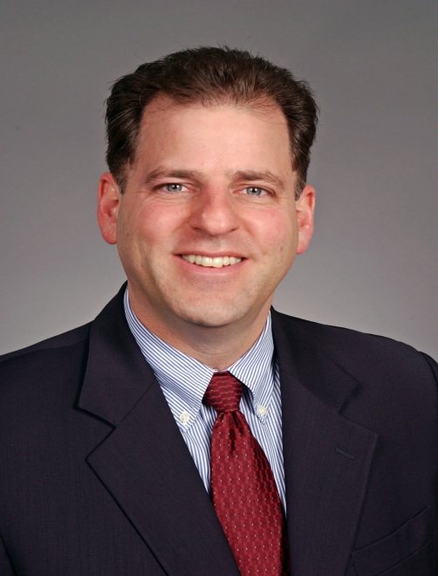
Mike Ellenbogen - Bio
Founder & CEO - Reveal Imaging Technologies, Inc. (Acquired by SAIC in 2010)
Founded and successfully led the company as President and CEO, achieving double digit growth in both revenue and profitability from its inception
Successfully built new explosives detection systems from initial vision through R&D, validation, scale-up, deployment and ongoing service
Raised over $35M in venture capital, private equity and debt
Grew organization to 160 people, with 55 person technical development team, including industry leading hardware, software and automated detection algorithm (machine vision) capabilities
Achieved 2010 Revenue of $105M, and $23.5M EBITDA while maintaining over 50% revenue growth and 100% EBITDA growth over multiple years
Secured over $30M in Government funding to leverage company’s product development investments, while maintaining control of core intellectual property
Drove successful company sale, providing over 8x return on investor’s equity
Skilled at identifying market opportunities and translating concepts into specific product plans and growth strategies, planning and executing global business development programs to establish market share, drive revenue and achieve earnings targets.

Slide 5
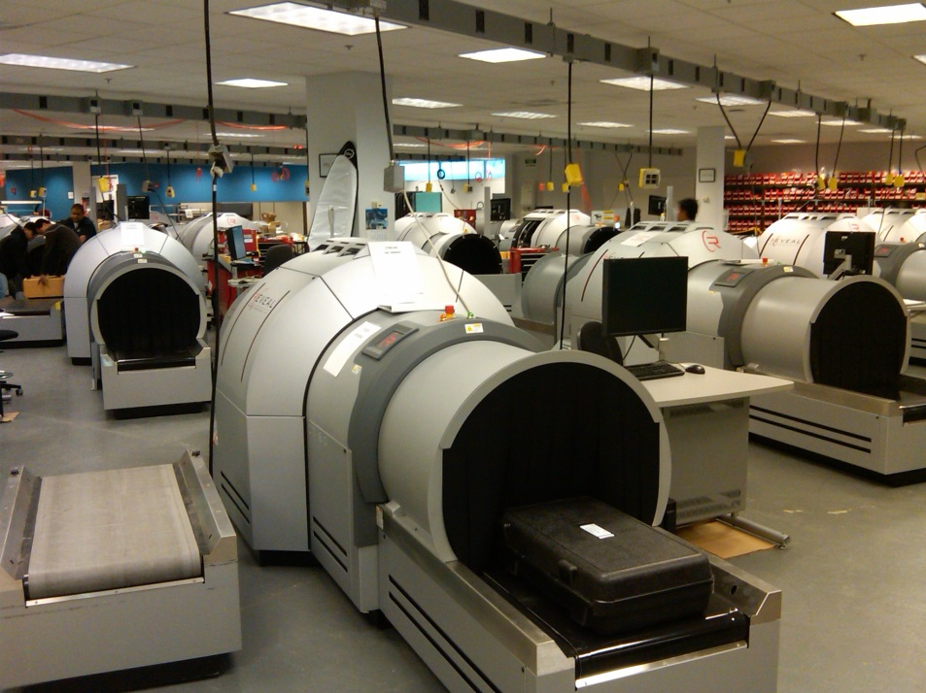
Reveal Imaging Technologies, Inc.
Founded: October, 2002
Headquarters: Bedford, MA
Developed the first new explosives detection technology for aviation baggage and personnel inspection applications designed to address the post-9/11 regulatory environment. Reveal’s small, cost effective systems are deployed at over 250 US and 50 International airports as well as high risk government facilities worldwide.
Recognized as the industry leader in automated explosives detection, using X-ray based computed tomography and advanced machine vision algorithms to significantly lower cost of ownership and improve the passenger experience.
Grew organization to 160 people, with 55 person technical development team, including industry leading hardware, software and automated detection algorithm (machine vision) capabilities.
Achieved 2010 Revenue of $105M, and $23.5M EBITDA while achieving over 50% revenue growth and 100% EBITDA growth over multiple years.
Secured over $30M in Government funding to leverage company’s product development investments, while maintaining control of core intellectual property.
Introduced disruptive new technology into market against two incumbent Fortune 500 competitors
Drove successful sale of company in August 2010, providing approximately 8x return on investor’s equity.

Slide 6
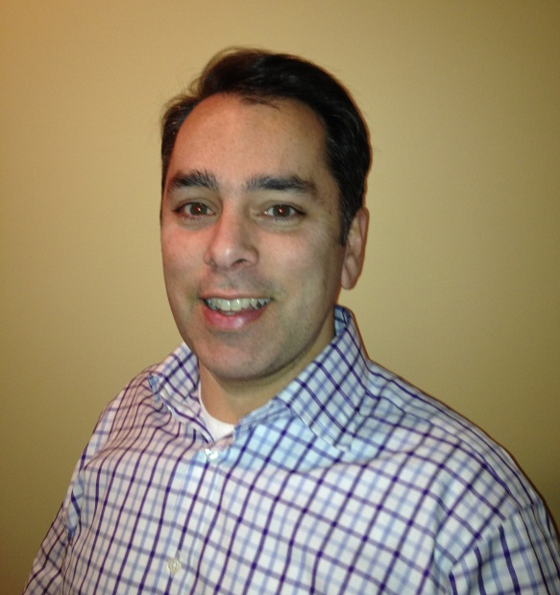
Anil R. Chitkara - Bio
Skills and Experience
Senior Sales, Marketing, Business Development Executive
Identifying and executing product and services strategies to
drive non-liner growth
Development of new, disruptive business models
Positioning and evangelizing disruptive market opportunities
Creating compelling ROI-based value propositions
Building and driving customer-focused teams
Senior VP, Market Development - Oco, Inc. (Acquired by Deloitte in 2011)
Responsible for all aspects of revenue including go to market strategy; market positioning and evangelism; partnerships; direct and indirect channels; and sales from lead generation through the sales cycle to deal closure
Recruited to new executive team to restart the company; rebuilt sales, marketing, and partnership teams
Achieved 2010 sales growth of nearly 4x prior year; generated 90% solution expansion and 95% renewal rates across customer base
Changed the model from low-cost horizontal BI tool to packaged analytical apps (increased pricing by 5-10x)
Added blue chip customers: Caterpillar, Fidelity Investments, Thermo Fisher Scientific, Office Depot, Welch’s
Drove recognition as the leader in SaaS Business Analytics by analysts and press; received numerous awards
Helped raise $20M in venture capital; presented the company through successful sales process; closed sale to Deloitte Analytics in May 2011

Slide 7
Anil R. Chitkara - Bio
Vice President, Parametric Technology Corp. (PTC)
Led development and launch of Windchill PDMLink which accounts for about $400 million in 2011 revenue
Managed product management team that developed Windchill PDMLink including use case development, storyboarding, requirements definition; co-managed 18 functional engineering teams that built the product
Led global launch of Windchill PDMLink including market positioning and messaging, field marketing, sales and technical sales training, services enablement, and press and analyst interviews
Drove industry verticalization program that included hiring industry experts to define product requirements, create market positioning, execute marketing programs, and support the field sales organization
Led global product development program to enable manufacturing customers to create and integrate global engineering centers in BRIC countries
Launched and led new business model leveraging PTC software and India based delivery team to provide outsourced technical publications process
Co-author: Eppinger S. and Chitkara A. “The New Practice of Global Product Development”, MIT Sloan Management Review, 47.4 (Summer 2006): 22-30.
Senior Manager, Accenture Consulting
Led various teams to develop business unit and functional strategies for U.S. and European clients in Consumer, Industrial and Life Sciences industries
Led internal evaluation and development of new consulting offerings to drive revenue growth
Chaired, CPG Senior Managers Advisory Committee; member eCommerce Strategy Steering Committee; faculty, Accenture Strategy College; team lead, Tuck MBA Recruiting

Slide 8
Project 2: Unleashing the Innovator
There are many people who have great ideas for new products, but find it difficult to find and coordinate the various people required to come up with a working prototype (electrical, software, mechanical, testers). Then the process of finding somebody to make the product, package it, take it to market, distribute it, etc, results in many of these products never leaving the idea stage.
What if there were a set of hardware and software building blocks that would allow these tinkerers to quickly and easily develop a prototype, then a process for them to get the product design hardened, manufacturing set up, and sales & distribution capabilities in place. Simple, straightforward, and all in one place.
The key capabilities may include:
Sensor block kit: provide a set of lego-like blocks that each contain a different sensor (e.g., humidity, temperature, accelerometer, velocity) with battery & data communications, and an easy data analytics software tool to gather the data, create analytics and drive some action (e.g., SMS text message).
Open innovation applications: set up an environment to have others use the sensor blocks to create and launch sensor-based services with our toolkit (both sensor blocks and analytics software). Provide a process to test the applications, package them together and market them.
Crowd source new sensor blocks: provide a “sensor block shell” that can be used by any inventor of a sensor or instrument to quickly enable their technology to plug and play into our sensor block kit.

Slide 9
Key questions: What is the optimum proposition and business model for this business?
Confirm the customer segments and their respective value propositions (the application creator). For each target segment:
What are the key needs and pain points? What are the barriers and stumbling blocks today? What must be provided to enable them to turn innovative ideas into real products?
How do you package and market these sensor block kits? What features and characteristics are most important to them? What else is required to enable people to build applications with the sensor blocks?
How do you reach these groups? How do you move from classic early adopters to the mainstream, larger market segment?
Example A: Home heating and air-conditioning service wants to provide an easy, low cost sensor monitoring solution for its customers. They want to measure the temperature and humidity of the house, the water level in the drop pan (under the AC unit) and the flow of air intake just beyond the filter. They want a package of sensors that they can easily put around a customer’s house, connect them to the home WiFi to push data to the cloud, and track the data on a 10 minute basis. They also want to be able to set alerts. For example, if the air flow near the filter drops below a certain amount, an SMS text message goes to the AC service company to let them know it’s time to change the filter. If the water level in the pan is higher than 5 mm, time to empty the pan.
Confirm the new sensor developer segment and their value proposition.
How do new developers of sensors or analytical instruments build and take their sensors to market today? How do individual inventors go through the process? What is important to them?
What are the key pain points and barriers for them to get their sensors prototyped, tested and built today?
How can you create an environment to have new sensors developed by others and included in the sensor block kit?
Example B: An academic has developed a new miniature technology for a specific chemical sensor. She has proven the technology works through a proof of concept. However, she does not know how to turn this new technology into a prototype, get market feedback, refine it and get the design finalized, manufactured and sold.
Note: We are not asking the team to understand or vet different technology options or software products. However, they should look at other companies and business models to inform their point of view.

Slide 10

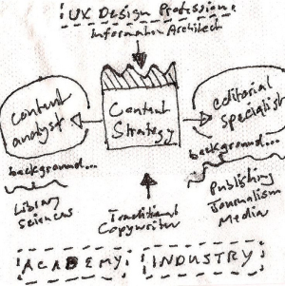
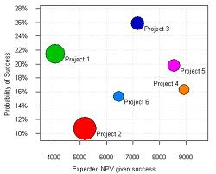




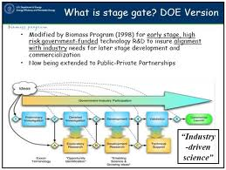
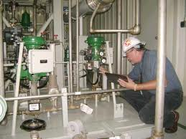

Idea Graveyard

Slide 11


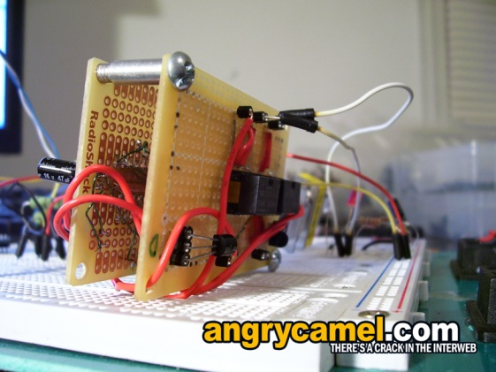



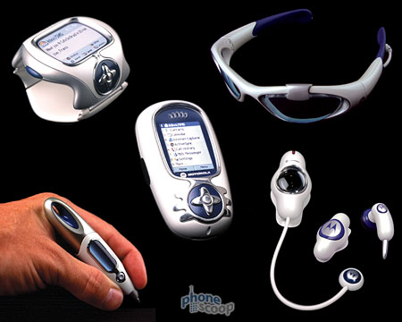
“Making Hardware as Easy to Build as Software”
???
$$$
Available on the
H/W App Store

Slide 12
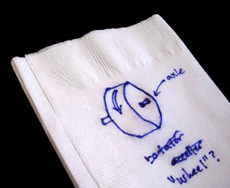
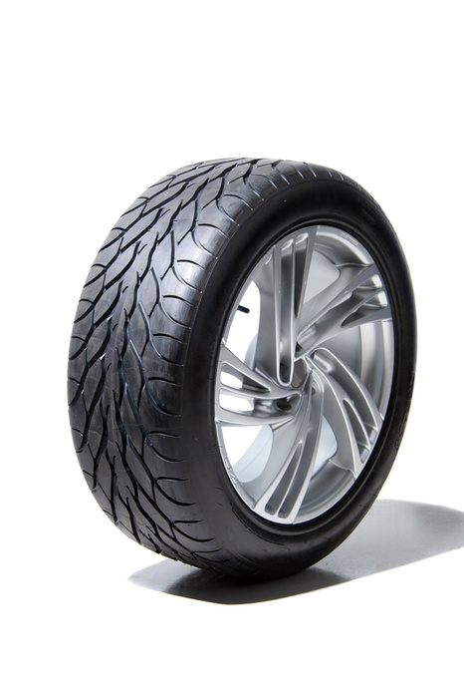
Innovation Unleashed
Mission
Turning cocktail napkins into real products
Vision
To provide a fully integrated ecosystem with the expertise, components, processes, and capacity to get anybody’s (device) idea designed, produced and sold in the global marketplace

Slide 13
Turning Napkins into Reality
Innovation Collective
Mobilize Instrumentation
Ends of the Earth
Ubiquitous
Sensing
Unleash the Tinkerer
Sensor-Centric Economy
Prepackaged sensors
Data communications
Data analytics and visualizer
Easy app builder
Sample prep
Analytical processing
Results actuator
Smaller, cheaper, better
Anyplace, anytime
Vertical application coaches
Product development path
Test marketing and beta customer program
Industrial design and packaging
Manufacturing and distribution network
Sales and marketing channels
Crowdsourcing based development
Social media data ties (Facebook, Twitter)
Application Wish Board
Subsystem module designer (DSM)
IP and development sharing model
Channel reverse auction GTM
Collaborative research initiatives
Micro market creator (a la microfinance)
Global sales and support channels
Product expansion module

Slide 14
Project 1
In Search of the Killer Sensing App

Slide 15
Agenda for Today’s Project Kickoff
1. Introductions and Personal Background
  a. Cornell team
  b. Mike & Anil
2. Introduction to the project (Mike and Anil)
  a. Review objectives
  b. Review thinking to date
  c. Discuss deliverables and scope (Mike & Anil and team)
3. Discussion of the project structure
  a. Discuss major workstreams
  b. Discuss key milestones
  c. Discuss process going forward
4. Any other open items

Slide 16
Mike Ellenbogen - Bio
Founder & CEO - Reveal Imaging Technologies, Inc. (Acquired by SAIC in 2010)
Founded and successfully led the company as President and CEO, achieving double digit growth in both revenue and profitability from its inception
Successfully built new explosives detection systems from initial vision through R&D, validation, scale-up, deployment and ongoing service
Raised over $35M in venture capital, private equity and debt
Grew organization to 160 people, with 55 person technical development team, including industry leading hardware, software and automated detection algorithm (machine vision) capabilities
Achieved 2010 Revenue of $105M, and $23.5M EBITDA while maintaining over 50% revenue growth and 100% EBITDA growth over multiple years
Secured over $30M in Government funding to leverage company’s product development investments, while maintaining control of core intellectual property
Drove successful company sale, providing over 8x return on investor’s equity
Skilled at identifying market opportunities and translating concepts into specific product plans and growth strategies, planning and executing global business development programs to establish market share, drive revenue and achieve earnings targets.

Slide 17
Reveal Imaging Technologies, Inc.
Founded: October, 2002
Headquarters: Bedford, MA
Developed the first new explosives detection technology for aviation baggage and personnel inspection applications designed to address the post-9/11 regulatory environment. Reveal’s small, cost effective systems are deployed at over 250 US and 50 International airports as well as high risk government facilities worldwide.
Recognized as the industry leader in automated explosives detection, using X-ray based computed tomography and advanced machine vision algorithms to significantly lower cost of ownership and improve the passenger experience.
Grew organization to 160 people, with 55 person technical development team, including industry leading hardware, software and automated detection algorithm (machine vision) capabilities.
Achieved 2010 Revenue of $105M, and $23.5M EBITDA while achieving over 50% revenue growth and 100% EBITDA growth over multiple years.
Secured over $30M in Government funding to leverage company’s product development investments, while maintaining control of core intellectual property.
Introduced disruptive new technology into market against two incumbent Fortune 500 competitors
Drove successful sale of company in August 2010, providing approximately 8x return on investor’s equity.

Slide 18
Anil R. Chitkara - Bio
Skills and Experience
Senior Sales, Marketing, Business Development Executive
Identifying and executing product and services strategies to
drive non-liner growth
Development of new, disruptive business models
Positioning and evangelizing disruptive market opportunities
Creating compelling ROI-based value propositions
Building and driving customer-focused teams
Senior VP, Market Development - Oco, Inc. (Acquired by Deloitte in 2011)
Responsible for all aspects of revenue including go to market strategy; market positioning and evangelism; partnerships; direct and indirect channels; and sales from lead generation through the sales cycle to deal closure
Recruited to new executive team to restart the company; rebuilt sales, marketing, and partnership teams
Achieved 2010 sales growth of nearly 4x prior year; generated 90% solution expansion and 95% renewal rates across customer base
Changed the model from low-cost horizontal BI tool to packaged analytical apps (increased pricing by 5-10x)
Added blue chip customers: Caterpillar, Fidelity Investments, Thermo Fisher Scientific, Office Depot, Welch’s
Drove recognition as the leader in SaaS Business Analytics by analysts and press; received numerous awards
Helped raise $20M in venture capital; presented the company through successful sales process; closed sale to Deloitte Analytics in May 2011

Slide 19
Anil R. Chitkara - Bio
Vice President, Parametric Technology Corp. (PTC)
Led development and launch of Windchill PDMLink which accounts for about $400 million in 2011 revenue
Managed product management team that developed Windchill PDMLink including use case development, storyboarding, requirements definition; co-managed 18 functional engineering teams that built the product
Led global launch of Windchill PDMLink including market positioning and messaging, field marketing, sales and technical sales training, services enablement, and press and analyst interviews
Drove industry verticalization program that included hiring industry experts to define product requirements, create market positioning, execute marketing programs, and support the field sales organization
Led global product development program to enable manufacturing customers to create and integrate global engineering centers in BRIC countries
Launched and led new business model leveraging PTC software and India based delivery team to provide outsourced technical publications process
Co-author: Eppinger S. and Chitkara A. “The New Practice of Global Product Development”, MIT Sloan Management Review, 47.4 (Summer 2006): 22-30.
Senior Manager, Accenture Consulting
Led various teams to develop business unit and functional strategies for U.S. and European clients in Consumer, Industrial and Life Sciences industries
Led internal evaluation and development of new consulting offerings to drive revenue growth
Chaired, CPG Senior Managers Advisory Committee; member eCommerce Strategy Steering Committee; faculty, Accenture Strategy College; team lead, Tuck MBA Recruiting

Slide 20
Project 1: Focus on large market opportunities (killer apps)
Focused on two vertical industry areas: Agriculture and Natural Gas
Ag: From planting to harvesting and distribution (row crops, specialty vegetables, fruits & nuts)
Natural Gas: Exploration & Production including drilling, completion services, hydraulic fracturing, frack fluid / water treatment, well head monitoring and anlaysis (will discuss tightening scope with the team)
Key questions: What are the top 3 issues (pain points) that sensor / analytical instrument data-driven solutions can address in Agriculture and Natural Gas to lower cost of production or increase yields or production?
What are some specific pain points within the each area? How can data/information provided from the technology add significant value? What would be done differently?
What are the current approaches to address these issues and what are the deficiencies in these current approaches? Are they too slow, too costly, too big?
What would be required in the solution set to address these issues (in a complete, turnkey manner)? This may include hardware, software, services, data.
Who "owns" these issues i.e., who can do something about them (influence or buy solutions)? Who would we most likely sell to and why? Who else can influence the purchase decision?
What are the best channels / specific channel players to sell technology solutions for these top issues? What are the watering holes where these buyers / influencers look for information, recommendations, etc.?
One illustrative example: Corn production is the largest US crop by $ sales ($66 billion). Fertilizer is the single largest cost component in corn production (~30% of variable costs) and can have a significant impact on the corn yield / acre and the cost of growing corn per acre. The yield on a field with too little nitrogen can be improved by up to 50% (bushels / acre). Understanding exactly how much fertilizer to apply in what specific parts of a corn field would be a big opportunity. Conversely, in certain years no additional fertilizer may be required based on the field, weather and prior year’s crops. Currently farmers get soil samples taken on their field, sent to a lab with results returned in a few days. The process is very manual, takes a while to get results, is difficult to get granular level readings (most farmers soil every 1-2 acres or less precisely), and is often done every 2-3 years. How can sensors be used to improve corn profit per acre through more accurate application of fertilizer.

Slide 21
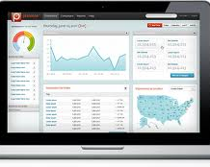

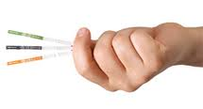



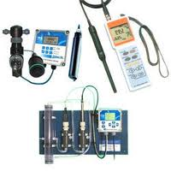
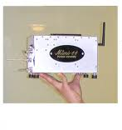
Solution Components
Cloud
Analytics

Slide 22
Complete Closed Loop Solution
Cloud receives and stores data
Highly secure, highly reliable
Integrate sensor data over time
Integrate syndicated and public data for more complete picture
Integrate business system data
Cloud
Connect
Actuate
Sense
Analyze
Sensor data pushed to co-located cell phone or MESH network
Local pre-processing
Smart phone pushes data to cloud
Apply business rules
Algorithms for deeper insight
Workflow based on insight or rules
Optimized sensors and analytical instruments
Measure gas, liquid, solid
Calibrate to specific set of targets based on application area
Integration / action back to business system
Signal back via wireless/ smartphone to actuator
Robust, sensor-based network solution to address specific applications by using optimized sensors for material / condition identification, analysis and action

Slide 23

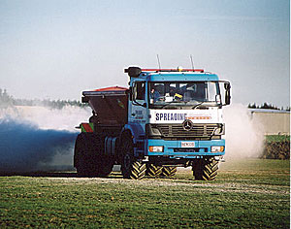
Example: ADAPT-N Optimizing Nitrogen for Corn
Analyze
Precipitation, Temp, Fertilizer, Soil Composition, Yield, Timing, Seed, etc.
Actuate
Sense
O2
H2O
Temp
N2
CO2

Slide 24
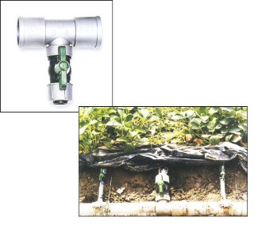
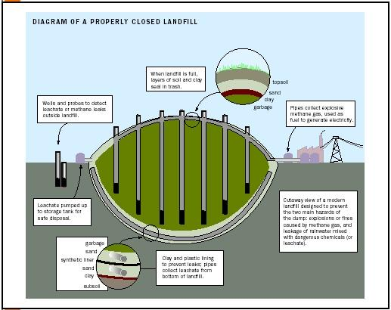
System Example: Landfill Gas Management
Analyze
Weather, Power Output
Temperature, Pressure Variation, etc.
Sense
Methane
CO2
O2
Temp
Flow
Absolute
Pressure
Actuate

Slide 25
Characteristics of a Killer App Market
Significantly better solution than what is currently available on the market today
  Order magnitude lower cost, weight, move from lab to field
  Strong ROI for the customer
Large, growing market
  Potential realizable revenue of $100 - $200 million
Sustainable differentiation
  Innovative technology and business model that can maintain differentiation through IP protection, know how and continuous innovation
Ability to efficiently reach customers
  Trusted channels to reach the customer
  Cost effective customer acquisition cost

