Slide 1
FL3X Config
Working with version control tools
(FL3X Config 1.1.3.0)

Slide 2
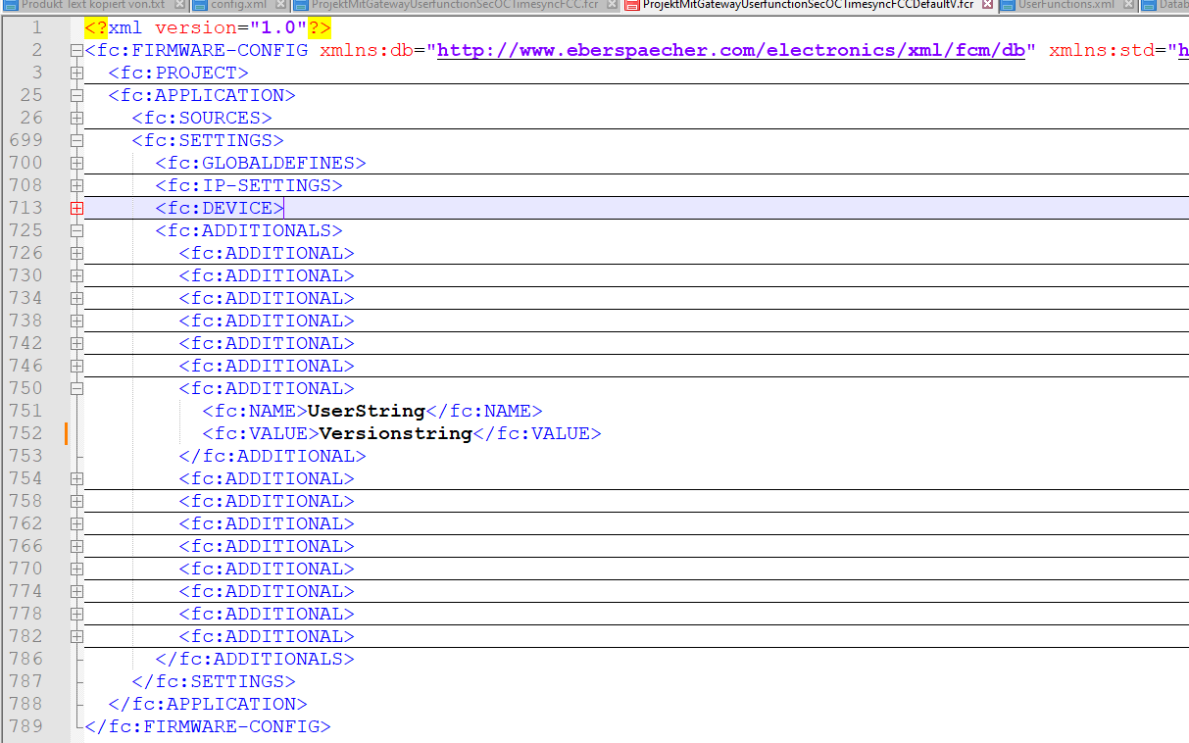


File-Based Project Customization
Project Name
The version string can be adjusted in the file fcr:
%Projektname%.fcr
<fc:ADDITIONAL>
<fc:NAME>UserString</fc:NAME>
<fc:VALUE>Versionstring</fc:VALUE>
</fc:ADDITIONAL>
The project name can be changed by renaming the %Projektname%.fcr file.

Slide 3
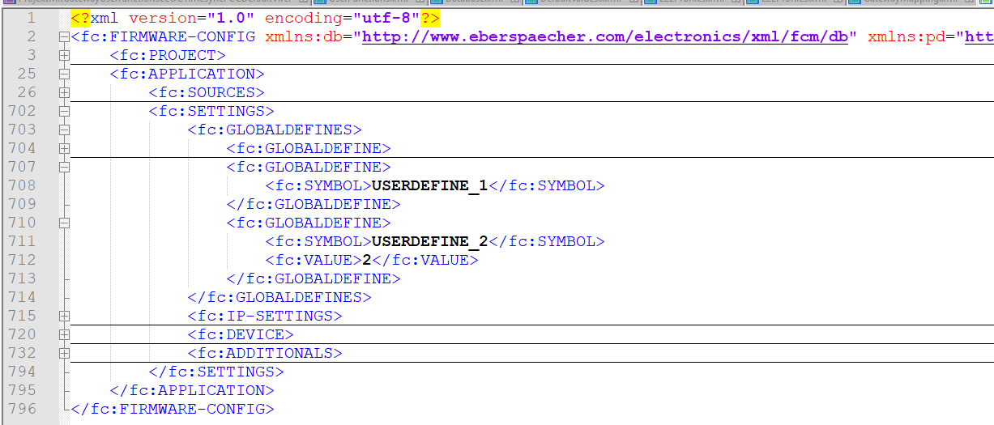
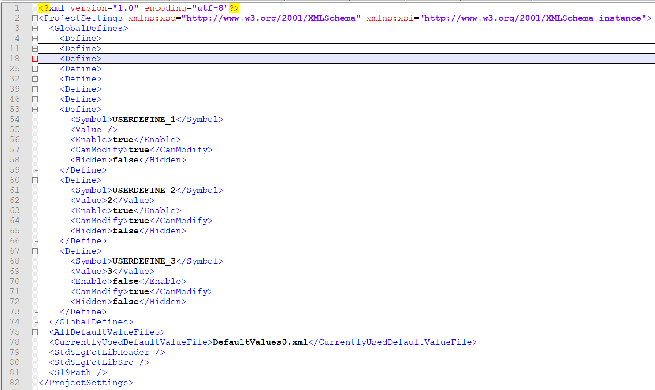
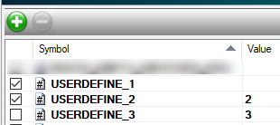

File-Based Project Customization
User Defines
The UserDefines are defined in the "config.xml" file and in the %Projektname%.fcr file:
%Projektname%.fcr
Contains the enabled user defines.
Contains the value assignment information
Config.xml
Contains the enabled and disabled user defines
Contains the value of the Defines
Contains the parameter that determines whether the Define (in the GUI) can be edited
Contains the setting that determines whether the Define (in the GUI) is displayed

Slide 4


File-Based Project Customization
User Function Editor - User Library / Load User Files
To load user files or user libraries, simply copy them into the "usr" folder in the project directory.

Slide 5
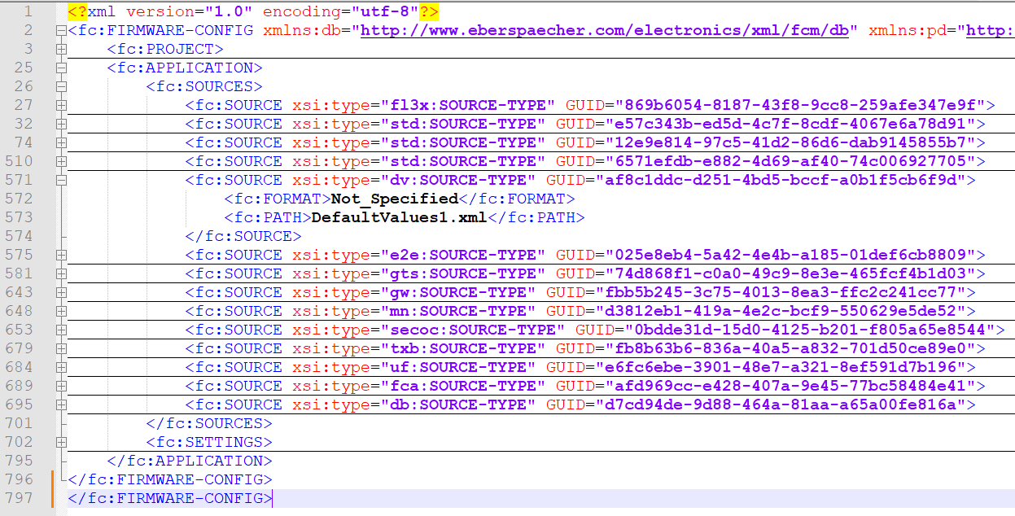
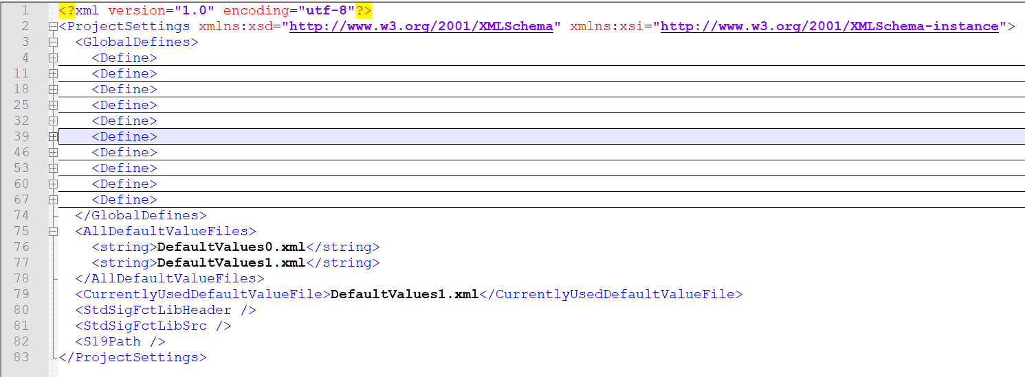
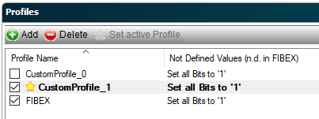


File-Based Project Customization
Default Values 1/2
If both files are present, which one takes priority?
Default values can be adjusted in the %Projektname%.fcr and "config.xml" files and in %DefaultVales_ProfileName%.xml:

Slide 6

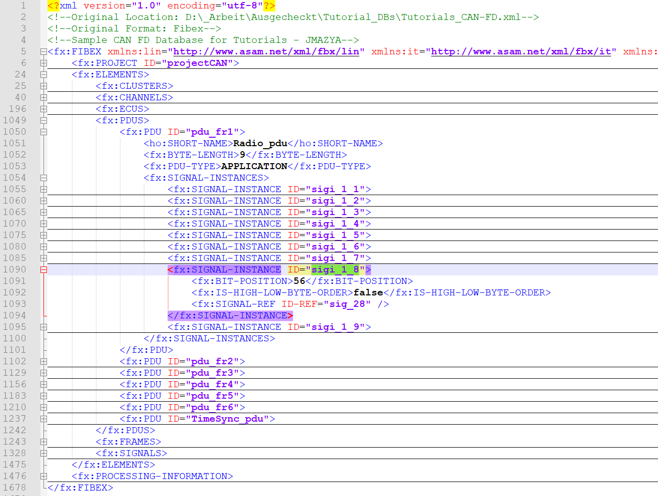
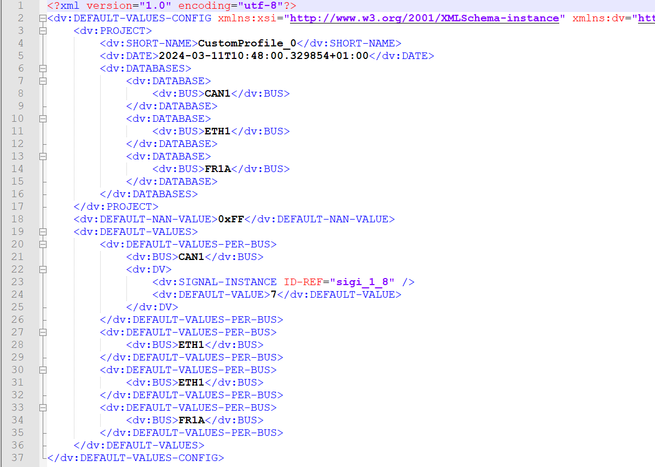
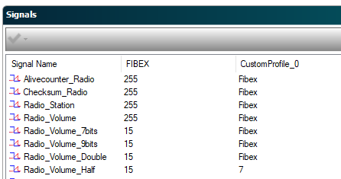
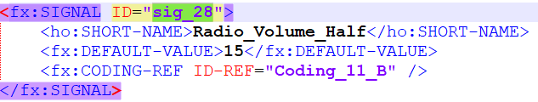
File-Based Project Customization
Default Values 2/2
Default values can be adjusted in the %DefaultVales_ProfileName%.xml file:
%DefaultVales_ProfileName%.xml
Contains the signal bus
Contains the signal reference (converted database)
Contains the default value
Only signal default value changes are saved; otherwise, the default value is the same as the database default value.

Slide 7
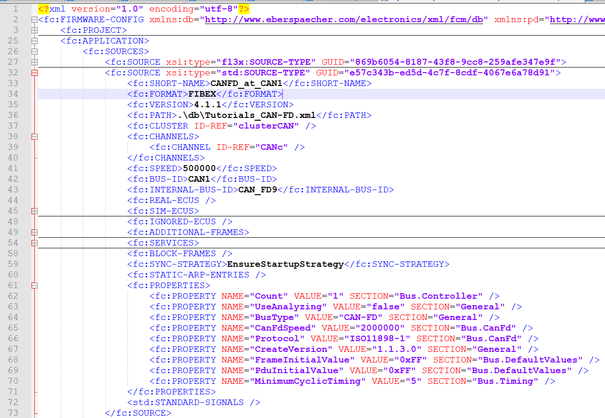
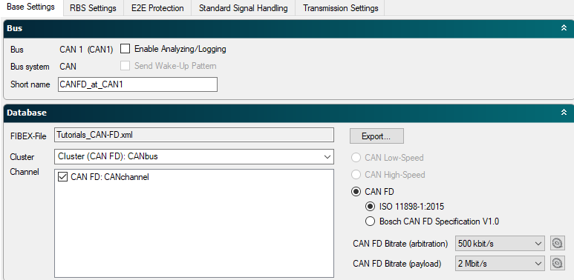
File-Based Project Customization
Bus Configuration – Base Settings CAN 1/2
Bus base settings can be adjusted in the %Projektname%.fcr:
%Projektname%.fcr
Contains the CAN arbitration bit rates
Contains the CAN data bit rate
Contains the CAN protocol

Slide 8
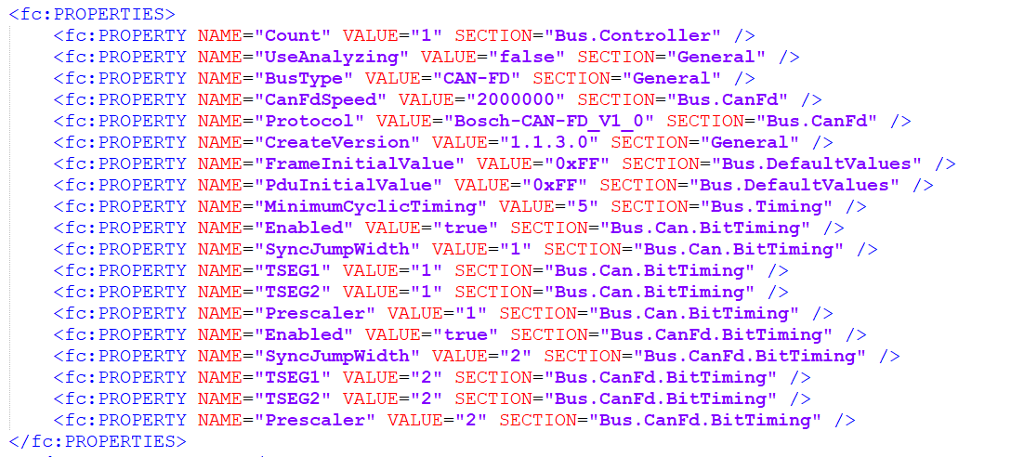
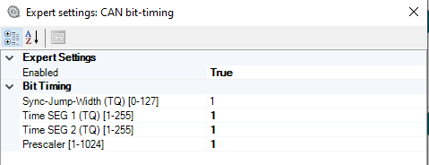
File-Based Project Customization
Bus Configuration – Base Settings CAN 2/2
Bus base settings can be adjusted in the %Projektname%.fcr:
%Projektname%.fcr
Contains the expert settings for CAN arbitration bit rates
Contains the expert settings for the CAN data bit rate

Slide 9
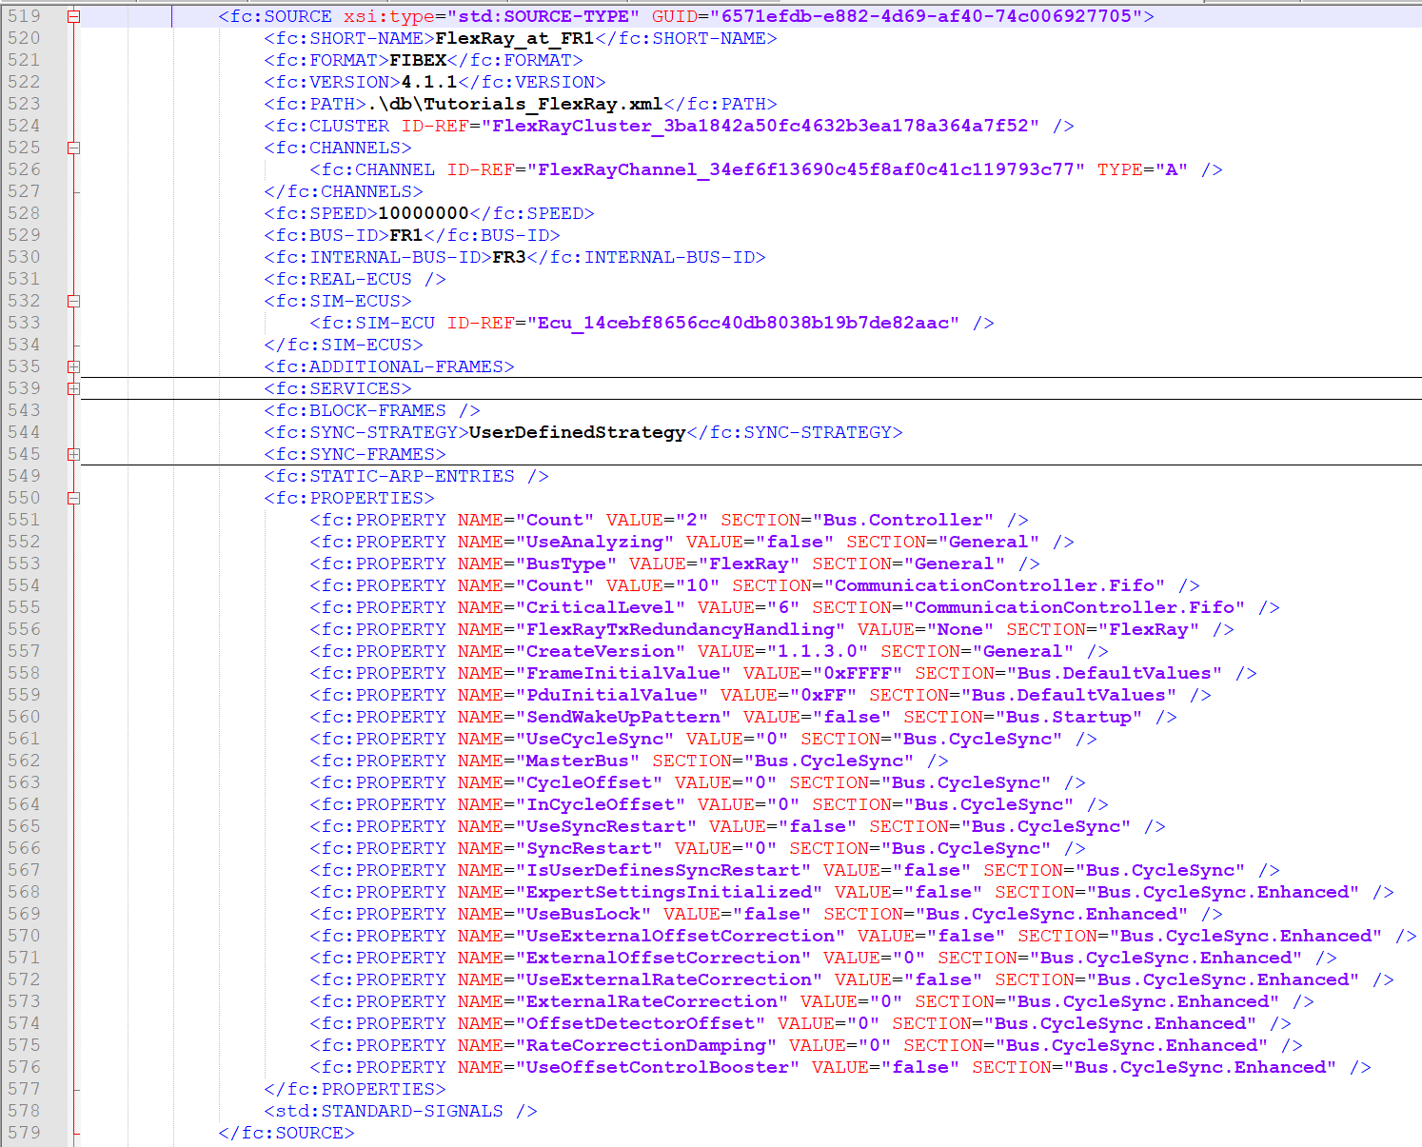
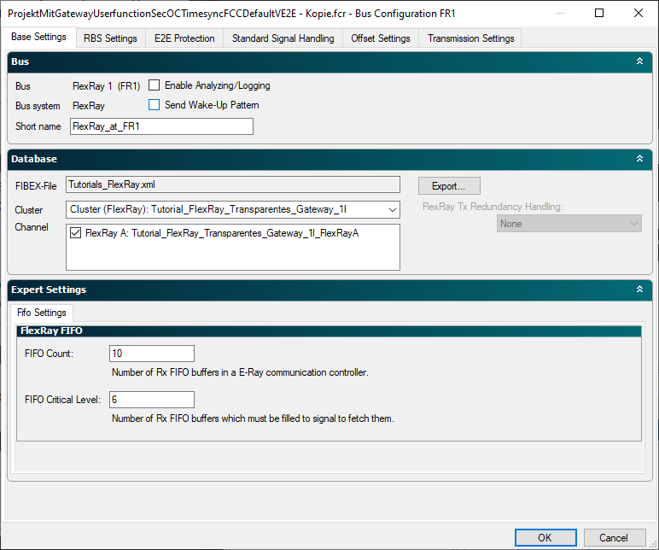
File-Based Project Customization
Bus Configuration – Base Settings
FlexRay 1/3
Bus base settings can be adjusted in the %Projektname%.fcr:
%Projektname%.fcr
-

Slide 10
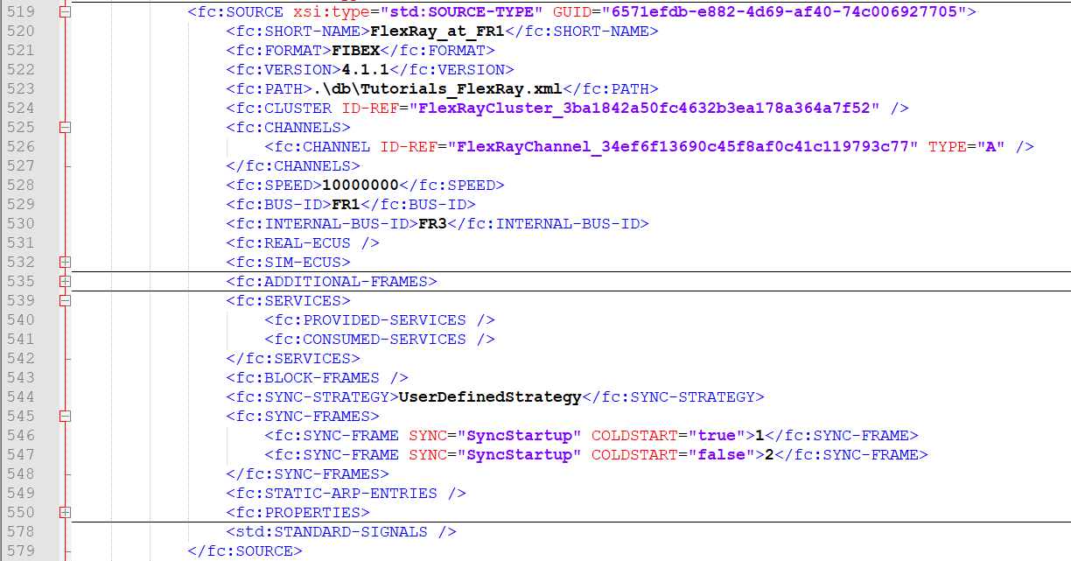
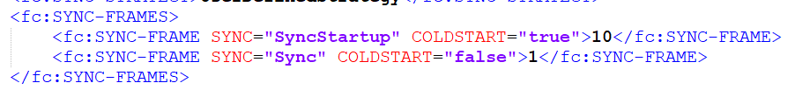
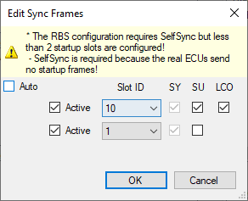
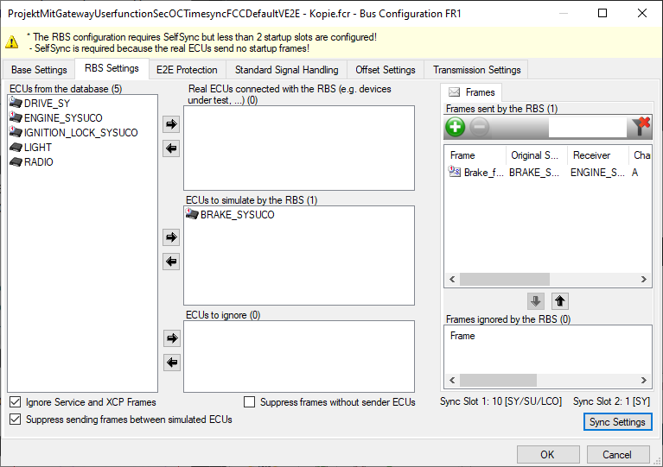
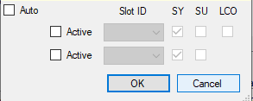
File-Based Project Customization
Bus Configuration – Base Settings
FlexRay 2/3
Bus base settings can be adjusted in the %Projektname%.fcr:
%Projektname%.fcr
Contains the sync configuration of a FlexRay bus
No entry "<fc:SYNC-Frames>"

Slide 11
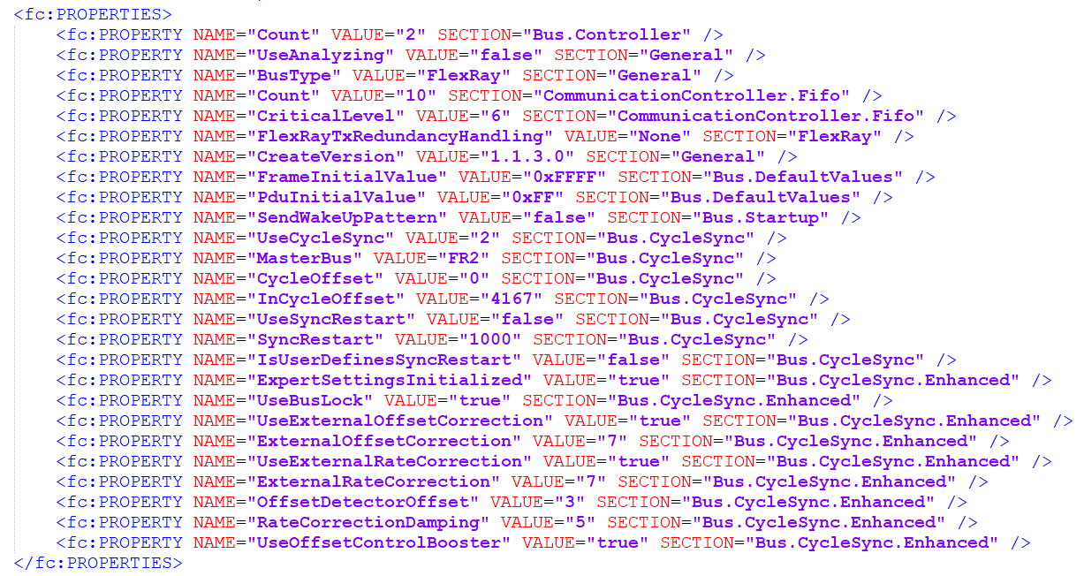
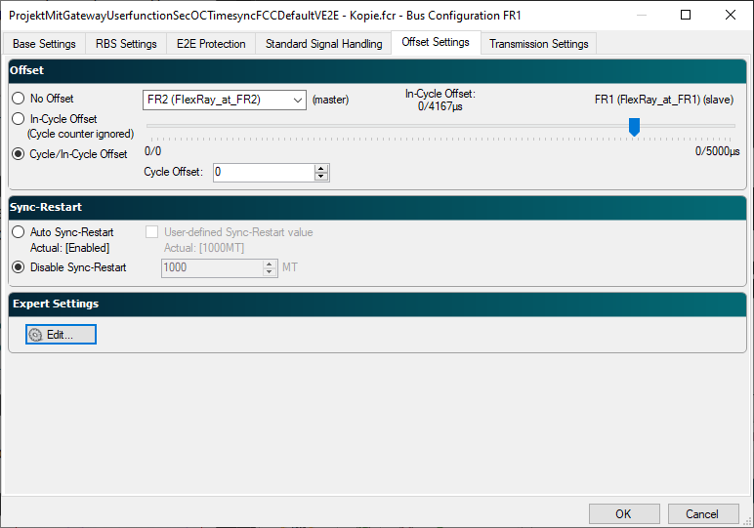
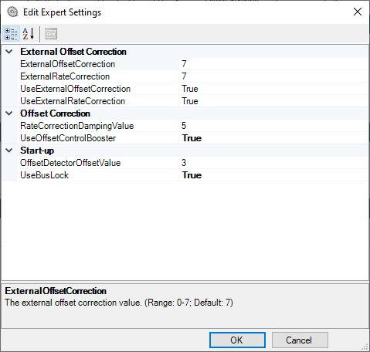
File-Based Project Customization
Bus Configuration – Base Settings
FlexRay 3/3
Offset control settings for a bus can be adjusted in the %Projektname%.fcr:
%Projektname%.fcr
Contains information about the offset control master
Contains information about the configured offset
Contains information about the offset control behavior (restart bus)
Contains information about the control parameters

Slide 12
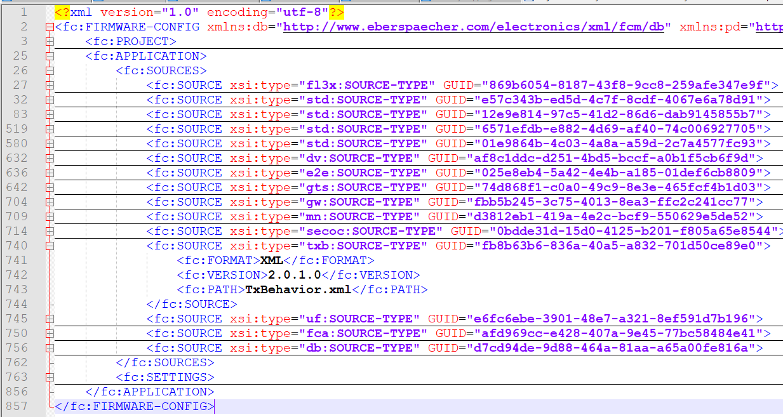
File-Based Project Customization
Transmission Settings
The transmission settings file is referenced in the %Projektname%.fcr file

Slide 13
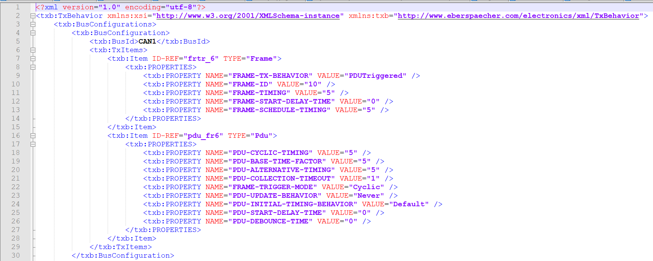

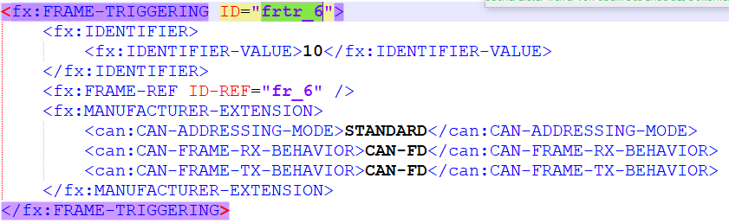
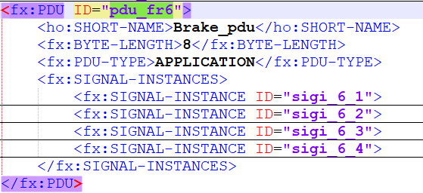
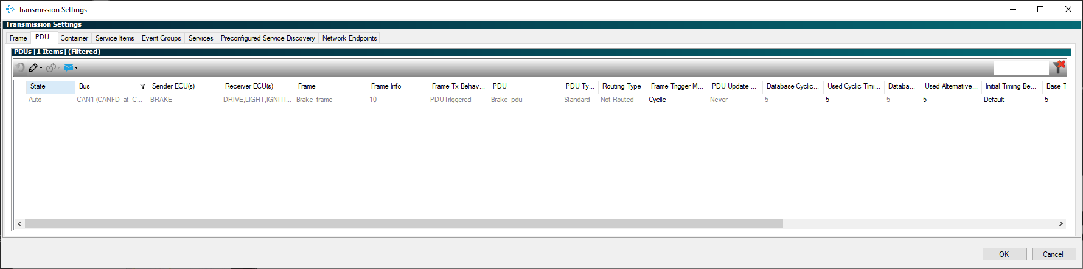
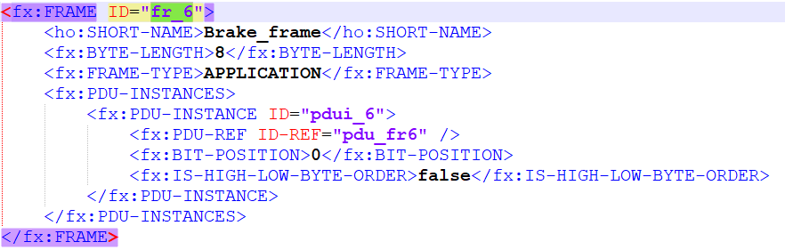
File-Based Project Customization
Transmission Settings - CAN
Transmission settings for CAN elements are linked to database IDs in the file.
The transmission settings values can be configured in the file.
WARNING:
For CANdb (*.dbc) databases, random IDs are generated here (based on the date).

Slide 14
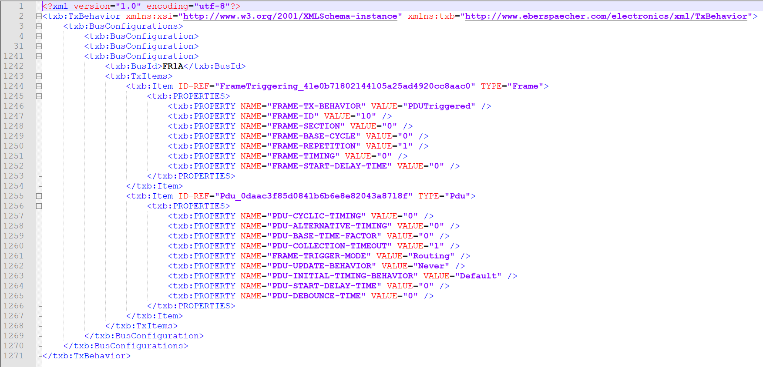
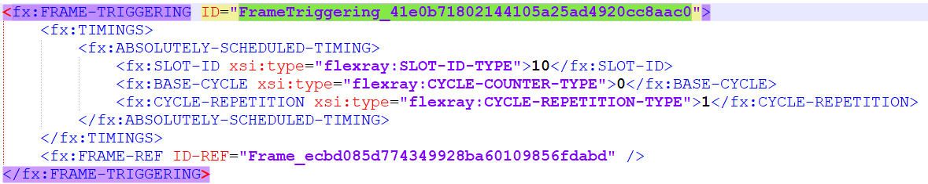
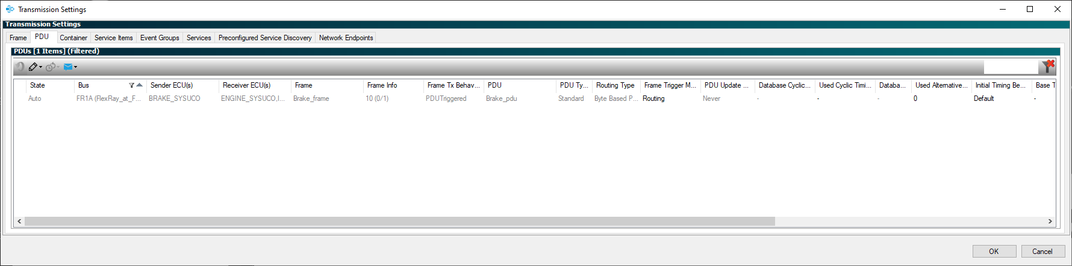
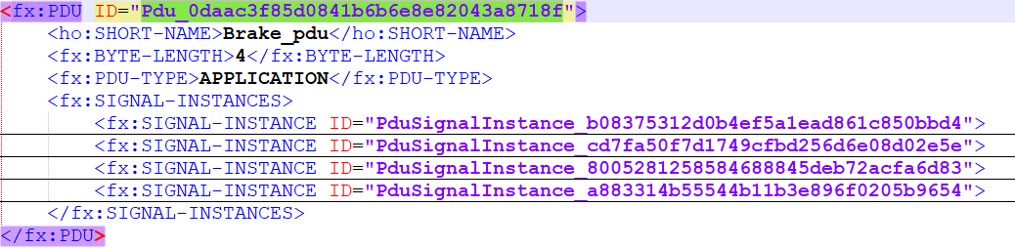
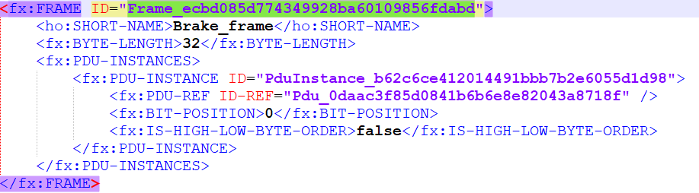
File-Based Project Customization
Transmission Settings – FlexRay
Transmission settings for FlexRay elements are linked to database IDs in the file.
The transmission settings values can be configured in the file.

Slide 15
File-Based Project Customization
Transmission Settings - Ethernet
Transmission settings for Ethernet elements are linked to database IDs in the file.
The transmission settings values can be configured in the file.

Slide 16
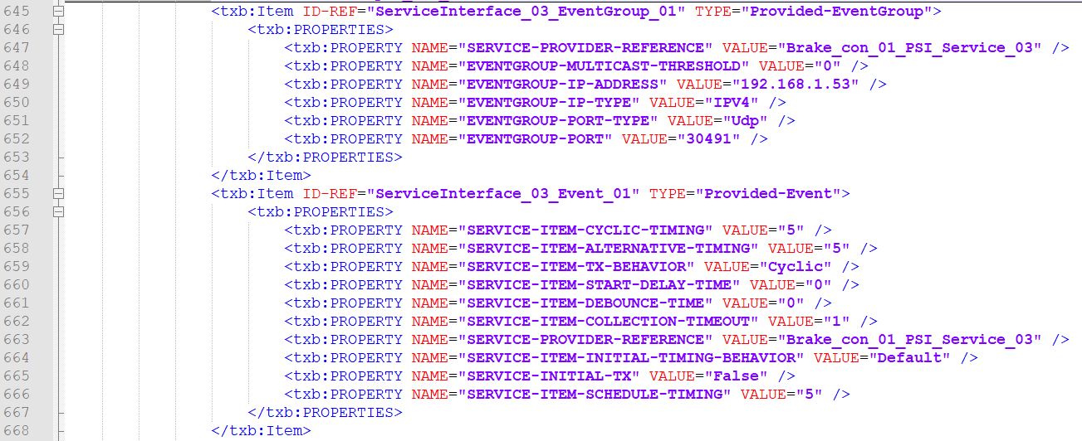
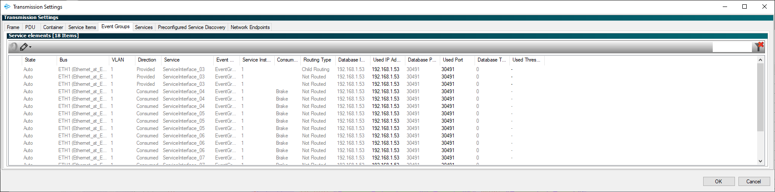
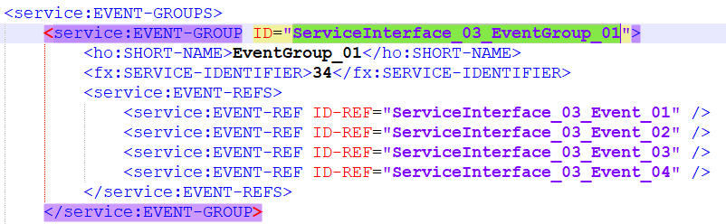
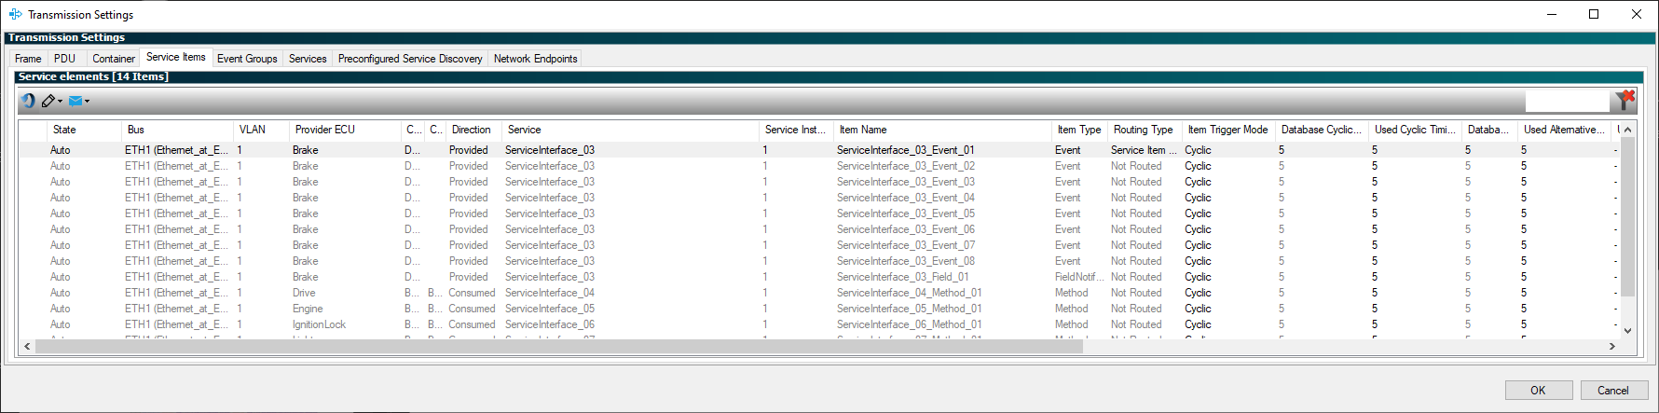
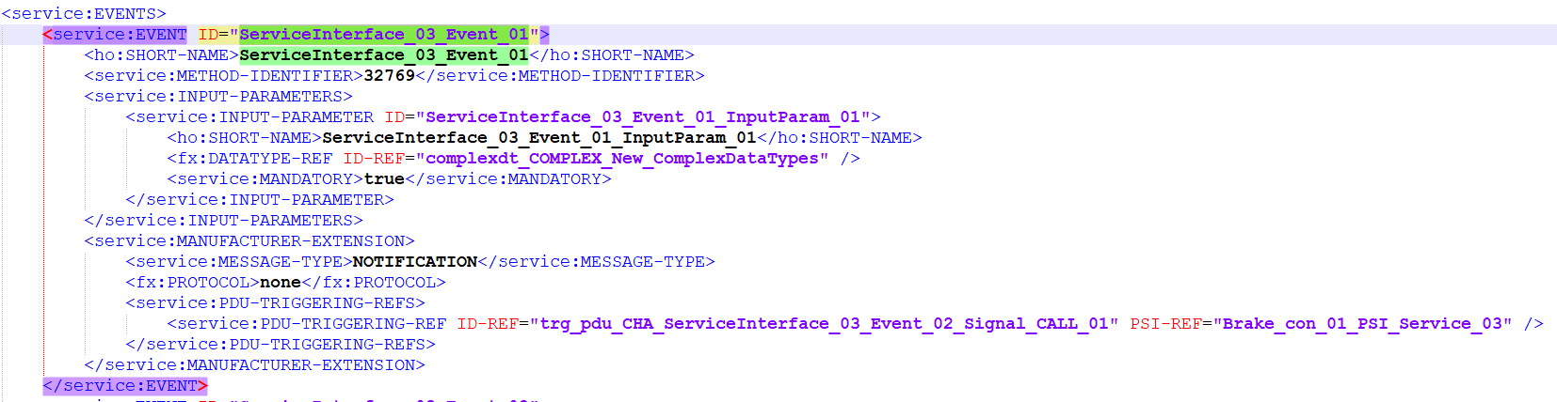
File-Based Project Customization
Transmission Settings - Ethernet
Transmission settings for Ethernet elements are linked to database IDs in the file.
The transmission settings values can be configured in the file.

Slide 17
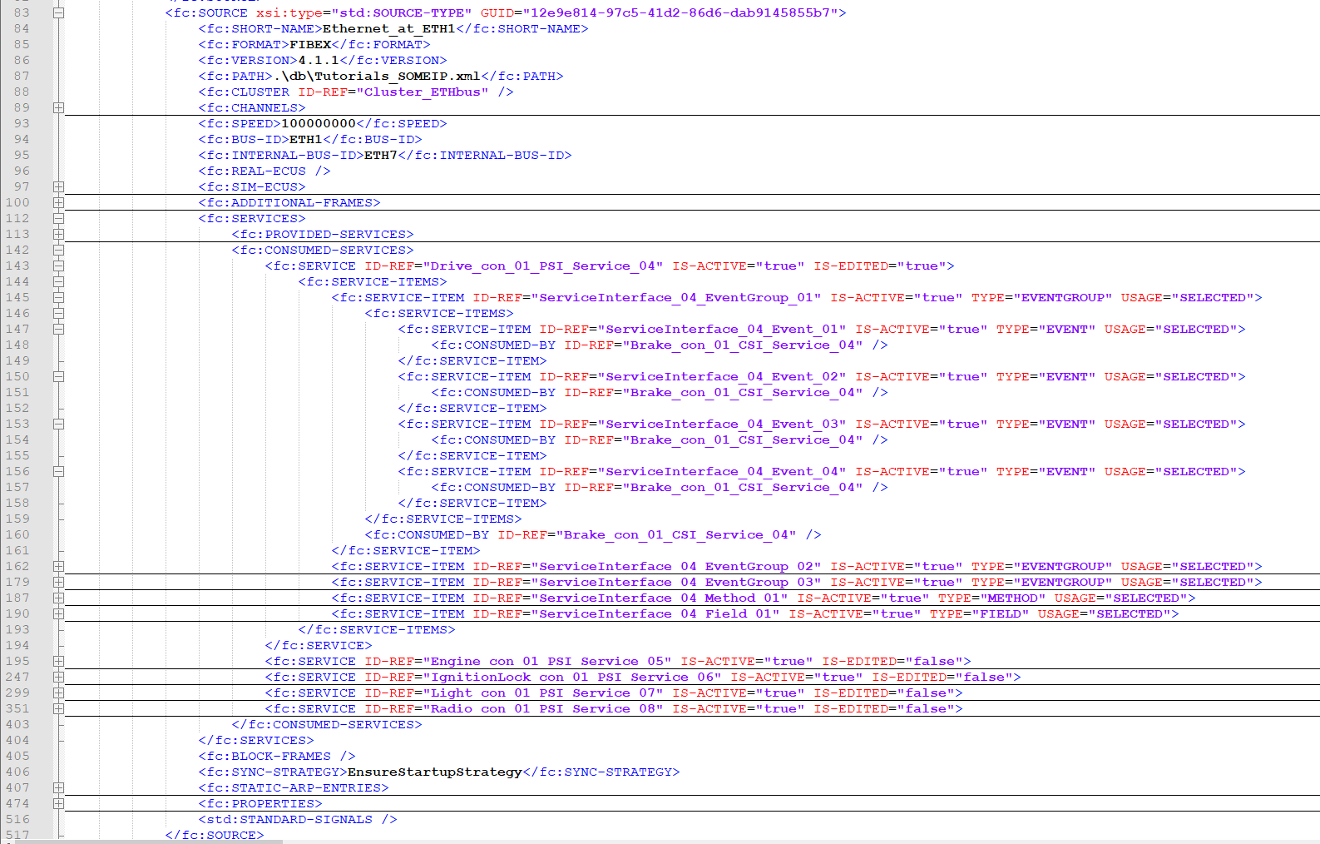

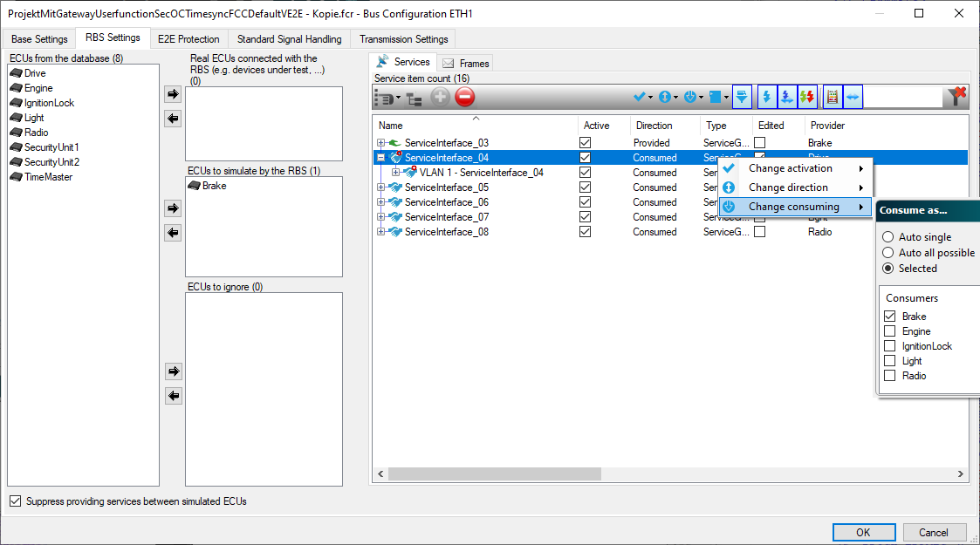
File-Based Project Customization
Consumed as - Ethernet
Transmission settings for Ethernet elements are linked to database IDs in the file.
The transmission settings values can be configured in the file.
Example: Multi Consumed

Slide 18
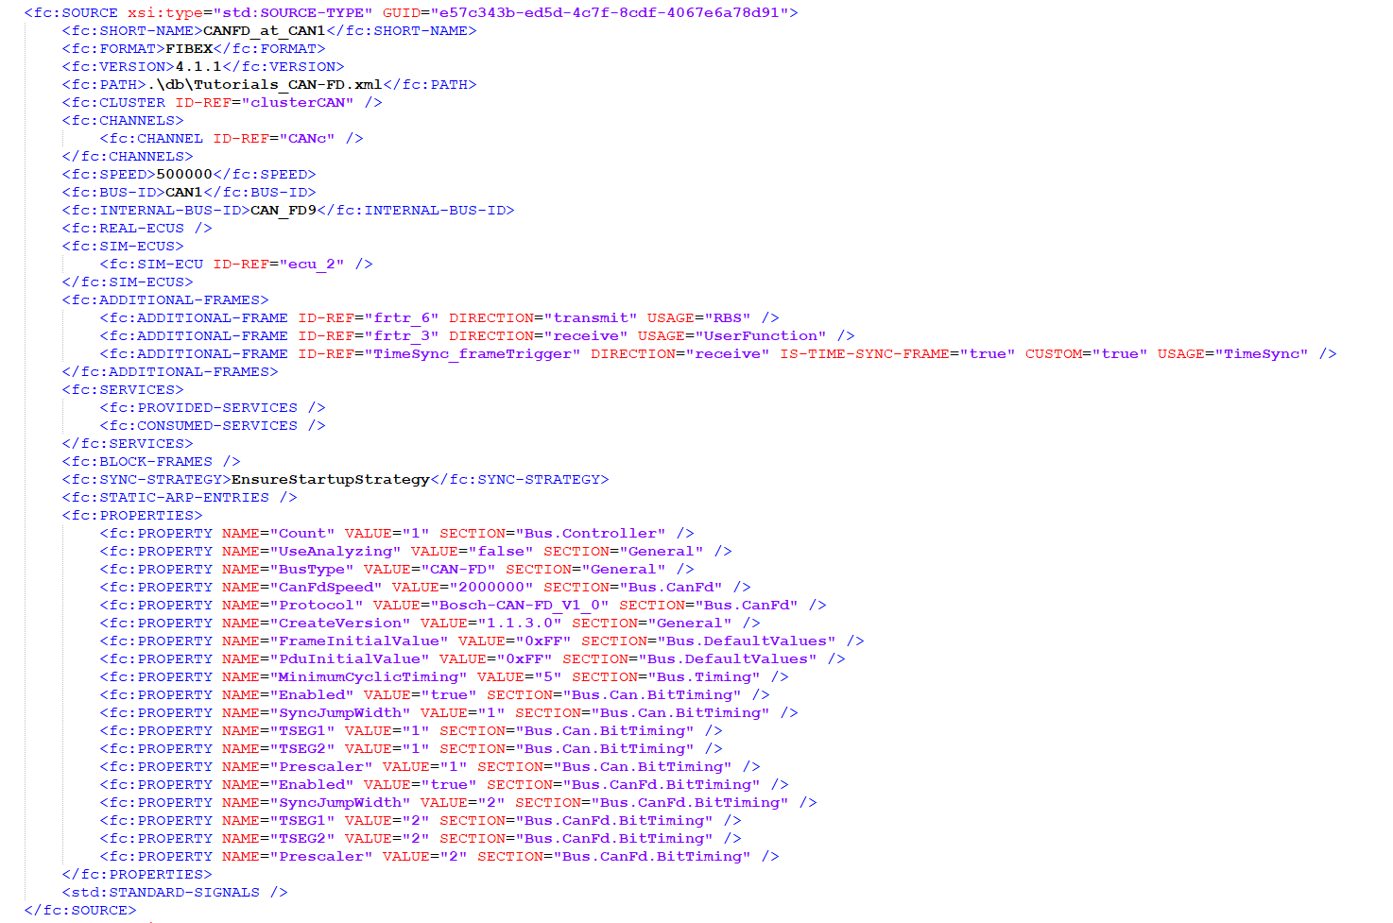
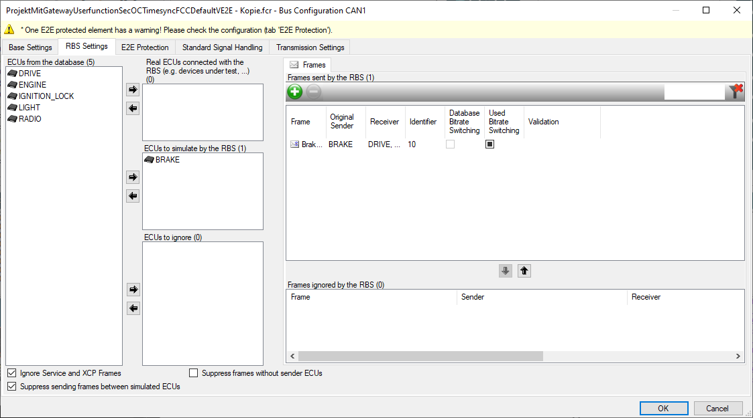
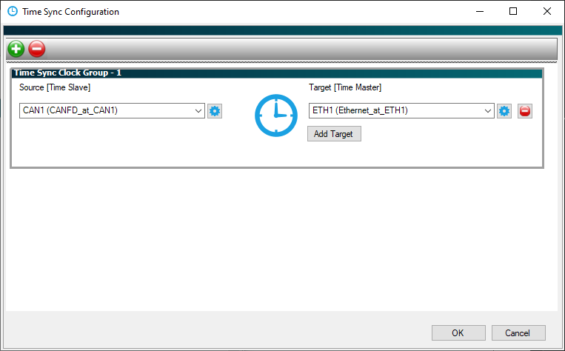
File-Based Project Customization
Restbus simulation
Info:
USAGE="RBS" for all simulated elements
USAGE="UserFunction" for all receive elements via UserFunction
USAGE="TimeSync" when the frame time is based on the TimeSync config settings.
Note: Gateway receive frames are not mapped here; Mapping.xml is sufficient for these.
Restbus simulation elements (rx and tx) are described in the %Projektname%.fcr file.

Slide 19
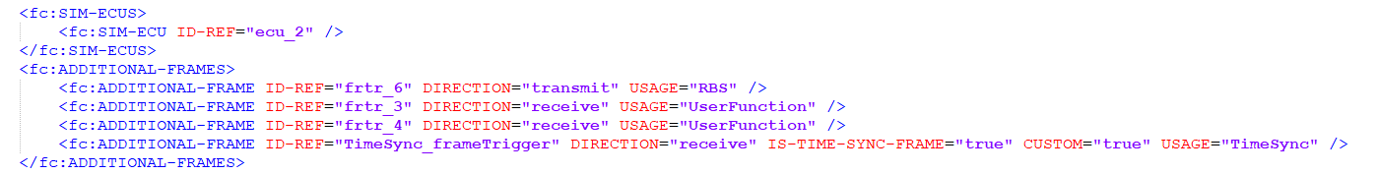
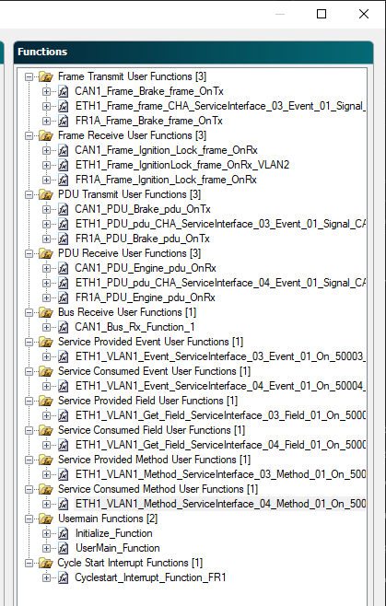
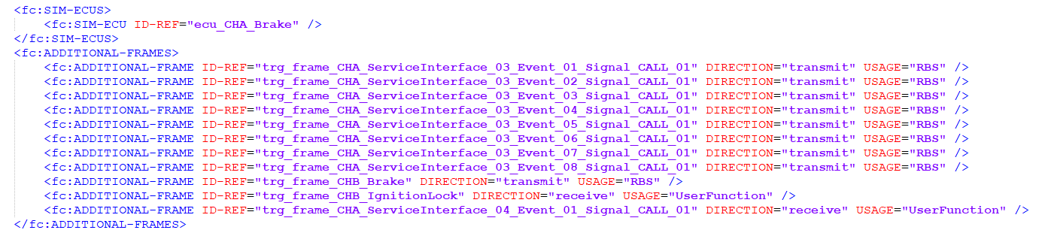
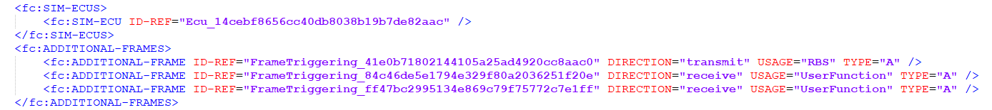





File-Based Project Customization
Userfunctions

Slide 20





File-Based Project Customization
Gateway

Slide 21






Project Files
Used by Bosch
Project | Create a new project | Project with database/channel assignment | Project with restbus simulation (at least 1 transmit element) | Project with gateway | Project with user functions
PreCompile
PostCompile
Info:
Not all configurations are shown here; for example, Default Values are missing

Slide 22





Project critical changes
>> FL3X Config -> Bus Configuration -> RBS Settings
FL3X Config performs automatic calculations (e.g., when simulating an ECU). This functionality cannot be replicated by editing the files (without enormous effort and a very deep understanding of the relationships)!
There is a high risk that file edits will break projects.
Affected functionality:
Change/configure ECU assignments
Change/configure elements (Frame/PDU/Service/…)
<Add/delete bus>

Slide 23

Project risky changes
>> FL3X Config automatic calculations
FL3X Config provides several validations to determine whether routings are valid and can be created.
When creating or modifying routings, invalid routings can be configured, resulting in unpredictable behavior.
Affected functionality:
Creating/modifying routings

Slide 24







Project less risky changes
Parameter changes are less risky
Several operations can be configured (or reconfigured) by modifying project files. If all relevant locations are taken into account, project configurations can be changed directly in the project files.
Affected functionality:
All parameter changes to existing project files (always observe parameter limits, e.g., version string -> 16 characters, no special characters, …)

Slide 25









FCR File Links

Slide 26
Disclaimer
>> Projects that no longer work (e.g., can no longer be loaded) due to changes to project files cannot be investigated as part of free standard support.
>> There is no guarantee that projects with a "broken" configuration can be made operational again.
>> A project may behave differently depending on whether it is compiled after modifying the project data, or whether all dialogs are reopened in the GUI and then compiled. (Automatic calculations triggered when closing a dialog may cause changes to take effect.)

