Slide 1

ANDROID
Presented By:
Anoop C.H
ImroKraft solution ptd

Slide 2
Content
History
Introduction of android
Android versions
Android architecture
Android lifecycle
Security
Features of android
Advantage of android
Conclusion

Slide 3
Introduction
Open source Frame work based on Linux kernal
Developed by the Open Handset Alliance, led by Google.
Beta version - SDK was released by Google in 2007
First commercial version- Android 1.0-September 2008.

Slide 4
Versions
1 Pre-commercial release versions (2007–2008)
1.1 Alpha
1.2 Beta
1.5 Cupcake
1.6 Donut
2.0 Eclair
2.0.1 Eclair
2.1 Eclair
2.2–2.2.3 Froyo
2.3–2.3.2 Gingerbread
2.3.3–2.3.7 Gingerbread
3.0 Honeycomb
3.1 Honeycomb
3.2 Honeycomb
4.0–4.0.2 Ice Cream Sandwich
4.0.3–4.0.4 Ice Cream Sandwich
4.1 Jelly Bean
4.2 Jelly Bean
4.3 Jelly Bean
4.4 KitKat
4.4 KitKat with wearable extensions
5.0 Lollipop

Slide 5
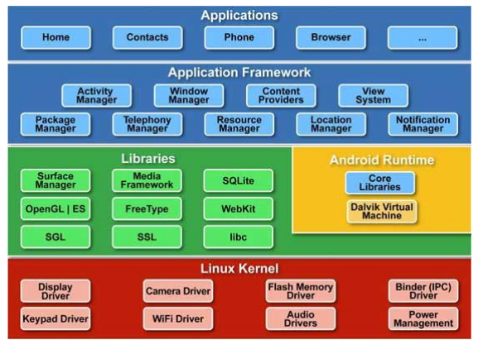
Architecture

Slide 6
Linux kernel:
This provides basic system functionality like process management, memory management, device management like camera, keypad, display etc
Libraries:
On top of Linux kernel there is a set of libraries including open-source Web browser engine WebKit, SQLite database which is a useful repository for storage and sharing of application data etc
Android Runtime:
Core libraries which enable Android application developers to write Android applications using standard Java programming language. The Dalvik VM enables every Android application to run in its own process, with its own instance of the Dalvik virtual machine.
Application Framework:
Layer provides many higher-level services to applications in th"e form of Java classes.
Applications:
Android application at the top layer. You will write your application to be installed on this layer only.

Slide 7
SAMPLE VIDEO

Slide 9
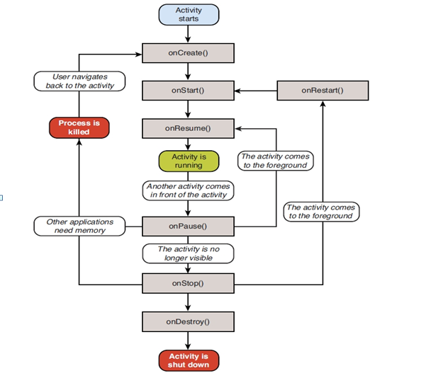
Lifecycle

Slide 10
onCreate() -This is the first callback and called when the activity is first created.
onStart() -This callback is called when the activity becomes visible to the user.
onResume() -This is called when the user starts interacting with the application.
onPause() -The paused activity does not receive user input and cannot execute any code and called when the current activity is being paused and the previous activity is being resumed.
onStop() - This callback is called when the activity is no longer visible.
onDestroy() -This callback is called before the activity is destroyed by the system.
onRestart() -This callback is called when the activity restarts after stopping it.

Slide 11
Security
Securing an open platform requires a robust security architecture
Android was designed with multi-layered security
Users are provided visibility into how applications work, and control over those applications.
Android was designed to reduce malware, and attacks on third-party applications on

Slide 12
Features of android

Slide 13
Advantage of android
Multitasking
Ease of Notification
Easy access to thousands of applications
Phone options are diverse
Can install a modified ROM

Slide 14
Why and who need android ?

Slide 15
THANK YOU

