Slide 1




Notes:
BOA Bar Control — unified inventory, ordering, and operations platform. Handles stock across 1,284 containers spanning Warehouse (638), Bars (520), and Hospitality (126). Real-time sync with live status, alerts on low stock and overdue counts.

Slide 2


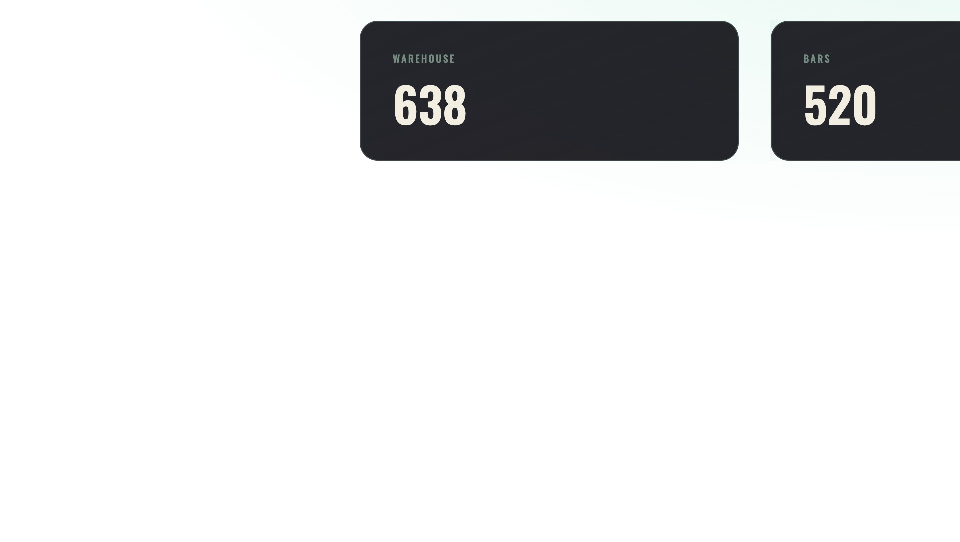

Notes:
Total stock snapshot. 1,284 containers distributed across Warehouse (638), Bars (520), and Hospitality (126). Live sync at 19:43 IST. This is the home screen view — real-time count with a 3-section breakdown.

Slide 3


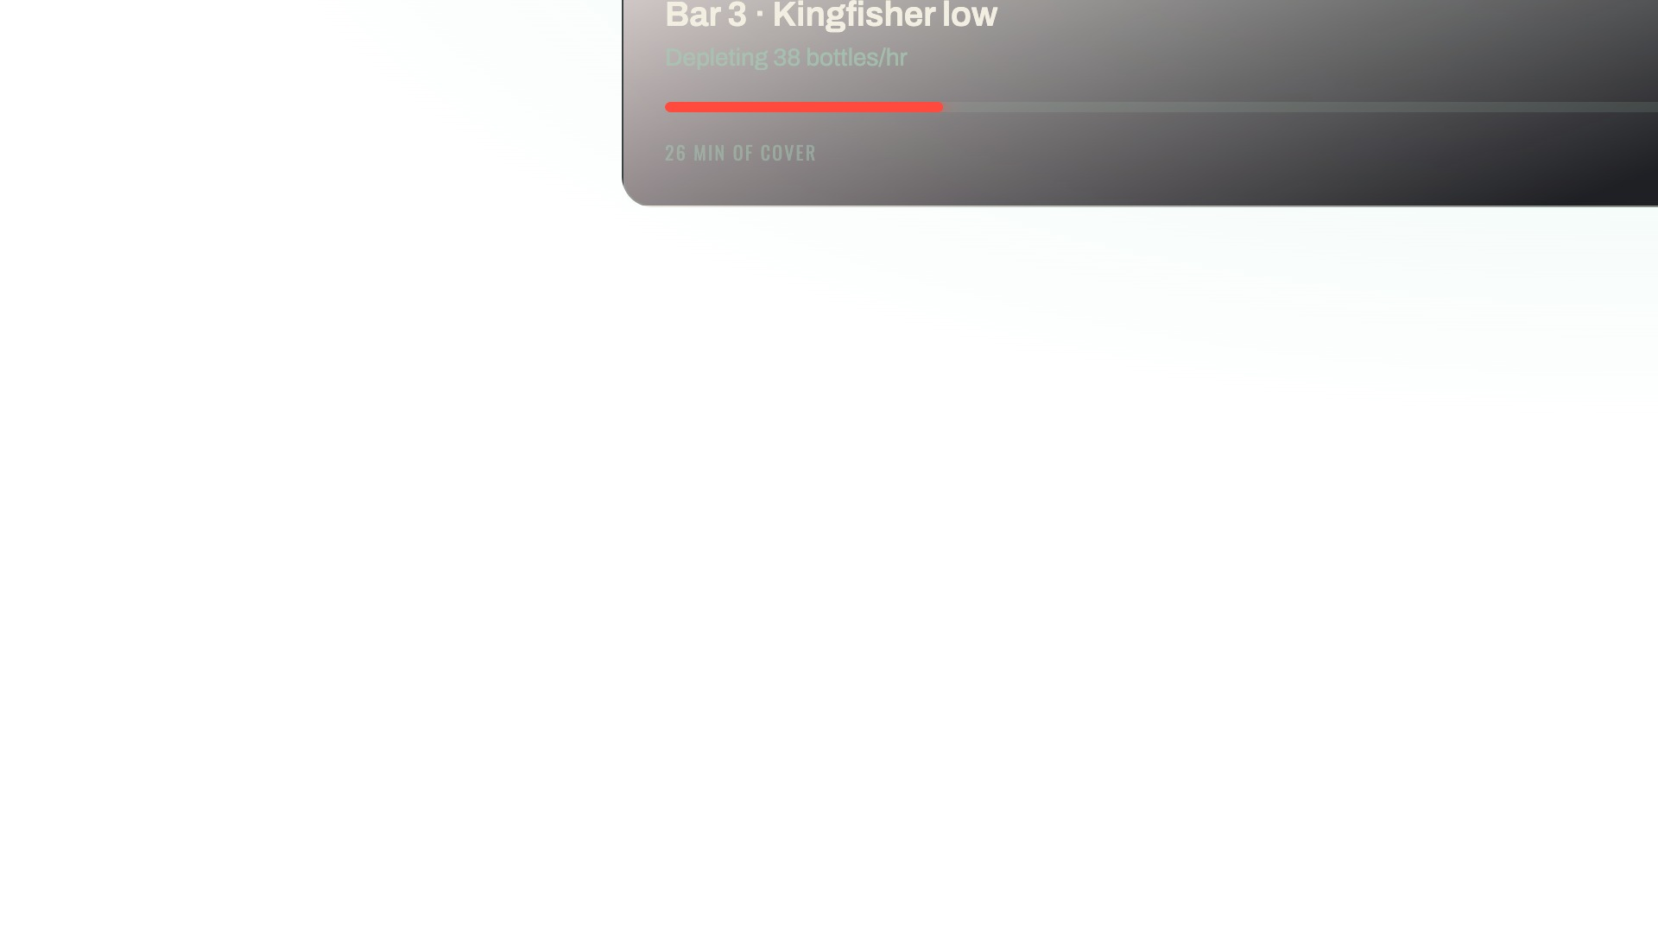

Notes:
Real-time alerts on the home screen. Three active: Kingfisher run-out (12 left, 26 min of cover) is critical; two dockets await acceptance (oldest 18 min, 30 min SLA); Bar 2 count 22 min overdue. Severity pill, urgency meter, and action button on each card.

Slide 4


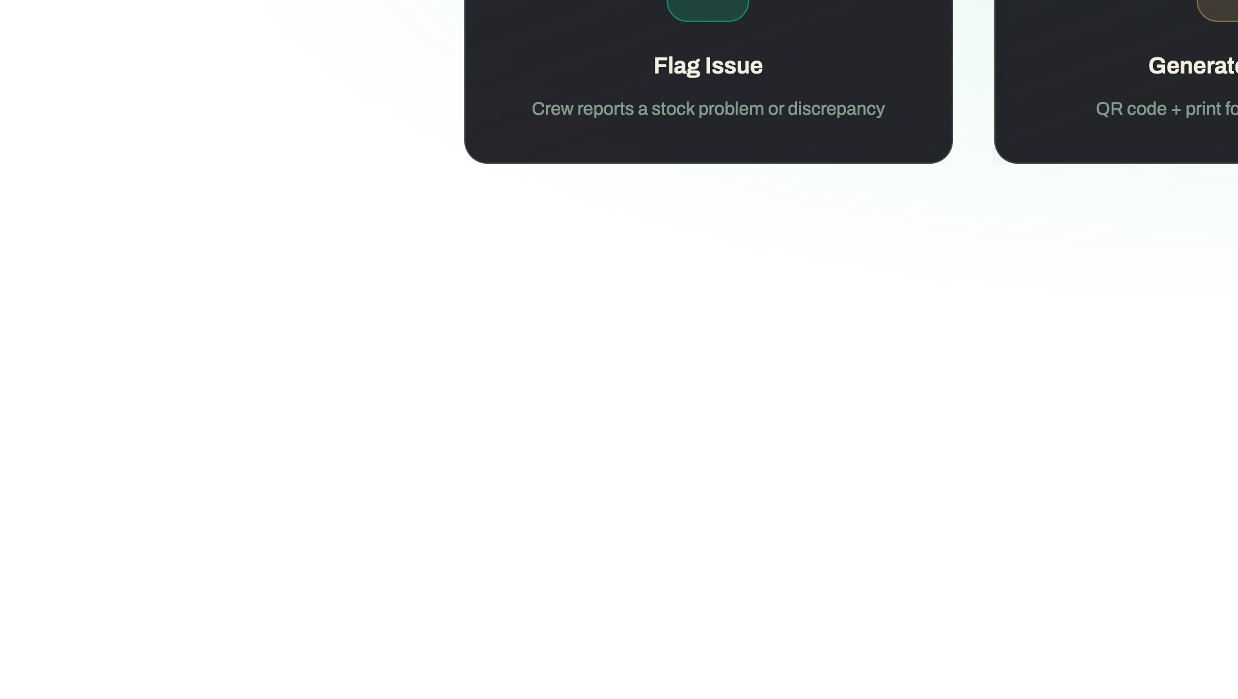
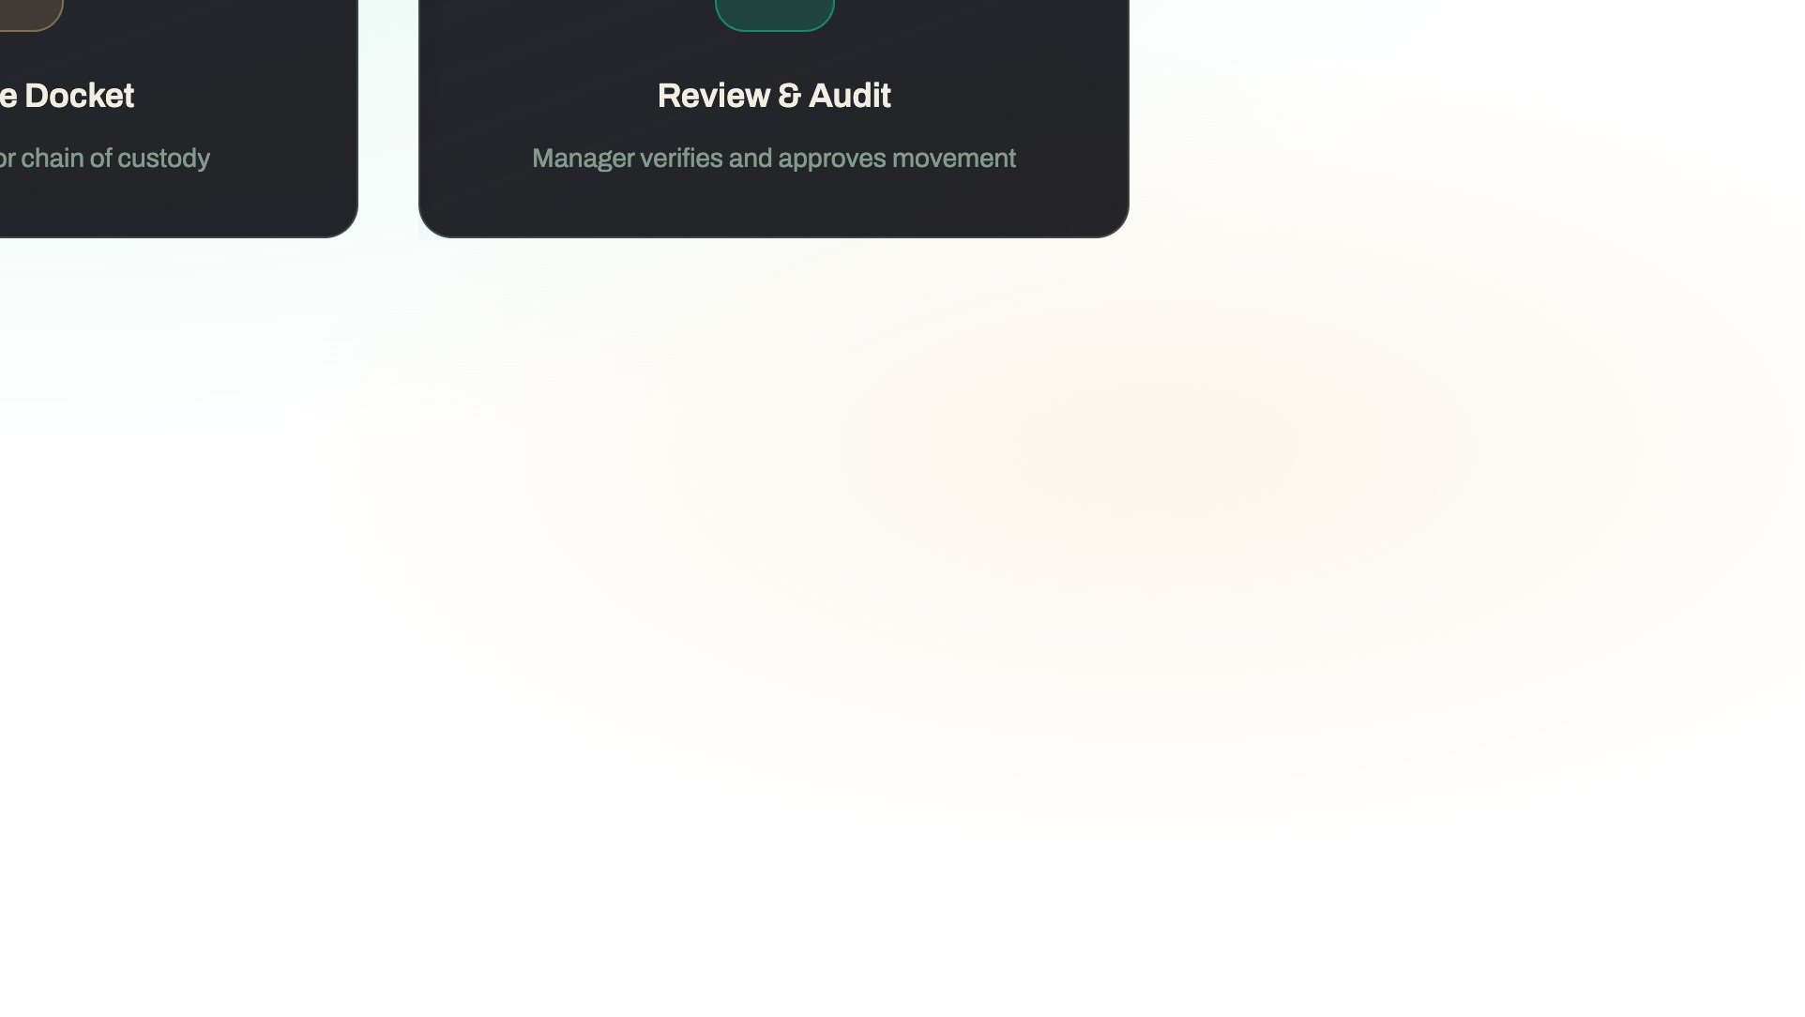
Notes:
When a run-out is detected, crew flags it. Issue screen confirms the SKU, location, and reason. Enters a queue for manager review. The docket is printed with a QR code for chain-of-custody tracking — every container movement is logged and auditable.

Slide 5


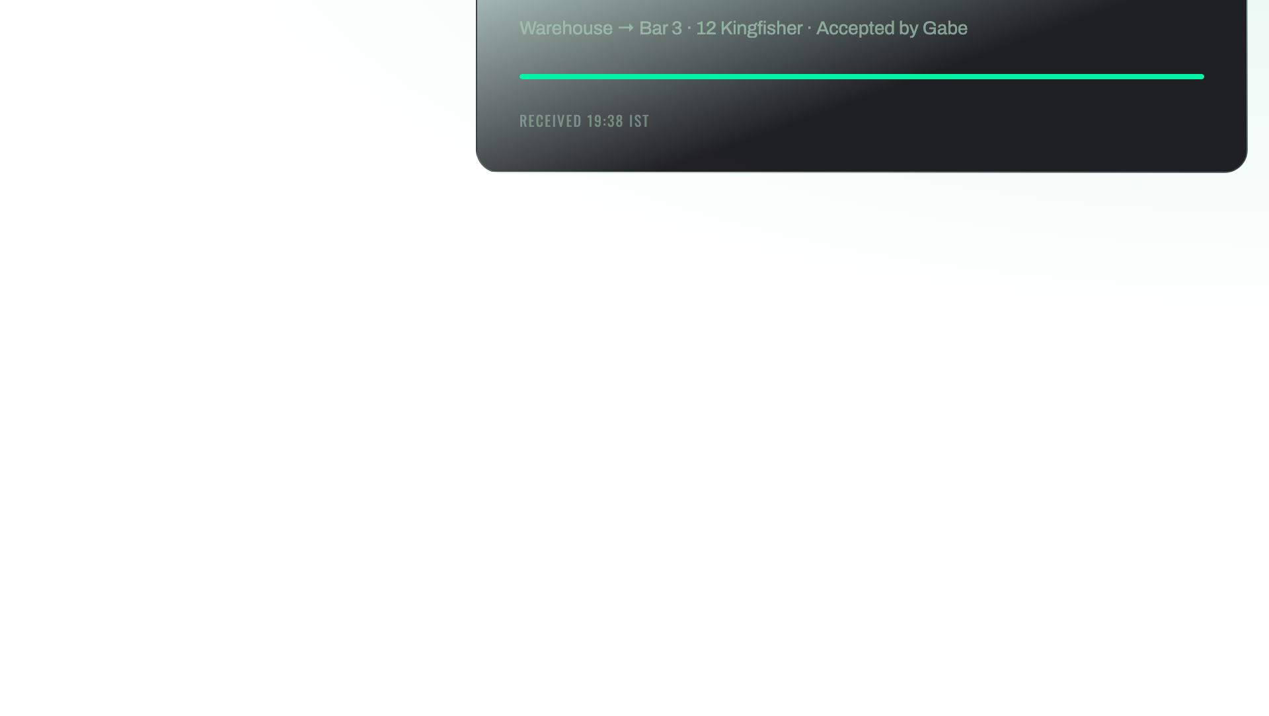

Notes:
Warehouse shipments arrive. Crew scans the docket QR, receives the container, confirms count. If there's a variance (broken, less than expected), they report it with a photo and note — full audit trail. Manager flags it for investigation.

Slide 6


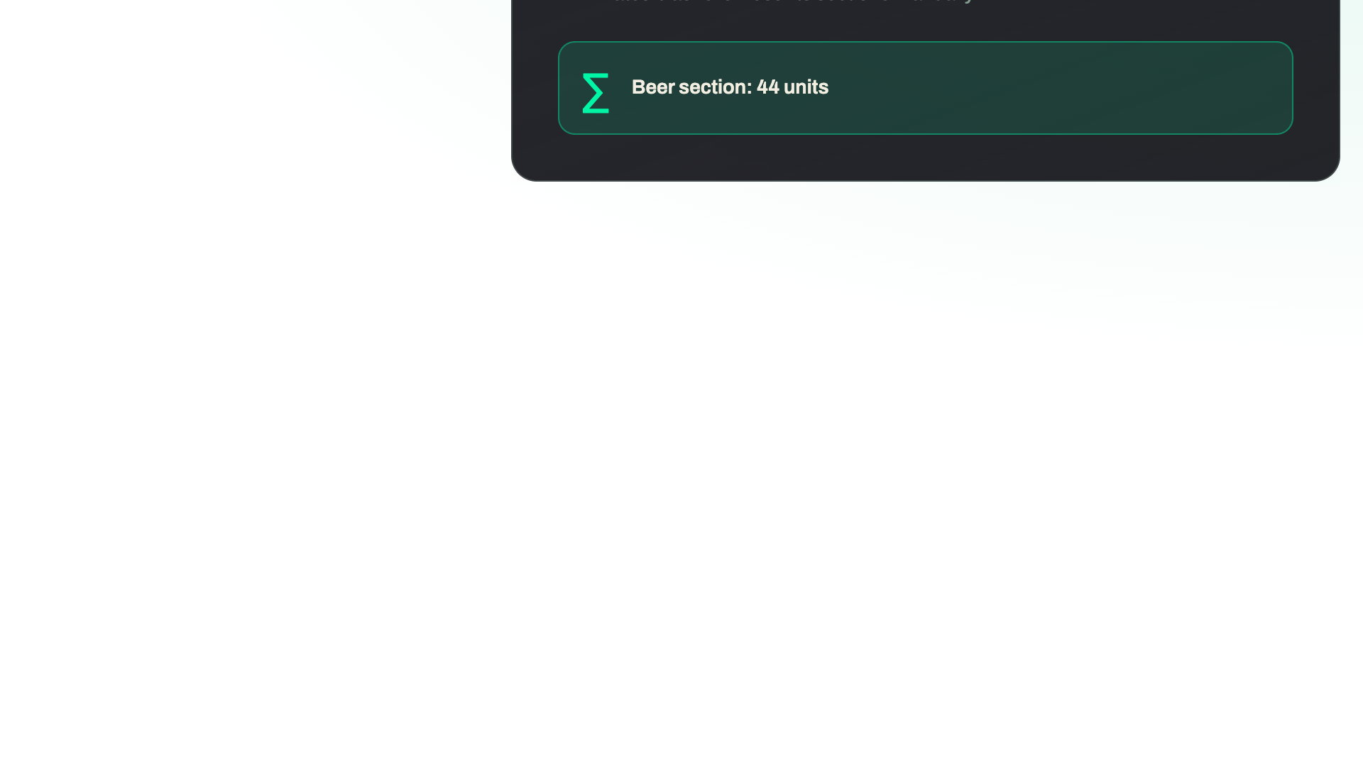
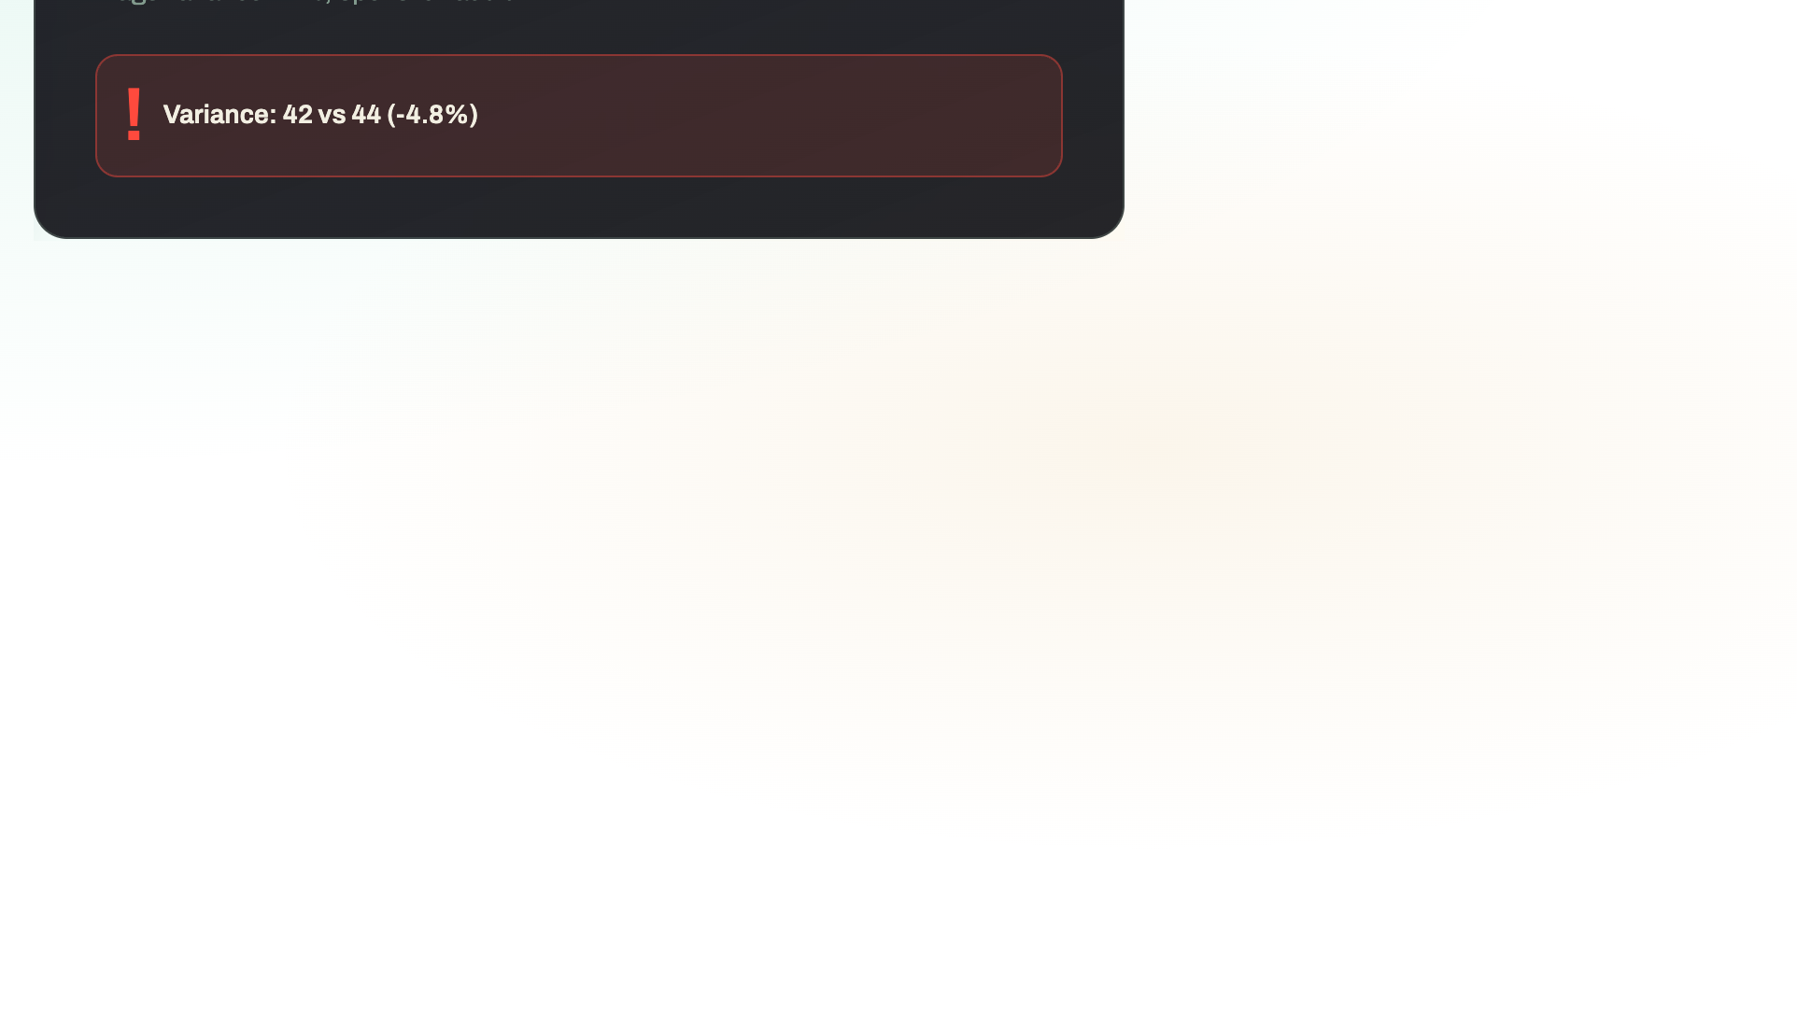
Notes:
Periodic counts without expected figures in view — prevents anchoring bias. Crew counts the section or bar, submits. System compares to the ledger and flags any big discrepancies. Full variance audit with photos, notes, and decision log.

Slide 7

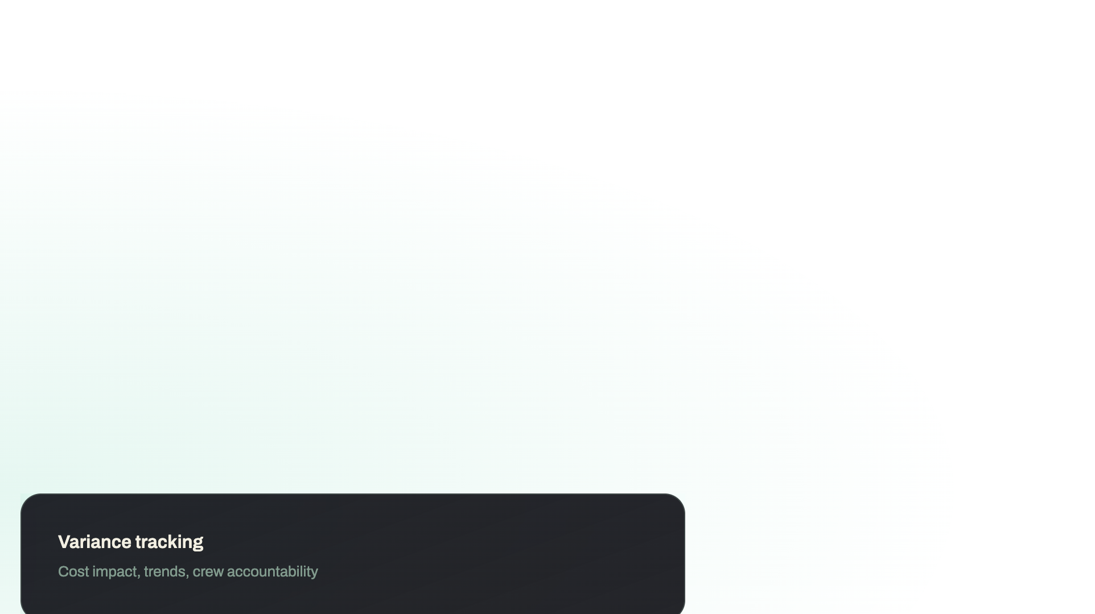
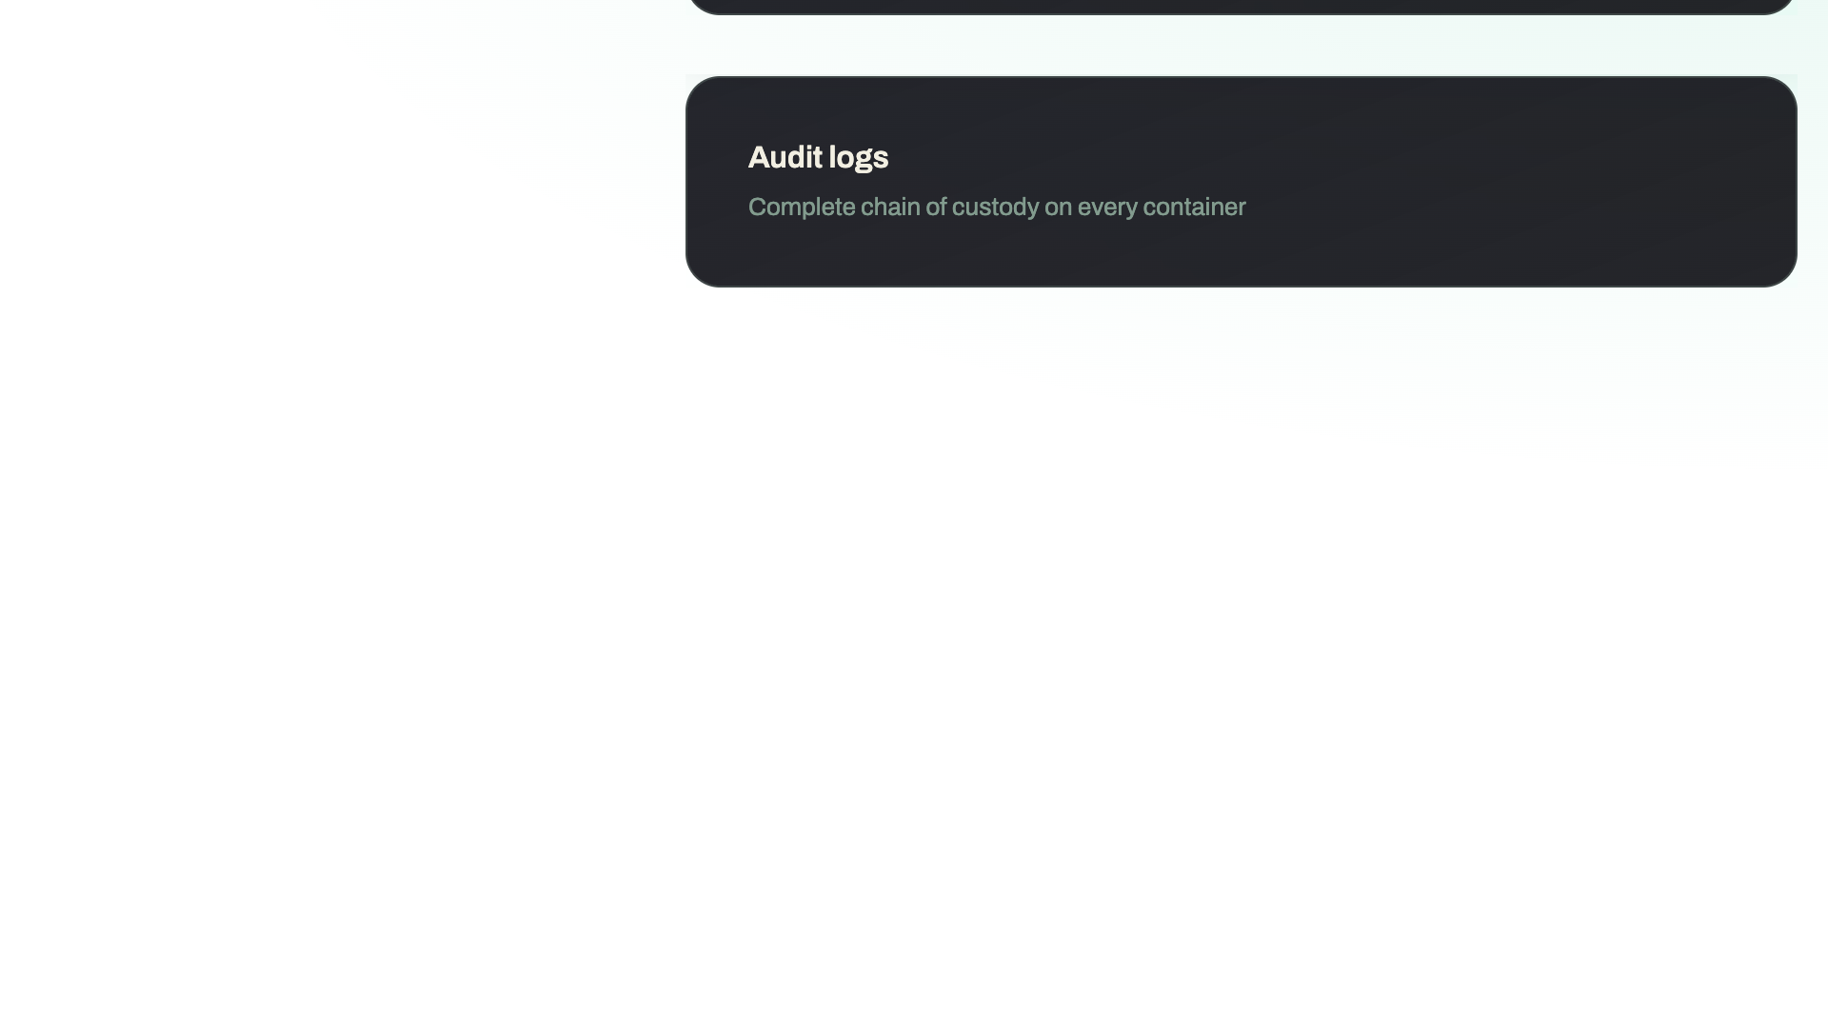

Notes:
Manager view of all alerts, variances, and activity. Configurable dashboards and real-time summaries. Variance trends, cost impact, and crew accountability. Export for compliance and audit — full chain of custody on every container.

Slide 8


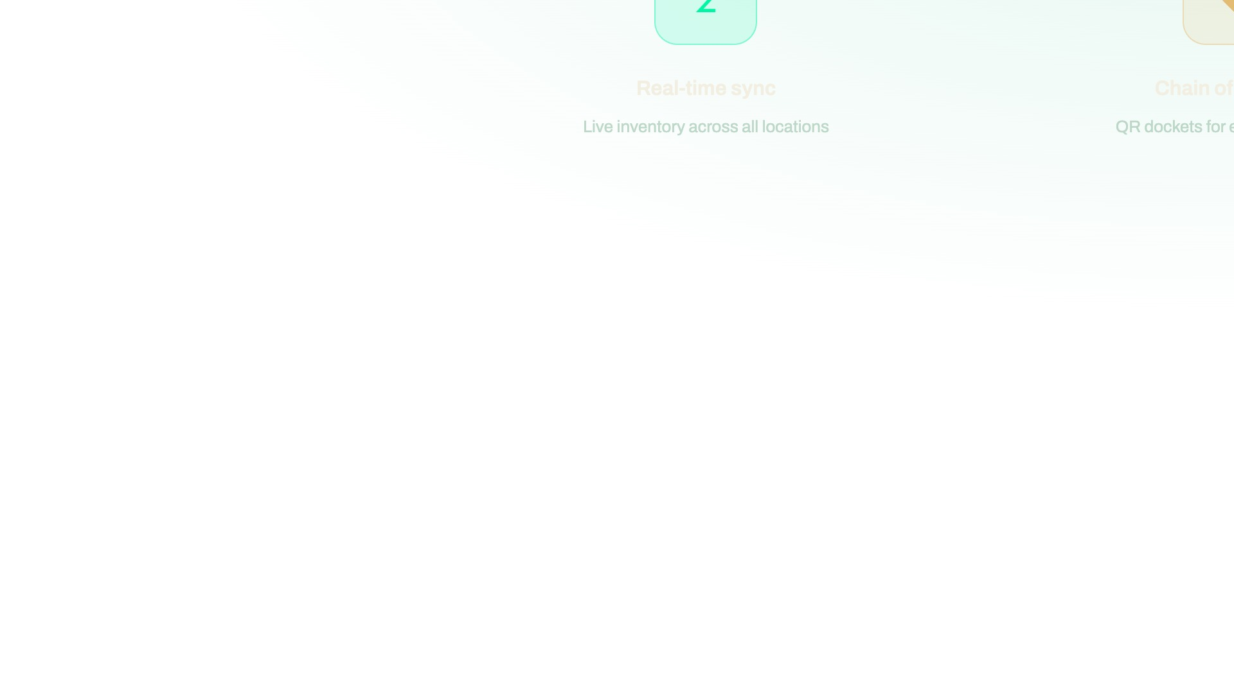

Notes:
Summary: Real-time visibility into 1,284 containers across three locations. Chain-of-custody dockets with QR codes. Blind-count audits to catch discrepancies early. Crew and manager roles with appropriate access. Full variance reporting with photos and decision logs. Designed for high-velocity bar operations where inventory moves fast.

