Slide 1






Statistics & Probability
ANKIT MIRAJKAR

Slide 2
AGENDA
What is Data?
Categories of data
What is statistics?
Basic terminologies
Sampling techniques
Types of statistics
Descriptive statistics
Probability

Slide 3
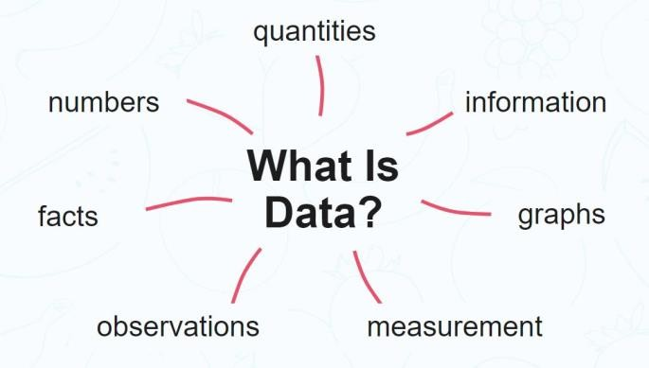
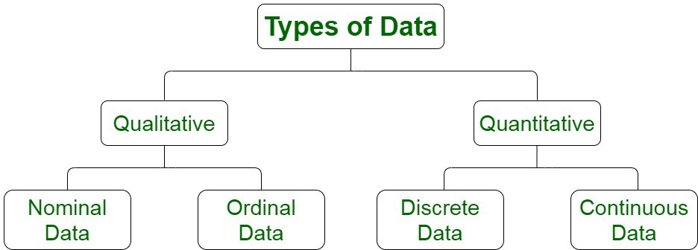
WHAT IS DATA?
Data refers to the facts and statistics collected for reference or analysis

Slide 4
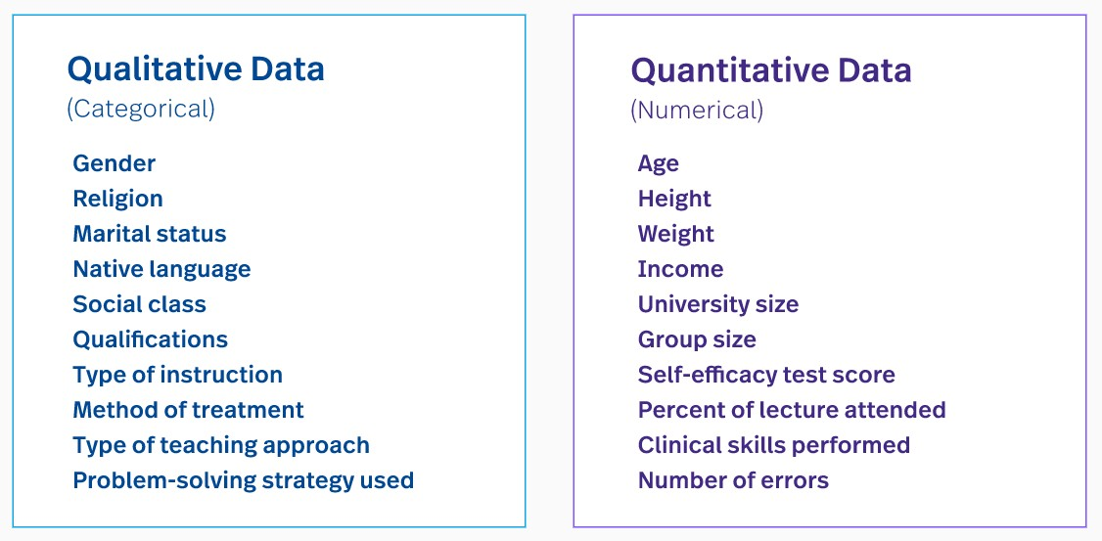
QUALITATIVE VS QUANTITATIVE DATA

Slide 5
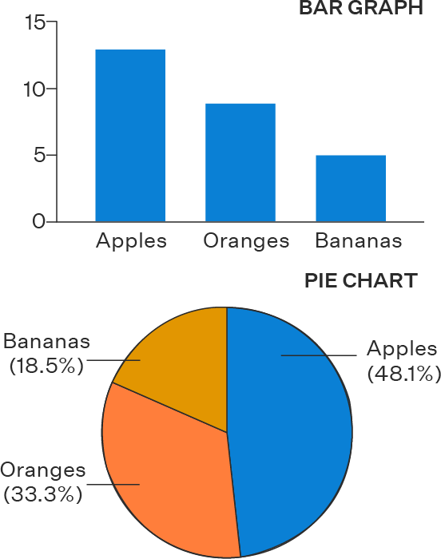
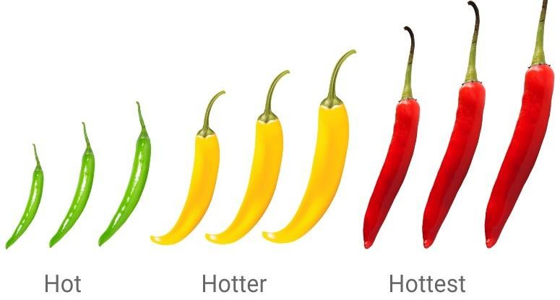
QUALITATIVE DATA
Qualitative data deals with characteristics and descriptors that can't be easily measured, but can be observed subjectively
Nominal Data
Data with no inherent order or ranking such as gender or race, such kind of data is called Nominal Data
Ordinal Data
Data with an ordered series, such as shown in the table, such kind of data is called Ordinal Data

Slide 6

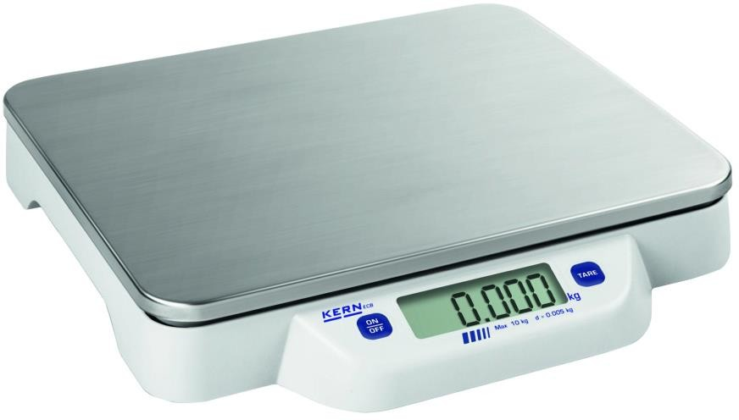
QUANTITATIVE DATA
Quantitative data deals with number and things you can measure objectively
Discrete Data
It can hold finite number of possible values
Continuous Data
Data that can hold infinite number of possible values.
E.g. Number of students in a class
E.g. Weight of a person

Slide 7
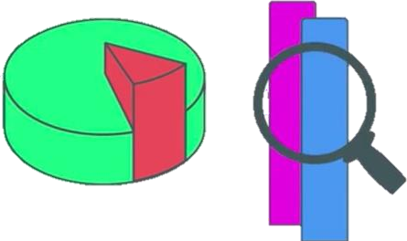
WHAT IS STATISTICS?
It is an area of applied mathematics concerned with the data collection, analysis, interpretation and presentation
Your company has created a new drug that may cure cancer. How would you conduct a test to confirm the drugs effectiveness?
You and your friend are at a cricket stadium, and he offers you a bet that neither team will hit a homerun in that
game. Should you take the bet?

Slide 8
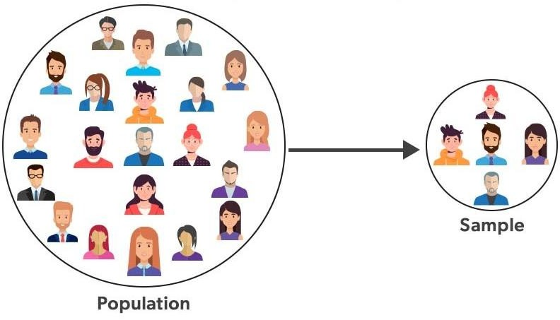
POPULATION AND SAMPLE DATA
Population: A collection or set of individuals or objects or events whose properties are yet to be analyzed
Sample: A subset of population is called “Sample”. A well-chosen sample contains most of the information about a
particular population parameter

Slide 9
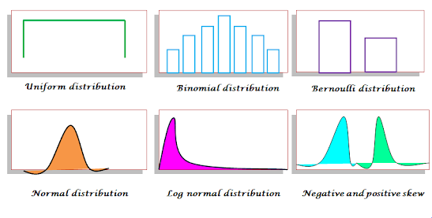
Distributions
A distribution shows how values of a variable are spread or dispersed.
Helps us understand the pattern and frequency of data.
Normal Distribution
Binomial & Poisson Distributions
Central Limit Theorem (CLT) – crucial for understanding inferential stats

Slide 10
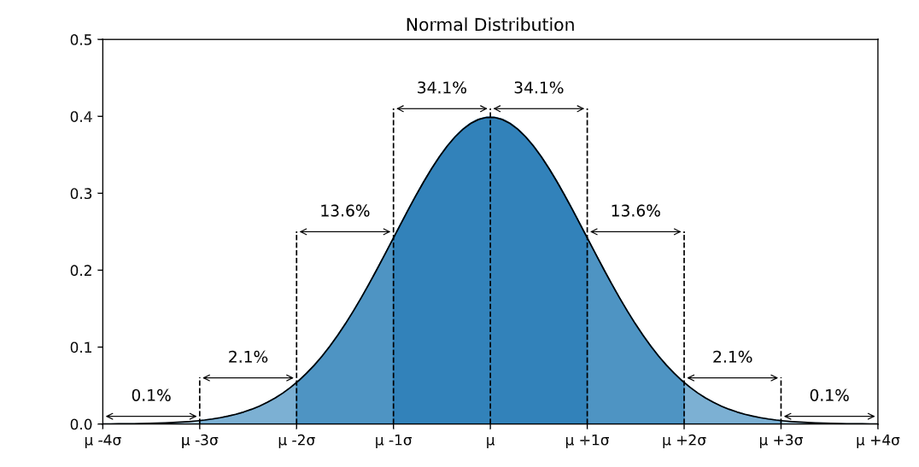
NORMAL DISTRIBUTION
The normal distribution is described by the mean () and the standard deviation ().
The normal distribution is often referred to as a 'bell curve' because of it's shape:
Most of the values are around the center ()
The median and mean are equal
It has only one mode
It is symmetric, meaning it decreases the same amount on the left and the right of the center
The area under the curve of the normal distribution represents probabilities for the data.
The area under the whole curve is equal to 1, or 100%

Slide 11
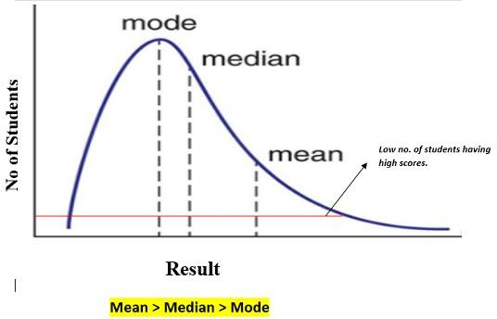
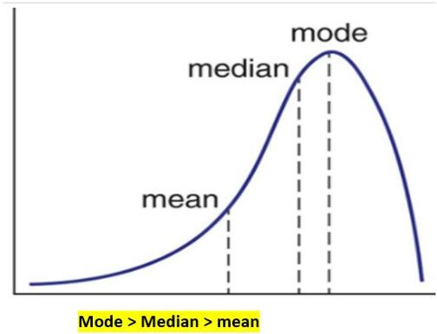
SKEWNESS
Skewness is a measure of the asymmetry of a distribution.
The normal distribution helps to know a skewness. A distribution is asymmetrical when its left and right side are not mirror images
Types of skewness:
Positive Skewed or Right-Skewed : A positively skewed or right-skewed distribution has a long right tail.
Negative Skewed or Left-Skewed : A negatively skewed or left-skewed distribution has a long left tail
Positive Skewed
Negative Skewed

Slide 12
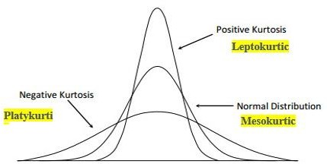
KURTOSIS
The measure of Kurtosis refers to the tailedness of a distribution. Tailedness refers how often the outliers occur.
Peakedness in a data distribution is the degree to which data values are concentrated around the mean.

Slide 13
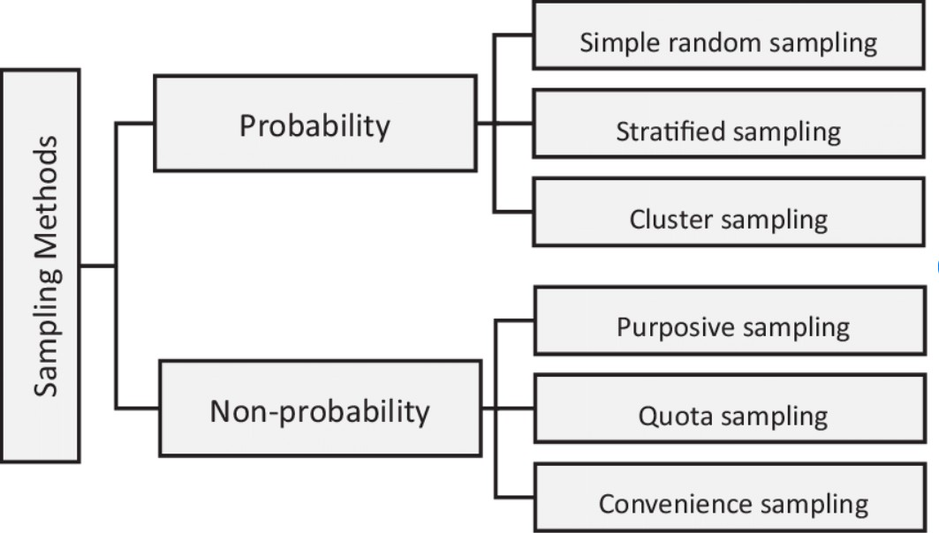
SAMPLING TECHNIQUES

Slide 14
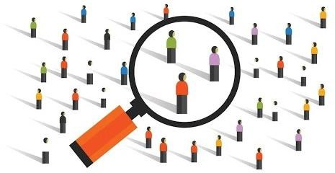
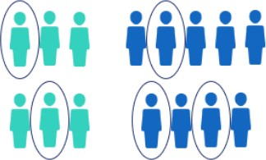
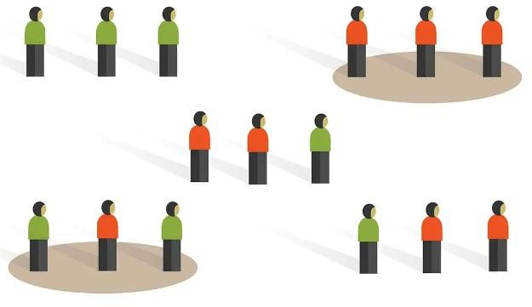
PROBABILITY SAMPLING
SIMPLE RANDOM SAMPLING
STRATIFIED SAMPLING
CLUSTER SAMPLING

Slide 15
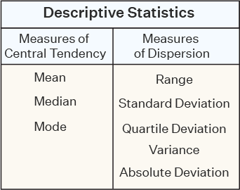
DESCRIPTIVE STATISTICS
Descriptive statistics uses the data to provide descriptions of the population, either through numerical calculations or graphs or tables
Descriptive Statistics focuses on the main characteristics of data. It provides summary of the data.

Slide 16
MEASURES OF SPREAD
A measure of spread also called as a measure of dispersion, is used to describe the variability in a sample or population
Range
Interquartile range
Variance
Standard deviation
Range is the given measure of how spread apart the values in a dataset are.
Range = Max (Xi) – Min (Xi)

Slide 17
MEASURES OF SPREAD
A measure of spread also called as a measure of dispersion, is used to describe the variability in a sample or population
Range
Interquartile range
Variance
Standard deviation
Interquartile range is the measure of variability, based on dividing a dataset into quartiles.
Quartiles divide a rank-ordered data set into four equal parts, denoted by Q1, Q2, and Q3, respectively
The interquartile range is equal to Q3 minus Q1, i.e., IQR = Q3 – Q1

Slide 18
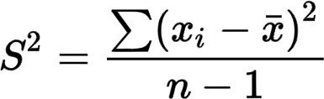
MEASURES OF SPREAD
A measure of spread also called as a measure of dispersion, is used to describe the variability in a sample or population
Range
Interquartile range
Variance
Standard deviation
Variance describe how much a random variable differs from its expected value.
It entails computing squares of deviations
S2 = sample variance
Xi = the value of the one observation
X bar = mean value of all observations n = number of observations

Slide 19
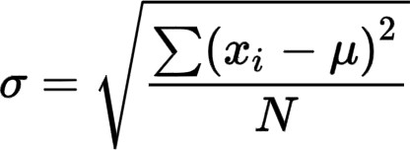
MEASURES OF SPREAD
A measure of spread also called as a measure of dispersion, is used to describe the variability in a sample or population
Range
Interquartile range
Variance
Standard deviation
Standard Deviation is the measure of the dispersion of a set of data from its mean

Slide 20
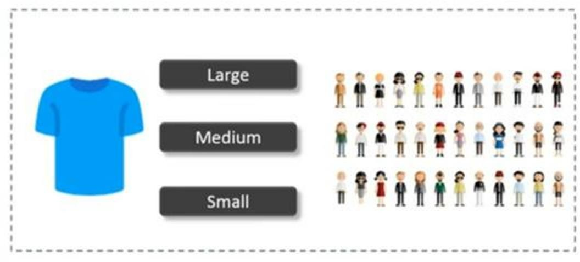
INFERENTIAL STATISTICS
Inferential statistics makes inferences and predictions about a population based on a sample of data taken from the population
Inferential statistics, generalizes a large dataset and applies probability to draw a conclusion. It allows us to infer data parameters based on a statistical model using a sample data

