Slide 1
IoT Practice-II Arduino Programming on WoW Kit (Others)

Slide 2
6. Ambient Light Sensor

Slide 3
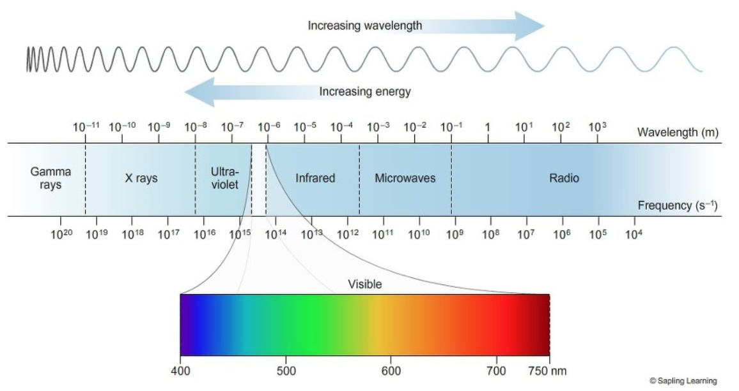
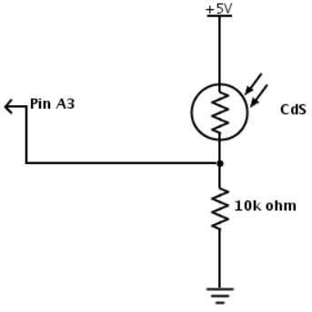
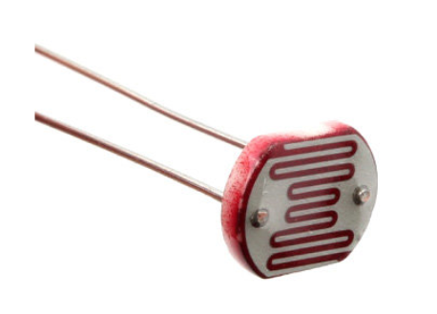
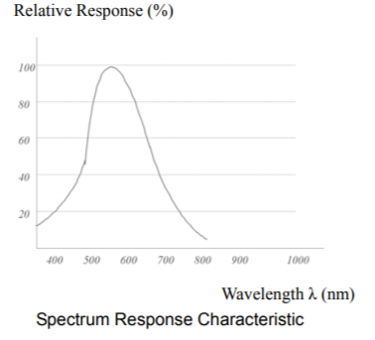
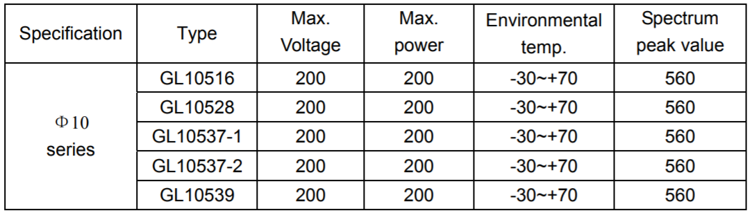
Ambient Light Sensor
GL10537-1 photoresistor
CDS(Cadmium sulfide)
The larger the light is injected,
The smaller the resistance of CDS becomes.

Slide 4
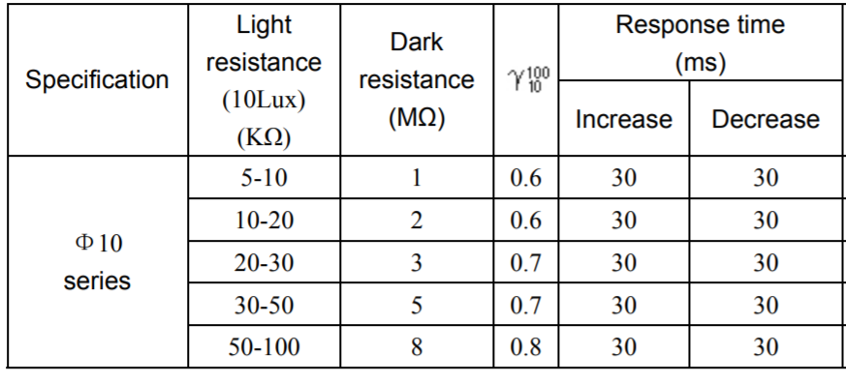
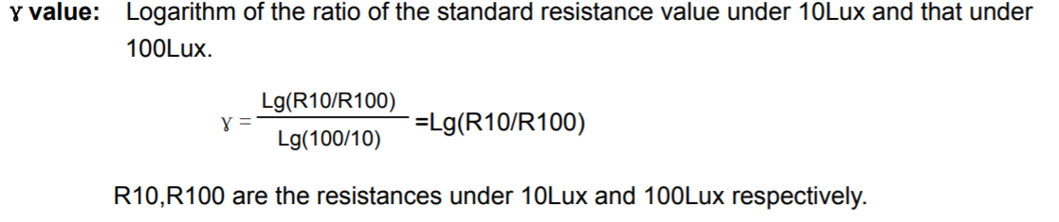
Ambient Light Sensor
GL10537-1 photoresistor

Slide 5
Sample : Ambient Light Sensor
#define LIGHT A3
#define LED 9
void setup() {
Serial.begin(9600);
pinMode(LIGHT, INPUT);
pinMode(LED, OUTPUT);
}
void loop() {
int value = analogRead(LIGHT);
int data = map(value, 0, 1023, 1023, 0);
Serial.print("LIGHT : ");
Serial.println(data);
analogWrite(LED, value);
delay(100);
}
map(value, fromLow, fromHigh, toLow, toHigh);
// change the dynamic range of value

Slide 6
LAB-6 : Ambient Light Sensor
Program the system satisfying the following specification
Spec.-1 : Design an obstacle detector which beeps a sound when an obstacle passes by
in front of photoresistor.
Spec.-2 : (optional)
Program the remote monitoring system of the amount of room’s ambient light
using IoTMakers cloud.

Slide 7
7. Ultrasonic Sensor

Slide 8
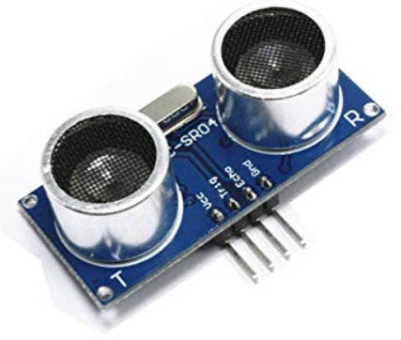
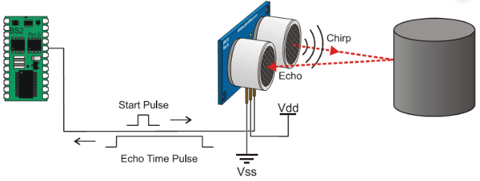
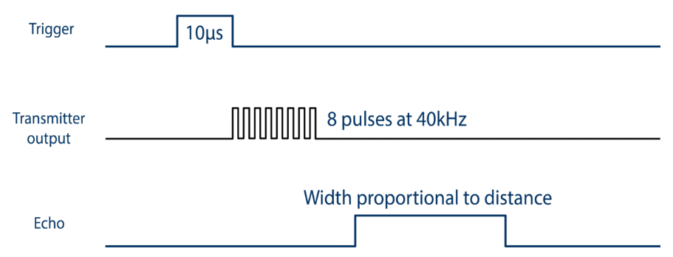
Ultrasonic Sensor
HC-SR04
Non-contact distance measurement
2~400cm
Measuring angle : 15 degrees
Procedure to measure the distance
Using IO trigger for at least 10us high level signal.
The Module automatically sends eight 40 kHz and detect whether there is a pulse signal back.
If the signal back, through high level , time of high output IO duration is the time from sending ultrasonic to returning.
Test distance = (high level time × velocity of sound (340M/S) / 2,

Slide 9
Sample-I : Ultrasonic Sensor
void loop() {
long duration, distance;
digitalWrite(trigPin, LOW);
delayMicroseconds(2);
digitalWrite(trigPin, HIGH);
delayMicroseconds(10);
digitalWrite(trigPin, LOW);
duration = pulseIn(echoPin, HIGH);
distance = duration * 17 / 1000;
if (distance >= 200 || distance <= 0) {
Serial.println("Unable to measure distance");
} else {
Serial.print(distance);
Serial.println(" cm");
}
delay(500);
}
#define trigPin 13
#define echoPin 12
void setup() {
Serial.begin (9600);
pinMode(trigPin, OUTPUT);
pinMode(echoPin, INPUT);
}
pulsing(pin, pulse);
* Read a pulse on the pin.

Slide 10
Sample-II : Ultrasonic Sensor with Warning
if (distance >= 200 || distance <= 0) {
Serial.println("Unable to measure distance");
} else {
Serial.print(distance);
Serial.println(" cm");
}
if(distance <= 20) {
tone(BUZZER, 600);
delay(distance * 10);
noTone(BUZZER);
delay(distance * 10);
} else {
delay(500);
}
}
#define trigPin 13
#define echoPin 12
void setup() {
Serial.begin (9600);
pinMode(trigPin, OUTPUT);
pinMode(echoPin, INPUT);
}
void loop() {
long duration, distance;
digitalWrite(trigPin, LOW);
delayMicroseconds(2);
digitalWrite(trigPin, HIGH);
delayMicroseconds(10);
digitalWrite(trigPin, LOW);
duration = pulseIn(echoPin, HIGH);
distance = duration * 17 / 1000;
pulsing(pin, pulse);
* Read a pulse on the pin.

Slide 11
LAB-7 : Ultrasonic Sensor
Program the system satisfying the following specification
Spec.-1 : Design an obstacle detector which beeps a sound when an obstacle approaches less than 30cm.
Spec.-2 : (optional)
Create a level meter which shows the distance between the device
and obstacles with full-color LED. The brightness of LED depends on the amount of distance from obstacle. If the obstacle is far from the sensor,
the color of LED becomes darker.

Slide 12
8. Infrared Sensor

Slide 13
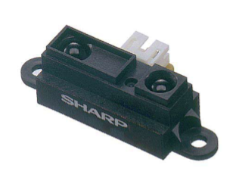
Infrared Sensor
Sharp GP2Y0A21YK0F
Distance measuring sensor unit
10~80cm
Composed of an integrated combination of position sensitive detector(PSD) and infrared emitting diode(IRED) and signal processing unit.
The voltage output is corresponding to the detection distance.
Also used as a proximity sensor.
Application
Touch-less switch (sanitary equipment, control of illumination)
Robot cleaner
Sensor for energy saving (ATM, Copier, Vending machine)
Amusement equipment (Robot, Arcade game machine)

Slide 14
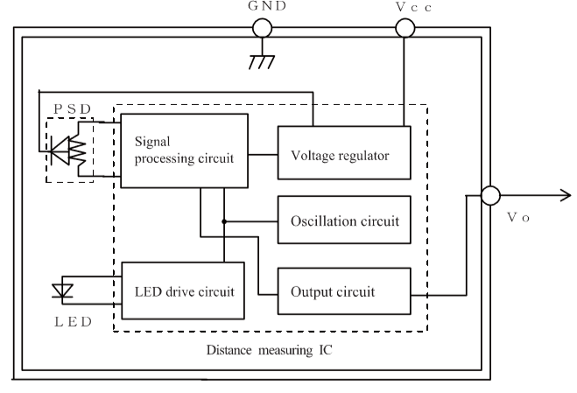
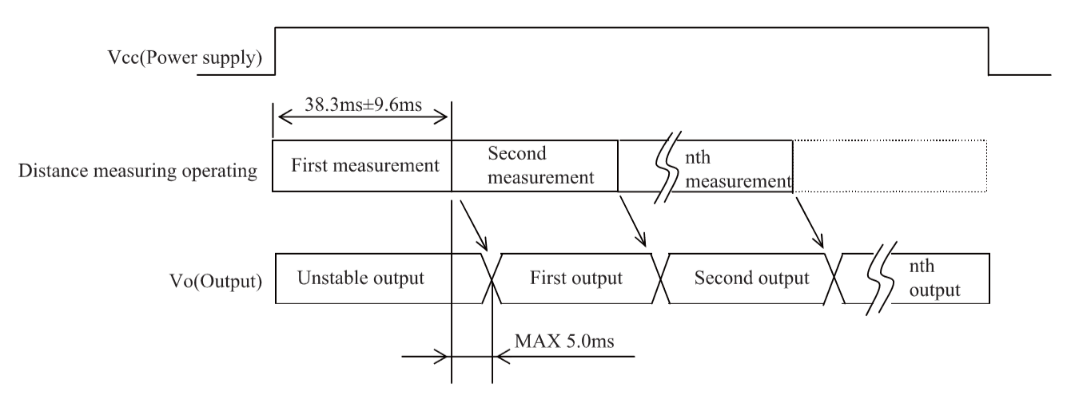
Infrared Sensor
Block diagram of Sharp GP2Y0A21YK0F

Slide 15
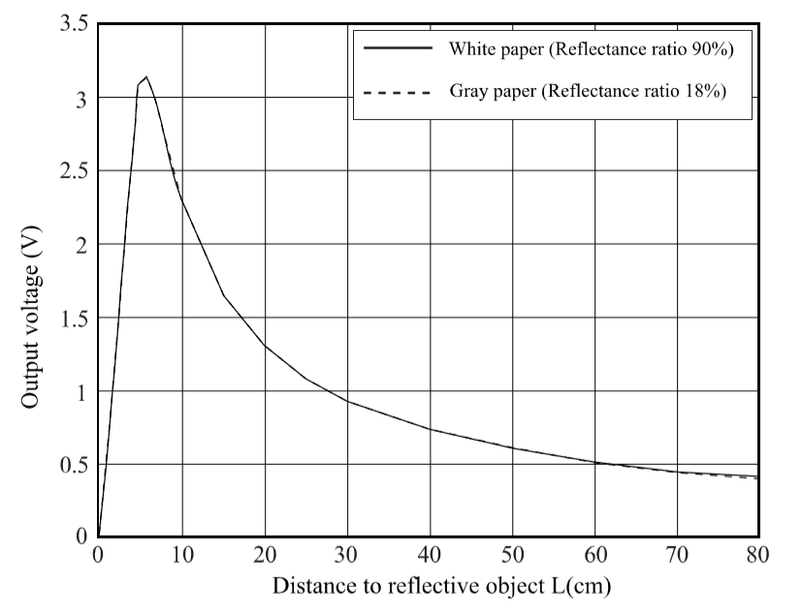
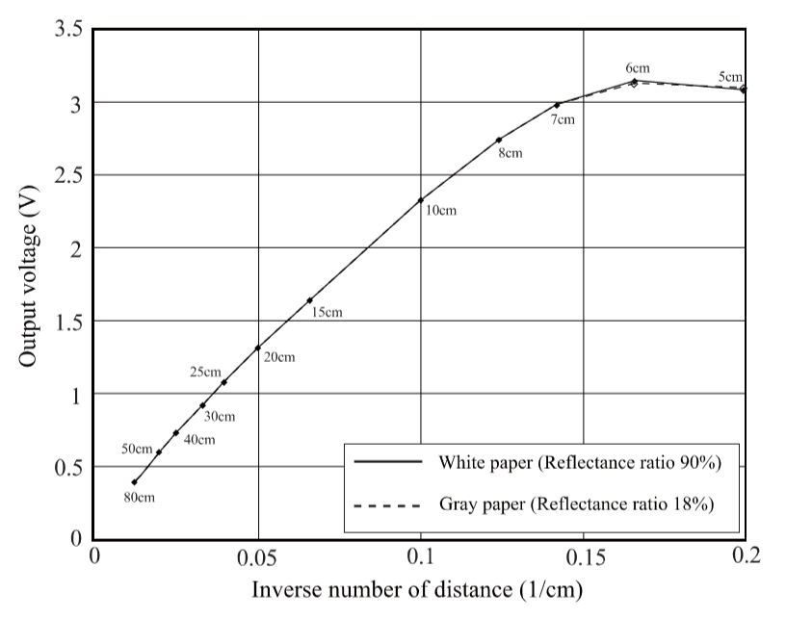
Infrared Sensor
Distance measuring characteristics of Sharp GP2Y0A21YK0F

Slide 16
Sample-I : Infrared Sensor
int distance = 0;
void setup() {
Serial.begin(9600);
}
void loop() {
int volt = map(analogRead(A0), 0, 1023, 0, 5000);
distance = (27.61 / (volt - 0.1696)) * 1000; // empirical equation
Serial.print(distance);
Serial.println(" cm");
delay(500);
}

Slide 17
Sample-II : Infrared Sensor with Alarming
#define BUZZER 6
#define SIGNAL_PIN A0
int distance = 0;
void setup() {
Serial.begin(9600);
pinMode(BUZZER, OUTPUT);
pinMode(SIGNAL_PIN, INPUT);
}
void loop() {
int volt = map(analogRead(SIGNAL_PIN), 0, 1023, 0, 5000);
distance = (21.61 / (volt - 0.1696)) * 1000;
if(distance <= 20)
{
tone(BUZZER, 600);
delay(distance * 5);
noTone(BUZZER);
delay(distance * 5);
}
else
{
delay(500);
}
Serial.print(distance);
Serial.println(" cm");
delay(500);
}

Slide 18
Sample-III : Infrared Sensor with IoTMakers
#include <WiFi.h>
#include <IoTStarterKit_WiFi.h>
#include <OneWire.h>
IoTMakers g_im;
#define deviceID "{YOUR_DEVICE_ID}"
#define authnRqtNo "{YOUR_DEVICE_PASSWORD}"
#define extrSysID "{YOUR_GATEWAY_ID}"
#define WIFI_SSID "{WIFI_NAME}"
#define WIFI_PASS "{WIFI_PASSWORD}"
#define LIGHT A3
#define TAG_ID "LIGHT“ // be careful !
void init_iotmakers() {
while(1) {
Serial.print(F("Connect to AP..."));
while(g_im.begin(WIFI_SSID, WIFI_PASS) < 0) {
Serial.println(F("retrying"));
delay(100);
}
Serial.println(F("Success"));
g_im.init(deviceID, authnRqtNo, extrSysID);
Serial.print(F("Connect to platform..."));
while(g_im.connect() < 0) {
Serial.println(F("retrying."));
delay(100);
}
Serial.println(F("Success"));
Serial.print(F("Auth..."));
if(g_im.auth_device() >= 0) {
Serial.println(F("Success..."));
return;
}
}
}

Slide 19
Sample-III : Infrared Sensor with IoTMakers
void setup() {
Serial.begin(9600);
pinMode(LIGHT, INPUT);
init_iotmakers();
}
void loop() {
static unsigned long tick = millis();
if(g_im.isServerDisconnected() == 1) {
init_iotmakers();
}
if((millis() - tick) > 1000) {
send_temperature();
tick = millis();
}
g_im.loop();
}
int send_ambient_light()
{
int value = analogRead(LIGHT);
int data = map(value, 0, 1023, 1023, 0);
Serial.print("LIGHT : ");
Serial.println(data);
if(g_im.send_numdata(TAG_ID, (double)data) < 0) {
Serial.println(F("fail"));
return -1;
}
return 0;
}

Slide 20
LAB-8 : Infrared Sensor
Program the system satisfying the following specification
Spec.-1 : Measure the distance between IR sensor and obstacles
at every 0.5 sec..
Spec.-2 : (optional) Calibrate the measurement by adjusting the coefficient
of equation. .

Slide 21
9. Servo Motor

Slide 22
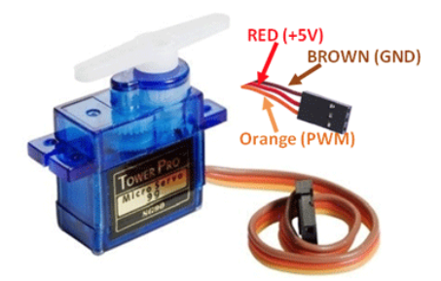
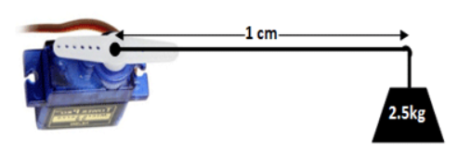
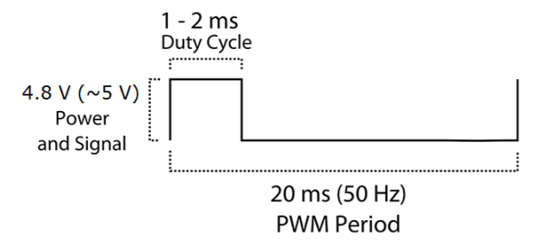
Servo Motor
SG90
Operating Voltage is +5V typically
Torque: 2.5kg/cm
Operating speed is 0.1s/60°
Gear Type: Plastic
Rotation : 0°-180°
Weight of motor : 9gm
Positioning of arm
When on-time is
1ms, the position of arm is 0 degree.
1.5ms, 90 degree
2ms, 180 degree
Torque of 2.5kg/cm

Slide 23
Sample : Servo Motor
#include <Servo.h>
Servo myServo;
int angle = 0;
void setup() {
Serial.begin(9600);
myServo.attach(3);
}
void loop() {
// move from 0 to 180 degrees
for(angle = 0; angle < 180; angle++) {
myServo.write(angle);
delay(15);
}
// move in reverse direction, from 180 to 0 degrees
for(angle = 180; angle > 0; angle--) {
myServo.write(angle);
delay(15);
}
}

Slide 24
LAB-9 : Servo Motor
Program the system satisfying the following specification
Spec.-1 : Calculate the average swing speed after measuring 10 times swings forward &
backward, and compare the value of datasheet (0.1s/60 degree).
* To measure the elapsed time, use millis() function.
Spec.-2 : (optional) Report the position of arm at every 0.5 sec. to IoTMakers.

Slide 25
10. Piezo Vibration Sensor

Slide 26
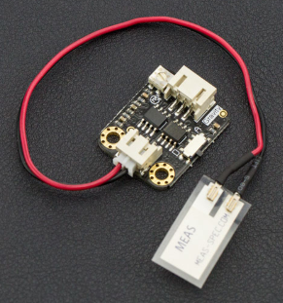
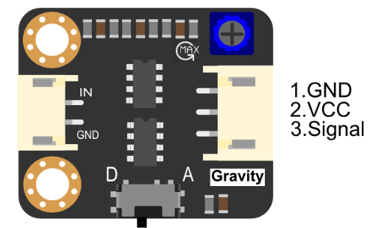
Piezo Vibration Sensor
SEN0209
Able to detect vibration, flexibility, impact and touch.
Operating voltage : 5V
Interface : Gravity PH2.0 3-pin interface
Operating temperature : 0~85

Slide 27
Sample-I : Piezo Vibration Sensor
#define VIB_SENSOR A0
void setup() {
// put your setup code here, to run once:
Serial.begin(9600);
pinMode(VIB_SENSOR, INPUT);
}
void loop() {
// put your main code here, to run repeatedly:
Serial.println(analogRead(VIB_SENSOR));
delay(100);
}

Slide 28
Sample-II : Touch Switch with Piezo Vibration Sensor
#define VIB_SENSOR A0
void setup() {
// put your setup code here, to run once:
Serial.begin(9600);
pinMode(VIB_SENSOR, INPUT);
}
void loop() {
// put your main code here, to run repeatedly:
Serial.println(analogRead(VIB_SENSOR));
delay(100);
}
#define VIB_SENSOR A0
#define TOUCH 1
void setup() {
// put your setup code here, to run once:
Serial.begin(9600);
pinMode(VIB_SENSOR, INPUT);
}
void loop() {
// put your main code here, to run repeatedly:
int isTouch = digitalRead(VIB_SENSOR);
if(isTouch == TOUCH)
Serial.println("TOUCH");
delay(100);
}

Slide 29
LAB-10 : Piezo Vibration Sensor
Program the system satisfying the following specification
Spec.-1 : Display the measured analog level, at which Sample-II code detects touching.
Spec.-2 : (optional)
Upload the measured analog output to IoTMakers.

Slide 30
Q&A

