Slide 1
IoT Practice-II Arduino Programming on WoW Kit (I/O Handling) Part-I

Slide 2
1. LED

Slide 3
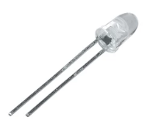
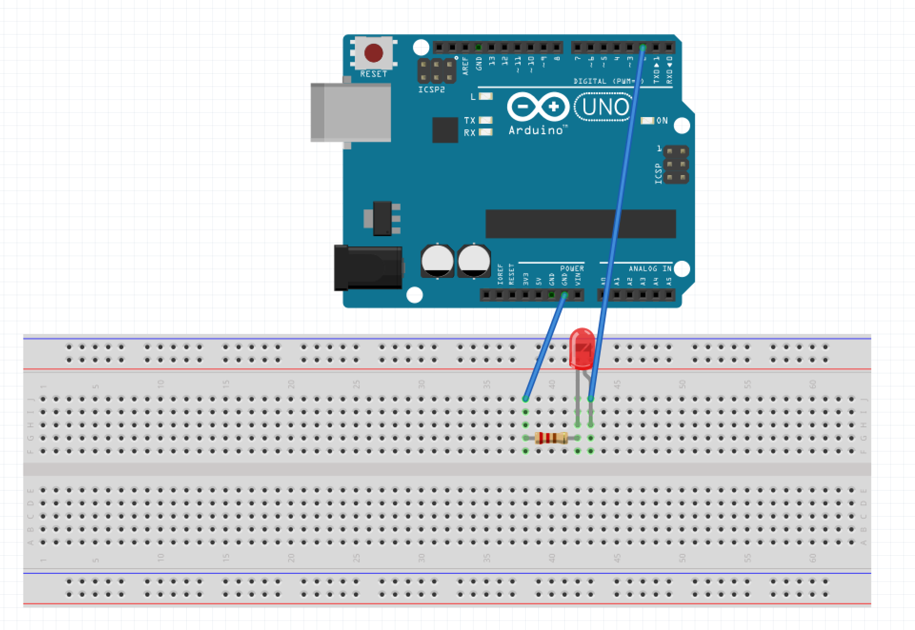
Sample Code - LED
#define LED 2
void setup() {
pinMode(LED, OUTPUT);
digitalWrite(LED, HIGH);
}
void loop() {
led_on();
delay_1s();
led_off();
delay_1s();
}
void led_on()
{
digitalWrite(LED, LOW);
}
void led_off()
{
digitalWrite(LED, HIGH);
}
void delay_1s()
{
delay(1000);
}
Single Color
+

Slide 4
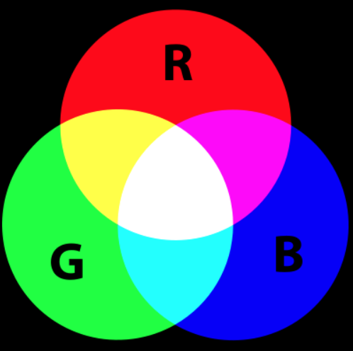
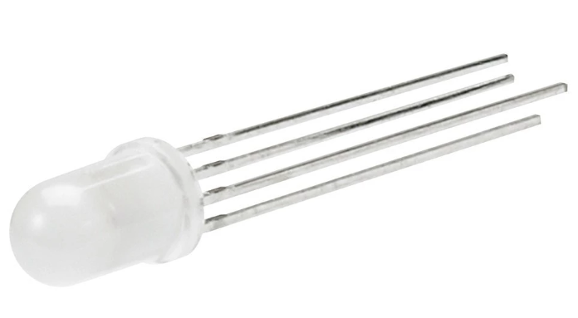
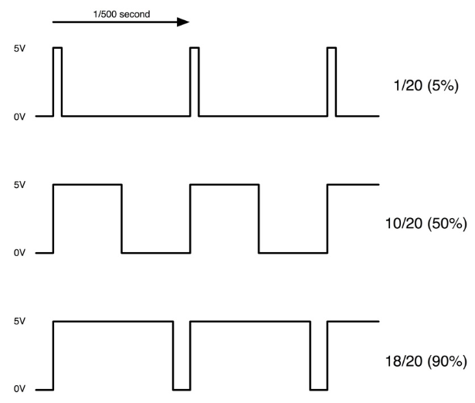
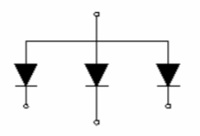
Sample Code – Fullcolor LED
int redPin = 11;
int greenPin = 10;
int bluePin = 9;
void setup()
{
pinMode(redPin, OUTPUT);
pinMode(greenPin, OUTPUT);
pinMode(bluePin, OUTPUT);
}
void loop()
{
setColor(255, 0, 0); // red
delay(1000);
setColor(0, 255, 0); // green
delay(1000);
setColor(0, 0, 255); // blue
delay(1000);
setColor(255, 255, 0); // yellow
delay(1000);
setColor(80, 0, 80); // purple
delay(1000);
setColor(0, 255, 255); // aqua
delay(1000);
}
void setColor(int red, int green, int blue)
{
analogWrite(redPin, red);
analogWrite(greenPin, green);
analogWrite(bluePin, blue);
}
analogWrite(pin, value);
use PWM of Timer.
Control power of output, value= 0~255
1
Full Color
2
2
1
3
4
R
B
G
Common Anode

Slide 5
LAB-1 Control Fullcolor LED
Program the system satisfying the following specification
Spec.-1 : Change the color sequence of f-LED to any favorite color pattern at every second.
Spec.-2 : (optional)
* Make a rainbow of 7 f-LED’s.
* Careful for connecting 7 LED’s.
* Which connection type is more preferable ? Serial or Parallel ?

Slide 6
2. LED & Switch

Slide 7
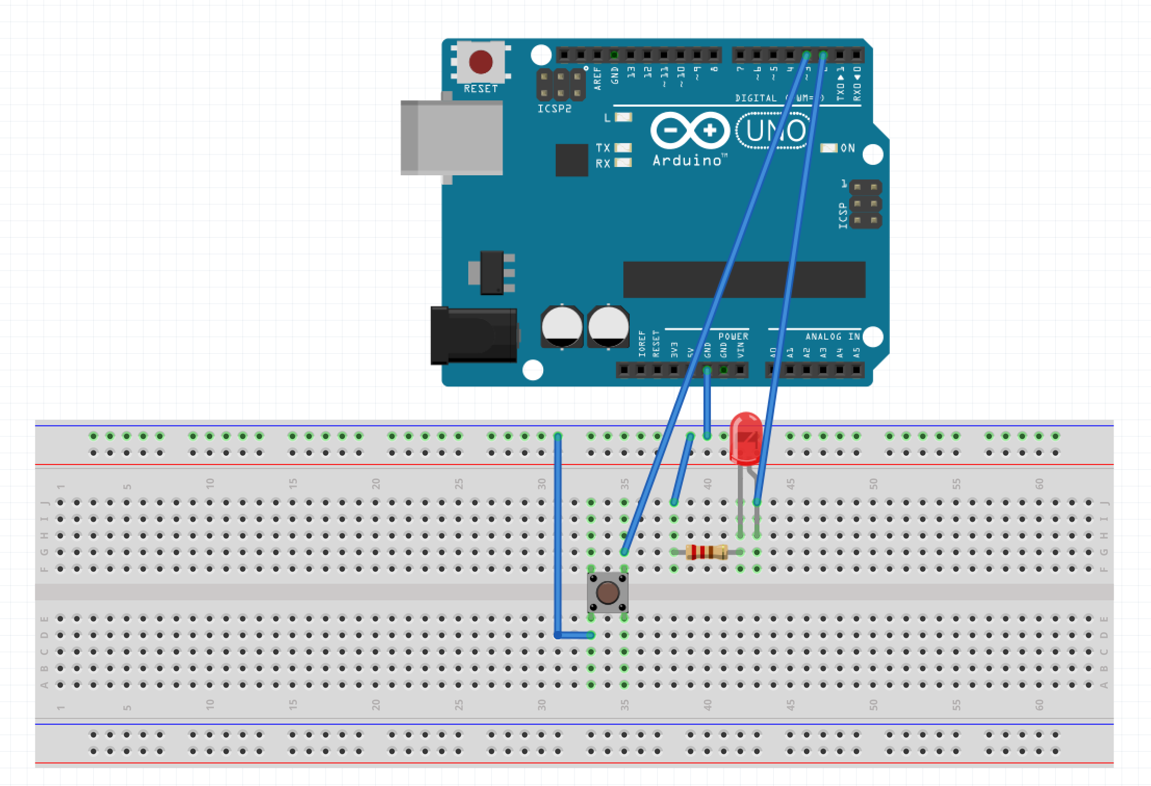
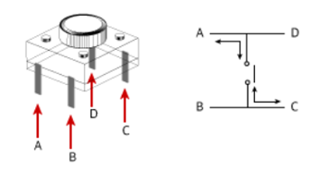
Sample Code – LED & Switch
#define LED 2
#define SWITCH 3
void setup() {
pinMode(LED, OUTPUT);
pinMode(SWITCH, INPUT_PULLUP);
digitalWrite(LED, LOW);
}
void loop() {
if(digitalRead(SWITCH) == 0)
digitalWrite(LED, HIGH);
else
digitalWrite(LED, LOW);
}

Slide 8
Sample Code – LED & Switch
#define LED 2
#define SWITCH 3
boolean isLedOn = false;
void setup() {
pinMode(LED, OUTPUT);
pinMode(SWITCH, INPUT_PULLUP);
attachInterrupt(digitalPinToInterrupt(SWITCH), interrupt, CHANGE);
digitalWrite(LED, LOW);
}
void loop() {
digitalWrite(LED, !isLedOn);
}
void interrupt() // interrupt handler
{
// State transition
isLedOn = !isLedOn;
}

Slide 9
LAB-2 Interrupted LED
Program the system satisfying the following specification
Spec.-1 : Change the way of lighting LED in sample code.
(if LED is on when switch is pushed, reverse it!)
Spec.-2 : (optional)
Modify the result of LAB-1 with switch (interrupted)
* Change the color of f-LED if switch is pushed.

Slide 10
3. FND

Slide 11
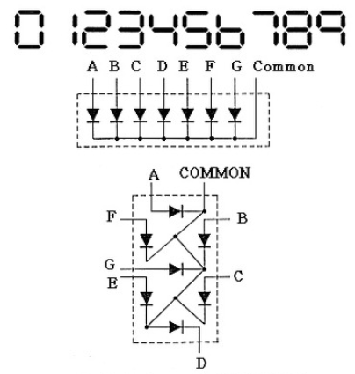
Sample Code – FND(flexible numeric display)
FND (Flexible Numeric Display)
7-Segment LED

Slide 12
Sample Code – FND(flexible numeric display)
int fnd_pin[8] = {2, 3, 4, 5, A2, A3, A4, A5};
int fnd_digits[10][8] = {
{1, 1, 1, 1, 1, 1, 0, 0}, // 0
{0, 1, 1, 0, 0, 0, 0, 0}, // 1
{1, 1, 0, 1, 1, 0, 1, 0}, // 2
{1, 1, 1, 1, 0, 0, 1, 0}, // 3
{0, 1, 1, 0, 0, 1, 1, 0}, // 4
{1, 0, 1, 1, 0, 1, 1, 0}, // 5
{1, 0, 1, 1, 1, 1, 1, 0}, // 6
{1, 1, 1, 0, 0, 0, 0, 0}, // 7
{1, 1, 1, 1, 1, 1, 1, 0}, // 8
{1, 1, 1, 1, 0, 1, 1, 0} // 9
};
void setup() {
for(int i = 0 ; i < 8 ; i++)
{
pinMode(fnd_pin[i], OUTPUT);
}
}
void loop() {
// Display 0 to 9
for(int i = 0 ; i < 10 ; i++)
{
display(i);
delay(1000);
}
}
void display(int num)
{
if(num < 0) num = 0;
else if(num >= 10) num = 9;
for(int i = 0 ; i < 8 ; i++)
{
digitalWrite(fnd_pin[i], fnd_digits[num][i]);
}
}

Slide 13
LAB-3 FND
Program the system satisfying the following specification
Spec.-1 : Make a down-counting timer.
* the initial value is ‘9’.
* Count down every 0.5 second.
* If FND reaches to ‘0’, blink all LED’s 5 times.
* Blink a dot at the lower light corner of FND.
Spec.-2 : (optional)
Modify the result of Spec.-1 with wrap-around function.
* If the value of FND becomes ‘0’, the next will be ‘9’.

Slide 14
4. Buzzer

Slide 15
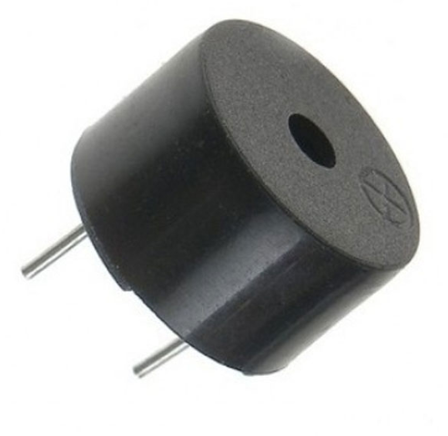
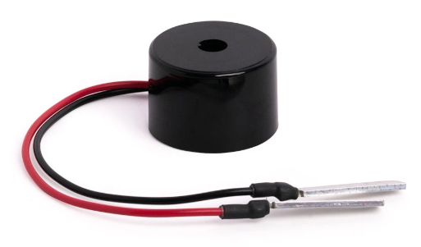
Sample Code – Buzzer
int BUZZER = 6;
void setup() {
pinMode(BUZZER, OUTPUT);
}
void loop() {
tone(BUZZER, 400);
delay(1000);
// - Piezo Buzzer Off
Serial.println("OFF");
noTone(BUZZER);
delay(1000);
}
tone(pin, freq);
// pin : Arduino pin number
// freq : freqeuncy of tone
+

Slide 16
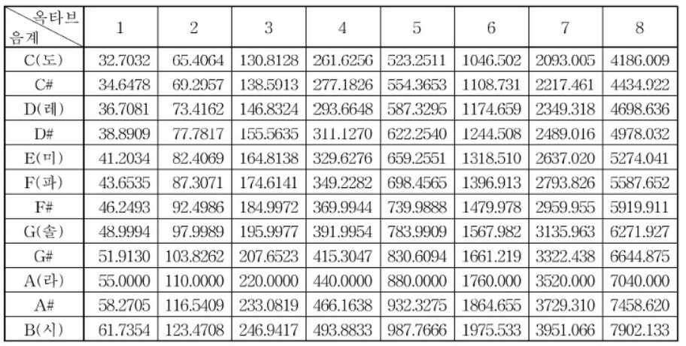
Sample Code – Buzzer
Octave Table
Do
Re
In Hz

Slide 17
LAB-3 Buzzer
Program the system satisfying the following specification
Spec.-1 : Change the sound(tone) if the switch is pushed.
* More than 3 types of tones.
Spec.-2 : (optional)
Make the melody up by 1 octave.
* The melody(Super Mario) is uploaded in GitHub.

Slide 18
Q&A

