Slide 1
IoT Practice-II Arduino Programming on WoW Kit (I/O Handling) Part-II

Slide 2
5. Temperature Sensor

Slide 3
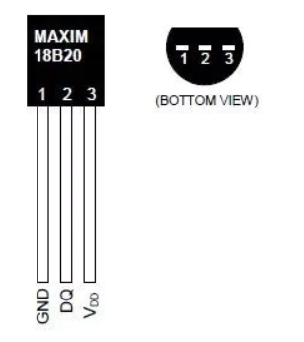
Sample Code – Temperature Sensor
#include <OneWire.h>
OneWire ds(2);
void setup() {
Serial.begin(9600);
}
void loop() {
byte i;
byte present = 0;
byte data[12];
byte addr[8];
float Temp;
if (!ds.search(addr)) {
ds.reset_search();
return;
}
ds.reset();
ds.select(addr);
ds.write(0x44,1); // start conversion, with parasite power on at the end
delay(1000);
present = ds.reset();
ds.select(addr);
ds.write(0xBE); // Read Scratchpad
for (i = 0; i < 9; i++)
data[i] = ds.read();
}
Temp=(data[1]<<8)+data[0];
Temp=Temp/16;
Serial.print("C="); // Celsius output
Serial.print(Temp);
Serial.print(", ");
}

Slide 4
Sample Code – Temperature Sensor
Temperature sensor : DS18B20
Hardware Spec
Temperature range : -55 ~ +125 ('C)
Accuracy : ±0.5
DS18B20 Function Commands
Address 0x44
Convert T : initiates a single temperature conversion
Address 0xBE
Read Scratchpad : allows the master to read the contents of the scratchpad.
9 bytes = data byte 8 + CRC byte 1
OneWire library
The library for accessing 1-wire temperature sensor, memory & chips.
https://www.arduinolibraries.info/libraries/one-wire

Slide 5
LAB-3 FND
Program the system satisfying the following specification
Spec.-1 : Change the sound(tone) if the switch is pushed.
* More than 3 types of tones.
Spec.-2 : (optional)
Make the melody up by 1 octave.
* The melody(Super Mario) is uploaded in GitHub.

Slide 6
Q&A

