Slide 1
IoT Practice-II Arduino Programming on WoW Kit (Temperature Sensor)

Slide 2
5. Temperature Sensor

Slide 3
Temperature Sensor
Maxim DS18B20
9-bit~12-bit Celsius temperature measurement.
Alarm function
1-wire comm. protocol (~16.3Kbps)
can derive power directly from the data line (“parasite power”), eliminating the need for an external power supply.
Each DS18B20 chip has a unique 64-bit serial code, which allows multiple DS18B20s to function on the same 1-Wire bus.
Least significant 8 bits : 0x28 (family code for DS18B20)
48-bit : unique serial number
Most significant 8 bits : CRC for 56-bit.

Slide 4
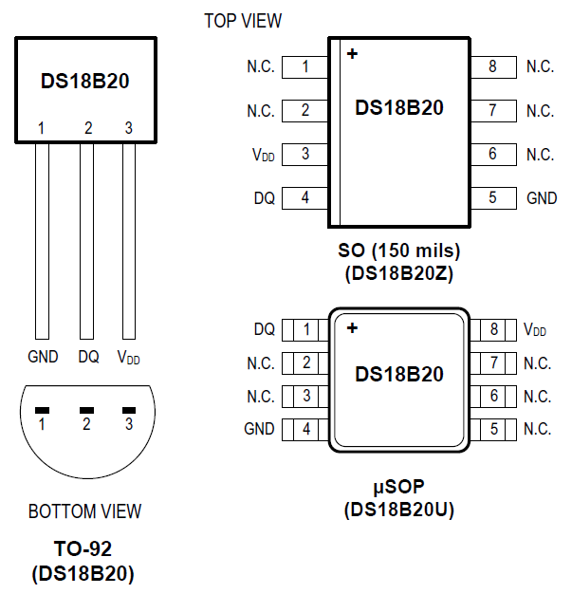
Temperature Sensor
Application
HVAC(Heating, Ventilation & Air Conditioning) environment control
Temperature monitoring inside building, equipment, machinery.
Hardware Spec
Temperature range : -55 ~ +125 ('C)
Accuracy : ±0.5
Programmable resolution : 9~12 bits

Slide 5
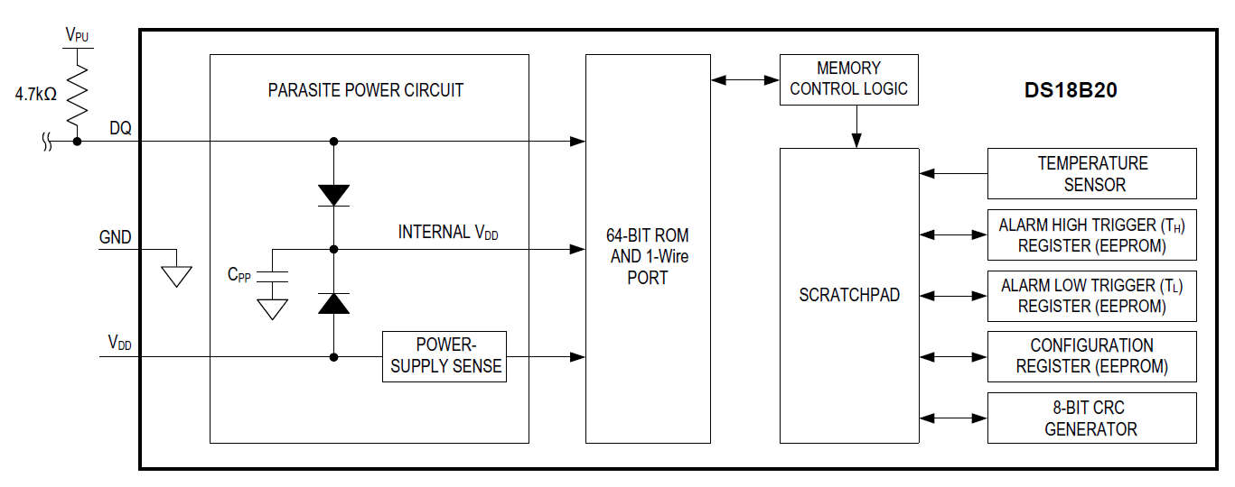
Temperature Sensor
Block Diagram

Slide 6
Temperature Sensor
Unique serial code
Each DS18B20 chip has a unique 64-bit serial code, which allows multiple DS18B20s to function on the same 1-Wire bus.
Least significant 8 bits : 0x28 (family code for DS18B20)
48-bit : unique serial number
Most significant 8 bits : CRC for 56-bit.

Slide 7
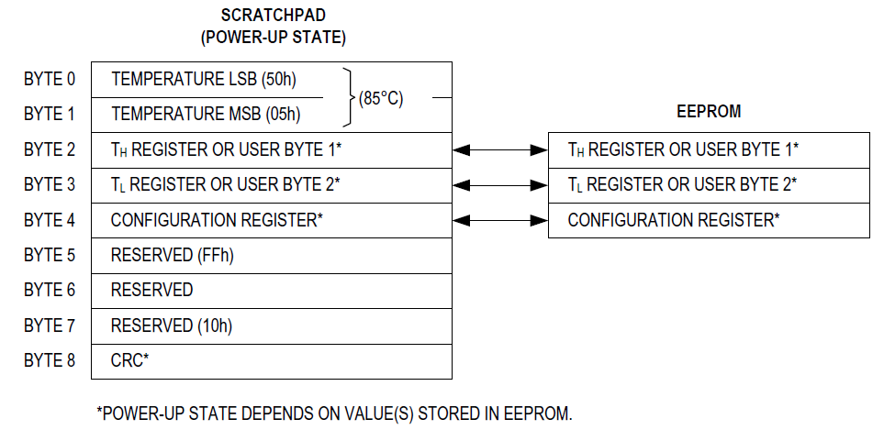
Temperature Sensor
Memory map
SRAM scratchpad (9 Bytes) + EEPROM (3 Bytes)
Byte 8 of the scratchpad is read-only and contains the CRC code for bytes 0 through 7 of the scratchpad.
To transfer the TH, TL and configuration data from the scratchpad to EEPROM, the master must issue the Copy Scratchpad [48h] command.
At power-up the EEPROM data is reloaded into the corresponding scratchpad locations.

Slide 8
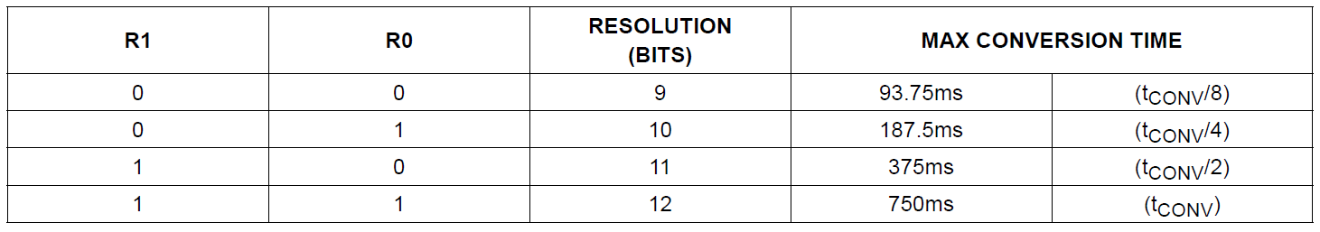
Temperature Sensor
Configuration register

Slide 9
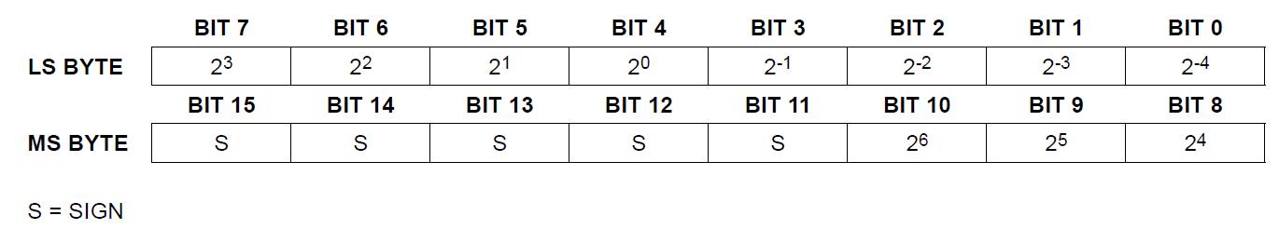
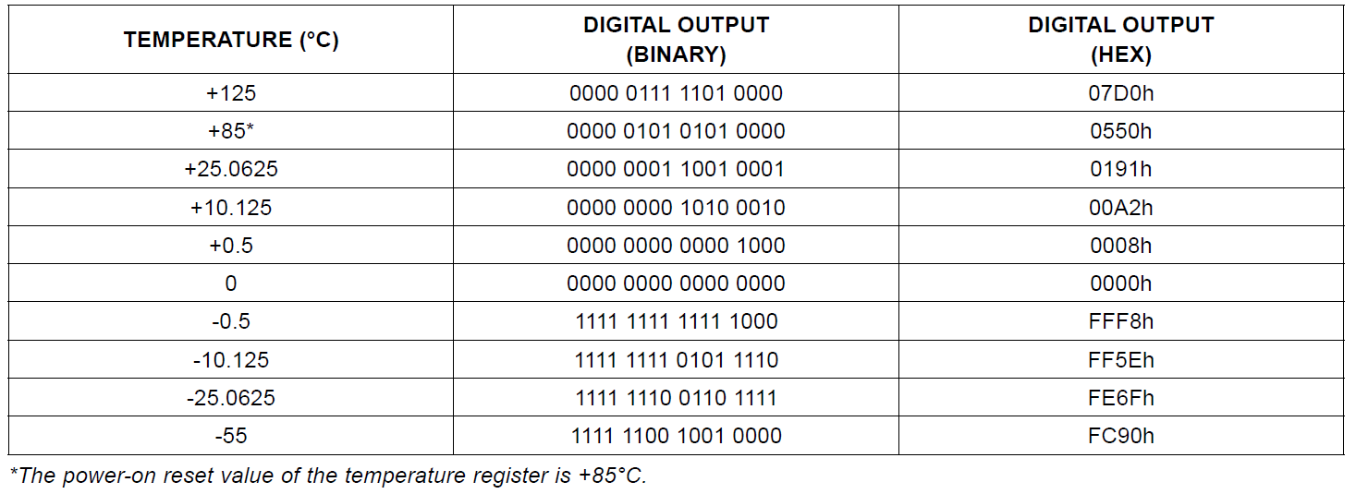
Temperature Sensor
Temperature register
Default : 12-bit resolution
Value = 16-bit sign-extended 2’s complement

Slide 10
Temperature Sensor
Alarm register
1-Byte T_{H} (high-limit) & T_{L} (low-limit) register in EEROM
Comparison for alarm
Only bits 11 through 4 of the temperature register are used in the TH and TL comparison since TH and TL are 8-bit registers.
If the measured temperature is lower than or equal to TL or higher than or equal to TH, an alarm condition exists and an alarm flag is set inside the DS18B20.
This flag is updated after every temperature measurement; therefore, if the alarm condition goes away, the flag will be turned off after the next temperature conversion.

Slide 11
Temperature Sensor
Transaction sequence btw CPU and sensor
Step 1. Initialization
Step 2. ROM Command (followed by any required data exchange)
Step 3. DS18B20 Function Command (followed by any required data exchange)
It is very important to follow this sequence every time the DS18B20 is accessed, as the DS18B20 will not respond if any steps in the sequence are missing or out of order.
Exceptions to this rule are the Search ROM [F0h] and Alarm Search [ECh] commands.
After issuing either of these ROM commands, the master must return to Step 1 in the sequence.

Slide 12
Temperature Sensor
ROM command set
Search ROM [0xF0]
Read ROM [0x33]
Match ROM [0x55]
Skip ROM [0xCC]
Alarm Search [0xEC]
Search ROM [0xF0]
When a system is initially powered up, the master must identify the ROM codes of all slave devices on the bus, which allows the master to determine the number of slaves and their device types.
The master learns the ROM codes through a process of elimination that requires the master to perform a Search ROM cycle (Search ROM command followed by data exchange) as many times as necessary to identify all of the slave devices.
If there is only one slave on the bus, the simpler Read ROM [33h] command can be used in place of the Search ROM process.

Slide 13
Temperature Sensor
Read Rom [33h]
This command can only be used when there is one slave on the bus.
It allows the bus master to read the slave’s 64-bit ROM code without using the Search ROM procedure.
If this command is used when there is more than one slave present on the bus, a data collision will occur when all the slaves attempt to respond at the same time.
Match Rom [55H]
The match ROM command followed by a 64-bit ROM code sequence allows the bus master to address a specific slave device on a multidrop or single-drop bus.
Only the slave that exactly matches the 64-bit ROM code sequence will respond to the function command issued by the master.
All other slaves on the bus will wait for a reset pulse.

Slide 14
Temperature Sensor
Skip ROM [CCh]
The master can use this command to address all devices on the bus simultaneously without sending out any ROM code information.
For example, the master can make all DS18B20s on the bus perform simultaneous temperature conversions by issuing a Skip ROM command followed by a Convert T [44h] command.
Note that the Read Scratchpad [BEh] command can follow the Skip ROM command only if there is a single slave device on the bus.
Alarm Search [ECh]
The operation of this command is identical to the operation of the Search ROM command except that only slaves with a set alarm flag will respond.
This command allows the master device to determine if any DS18B20s experienced an alarm condition during the most recent temperature conversion.
After every Alarm Search cycle (i.e., Alarm Search command followed by data exchange), the bus master must return to Step 1 (Initialization) in the transaction sequence.

Slide 15
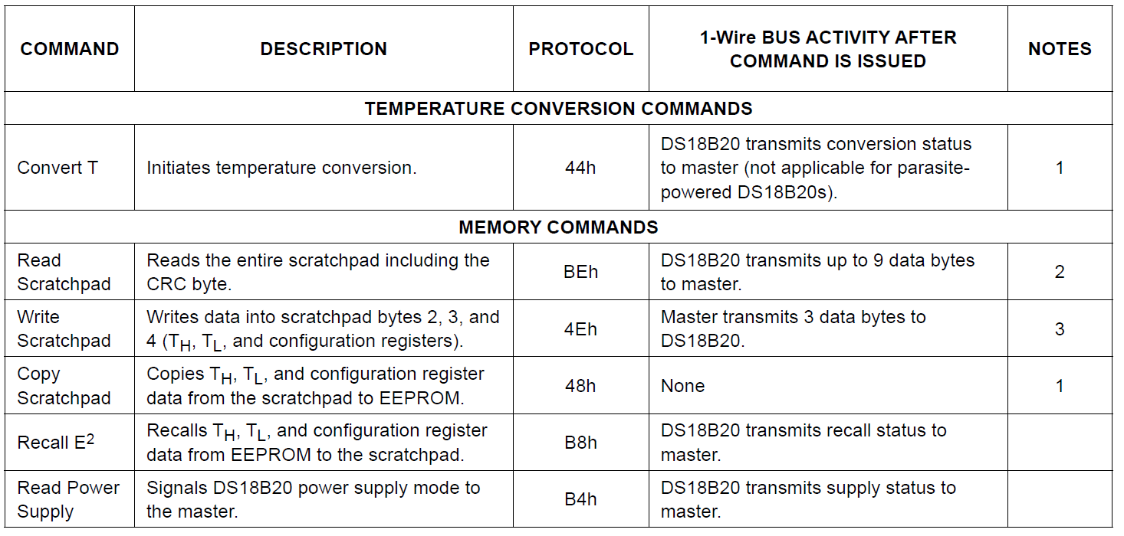
Temperature Sensor
Function command set
All data and commands are transmitted least significant bit first over the 1-Wire bus.

Slide 16
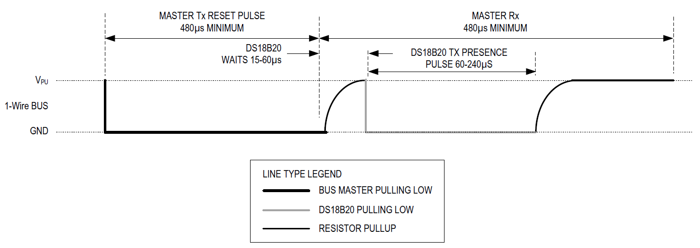
Temperature Sensor
Initialization
Initialization sequence
consists of a reset pulse from the master followed by a presence pulse from the DS18B20.
After the bus master has detected a presence pulse, it can issue a ROM command.

Slide 17
Temperature Sensor
OneWire library
The library for accessing 1-wire temperature sensor, memory & chips.
https://www.arduinolibraries.info/libraries/one-wire

Slide 18
Control I/O Device
Most of processors control their I/O devices through registers, control registers.
Control registers are mapped into memory (memory-mapped-I/O) or their own space (Isolated-I/O).
Command + Status + Result
I/O Device
Processor
Command
Status
Result
I/O Circuit

Slide 19

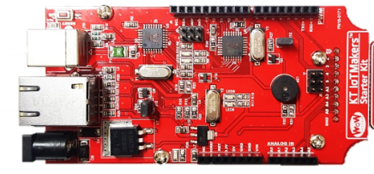
Local Monitoring of Arduino
Arduino use built-in serial monitor to communicate host computer.
“Serial” : serial port object
int incomingByte = 0; // for incoming serial data
void setup() {
Serial.begin(9600); // opens serial port,
// sets data rate to 9600 bps
}
void loop() {
// send data only when you receive data:
if (Serial.available() > 0) {
// read the incoming byte:
incomingByte = Serial.read();
// say what you got:
Serial.print("I received: ");
Serial.println(incomingByte, DEC);
}
}
USB
USB-2-Serial
Host Computer
Target Board
IDE : Arduino Software
Built-in Serial Monitor
- Sending data : keying
- Receiving data : displaying
WoW Starter Kit
UNO has just one serial port.
What if we need an another serial port ?

Slide 20
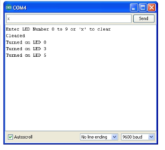


Cloud Connection
WoW kit can connect to cloud server (IoTMakers) through Wired/Wireless Ethernet connection.
Built-in Serial Monitor
Configuration
Browser
GiGA IoT Makers
Host Computer
Starter Kit
Access
Point
cmd(ON/OFF)
Local Monitoring
Target Board
Remote Monitoring

Slide 21
Cloud Connection
Procedure of connecting IoTMakers from Arduino
Create a device in IoTMakers.
Connect Ethernet
Arduino communicates with Ethernet shield using SPI interface.
Connect to IoTMakers
Device ID
Device password
Gateway ID
Check device’s authentication.
Sending data
Server listening
Check data from IoTMakers. (listening)
SPI.h, Ethernet.h
EthernetClient client;
Ethernet.begin();
IoTStarterKit_Eth.h
IoTStarterKit_Eth g_im;
g_im.init(devID, devPWD, gwID, client);
g_im.connect();
g_im.auth_device();
g_im.send_numdata();
g_im.loop()

Slide 22
Saving Memory Space
In case of ATmega328, the size of flash memory is 32KB, instead SRAM equals to 8KB. In order to save the space of 8KB SRAM, you’d better save constant, specially string constant to flash instead of SRAM, if possible.
How to save data into flash memory
Use PROGMEM keyword
Use F() macro.
Only after Arduino Software version v1.0.
Save string constant into Flash.
const dataType variableName[] PROGMEM = {}; // use this form const PROGMEM dataType variableName[] = {}; // or this one const dataType PROGMEM variableName[] = {}; // not this one
const PROGMEM uint16_t charSet[] = { 65000, 32796, 16843, 10, 11234};
Serial.print(F("I save this into flash memory."));

Slide 23
Sample-I : Temperature Sensor
#include <OneWire.h>
OneWire ds(2);
void setup() {
Serial.begin(9600);
}
void loop() {
byte i;
byte present = 0;
byte data[12];
byte addr[8];
float Temp;
if (!ds.search(addr)) {
ds.reset_search();
return;
}
ds.reset();
ds.select(addr);
ds.write(0x44,1); // start conversion, with parasite power on at the end
delay(1000);
present = ds.reset();
ds.select(addr);
ds.write(0xBE); // Read all data of Scratchpad
for (i = 0; i < 9; i++)
data[i] = ds.read();
}
Temp=(data[1]<<8)+data[0]; // calculate the Celsius.
Temp=Temp/16;
Serial.print("C="); // Celsius output
Serial.print(Temp);
Serial.print(", ");
}

Slide 24
Sample-II : Temperature Sensor with Alarming
#include <OneWire.h>
OneWire ds(2);
#define BUZZER 6
void setup() {
Serial.begin(9600);
pinMode(BUZZER, OUTPUT);
}
void loop() {
float temp = get_temperature();
Serial.print("C = ");
Serial.println(temp);
if(temp > 31) {
tone(BUZZER, 400);
delay(100);
noTone(BUZZER);
delay(100);
}
}
float get_temperature() {
byte i;
byte present = 0;
byte data[12];
byte addr[8];
float Temp;
if (!ds.search(addr)) {
ds.reset_search();
return;
}
ds.reset();
ds.select(addr);
ds.write(0x44,1); // start conversion
delay(1000);
present = ds.reset();
ds.select(addr);
ds.write(0xBE); // Read Scratchpad
for (i = 0; i < 9; i++) {
data[i] = ds.read();
}
Temp=(data[1]<<8)+data[0];
Temp=Temp/16;
return Temp;
}

Slide 25
Sample-III : Temperature Sensor with IoT Makers
#include <WiFi.h>
#include <IoTStarterKit_WiFi.h>
#include <OneWire.h>
#include <DallasTemperature.h>
IoTMakers g_im;
#define deviceID "{YOUR_DEVICE_ID}"
#define authnRqtNo "{YOUR_DEVICE_PASSWORD}"
#define extrSysID "{YOUR_GATEWAY_ID}"
#define WIFI_SSID "{WIFI_NAME}"
#define WIFI_PASS "{WIFI_PASSWORD}"
#define ONE_WIRE_BUS 2
#define TAG_ID "Temperature"
OneWire ourWire(ONE_WIRE_BUS);
DallasTemperature sensors(&ourWire);
void init_iotmakers() {
while(1) {
Serial.print(F("Connect to AP..."));
while(g_im.begin(WIFI_SSID, WIFI_PASS) < 0) {
Serial.println(F("retrying"));
delay(100);
}
Serial.println(F("Success"));
g_im.init(deviceID, authnRqtNo, extrSysID);
Serial.print(F("Connect to platform..."));
while(g_im.connect() < 0) {
Serial.println(F("retrying."));
delay(100);
}
Serial.println(F("Success"));
Serial.print(F("Auth..."));
if(g_im.auth_device() >= 0) {
Serial.println(F("Success..."));
return;
}
}
}

Slide 26
Sample-III : Temperature Sensor with IoT Makers
int send_temperature()
{
sensors.requestTemperatures();
int data = sensors.getTempCByIndex(0);
Serial.print("Temperature : ");
Serial.print(data);
Serial.println(" Celsius");
if(g_im.send_numdata(TAG_ID, (double)data) < 0) {
Serial.println(F("fail"));
return -1;
}
return 0;
}
void setup() {
Serial.begin(9600);
sensors.begin();
init_iotmakers();
}
void loop() {
static unsigned long tick = millis();
if(g_im.isServerDisconnected() == 1) {
init_iotmakers();
}
if((millis() - tick) > 1000) {
send_temperature();
tick = millis();
}
g_im.loop();
}

Slide 27
LAB-5 Temperature Sensor
Program the system satisfying the following specification
Spec.-1 : Change the sampling period to 2 second.
* propose how to set the sampling period using millis() function.
Spec.-2 : (optional)
Propose a method to reduce the amount of sensing data.
Propose how to set the sampling period using millis() function.

Slide 28
Q&A

