Slide 1
IoT Practice-II Arduino Programming on WoW Kit (Bluetooth)

Slide 2
12. Bluetooth Module

Slide 3
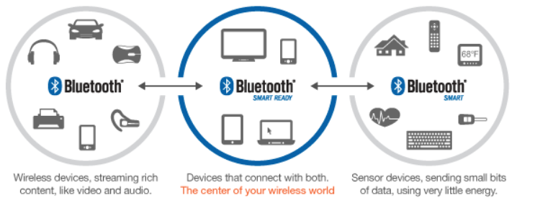
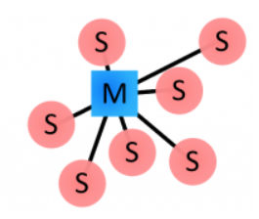
Bluetooth
Bluetooth 4.0
Classic : BT
Smart : BLE (BT Low Energy)
Smart Ready : BT + BLE
Frequency area
2.4GHz ISM band/1Mbps GFSK
40ch with 2MHz interval
37 data channels
3 advertising channels (37, 38, 39)
BT network : Piconet
1 Master + up to 7 Slaves
Address of BT device
Unique 48-bit address : 24-bit(OUI: organization unique identifier) + 24-bit serial number

Slide 4
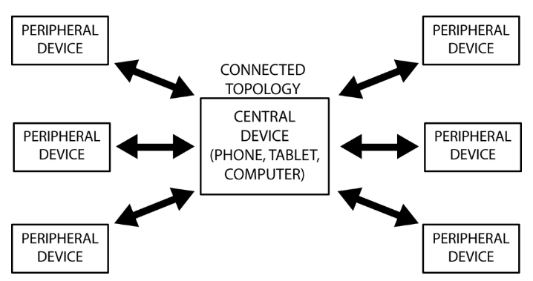
Bluetooth
BT connection procedure
Inquiry
Paging(connecting)
Connection
Active mode
Sniff mode
Hold mode
Park Mode
Bonding & pairing of BT
BT profile
Serial Port Profile(SPP)
Human Interface Device(HID)
Hands-Free Profile(HFP)
Headset Profile(HSP)
Advanced Audio Distribution Profile(A2DP)
A/V Remote Control Profile(AVRCP)

Slide 5
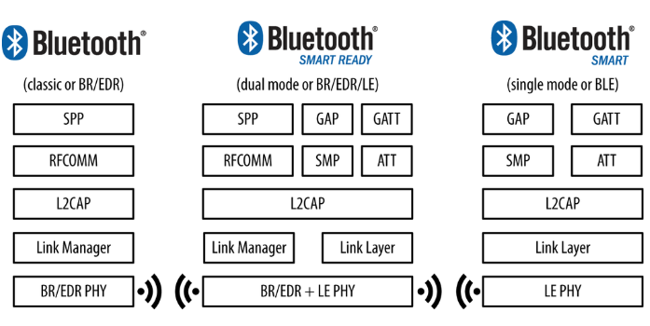
Bluetooth
BT protocol version
BT 1.2
BT 2.1 + EDR
BT 3.0 + HS
BT 4.0 + BLE

Slide 6
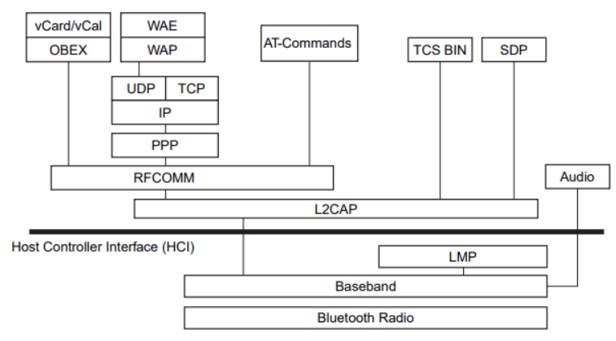
Bluetooth
BT stack

Slide 7
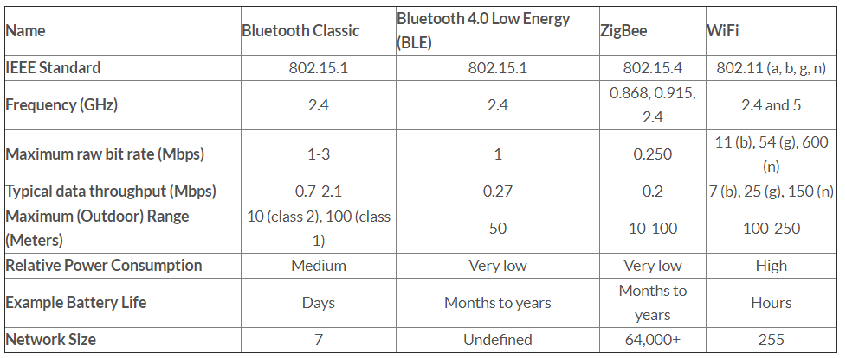
Bluetooth
Comparison btw wireless solutions

Slide 8
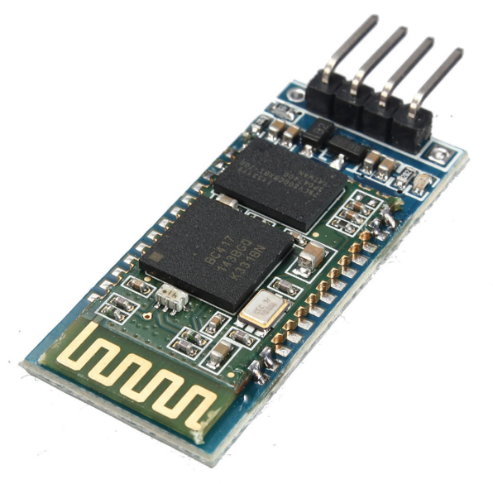
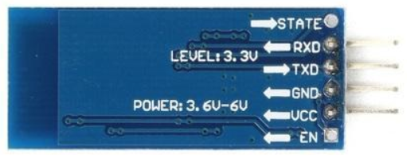
Bluetooth Module
HC-06
CSR’s BlueCore4-External
USB protocol : Full speed USB1.1, Compliant With 2.0+EDR
Baud rate : 4.8, 9.6, 19.2, 38.4, 115.2, ~1.3M
Supply voltage : 3.6~6V
Current consumption : 30mA@unpaired, 10mA@paired
Effective communication distance : 10m
Emitting power : 3dBm

Slide 9
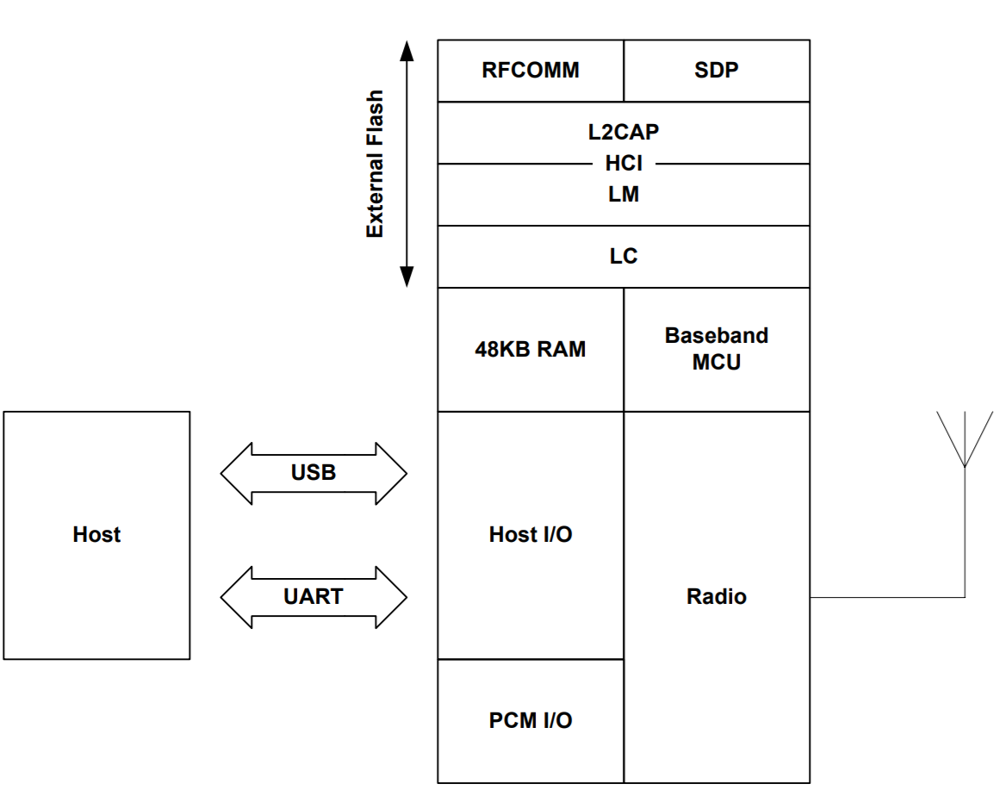
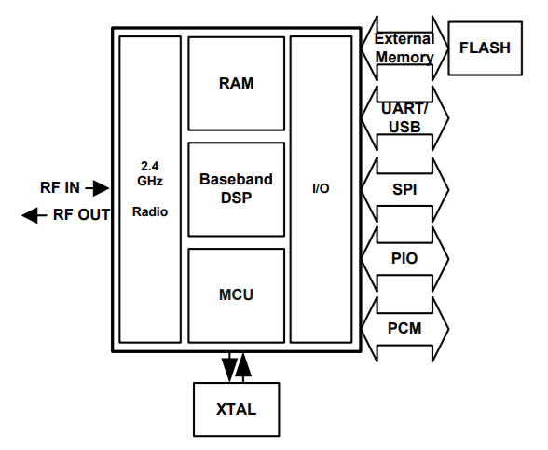
Bluetooth Module
Block diagram of BlueCore4
~8M

Slide 10
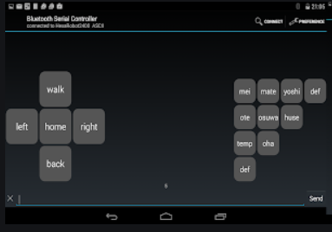
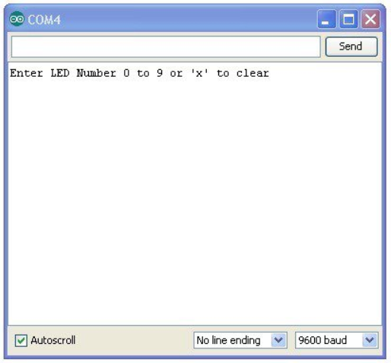


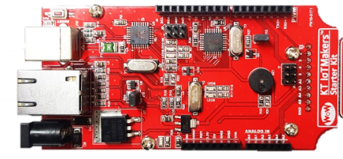
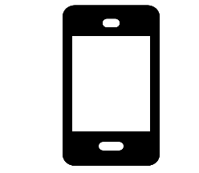
Bluetooth Module
Practice Environment
HC-06
(Master)
Built-in Serial Monitor
Bluetooth Serial Controller
USB
UART
Host Computer
Target Board
Mobile
(Master)
HC-06
(Slave)

Slide 11
Code for Changing BT Module Name & Pin Number
#include <SoftwareSerial.h>
#define BT_TX 2
#define BT_RX 3
SoftwareSerial mySerial(BT_TX, BT_RX);
void setup() {
Serial.begin(9600);
mySerial.begin(9600);
}
void loop() {
if (mySerial.available()) {
Serial.write(mySerial.read());
}
if (Serial.available()) {
delay(5);
mySerial.write(Serial.read());
}
}
* Built-in Serial Monitor Setting : “No line ending”, “9600”
1. Test connection
AT
OK
2. Set operation mode (master + slave)
AT+ROLE=M or AT+ROLE=S
3. Set baud rate
AT+BAUDx
Okxxxx
4. Set module name
AT+NAMExxxx
Okxxxx
5. Set pairing password
AT+PINxxxx
Oksetpin
6. Reset the module
AT+RESET
Baud rate Table
1 - 1200
2 - 2400
3 - 4800
4 – 9600 (default)
5 - 19200
6 - 38400
7 - 57600
8 - 115200
Max. Name = 20 characters.
PIN number = 4-digits
Test Command
AT+UASRT?
AT+ROLE? // slave = 0
AT+ADDR?

Slide 12
Sample-I : BT
#include <SoftwareSerial.h>
#define BT_TX 2
#define BT_RX 3
SoftwareSerial mySerial(BT_TX, BT_RX);
String myString="";
void setup() {
Serial.begin(9600);
mySerial.begin(9600);
}
void loop() {
while(mySerial.available()) {
char myChar = (char)mySerial.read();
myString+=myChar;
delay(5);
}
if(!myString.equals("")) {
Serial.println(“Received : "+myString);
myString=""; // clear
}
}
In app store,
Download & install “Bluetooth Serial Controller”.
void setup() {
….
pinMode(13, OUTPUT);
}
void loop() {
if(!myString.equals("")) {
Serial.println("input value: "+myString);
if(myString=="on") {
digitalWrite(13, HIGH);
} else {
digitalWrite(13, LOW);
}
myString="";
}
}

Slide 13
LAB-12 : Gyro Sensor
Program the system satisfying the following specification
Spec.-1 : Modify the given sample code to change the color of full color LED as the followings.
* Change to green when you typed “G”, blue when “B”, read When “R”
* Turn on red, green, blue in order repeatedly when “AUTO”.
* Use PIN 9, 10, 11 for full-color LED.
Spec.-2 : (Challenge!!!!)
* Chat with your friend (up to 8 persons) by setting master/slave.
- At master, AT+ADDR?
- At slave, AT+CO0xxxxx // xxxx = MAC address of master

Slide 14
Q&A

