Slide 1
IoT Practice-II Arduino Programming on WoW Kit (Gyro)

Slide 2
11. Gyro Sensor

Slide 3
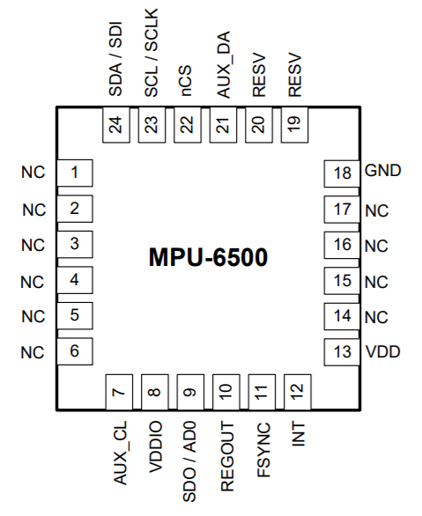
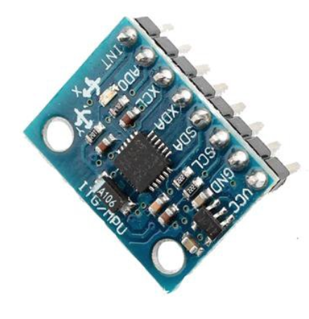
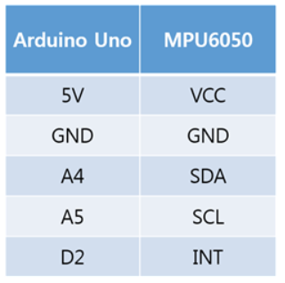
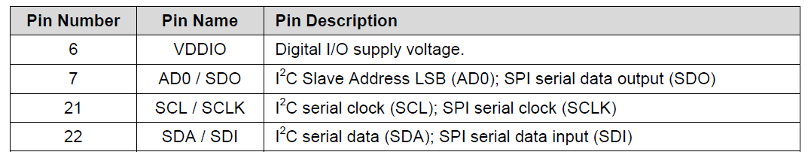
Gyro Sensor
MPU6050
6-axis motion tracking device consists of …
3-axis gyroscope : a device used for measuring angular velocity.
3-axis accelerometer : a device used for measuring gravity acceleration.
Digital Motion Processor (DMP) : offloads computation of motion processing algorithms from the host processor.
I2C@400KHz, SPI@1MHz interface

Slide 4
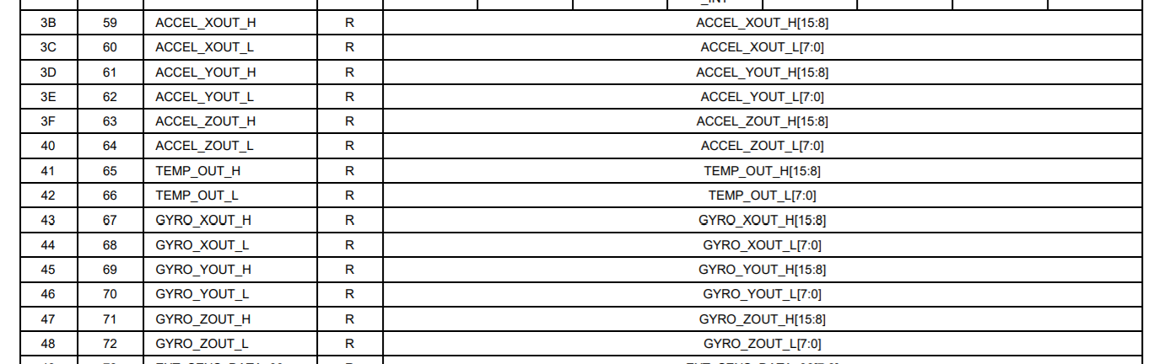
Gyro Sensor
Register map of MPU6050
0x00~0x7E address space

Slide 5
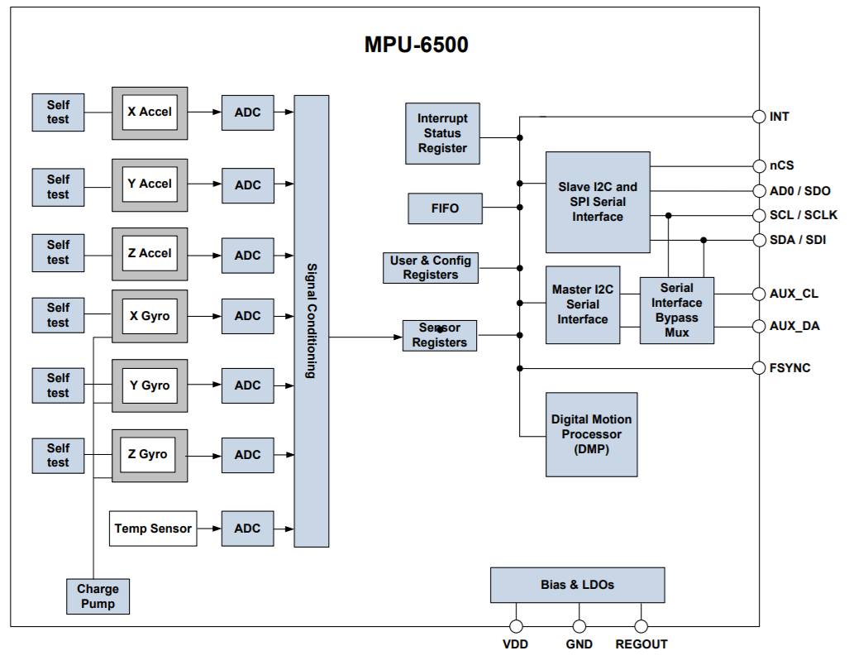
Gyro Sensor
16-bit resolution
Block diagram of MPU6050
512-byte
Die’s temp.
Regulator filter capacitor connection

Slide 6
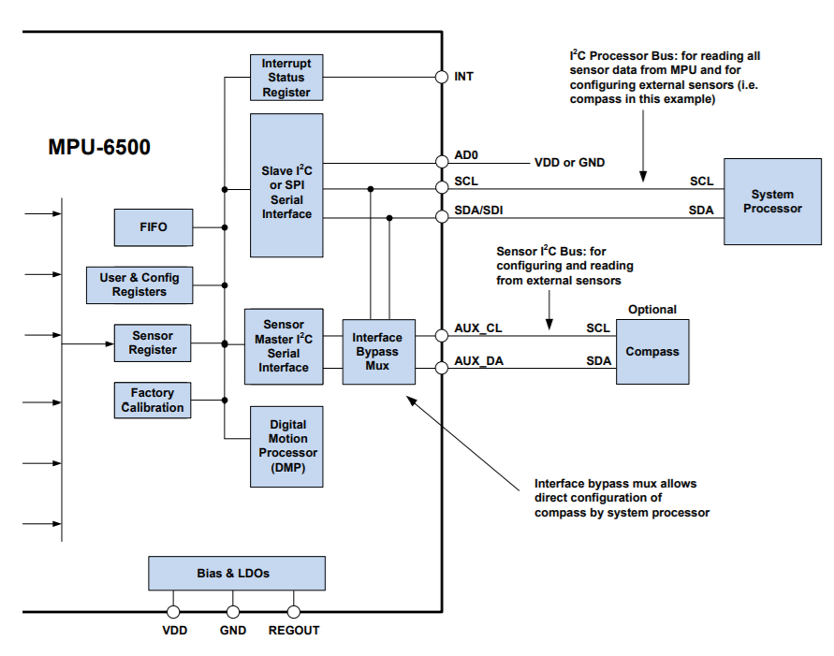
Gyro Sensor
Block diagram of MPU6050 using I2C interface
2-wire sync. Serial : SDA (serial data), SCL(serial clock)

Slide 7
Gyro Sensor
I2C interface
The MPU-6500 always operates as a slave device when communicating to the system processor, which thus acts as the master.
SDA and SCL lines typically need pull-up resistors to VDD.
The maximum bus speed is 400 kHz.
Slave address of the MPU-6500
7-bit long (b110100X)
The LSB bit of the 7 bit address is determined by the logic level on pin AD0.
This allows two MPU-6500s to be connected to the same I2C bus.
b1101000 (pin AD0 is logic low) : 0x68
b1101001 (pin AD0 is logic high) : 0x69

Slide 8
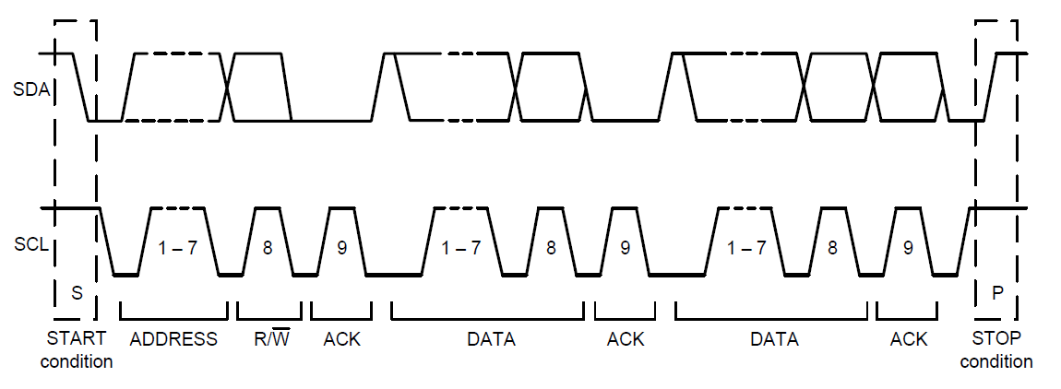
Gyro Sensor
I2C data transmission

Slide 9
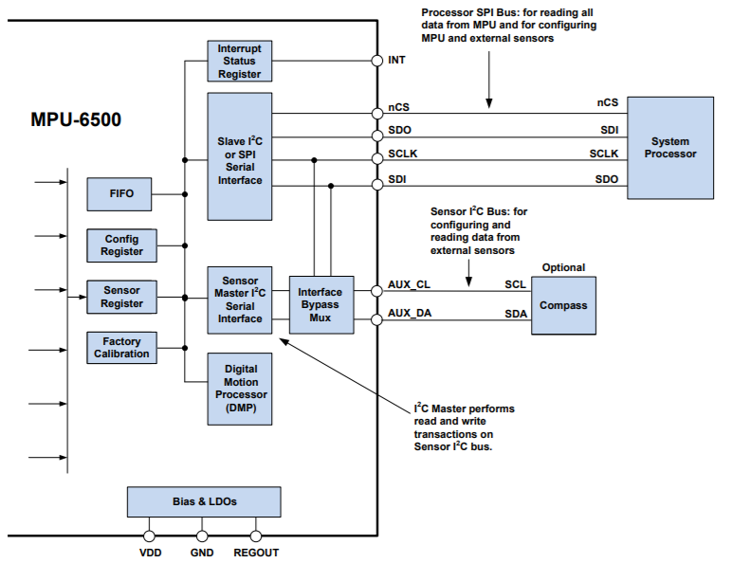
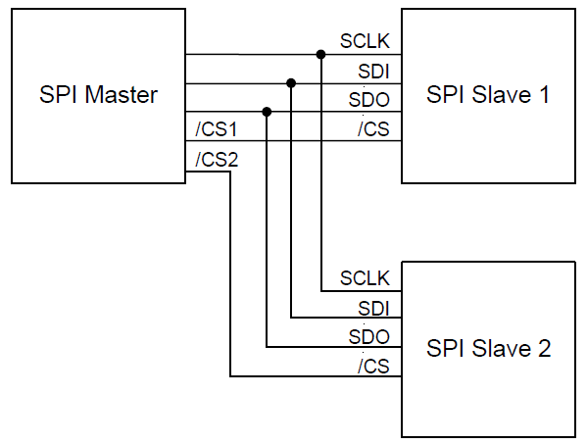
Gyro Sensor
Block diagram of MPU6050 using SPI interface
4-wire sync. Serial : SCLK, SDO, SDI, nCS

Slide 10
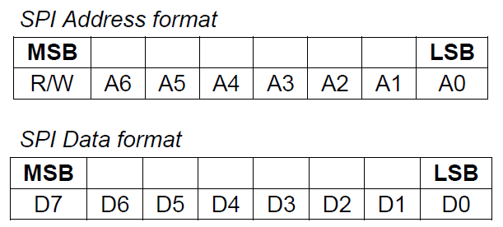
Gyro Sensor
SPI interface
Data is delivered MSB first and LSB last
Data is latched on the rising edge of SCLK
Data should be transitioned on the falling edge of SCLK
The maximum frequency of SCLK is 1MHz
SPI read and write operations are completed in 16 or more clock cycles (two or more bytes).
The first byte contains the SPI Address, and the following byte(s) contain(s) the SPI data.
The first bit of the first byte contains the Read/Write bit and indicates the Read (1) or Write (0) operation. The following 7 bits contain the Register Address.
Support single or burst read/writes
In cases of multiple-byte Read/Writes, data is two or more bytes:

Slide 11
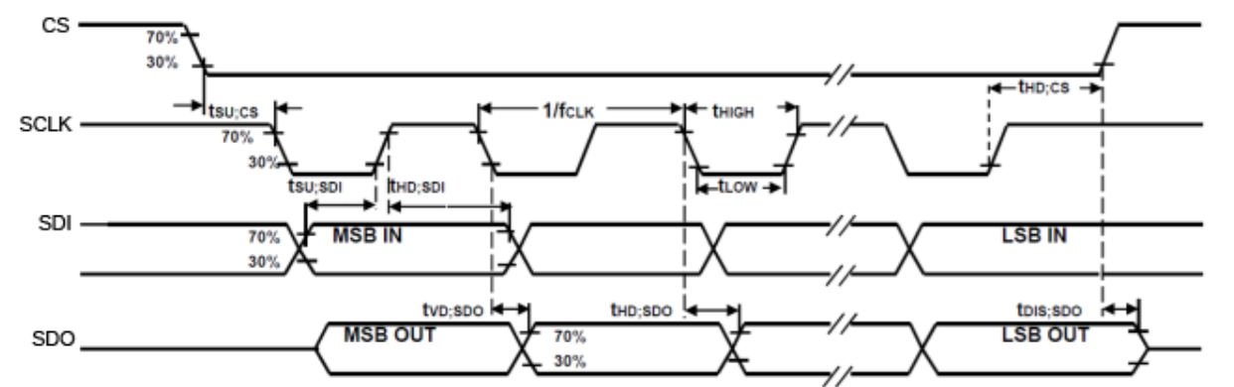
Gyro Sensor
Bus timing of SPI interface

Slide 12
Gyro Sensor
Arduino’s I2C library : Wire.h
begin(addr) : initiate Wire library & join I2C bus as a master or slave.
beginTransmission(addr) : begin a transmission to I2C slave with the given address.
write(val) : queues bytes for transmission from a master to slave device. Or writes data from a slave in response to a request from a master.
endTransmission() : ends a transmission to a slave device and transmit the bytes queued by write().
requestFrom() : the master requests bytes from a slave device.
Available() : return the number of bytes available for retrieval with read().
read() : read a byte transmitted from a slave device to a master.
SetClock() : change the clock frequency for I2C communication.
onReceive() : register a function to be called when a slave device receives a transmission from a master.
onRequest() : register a function to be called when a master requests data from this slave device.

Slide 13
Sample : Gyro Sensor
#include<Wire.h>
const int MPU = 0x68; // I2C address of MPU-6050
int16_t AcX, AcY, AcZ, Tmp, GyX, GyY, GyZ;
void setup() {
Serial.begin(9600);
Wire.begin();
Wire.beginTransmission(MPU);
Wire.write(0x6B); // PWR_MGMT_1 register
Wire.write(0); // set to zero (wakes up the MPU-6050)
Wire.endTransmission(true);
// gyro scale
Wire.beginTransmission(MPU);
Wire.write(0x1B);
Wire.write(0xF8);
Wire.endTransmission(true);
// acc scale
Wire.beginTransmission(MPU);
Wire.write(0x1C);
Wire.write(0xF8);
Wire.endTransmission(true);
}
void loop() {
Wire.beginTransmission(MPU);
Wire.write(0x3B);
Wire.endTransmission(false);
Wire.requestFrom(MPU, 14, true);
AcX = Wire.read() << 8 | Wire.read(); // ACCEL_X
AcY = Wire.read() << 8 | Wire.read(); // ACCEL_Y
AcZ = Wire.read() << 8 | Wire.read(); // ACCEL_Z
Tmp = Wire.read() << 8 | Wire.read(); // Temperature
GyX = Wire.read() << 8 | Wire.read(); // GYRO_X
GyY = Wire.read() << 8 | Wire.read(); // GYRO_Y
GyZ = Wire.read() << 8 | Wire.read(); // GYRO_Z
int xAxis = (AcX - 1090);
int yAxis = (AcY - 930);
int zAxis = (AcZ - 1000);
Serial.print(xAxis);
Serial.print(" ");
Serial.print(yAxis);
Serial.print(" ");
Serial.print(zAxis);
Serial.println(" ");
delay(50);
}

Slide 14
LAB-11 : Gyro Sensor
Program the system satisfying the following specification
Spec.-1 : Modify the given sample code to display the measured value of gyroscope
& die temperature in MPU6050.
Spec.-2 : (optional)
Upload the measured die-temperature to IoTMakers.

Slide 15
Q&A

