Slide 1
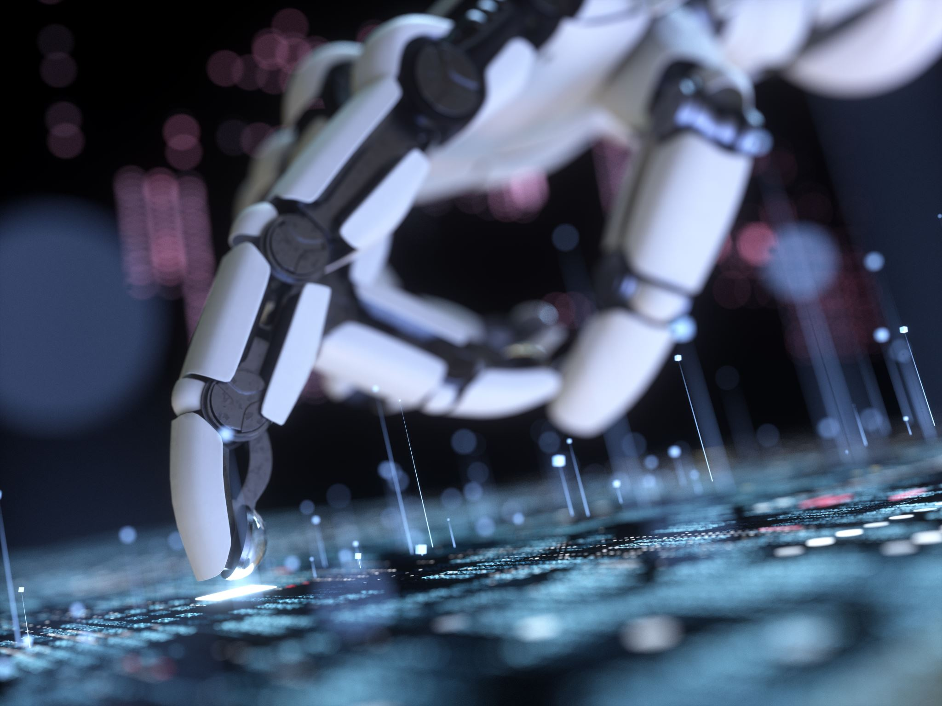
The Future of QA in 2026
AI, Agents & the Evolution of Quality Assurance
By: Viplove

Slide 2

QA Till Today (2025)
- Playwright, Cypress, Selenium dominate
- Script-based automation
- CI/CD focused
- High maintenance cost

Slide 3

Challenges with Traditional QA
- Flaky tests
- Slow scaling
- Manual bottlenecks
- Limited intelligence

Slide 4
AI Revolution in QA
- LLM-powered testing
- Auto test generation
- Smart bug detection
- Context-aware testing

Slide 5
QA Landscape in 2026
- AI-first pipelines
- Agent-driven QA
- Self-healing tests
- Continuous quality

Slide 6
Core Skills for QA in 2026
- Strong coding foundation
- AI & LLM understanding
- Agent workflow orchestration
- Quality strategy mindset

Slide 7
Agentic QA Workflows
- Autonomous test agents
- Self-maintaining suites
- Exploratory AI testing
- Production monitoring

Slide 8
Tooling Evolution
- Traditional tools + AI layer
- Playwright with agents
- AI-driven Cypress
- Intelligent Selenium

Slide 9
What QA Will Do in 2026
- Design quality systems
- Guide AI agents
- Validate AI output
- Risk-based testing

Slide 10
Why AI Won’t Replace QA
- Human judgment
- Business context
- Ethics & UX
- Strategic thinking

Slide 11
QA Workflow in 2026
1. Feature input
2. AI generates tests
3. Agent executes
4. AI reports
5. QA optimizes

Slide 12
Skills Roadmap
Learn
- Learn JS/Python
Master
- Master Playwright/Cypress
Learn
- Learn AI prompts
Build
- Build agent workflows

Slide 13
Benefits of AI-Driven QA
- Massive test coverage
- Faster releases
- Lower cost
- Better quality

Slide 14
Final Thought
QA in 2026 is not about writing tests.
It’s about designing intelligent quality systems.

Slide 15
Call To Action
Like, Share & Subscribe
Comment your thoughts on AI in QA

