Slide 1

Employee Data Analysis using Excel
STUDENT NAME: VIPRAJHA P
REGISTER NO: 312209515
DEPARTMENT: B.COM BANK MANAGEMENT
COLLEGE: ANNA ADARSH COLLEGE FOR WOMEN

Slide 2

PROJECT TITLE
Employee Performance Analysis using Excel

Slide 3


AGENDA
Problem Statement
Project Overview
End Users
Our Solution and Proposition
Dataset Description
Modelling Approach
Results and Discussion
Conclusion

Slide 4


PROBLEM STATEMENT
To analyze and evaluate the performance of employees over the past year to identify strengths, areas for improvement, and overall trends that can inform strategic HR decisions.

Slide 5


PROJECT OVERVIEW
Objective: To analyze and visualize employee performance data to identify trends, strengths, and areas for improvement, and to assist in decision-making processes related to employee development and resource allocation.
Data Types: Numeric data (e.g., EmpID), categorical data (e.g., Current Employee Rating), and textual data (e.g.,Employee performance level).
Data Cleaning: Remove duplicates, handle missing values, and correct inconsistencies.
Data Organization: Structure data in a tabular format with relevant columns such as EmpID, First Name, Business Type, Gender Code, and Current Employee Rating.
Charts and Graphs: Create bar charts to visualize performance metrics.
Dashboards: Develop interactive dashboards using Excel’s PivotTables and Pivot Charts to provide a dynamic view of performance data.
Summary Report: Prepare a report that includes key findings, visualizations, and actionable insights.

Slide 6


WHO ARE THE END USERS?
Board of Directors
Executives & Senior Leadership
HR Professionals
Employees in Development Programs
COOs
HR Analysts
Managers & Team Leaders
Team Leaders
Performance Improvement Specialists
Employees
CEOs
HR Manager
Department Heads
Consultants
Finance Professionals
Compensation Analysts
Individual Contributors

Slide 7


OUR SOLUTION AND ITS VALUE PROPOSITION
Conditional formatting – Missing
Filter – Remove
Formula – Performance
Pivot - Summary
Graph – Data Visualization

Slide 8

Dataset Description
employee_data= Kaggle
Total no. of features – 26
No. of features used – 9
EmpID - Numeric data
First Name - Textual data
Last Name - Textual data
Business unit - Textual data
Employee Status - Textual data
Employee type - Textual data
Gender code - Textual data
Current Employee Rating - Categorical data
Performance level - Textual data

Slide 9

THE "WOW" IN OUR SOLUTION
Interactive Dashboards:
Create dynamic dashboards with Excel’s PivotTables, slicers, and interactive charts. This allows stakeholders to slice and dice data effortlessly, filtering by departments, time periods, or performance categories with a simple click.
Automated Reporting:
Use Excel formulas, macros, and templates to automate repetitive tasks, like generating performance reports. This saves time and ensures consistency. An automated report generation feature can provide real-time updates on performance trends with minimal effort.
Employee Growth Trajectory Visualization:
Build performance trend lines and growth trajectory charts for individual employees, showing their development over time. Visualizing progress motivates employees and provides managers with a clear understanding of long-term performance.
The WOW Factor:
The "WOW" in this solution lies in its ability to transform raw data into insightful, actionable, and interactive performance analysis that empowers decision-makers, enhances employee engagement, and drives continuous improvement across the organization. With powerful visualizations, automation, and predictive capabilities, this solution elevates Excel from a basic tool to a sophisticated performance management platform.
9

Slide 10

MODELLING
1. Define Key Performance Indicators (KPIs)
Identify Metrics: Determine the KPIs that reflect employee performance. These may include:
Business unit (e.g., BPC,CCDR,EW, MSC, NEL, PL, PYZ, SVG, TNS, WBL)
Employee Status (e.g., Active, Future Start)
Employee Type (e.g., Contract , Full-Time, Part-Time)
Current Employee Rating (e.g., 1,2,3,4,5)
2. Data Collection and Organization
Data Sources: Collect data from various sources such as HR systems, performance reviews, and productivity tools.
Data Structure: Organize the data in Excel with the following columns (as an example):
EmpID
First Name
Last Name
Business unit
Employee Status
Employee type
Gender code
Current Employee Rating
Performance level
This data should be laid out in a structured table for ease of analysis.
10

Slide 11

3. Data Cleaning and Preparation
Handle Missing Data: Use Excel functions to fill in missing data, if possible, or remove incomplete entries.
4. Performance Dashboards
Interactive Dashboards: Create an interactive performance dashboard using slicers and PivotTables.
5. Data Visualization
PivotTables and PivotCharts: Create PivotTables to summarize data by department, job role, or time period. PivotCharts can visualize these summaries in bar charts
Trend Analysis: Use line charts to visualize performance level.

Slide 12

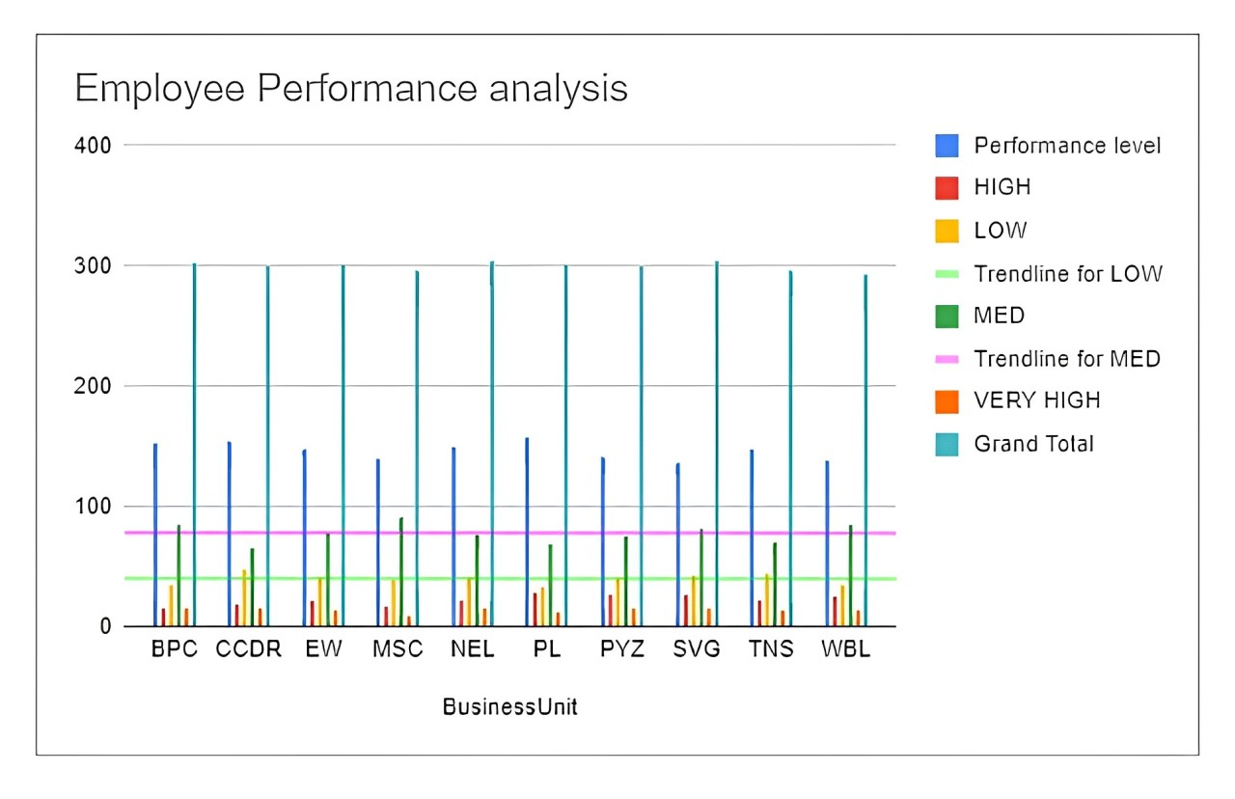
RESULTS
12

Slide 13
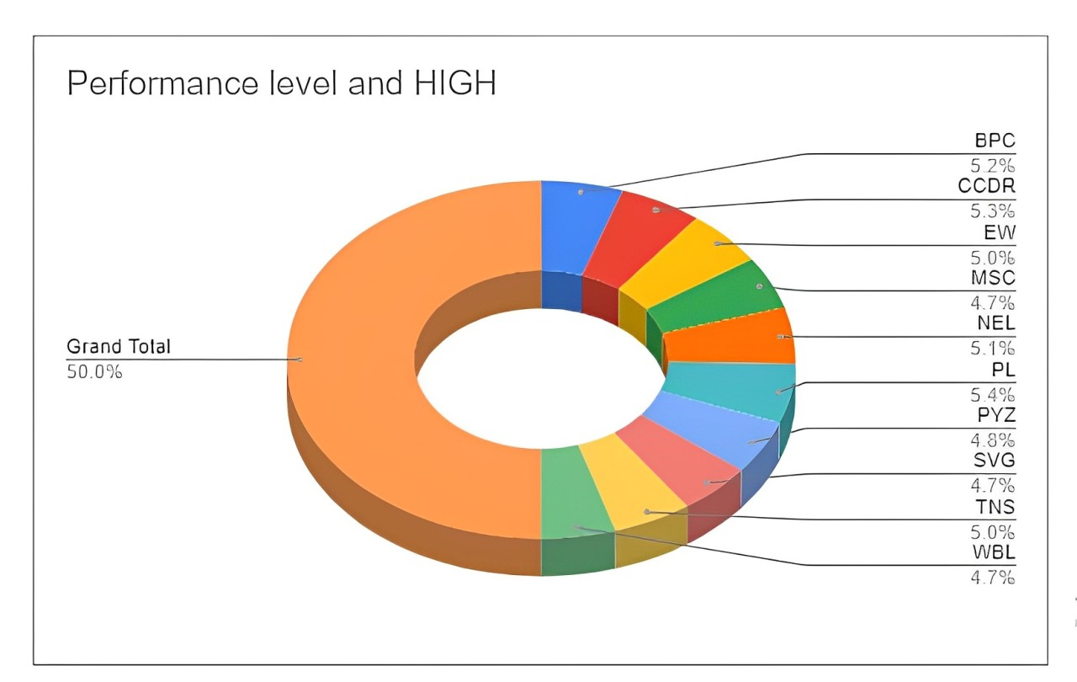

Slide 14

Conclusion
Employee performance analysis using Excel offers a powerful and flexible solution for organizations to assess, monitor, and improve employee productivity and effectiveness. Excel's wide range of features, such as data analysis tools, visualization capabilities, and automation options, makes it a valuable tool for turning raw performance data into actionable insights.

