Slide 2
Data as a Service(DaaS)
Team 7
Snigdha Joshi
Vipra Shah
Under the guidance of
Prof Sri Krishnamurthy

Slide 3
Data as a Service(DaaS)
DaaS is a member of as a service(aaS) family.
Data can be provided on demand
It allows to exchange data between any applications available on internet
DaaS vendors provide data mainly by two ways:
  Volume-based
  Datatype based
  Data can be accessed using REST services

Slide 4
Benefits - DaaS
Increased flexibility in Organization and Systems
Maximum discoverability and re-use of data
Employment on any web-enabled devices
Improved Data quality
Don’t need extensive knowledge to access the data

Slide 5
REST
API – allows product or service to talk to other products or services
REST allows to get data from web application using HTTP protocol
Client
Web Services
Request
XML, JSON, HTML

Slide 6
REST
HTTP – stateless protocol
Four methods:
  GET
  POST
  PUT
  DELETE

Slide 7
Benefits - REST
Identification of Resources
  Resources are identified in requests, example: URIs of website
  Manipulation of Resources
  Metadata is attached to the response, so it enables modification
  Self-descriptive messages
  Stateless
  Holds the data in session and can be transferred to next session

Slide 8
Open Databases
https://fred.stlouisfed.org/
https://www.ncdc.noaa.gov/cdo-web/
https://www.wunderground.com/history/
https://finance.yahoo.com/quote/DATA/
https://www.quandl.com/

Slide 9
OData
Allows to request resource using keys, by passing into RESTful API
Allows to create a new resource and relate resources
Allows you to invoke a function
http://www.odata.org/getting-started/understand-odata-in-6-steps/

Slide 10
POSTMAN
Powerful HTTP client for testing web services
Easy-to-use interface for
  Building API calls
  Saving into history
  Creating collection of API calls
  Collaborating in a team
  Efficient response viewer

Slide 11
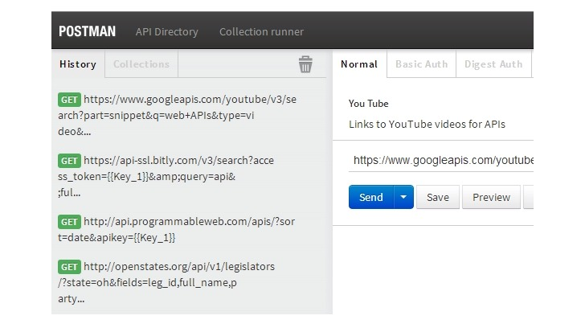
POSTMAN

Slide 12
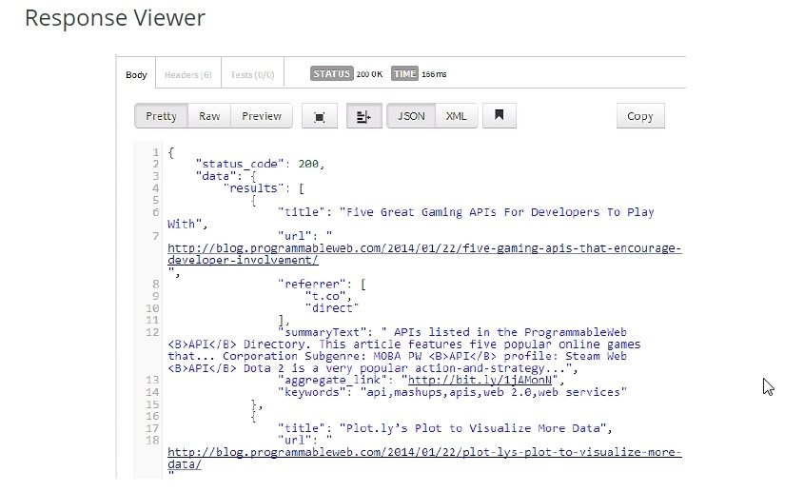
POSTMAN

Slide 13
DEMO

Slide 14
Other Technologies
Instead of using Flask, we can use Django as framework.
http://microservicesdocumentation.readthedocs.io/en/latest/index.html
To create web application, MongoDB, Express and Node.js are other alternatives.
https://closebrace.com/tutorials/2017-03-02/creating-a-simple-restful-web-app-with-nodejs-express-and-mongodb

Slide 15
Conclusion
DaaS allows you to access worldwide data from any data sources using REST API
Can be accessed with authentication
You can embed this data into web services using programming languages such as JAVA,Python, C++, JavaScript

Slide 16
Thank You!

