Slide 1
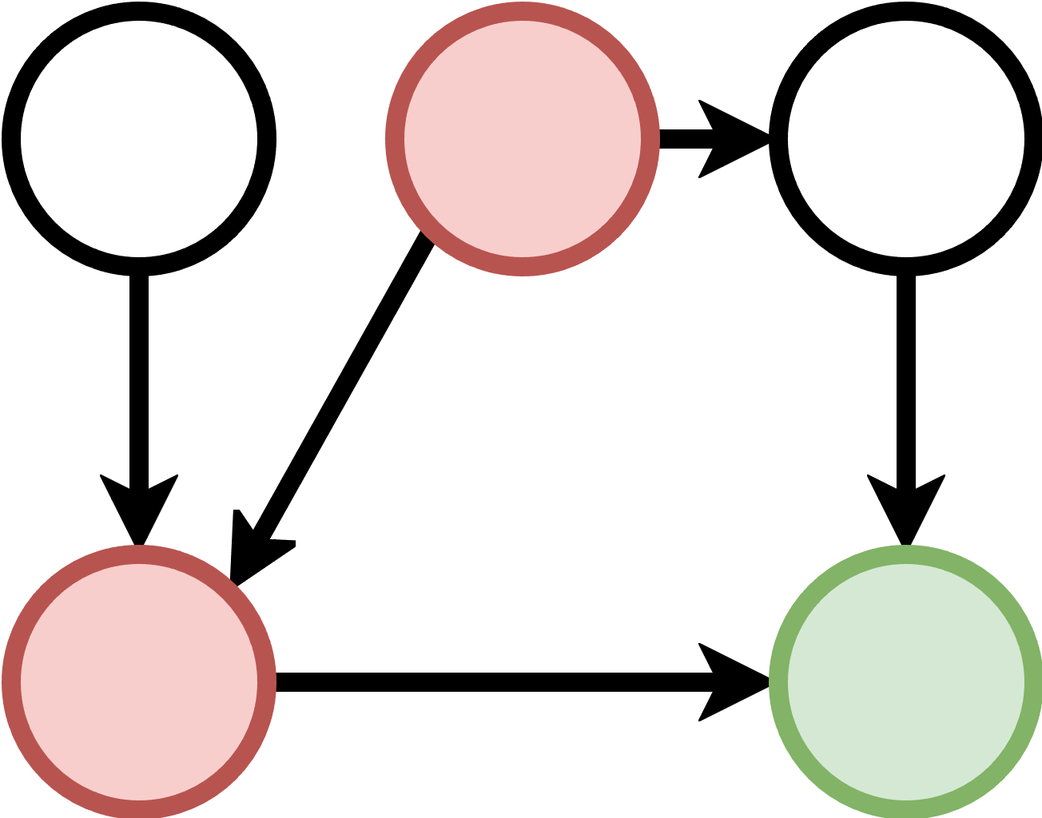
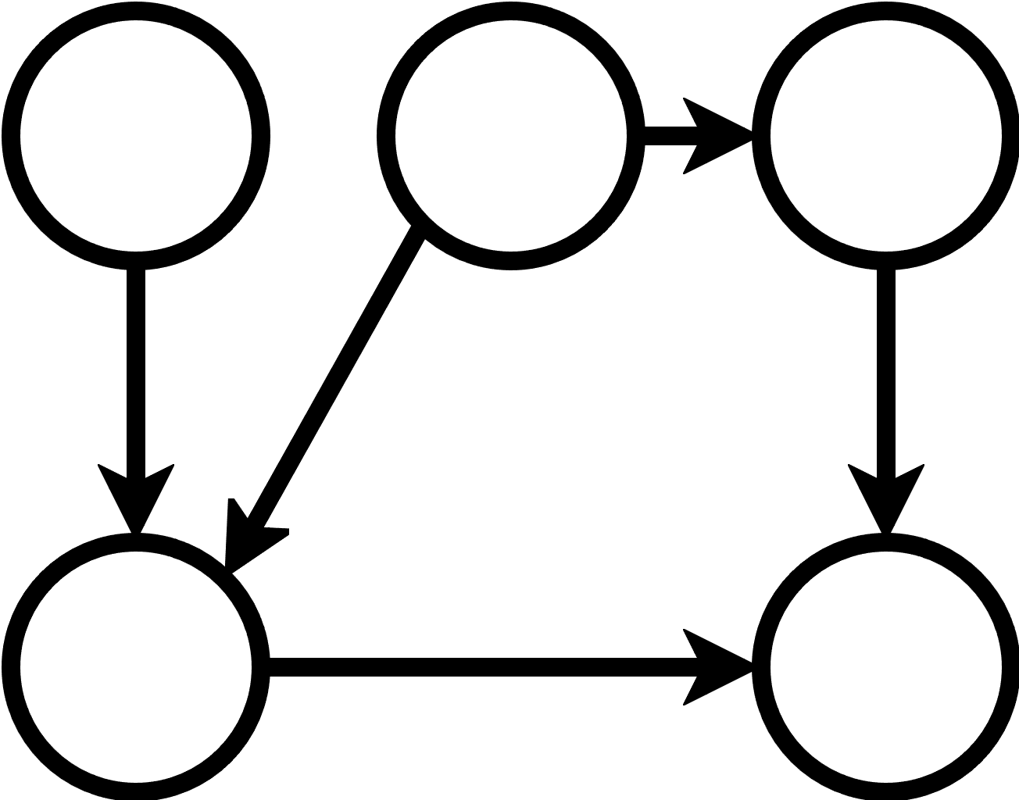
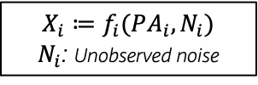
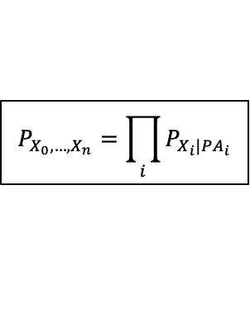
As a user, I’d like to perform:
Modeling Causal Relations
Performing Causal Tasks
A
Modeling Steps
Chapter
Out-of-Distribution Prediction
Define Causal Graph
Causal Prediction
Effect estimation
Identification
Effect Estimation
Recommended:
Refute estimation
Average Causal Effect
Conditional Causal Effect
Quantify Causal Influence
Mediation Analysis
Quantify Natural Effect
Direct Arrow Strength
Model cause-effect relationships with causal mechanisms
Recommended:
Evaluate mechanisms and falsify graphical causal model
Quantify Arrow Strength and Intrinsic Influences
Intrinsic Causal Influence
Based on domain knowledge or using causal discovery algorithms (e.g., py-why/causal-learn).
$$P_{X_{0},…,X_{n}}=\prod_{i}{P_{X_{i}|{PA}_{i}}}$$
What if
Asking and Answering What-If Questions
Interventions
Counterfactuals
such as functional causal models:
Root Cause Analysis & Explanations
Distribution Change Attribution
Root-Causing and Explaining Observed Effects
$$X_{i}≔f_{i}(PA_{i}, N_{i})$$
$N_{i}$: Unobserved noise
Anomaly Attribution
Together with a graph, this defines a GCM.
Feature Relevance Attribution
Unit Change Attribution

