Slide 1
Technical Stack
Libraries
ReactJS v15
Redux
Jest
Sass
Webpack 2
Bootstrap
Lint packages for React and Sass
Tools/Editors:-
Visual Studio Code editor
Node.Js command utility
Git
Browsers[Chrome,IE,FireFox,Edge,Safari]

Slide 2
React 15.0
Features:
Improvement to interact with the DOM by rid of the data-reactid attribute
Support of all attributes for SVG
Remove extra “span” for text to make clean DOM output
Remove deprecated patterns of version 0.14
Rendering null now uses comment nodes
Functional components can now return null too
New helpful warnings
bug fixes
Other improvements of the react classes
https://facebook.github.io/react/blog/2016/04/07/react-v15.html

Slide 3
Redux
Features
Store and change logic are separate
Single source of truth [ Single Store]
Single store with hierarchical reducers
No dispatcher
State is immutable
Changes are made with pure functions
No publisher-subscriber model

Slide 4
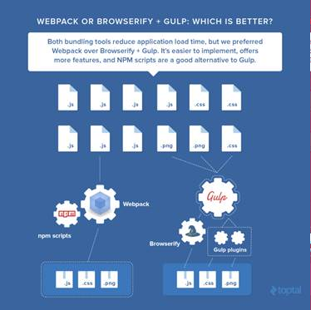
Webpack 2
Features
Reuse modules and components for single/multiple entry point(s)
build unique bundles for each entry point
build a common bundle for the entry points
Easier configuration for both Dev and Production environment.
Easier to concating and minifying files and assets.
HOT Reloading (using React its just keep the state when file change).
Webpack default have some of ES6 Features like Import Export.
Webpack require less dependencies to build and code structure.
We can run webpack using simple Node command.
Webpack have its own dev-server for easier dev and production server
configuration.

