Slide 1
SOFTWARE ENGINEERING PROJECCT
Project name:
Hostel Inventory Management
System
Course Instructor:-
Dr Bishwajit R.Bhowmik

Slide 2
Project Team members
Team Leader: Mukul Sharma 170101028
Roushan Kumar 170101045
Vipul Kumar 170101054

Slide 3
INTRODUCTION
The Hostel Inventory Management System is developed for automating the activities of inventories of hostels.
This particular project deals with the problem of managing hostel inventory system and avoids the problems which occurred earlier when it was done manually.
As the working of any hostel is almost same so we have chosen our own hostel ‘Aryabhata Hall Of Residence’ to present the software and design.
Without computers,everything goes on register causing a lot of paper work with very less efficiency, that’s why this software can improve the overall inventory management

Slide 4
Technologies Implemented
Server:
XAMPP
Programming Language:
Html,Php,CSS,Javascript
PHP :-
Scripting language used in the web page development
MYSQL Database:
The backend database being used is Mysql which has been used
store all the hostel inventory details.

Slide 5
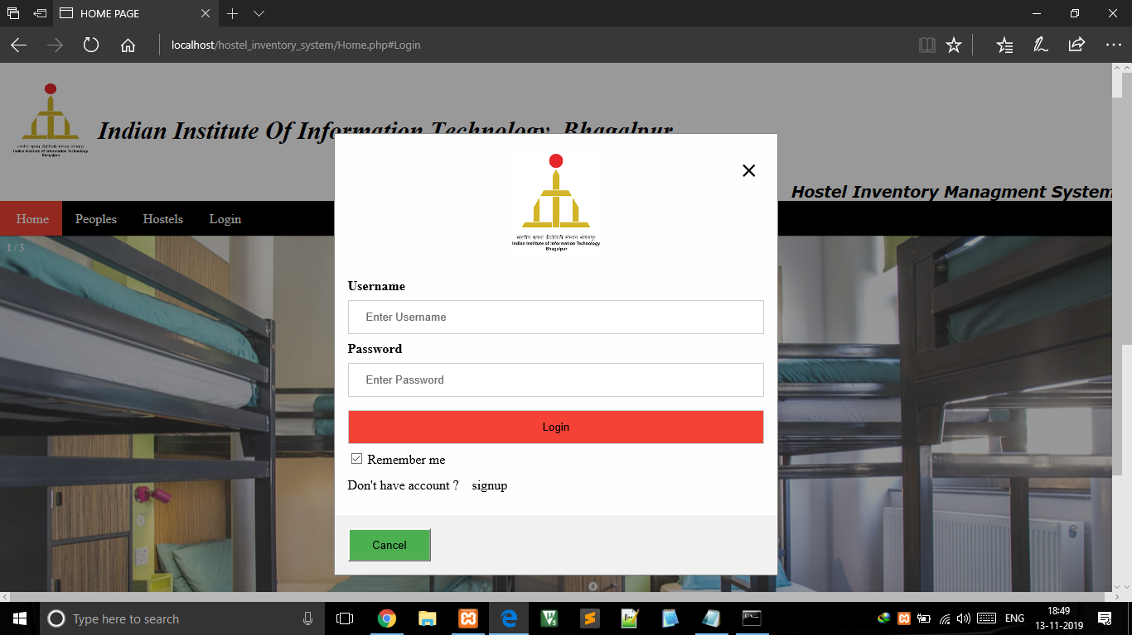
The first and main window of the software
expects the user to first help it in making the
connection with database. HOME PAGE
After the connection is
successful,the user can login with
their respective account.
The database connection,user
selection and their respective
features have been described
User Interface Design

Slide 6
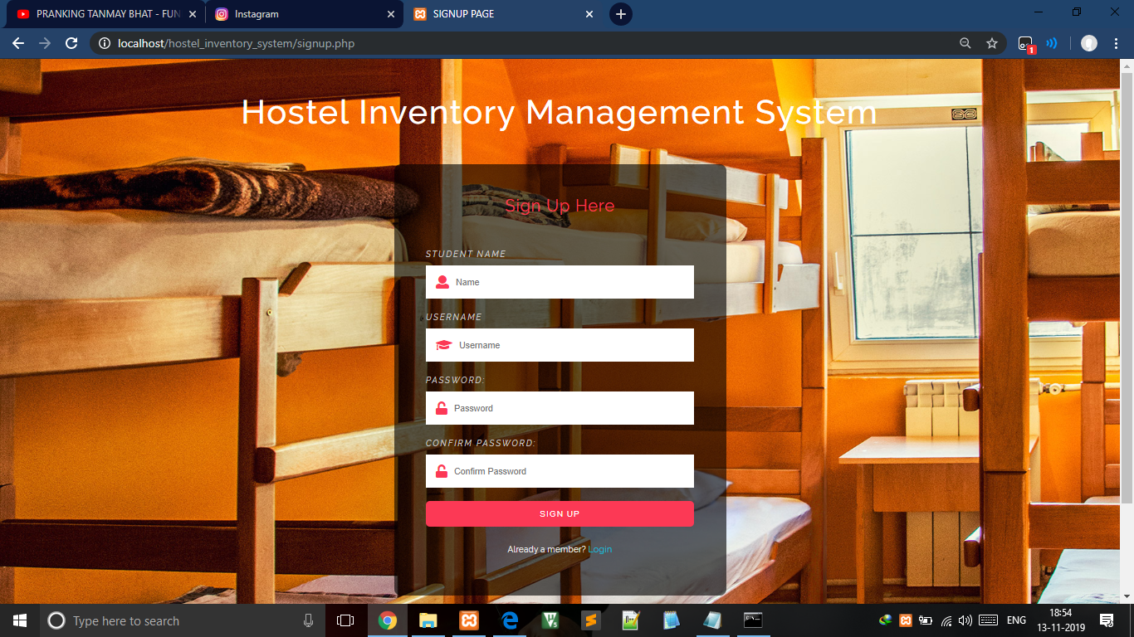
SignUp Page
Any new user either student or admin can create their new account if they don’t have.

Slide 7
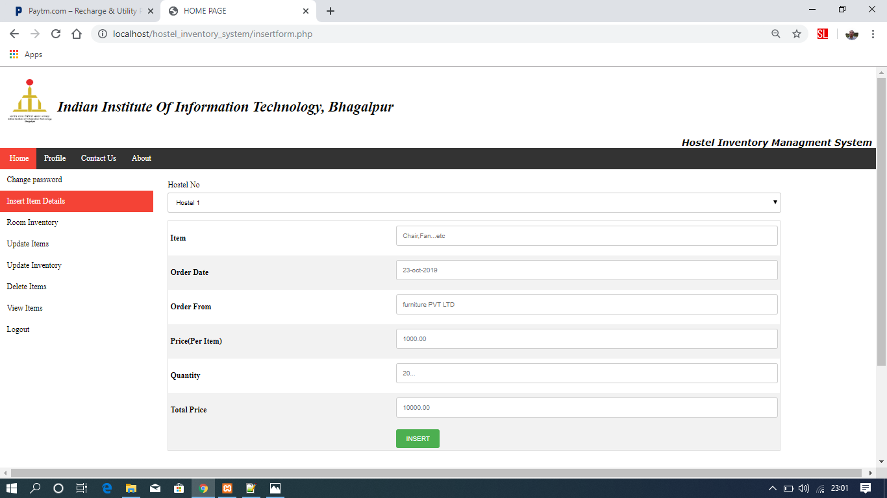
INSERT INVENTORY DETAILS
Admin can insert the inventory
details into the database
Admin can update ,delete and view the inventory details.

Slide 8
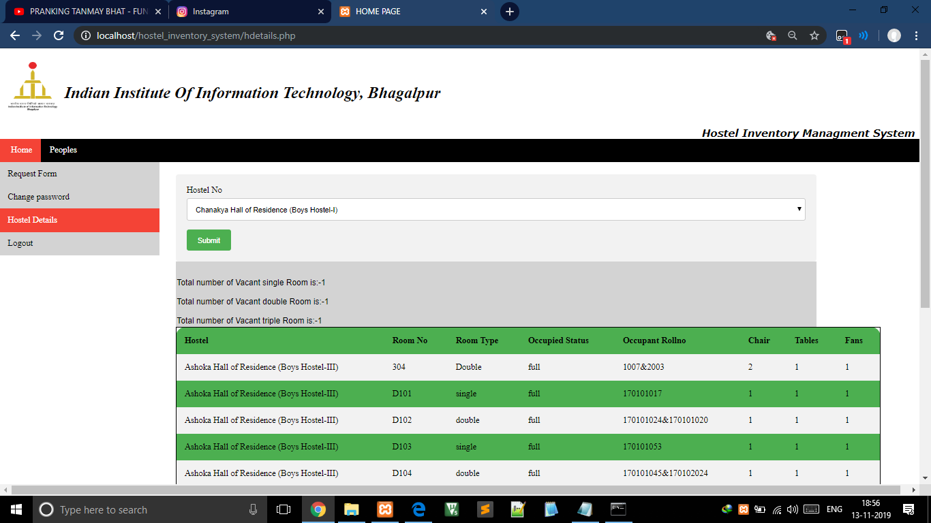
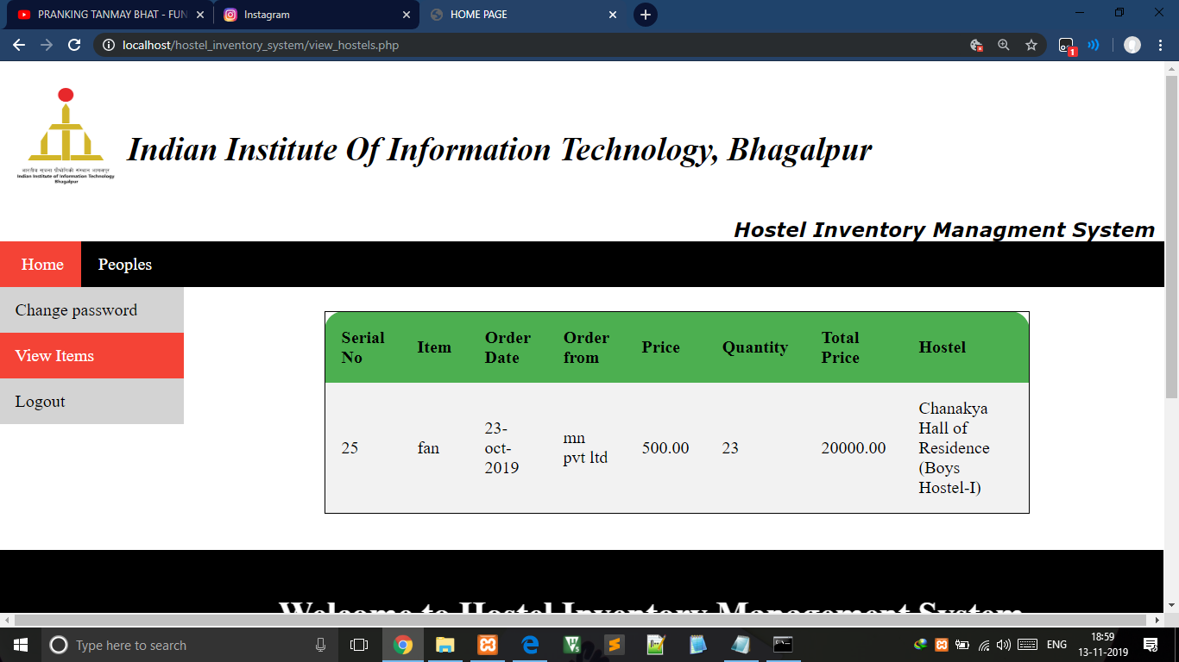
View Inventory Details
Students have the permission to view the inventory details from the database and admin have all the accessibilities.
Room inventory details Hostel inventory details

Slide 9
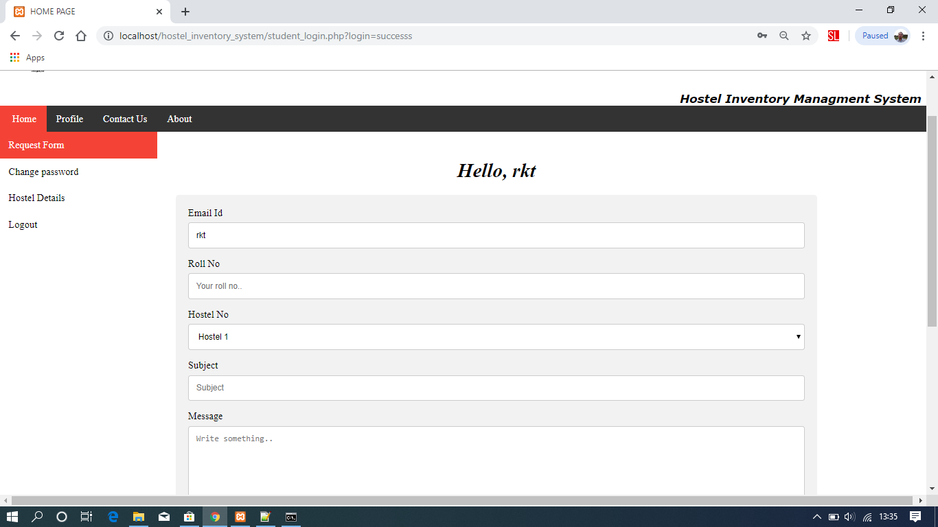
Students Requirement request
Students can request his/her hostel related requirement in the requirement field provided in the student section.

Slide 10
CONCLUSION
This project deals with the problems on managing a hostel and avoids the problem which occur when carried out manually.
To conclude the description about the project,The project is developed using HTML,PHP and SQL server is based on the requirement specification of the user and the analysis of the existing system,with failure enhancement.
Thanks!

